Slide 1
Previous Lectures 6, 7 & 8
Resistors in Series
Current in a Series Circuit
Total Series Resistance
Application of Ohm's Law
Voltage Sources in Series
Kirchhoff's Voltage Law
Voltage Dividers
Power in Series Circuits
Voltage Measurements

Slide 2
PARALLEL CIRCUITS
Lecture 9
Resistors in Parallel
Voltage in a Parallel Circuit
Kirchhoff's Current Law
Total Parallel Resistance
Application of Ohm's Law
Current Sources in Parallel
Current Dividers
Power in Parallel Circuits
Parallel Circuit Applications

Slide 3
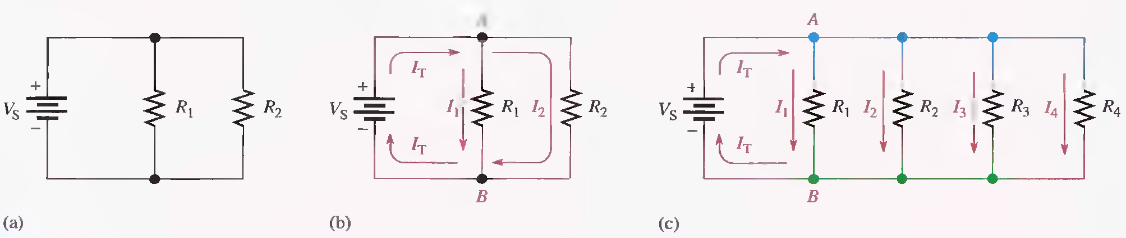
RESISTORS IN PARALLEL
When two or more resistors are individually connected between two separate points, they are in parallel with each other. A parallel circuit provides more than one path for current.
Each current path is called a branch, and a parallel circuit is one that has more than one branch.
Resistors in parallel.

Slide 4
RESISTORS IN PARALLEL
A rule for Identifying parallel circuits is as follows:
If there is more than one current path (branch) between two separate points and if the voltage between those two points also appears across each of the branches, then there is a parallel circuit between those two points.

Slide 5
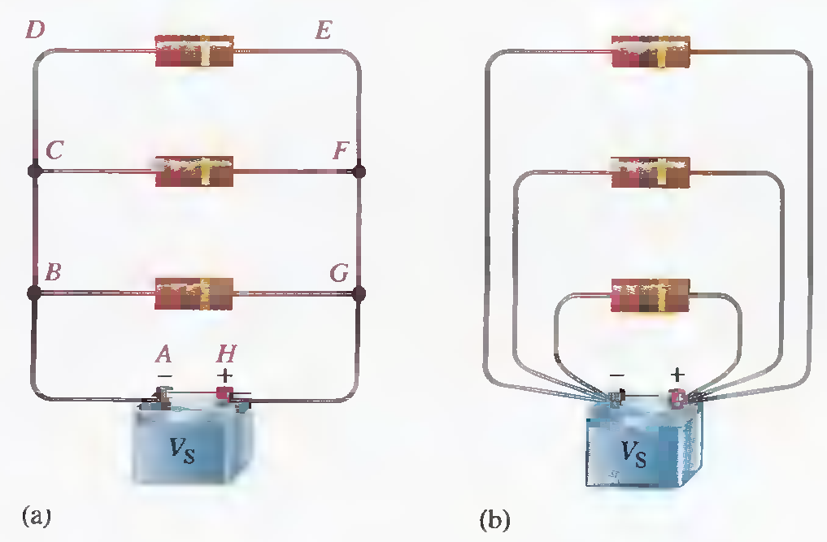
VOLTAGE IN A PARALLEL CIRCUIT
The voltage across any given branch of a parallel circuit is equal to the voltage across each of the other branches in parallel.
Voltage across parallel branches is the same.

Slide 6
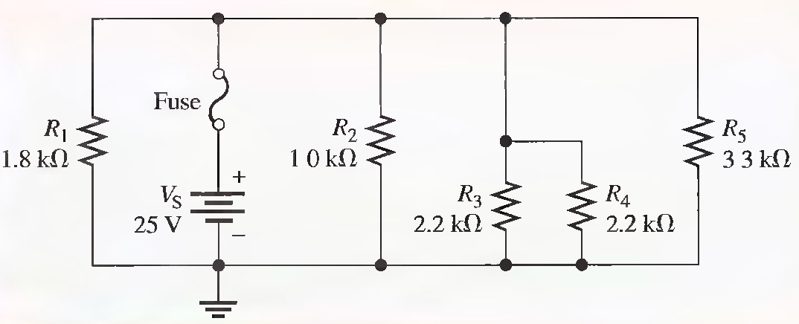
Determine the voltage across each resistor in the following Figure.

Slide 7
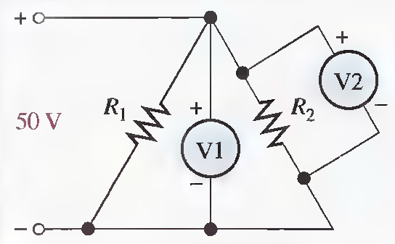
In the following Figure, how much voltage does voltmeter 1 indicate? Voltmeter 2?

Slide 8
KIRCHHOFF'S CURRENT LAW
Kirchhoff's voltage law deals with voltages in a single closed path. Kirchhoff’s current law applies to currents in multiple paths.
Kirchhoff's current law, often abbreviated KCL, can be stated as follows:
‘’The sum of the currents into a node (total current in) is equal to the sum of the currents out of that node (total current out)’’.

Slide 9
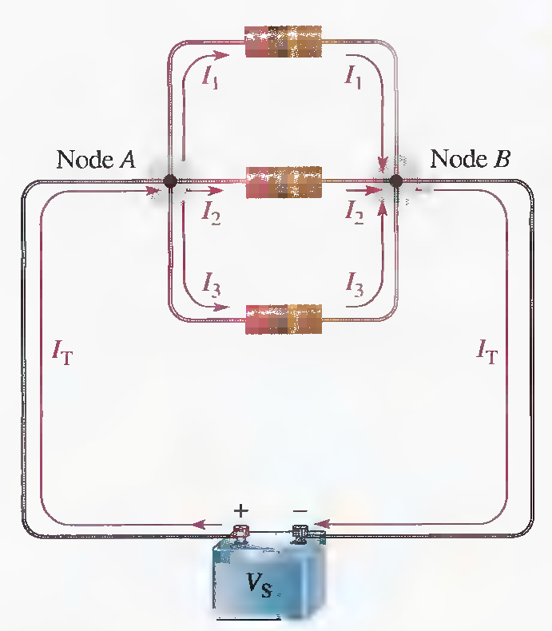

KIRCHHOFF'S CURRENT LAW
A node is any point or junction in a circuit where two or more components are connected. In a parallel circuit, a node or junction is a point where the parallel branches come together.
Node A
Node B

Slide 10
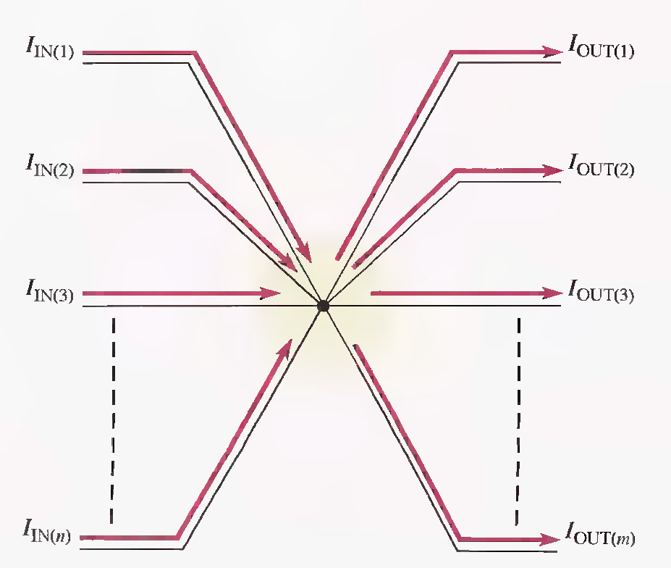
Generalized circuit node illustrating Kirchhoff's current law.
The algebraic sum of all the currents entering and leaving a node is equal to zero.

Slide 11
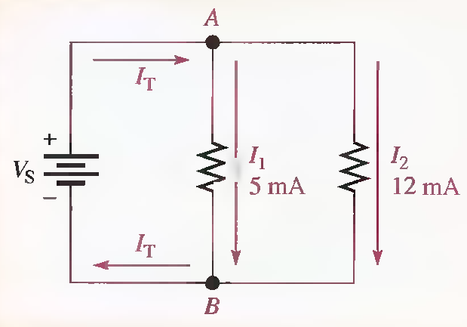
The branch currents are shown in the circuit of following Figure. Determine the total current entering node A and the total current leaving node B.

Slide 12
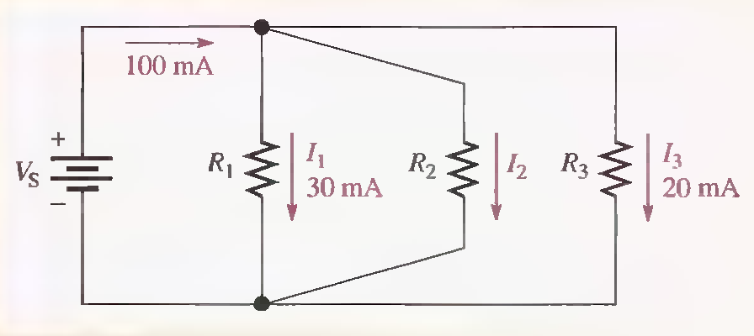
Determine the current I₂ through R₂ in the following Figure.

Slide 13
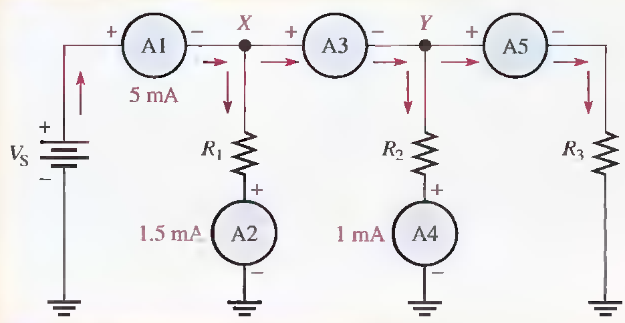
Use Kirchhoff's current law to find the current measured by ammeters A3 and A5 in the following Figure.

Slide 14
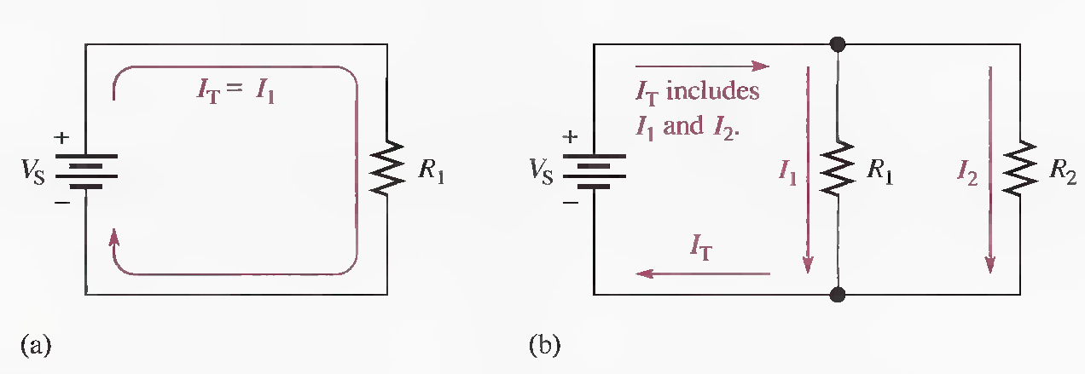
TOTAL PARALLEL RESISTANCE
When resistors are connected in parallel, the total resistance of the circuit decreases. The total resistance of a parallel circuit is always less than the value of the smallest resistor. For example, if a 10 Ω resistor and a 100 Ω resistor are connected in parallel the total resistance is less than 10 Ω.
Addition of resistors in parallel reduces total resistance and increases total current.

Slide 15
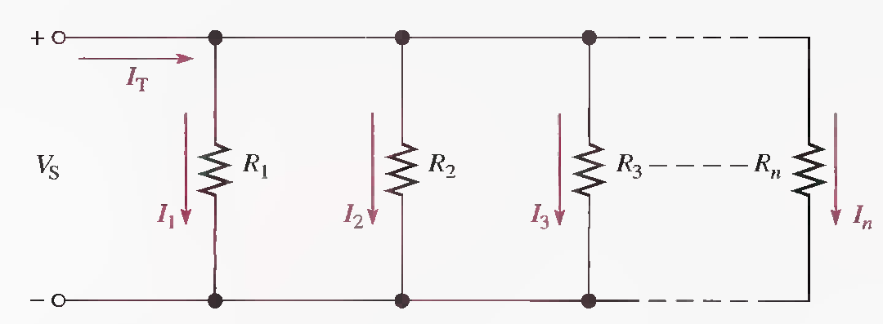

Formula for Total Parallel Resistance
The circuit in the following Figure shows a general case of n resistors in parallel (n can be any number).
From Kirchhoff's current law, the equation for current is

Slide 17
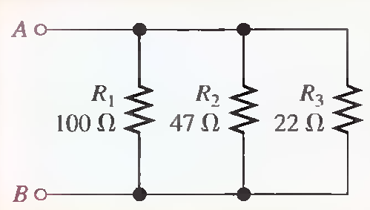
Calculate the total parallel resistance between points A and B of the circuit in the following Figure.
1OmS, 21.3 mS, 45.5 mS, 76.8 mS, 130Ω

Slide 18
The Case of Two Resistors in Parallel
The total resistance for two resistors in parallel is equal to the product of the two resistors divided by the sum of the two resistors.

Slide 19
The Case of Equal-Value Resistors in Parallel

Slide 20
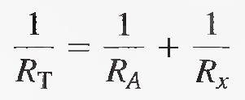
Determining an Unknown Parallel Resistor

Slide 21
Four 8 Ω speakers are connected in parallel to the output of an amplifier. What is the total resistance across the output of the amplifier?
Suppose that you wish to obtain a resistance as close to 150 Ω as possible by combining two resistors in parallel. There is a 330 Ω resistor available. What other value do you need?
275 Ω

Slide 22
Notation for Parallel Resistors

Slide 23
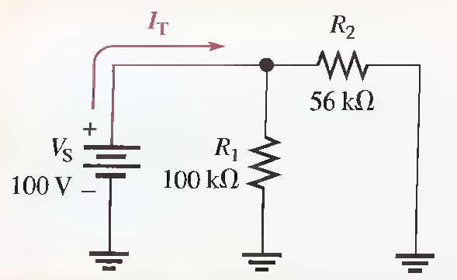
APPLICATION OF OHM'S LAW
Find the total current produced by the battery in the following circuit.
35.9kΩ, 2.79mA

Slide 24
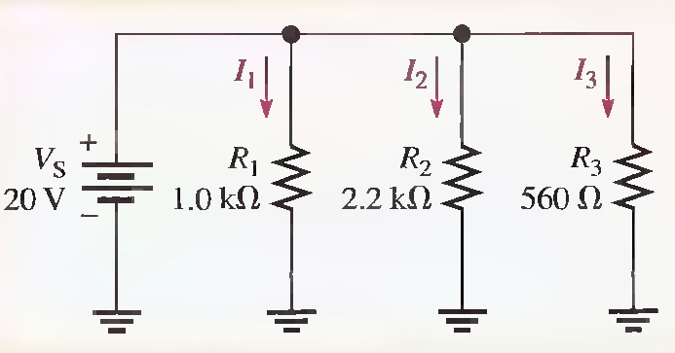
Determine the current through each resistor in the parallel circuit of following Figure.
20mA, 9.09mA, 35.7mA

Slide 25
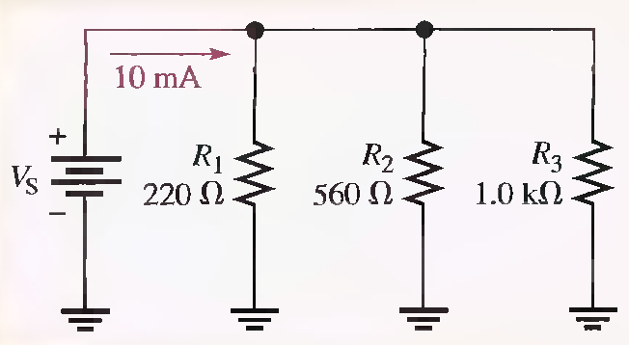
Find the voltage Vs across the parallel circuit in the given circuit.
136 Ω, 1.36V

Slide 26
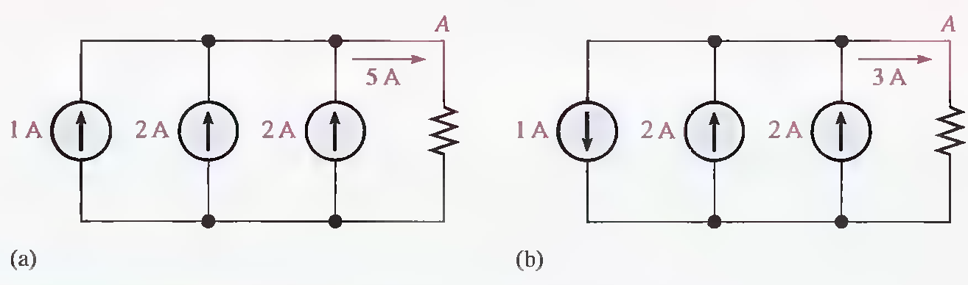
CURRENT SOURCES IN PARALLEL
A current source is a type of energy source that provides a constant current to a load even if the resistance of that load changes. A transistor can be used as a current source; therefore, current sources are important in electronic circuits.

Slide 27
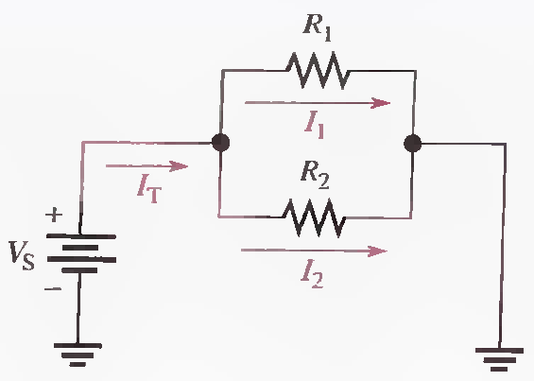
CURRENT DIVIDERS
A parallel circuit acts as a current divider because the current entering the junction of parallel branches "divides" up into several individual blanch currents.
Total current divides between the two branches.

Slide 28
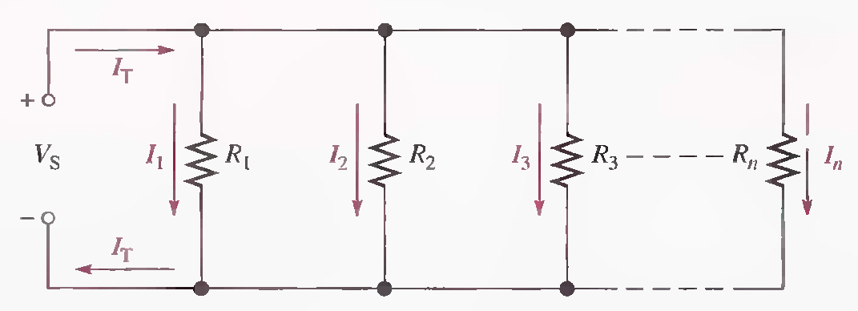
Current-Divider Formula

Slide 29
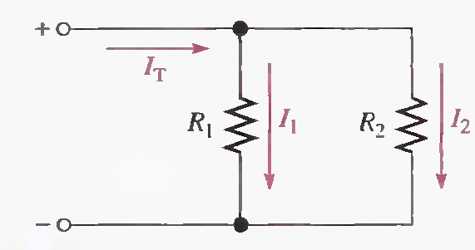
Current-Divider formulas for Two Branches

Slide 30
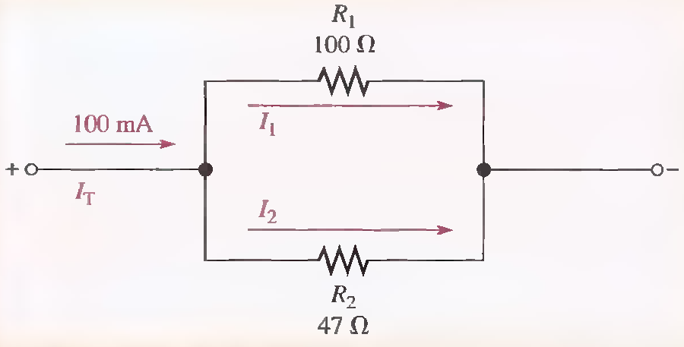
Find I₁ and l₂ in the following Figure.
32.0 mA, 68mA

Slide 31
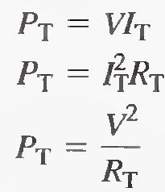
POWER IN PARALLEL CIRCUITS
the following equation states the formula for finding total power in a concise way for any number of resistors in parallel.
The following formulas are used to calculate the total power P_{T}

Slide 32
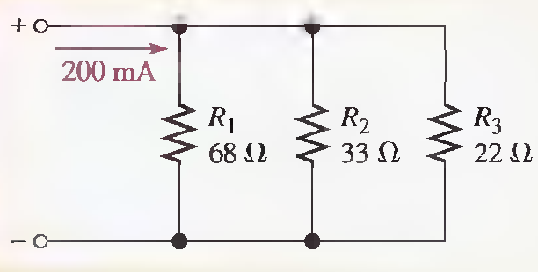
Determine the total amount of power in the parallel circuit in the following Figure.
11.1Ω, 444mW, 2.22 V, 72.5mW, 149mW, 224 m W

Slide 33
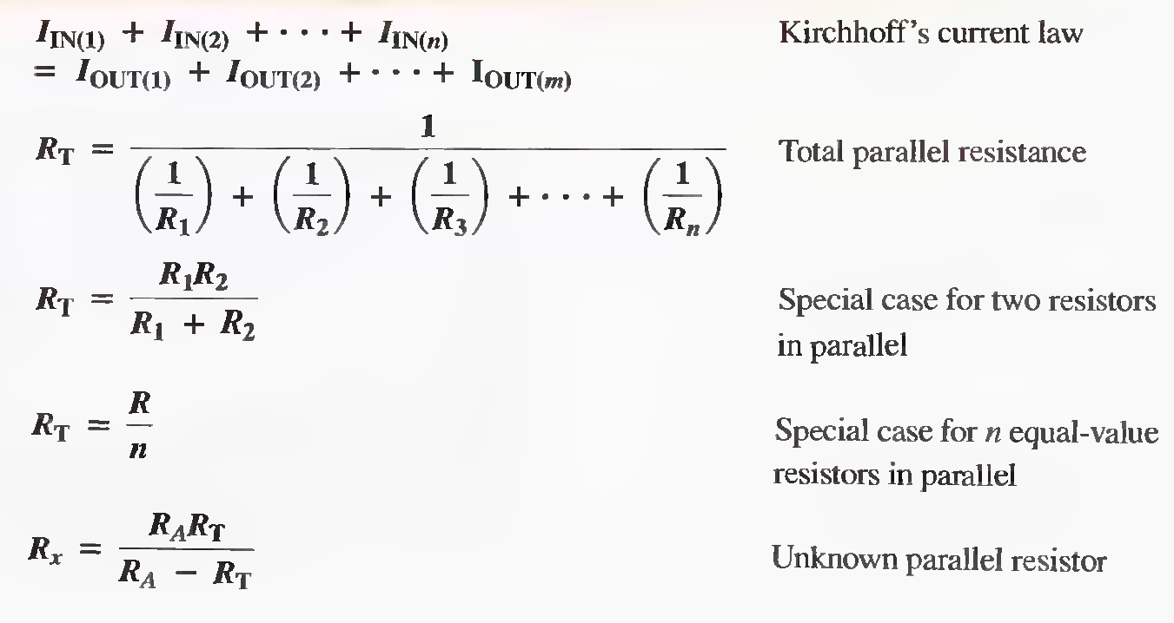
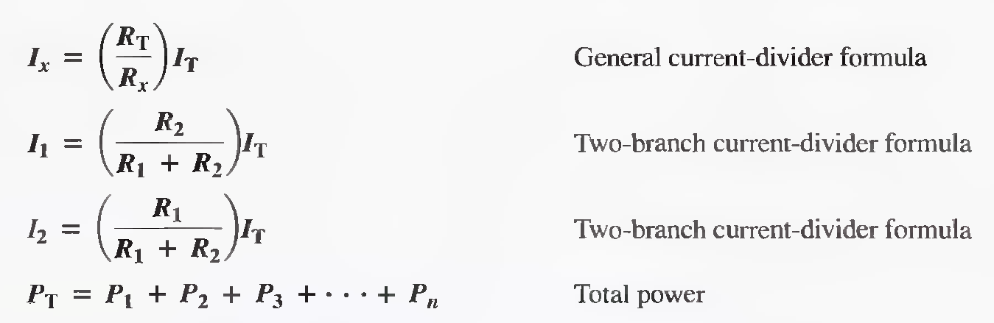
Some Important Formulas related to Parallel Circuits

Slide 34
Summary
Resistors in parallel are connected between two points (nodes).
A parallel combination has more than one path for current.
The total parallel resistance is less than the lowest-value resistor.
The voltages across all branches of a parallel circuit are the same.
Current sources in parallel add algebraically.
Kirchhoff's current law: The sum of the currents into a junction (total current in) equals the sum of the currents out of the junction (total current out).

Slide 35
Summary
The algebraic sum of all the currents entering and leaving a junction is equal to zero.
A parallel circuit is a current divider, so called because the total current entering the junction of parallel branches divides up into each of the branches.
If all of the branches of a parallel circuit have equal resistance, the currents through all of the branches are equal.
The total power in a parallel-resistive circuit is the sum of all of the individual powers of the resistors making up the parallel circuit.

Slide 36
Summary
The total power for a parallel circuit can be calculated with the power formulas using values of to-
tal current, total resistance, or total voltage.
If one of the branches of a parallel circuit opens, the total resistance increases, and therefore the
total current decreases.
If a branch of a parallel circuit opens, there is no change in current through the remaining
branches.

