Slide 1
Previous Lecture 7 (Problems Solving)
Resistors in Series
Current in a Series Circuit
Total Series Resistance
Application of Ohm's Law
Voltage Sources in Series
Kirchhoff's Voltage Law
Voltage Dividers
Power in Series Circuits
Voltage Measurements

Slide 2
Problems Solving
Lecture 8 (Continuum of Lecture 7)
Voltage Dividers
Power in Series Circuits
Voltage Measurements

Slide 3
Problems related to Voltage Dividers
Q. 1 The total resistance of a circuit is 560Ω. What percentage of the total voltage appears across a 27 Ω resistor that makes up part of the total series resistance?
4.82%

Slide 4
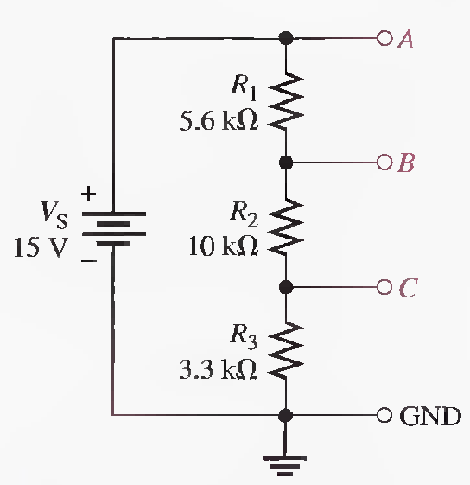
Q.2 Determine the voltage with respect to ground for output A, B, and C in the following Figure.
RT=18.9KΩ, VA=15 V, VB= 10.6V, VC= 2.62V

Slide 5
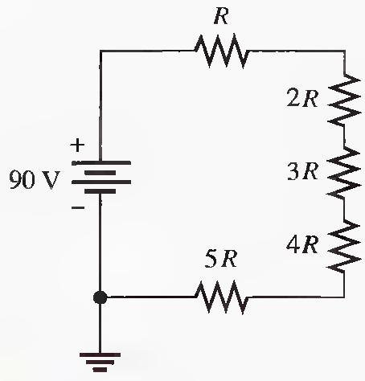
Q.3 What is the voltage across each resistor in the following Figure? R is the lowest-value resistor, and all others are multiples of that value as indicated.

Slide 6
Problems related to Power in Series Circuits
Q.1 The following 1/4 W resistors are in series: 1.2kΩ, 2.2k Ω, 3.9k Ω, and 5.6k Ω. What is the maximum voltage that can be applied across the series resistors without exceeding a power rating? Which resistor will burn out first if excessive voltage is applied?
The 5.6 kΩ resistor is the limiting element in terms of power dissipation.
Imax=6.68 mA, V _{1.2KΩ}=8.02 V, V _{2.2KΩ} =14.7 V, V _{3 .9KΩ} = 26.1 V, V _{5.6KΩ} =37.4 V, V_{Tmax}=86.2 V

Slide 7
Q.2 A certain series circuit consists of a 1/8 W resistor, a 1/4 W resistor and a 1/2 W resistor. The total resistance is 2400 Ω. If each of the resistors is operating in the circuit at its maximum power dissipation, determine the following: (Solved on 2 slides)
(a) I (b) V_{T} (c) The value of each resistor
I=19.1 mA, V_{T} = 45.8 V, R1= 343 Ω,R2= 686 Ω,R3= 1.37 kΩ

Slide 8
I=19.1 mA, V_{T} = 45.8 V, R1= 343 Ω,R2= 686 Ω,R3= 1.37 kΩ

Slide 9
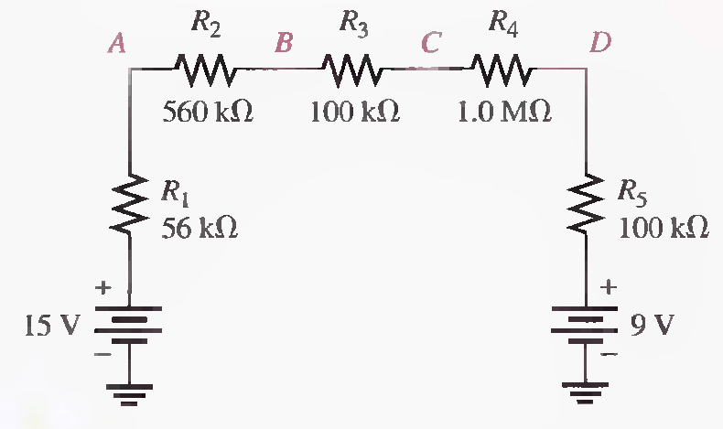
Problems related to Voltage Measurements
Q.1 Determine the voltage at each point with respect to ground in the given circuit. (Solved on 2 slides)
RT=1.816 MΩ, VT=6V, IT= 3.3 μA, V1= 185 mV, V2=, 1.85 V V3=, 330 mV V4=, 3.3 V
VA= 14.82 V, VB= 12.97 V,VC=, 12.64 V ,VD= 9.34 V.

Slide 10
RT=1.816 MΩ, VT=6V, IT= 3.3 μA, V1= 185 mV, V2=, 1.85 V V3=, 330 mV V4=, 3.3 V
VA= 14.82 V, VB= 12.97 V,VC=, 12.64 V ,VD= 9.34 V.

Slide 11
Series Circuits-Summary
The current is the same at all points in a series circuit.
The total series resistance is the sum of all resistors in the series circuit.
The total resistance between any two points in a series circuit is equal to the sum of all resistors connected in series between those two points.
If all of the resistors in a series circuit are of equal value, the total resistance is the number of resistors multiplied by the resistance value of one resistor
Voltage sources in series add algebraically.

Slide 12
Series Circuits-Summary
Kirchhoff's voltage law: The sum of all the voltage drops around a single closed path in a circuit is equal to the total source voltage in that loop.
Kirchhoff's voltage law: The algebraic sum of all the voltages (both source and drops) around a single closed path is zero.
The voltage drops in a circuit are always opposite in polarity to the total source voltage.
Conventional current is defined to be out of the positive side of a source and into the negative side.
Conventional current is defined to be into the positive side of each resistor and out of the more negative (less positive) side.

Slide 13
Series Circuits-Summary
A voltage drop results from a decrease in energy level across a resistor.
A voltage divider is a series arrangement of resistors connected to a voltage source.
A voltage divider is so named because the voltage drop across any resistor in the series circuit is divided down from the total voltage by an amount proportional to that resistance value in relation to the total resistance.
A potentiometer can be used as an adjustable voltage divider.
The total power in a resistive circuit is the sum of all the individual powers of the resistors making up the series circuit.

Slide 14
Series Circuits-Summary
Ground (common) is zero volts with respect to all points referenced to it in the circuit.
Negative ground is the term used when the negative side of the source is grounded.
Positive ground is the term used when the positive side of the source is grounded.
The voltage across an open component always equals the source voltage.
The voltage across a shorted component is always 0 V.

Slide 15
PARALLEL CIRCUITS
Resistors in Parallel
Voltage in a Parallel Circuit
Kirchhoff's Current Law
Total Parallel Resistance
Application of Ohm's Law
Current Sources in Parallel
Current Dividers
Power in Parallel Circuits
Parallel Circuit Applications

Slide 16
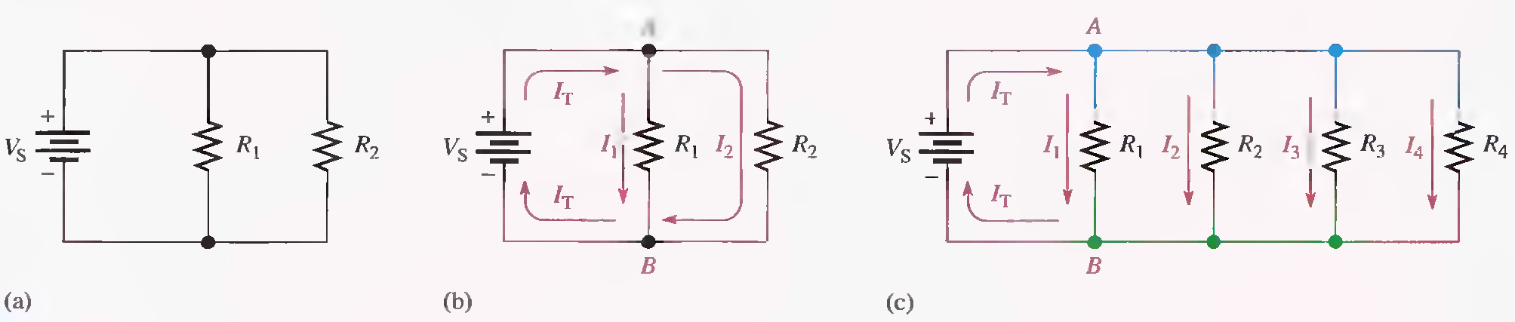
RESISTORS IN PARALLEL
When two or more resistors are individually connected between two separate points, they are in parallel with each other. A parallel circuit provides more than one path for current.
Each current path is called a branch, and a parallel circuit is one that has more than one branch.
Resistors in parallel.

Slide 17
RESISTORS IN PARALLEL
A rule for Identifying parallel circuits is as follows:
If there is more than one current path (branch) between two separate points and if the voltage between those two points also appears across each of the branches, then there is a parallel circuit between those two points.

Slide 18
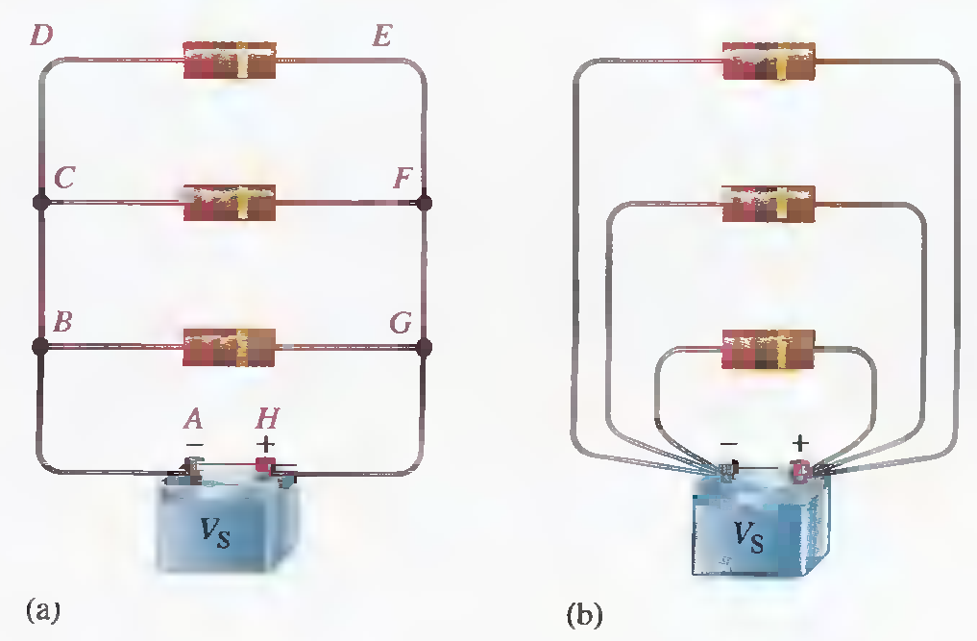
VOLTAGE IN A PARALLEL CIRCUIT
The voltage across any given branch of a parallel circuit is equal to the voltage across each of the other branches in parallel.
Voltage across parallel branches is the same.

Slide 19
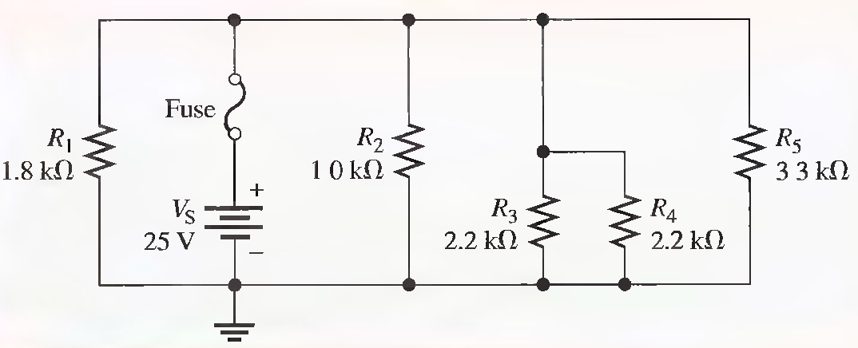
Determine the voltage across each resistor in the following Figure.

Slide 20
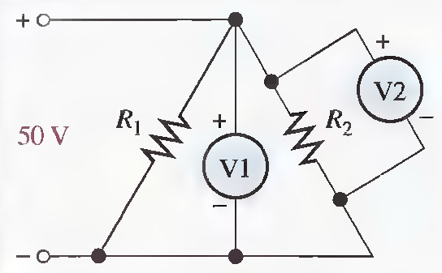
In the following Figure, how much voltage does voltmeter 1 indicate? Voltmeter 2?

Slide 21
KIRCHHOFF'S CURRENT LAW
Kirchhoff's voltage law deals with voltages in a single closed path. Kirchhoff s current law applies to currents in multiple paths.
Kirchhoff's current law, often abbreviated KCL, can be stated as follows:
‘’The sum of the currents into a node (total current in) is equal to the sum of the currents out of that node (total current out)’’.

Slide 22
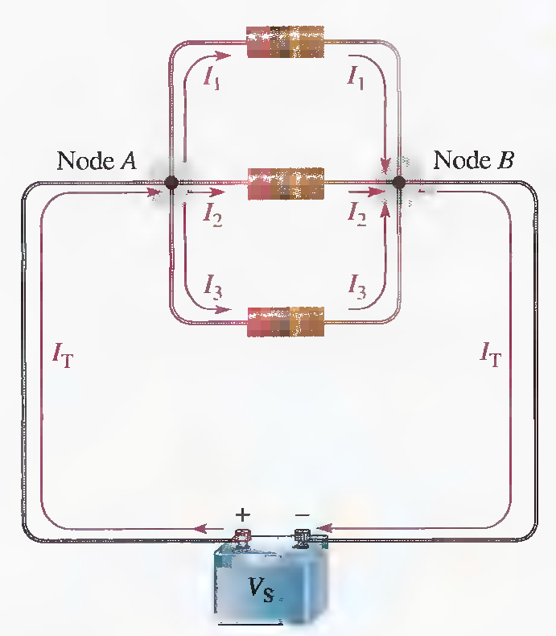

KIRCHHOFF'S CURRENT LAW
A node is any point or junction in a circuit where two or more components are connected. In a parallel circuit, a node or junction is a point where the parallel branches come together.
Node A
Node B

Slide 23
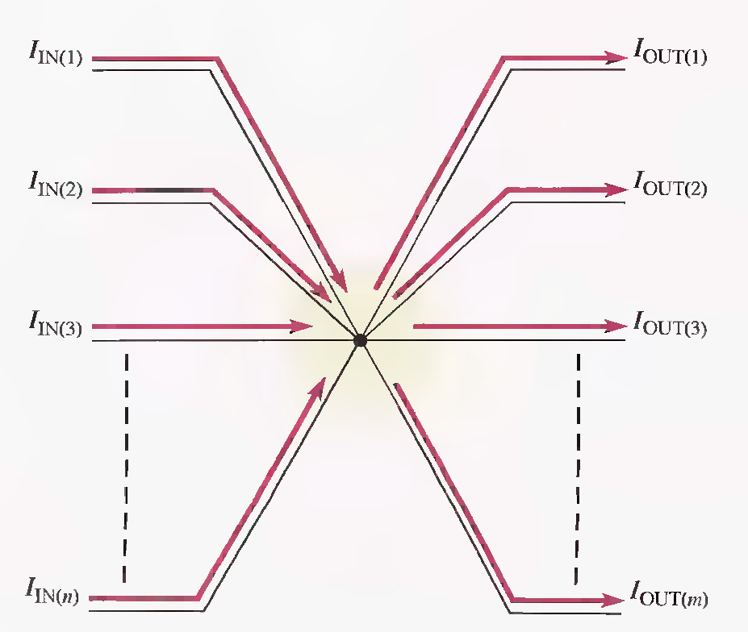
Generalized circuit node illustrating Kirchhoff's current law.
The algebraic sum of all the currents entering and leaving a node is equal to zero.

Slide 24
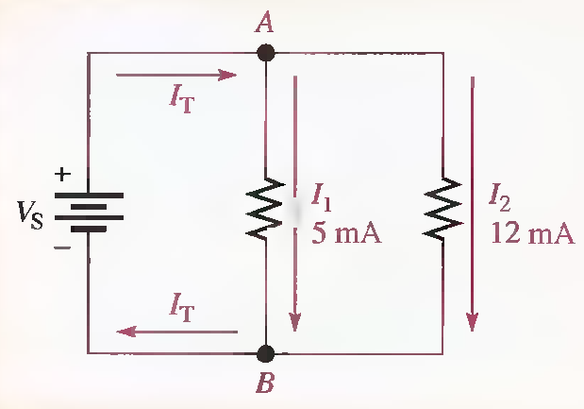
The branch currents are shown in the circuit of following Figure. Determine the total current entering node A and the total current leaving node B.

Slide 25
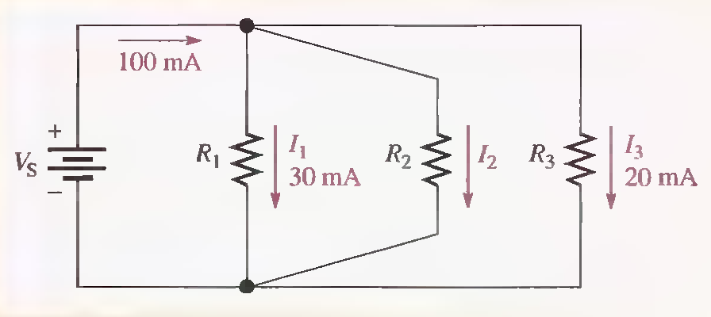
Determine the current I₂ through R₂ in the following Figure.

Slide 26
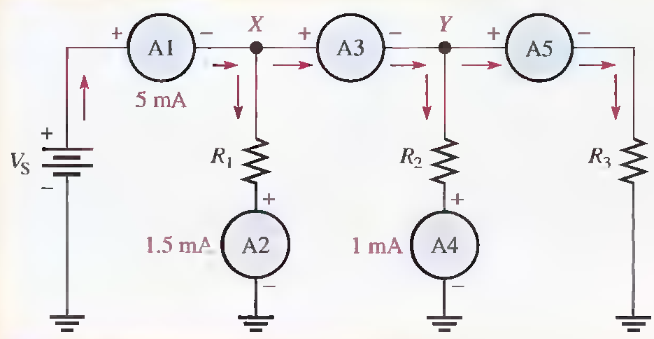
Use Kirchhoff's current law to find the current measured by ammeters A3 and A5 in the following Figure.

Slide 27
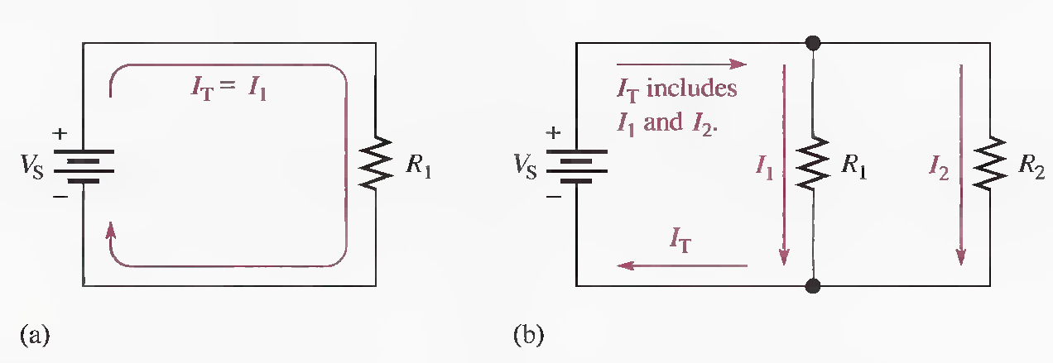
TOTAL PARALLEL RESISTANCE
When resistors are connected in parallel, the total resistance of the circuit decreases. The total resistance of a parallel circuit is always less than the value of the smallest resistor. For example, if a 10 Ω resistor and a 100 Ω resistor are connected in parallel the total resistance is less than 10 Ω.
Addition of resistors in parallel reduces total resistance and increases total current.

Slide 28
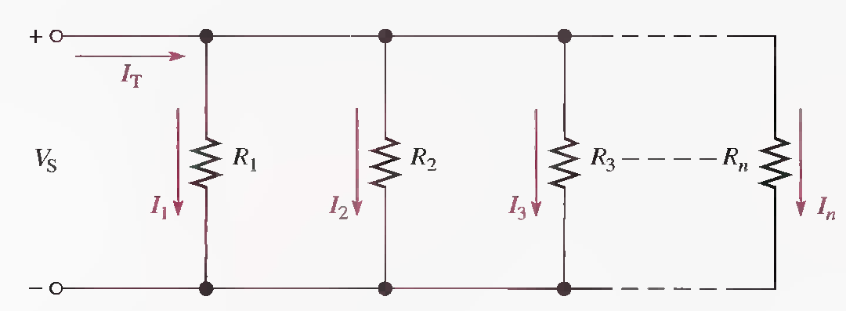

Formula for Total Parallel Resistance
The circuit in the following Figure shows a general case of n resistors in parallel (n can be any number).
From Kirchhoff's current law, the equation for current is

Slide 30
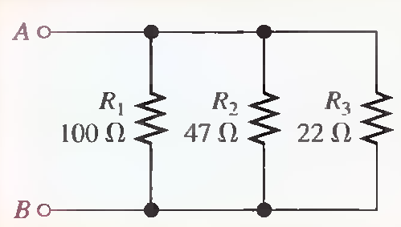
Calculate the total parallel resistance between points A and B of the circuit in the following Figure.
1OmS, 21.3 mS, 45.5 mS, 76.8 mS, 130Ω

Slide 31
The Case of Two Resistors in Parallel
The total resistance for two resistors in parallel is equal to the product of the two resistors divided by the sum of the two resistors.

Slide 32
The Case of Equal-Value Resistors in Parallel

Slide 33
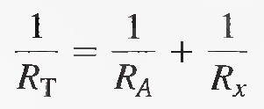
Determining an Unknown Parallel Resistor

Slide 34
Four 8 Ω speakers are connected in parallel to the output of an amplifier. What is the total resistance across the output of the amplifier?
275 Ω

Slide 35
Suppose that you wish to obtain a resistance as close to 150 Ω as possible by combining two resistors in parallel. There is a 330 Ω resistor available. What other value do you need?

