Slide 1
Previous Lecture 6
Resistors in Series
Current in a Series Circuit
Total Series Resistance
Application of Ohm's Law
Voltage Sources in Series
Kirchhoff's Voltage Law
Voltage Dividers

Slide 2
Series Circuits
Lecture 7
Power in Series Circuits
Voltage Measurements
Problems Solving

Slide 3
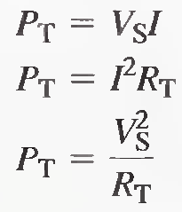
POWER IN SERIES CIRCUITS
The total amount of power in a series resistive circuit is equal to the sum of the powers in each resistor in series.
P_{T} = P₁ + P₂ + P₃ + ... + P_{n}
The following formulas are used to calculate the total power:

Slide 4
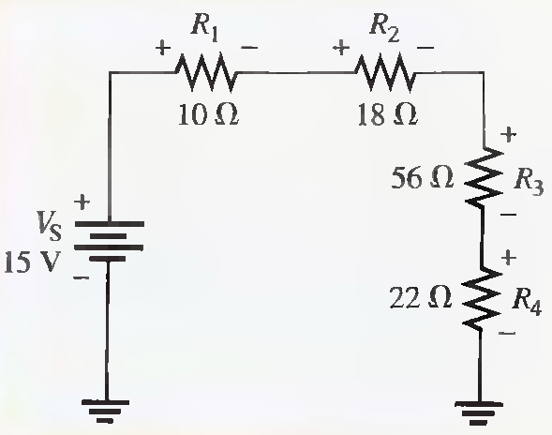
Determine the total amount of power in the series circuit in the following Figure. (Solved on 2 slides)
R_{T}=106Ω,P_{T}= 2.12W ,I_{T}= 142mA,P₁= 200mW,P₂= 360mW ,P₃= 1.12 W ,P₄= 441 mW

Slide 5
R_{T}=106Ω,P_{T}= 2.12W ,I_{T}= 142mA,P₁= 200mW,P₂= 360mW ,P₃= 1.12 W ,P₄= 441 mW

Slide 6
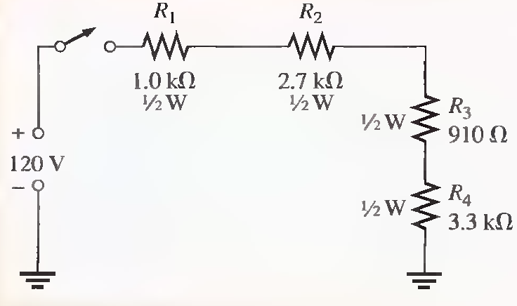
Determine if the indicated power rating (1/2 W) of each resistor in the following circuit is sufficient to handle the actual power. If a rating is not adequate, specify the required minimum rating.
R_{T}=7.91 kΩ,I_{T}= 15mA,P₁= 225mW ,P₂= 608 mW ,P₃= 205 mW ,P₄= 743 mW

Slide 7
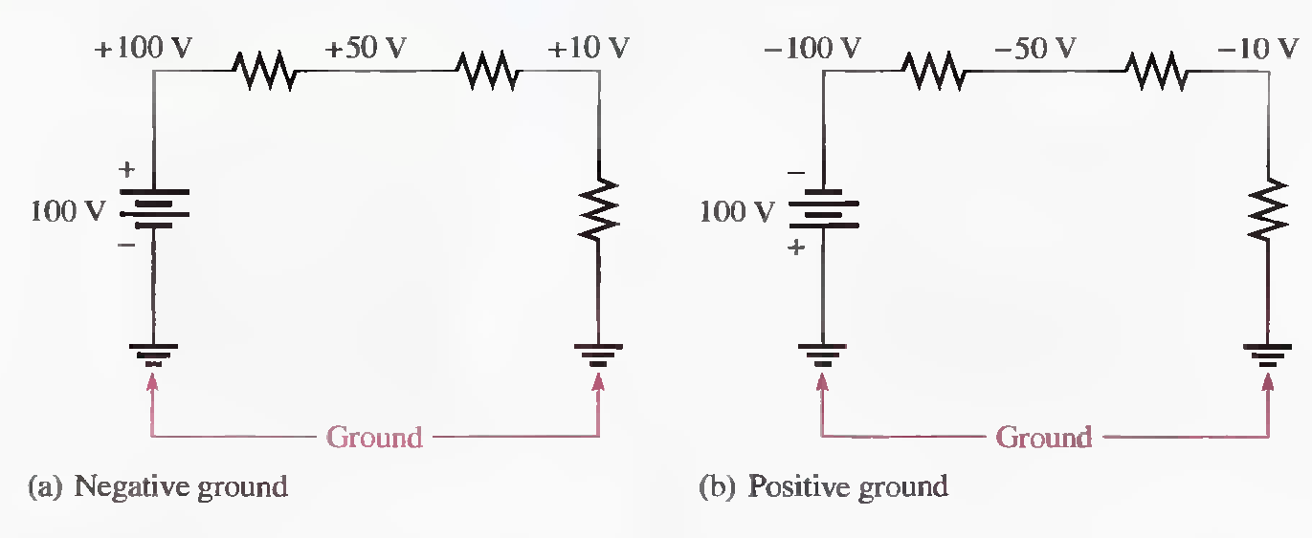
VOLTAGE MEASUREMENTS
Voltage is relative. That is, the voltage at one point in a circuit is always measured relative to another point. This reference point in circuit is called the ground or common point.

Slide 8
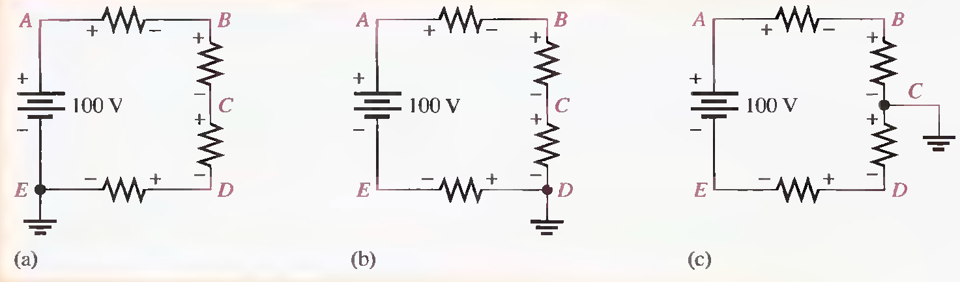
Determine the voltages with respect to ground of each of the indicated points in each circuit of following Figure. Assume that 25 V are dropped across each resistor.

Slide 9
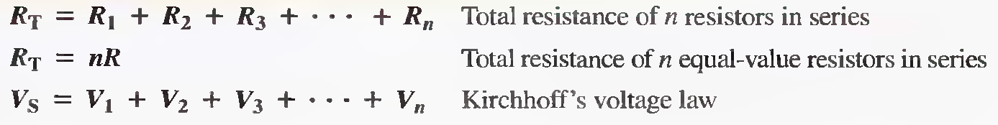
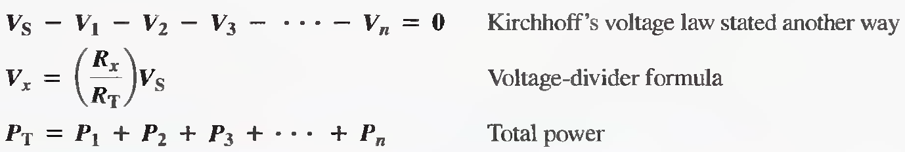
Some Important Formulas for Series Circuits

Slide 10
Problems Solving
Resistors in Series
Current in a Series Circuit
Total Series Resistance
Application of Ohm's Law
Voltage Sources in Series
Kirchhoff's Voltage Law
Voltage Dividers
Power in Series Circuits
Voltage Measurements

Slide 11
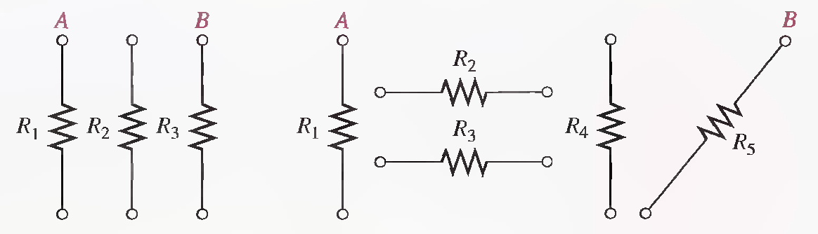
Problems related to Resistors in Series
Q.1 Connect each set of resistors in the following Figure in series between points A and B.
a) b)

Slide 12
Problems related to Current in a Series Circuit
Q.1 What is the current through each resistor in a series circuit if the total voltage is 12 V and the total resistance is 120Ω?
100 mA

Slide 13
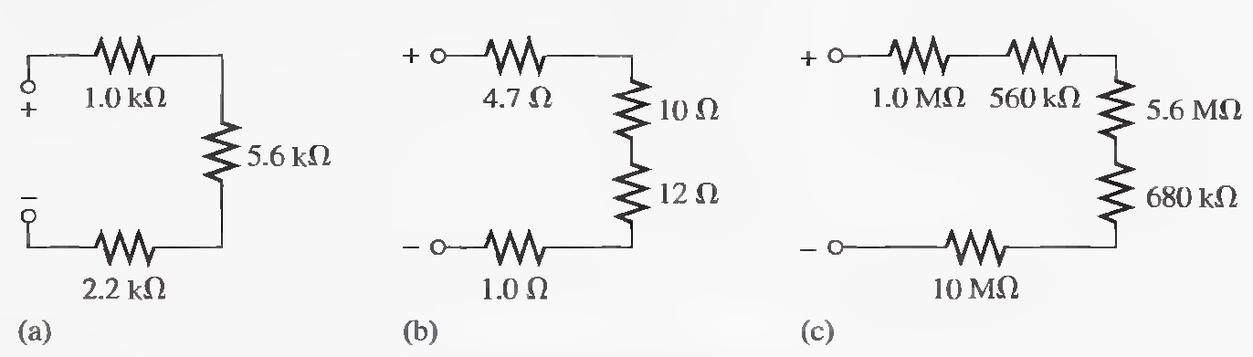
Problems related to Total Series Resistance
Q.1 Calculate R_{T} for each circuit of following Figure.
8.8 kΩ, 27.7 Ω, 17.84 MΩ

Slide 14
Q.2 Six 56 Ω resistors, eight 100 Ω resistors, and two 22 Ω resistors are all connected in series What is the total resistance?
336 Ω + 800 Ω + 44 Ω = 1180 Ω

Slide 15
Q.3 You have the following resistor values available to you in the lab in unlimited quantities: 1OΩ, 100 Ω, 470 Ω, 560 Ω, 680 Ω, 1.0 k Ω, 2.2 kΩ, and 5.6 kΩ. All of the other standard values are out of stock. A project that you are working on requires an 18 KΩ resistance. What combinations of the available values would you use in series to achieve this total resistance?
8(2.2 kΩ) + 4(100 Ω)= 18 kΩ or 3(5.6 kΩ) + 1 kΩ + 2(100 Ω) = 16.8 kΩ + 1 kΩ + 200 Ω = 18 kΩ

Slide 16
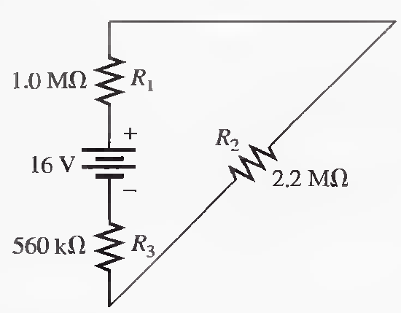
Problems related to Application of Ohm's Law
Q.1 What is the current in the circuit of following Figure?
RT = 3.76 MΩ, 4.26 μA

Slide 17
Q.2 Four equal-value resistors are in series with a 5 V battery, and 2.23 mA are measured. What is the value of each resistor?
R_{T}=2.24 kΩ, R_{each}=560 Ω

Slide 18
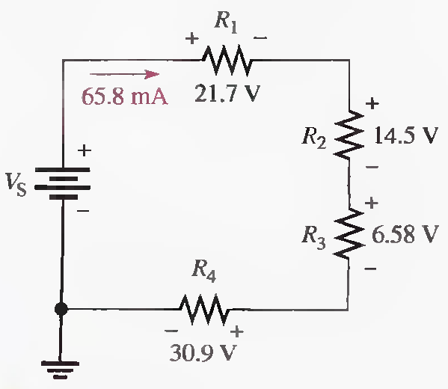
Q.3 What is the value of each resistor in the following circuit?
R1=330 Ω, R2=220 Ω, R2=100 Ω, R4=470 Ω

Slide 19
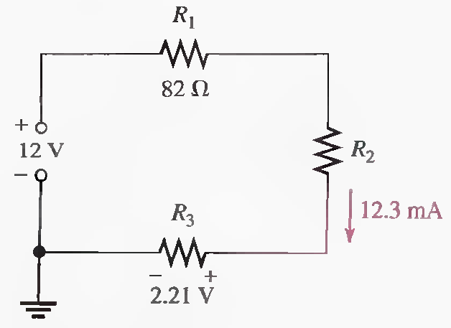
Q.4 Determine V_{R1}, R₂ , and R₃ in the following Figure.
V1=1.01 V, V2= 8.78V, R2= 714 Ω, R3=180 Ω

Slide 20
Problems related to Voltage Sources in Series
Q.1 Series aiding is a term sometimes used to describe voltage sources of the same polarity in series. If a 5 V and a 9 V source are connected in this manner, what is the total voltage?

Slide 21
Q.2 The term series opposing means that sources are in series with opposite polarities. If a 12 V and a 3 V battery are series opposing, what is the total voltage?

Slide 22
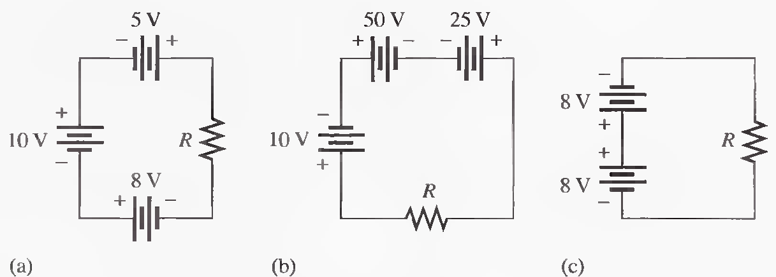
Q.3 Determine the total source voltage in each circuit of the following Figure.
23 V, 35V, 0V

Slide 23
Problems related to Kirchhoff's Voltage Law
Q.1 Five resistors are in series with a 20 V source. The voltage drops across four of the resistors are 1.5 V, 5.5 V, 3 V, and 6 V. How much voltage is dropped across the fifth resistor?
4 V

Slide 24
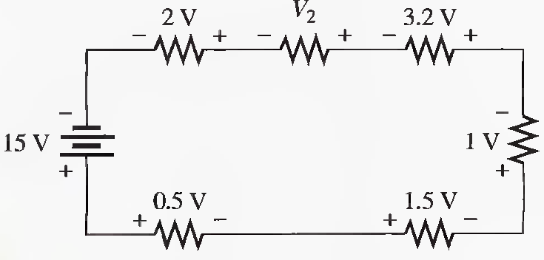
Q.2 Determine the unspecified voltage drop(s) in the circuit of following Figure. Show how to connect a voltmeter to measure each unknown voltage drop.
6.8 V

Slide 25
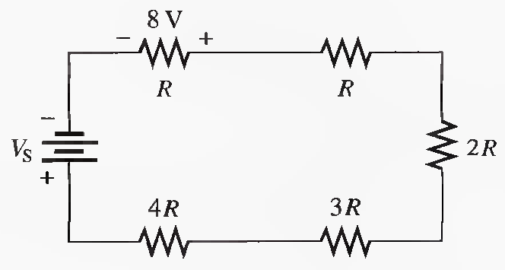
Q.3 Determine the unspecified voltage drop(s) in the circuit of following Figure. Show how to connect a voltmeter to measure each unknown voltage drop.
88 V

Slide 26
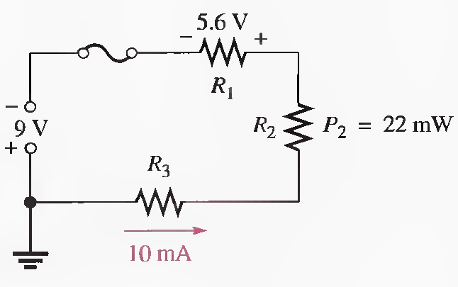
Q.4 Find R1, R 2 , and R3 in the following circuit.
R1=560 Ω, R2= 220 Ω, RT=900 Ω, R3=120 Ω

Slide 27
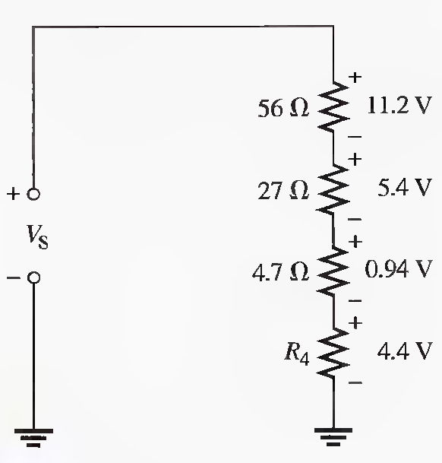
Q.5 In the circuit of following Figure, determine the resistance of R4
I=200 mA, R4=22 Ω

Slide 28
Problems related to Voltage Dividers
Q. 1 The total resistance of a circuit is 560Ω. What percentage of the total voltage appears across a 27 Ω resistor that makes up part of the total series resistance?
4.82%

Slide 29
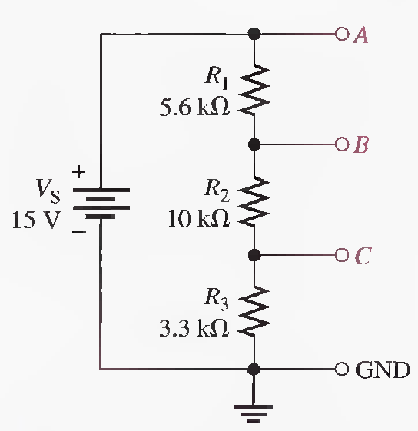
Q.2 Determine the voltage with respect to ground for output A, B, and C in the following Figure.
RT=18.9KΩ, VA=15 V, VB= 10.6V, VC= 2.62V

Slide 30
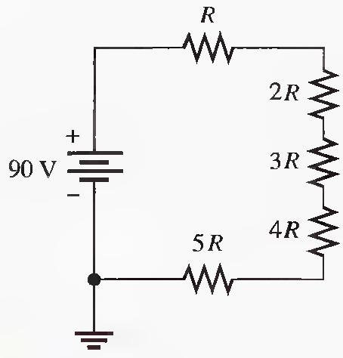
Q.3 What is the voltage across each resistor in the following Figure? R is the lowest-value resistor, and all others are multiples of that value as indicated.

Slide 31
Problems related to Power in Series Circuits
Q.1 The following 1/4 W resistors are in series: 1.2kΩ, 2.2k Ω, 3.9k Ω, and 5.6k Ω. What is the maximum voltage that can be applied across the series resistors without exceeding a power rating? Which resistor will burn out first if excessive voltage is applied?
The 5.6 kΩ resistor is the limiting element in terms of power dissipation.
Imax=6.68 mA, V _{1.2KΩ}=8.02 V, V _{2.2KΩ} =14.7 V, V _{3 .9KΩ} = 26.1 V, V _{5.6KΩ} =37.4 V, V_{Tmax}=86.2 V

Slide 32
Q.2 A certain series circuit consists of a 1/8 W resistor, a 1/4 W resistor and a 1/2 W resistor. The total resistance is 2400 Ω. If each of the resistors is operating in the circuit at its maximum power dissipation, determine the following: (Solved on 2 slides)
(a) I (b) V_{T} (c) The value of each resistor
I=19.1 mA, V_{T} = 45.8 V, R1= 343 Ω,R2= 686 Ω,R3= 1.37 kΩ

Slide 33
I=19.1 mA, V_{T} = 45.8 V, R1= 343 Ω,R2= 686 Ω,R3= 1.37 kΩ

Slide 34
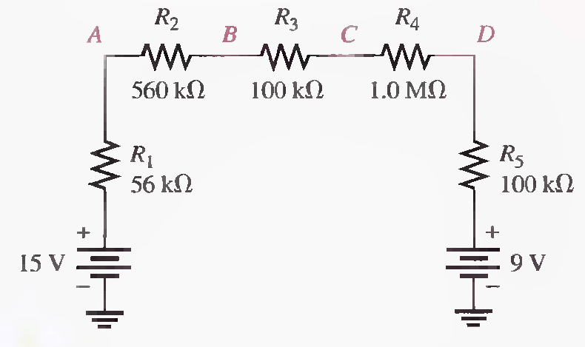
Problems related to Voltage Measurements
Q.1 Determine the voltage at each point with respect to ground in the given circuit. (Solved on 2 slides)
RT=1.816 MΩ, VT=6V, IT= 3.3 μA, V1= 185 mV, V2=, 1.85 V V3=, 330 mV V4=, 3.3 V
VA= 14.82 V, VB= 12.97 V,VC=, 12.64 V ,VD= 9.34 V.

Slide 35
RT=1.816 MΩ, VT=6V, IT= 3.3 μA, V1= 185 mV, V2=, 1.85 V V3=, 330 mV V4=, 3.3 V
VA= 14.82 V, VB= 12.97 V,VC=, 12.64 V ,VD= 9.34 V.

Slide 36
Summary
Power in Series Circuits
Voltage Measurements
Problems Solving related to following topics
  Resistors in Series
  Current in a Series Circuit
  Total Series Resistance
  Application of Ohm's Law
  Voltage Sources in Series
  Kirchhoff's Voltage Law
  Voltage Dividers
  Power in Series Circuits
  Voltage Measurements

