Slide 1
Previous Lecture 4
The Relationship of Current, Voltage, and Resistance
Calculating Current
Calculating Voltage
Calculating Resistance

Slide 2
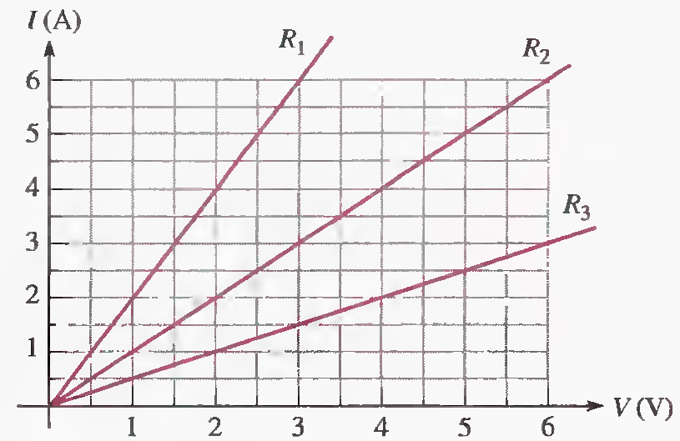
Ohm’s Law-Problems Solving
Lecture 5
Q.1 Figure shows a graph of current versus voltage for three resistance values. Determine R₁, R₂ , and R₃.
500 mΩ, 1Ω, 2Ω

Slide 3
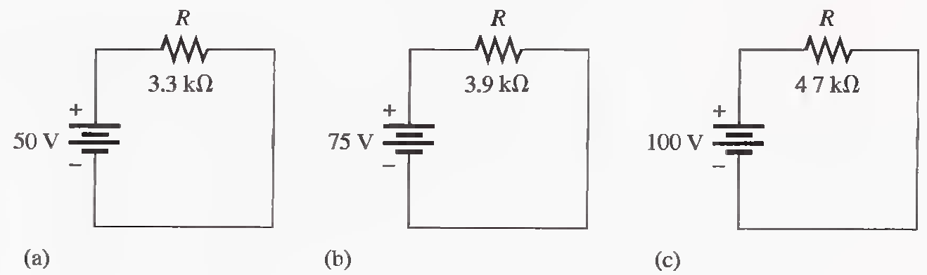
Q.2 Which circuit in Figure has the most current? The least current?
15.2 mA, 19.2 mA, 21.3 mA

Slide 4
Q.3 You are measuring the current in a circuit that is operated on a 10 V battery. The ammeter reads 50 mA. Later, you notice that the current has dropped to 30 mA. Eliminating the possibility of a resistance change, you must conclude that the voltage has changed. How much has the voltage of the battery changed, and what is its new value?
200 Ω, 6 V

Slide 5
Q.4 If you wish to increase the amount of current in a resistor from 100 mA to 150 mA by changing the 20 V source, by how many volts should you change the source? To what new value should you set it?
0.2KΩ, 30 V

Slide 6
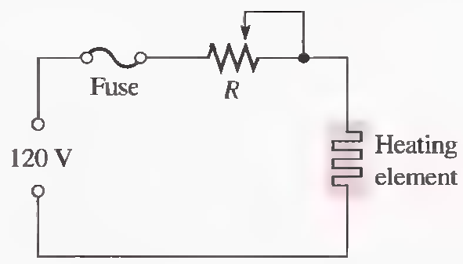
Q.5 The potentiometer connected as a rheostat in Figure is used to control the current to a heating element. When the rheostat is adjusted to a value of 8Ω or less, the heating element can bum out. What is the rated value of the fuse needed to protect the circuit if the voltage across the heating element at the point of maximum current is 100 V and the voltage across the rheostat is the difference between the heating element voltage and the source voltage?
2.5 A, 2A fuses suggested

Slide 7
Q.6 A certain electrical device has an unknown resistance. You have available a 12 V battery and an ammeter. How would you determine the value of the unknown resistance? Draw the necessary circuit connections.

Slide 8
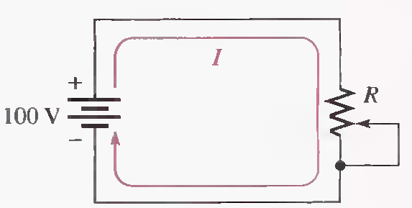
Q.7 By varying the rheostat (variable resistor) in the circuit , you can change the amount of current. The setting of the rheostat is such that the current is 750 mA. What is the resistance value of this setting? To adjust the current to 1A, to what resistance value must you set the rheostat? What is the problem with this circuit?
133 Ω, 100 Ω

Slide 9
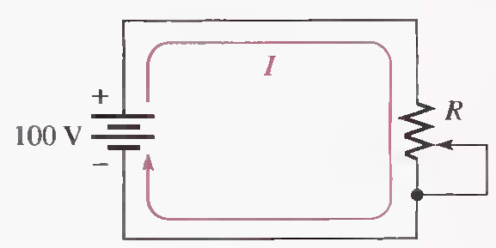
Q.8 By varying the rheostat (variable resistor) in the circuit, you can change the amount of current. The setting of the rheostat is such that the current is 750 mA. What is the resistance value of this setting? To adjust the current to 1 A, to what resistance value must you set the rheostat? What is the problem with this circuit?

Slide 10
Q.9 A 120 V lamp-dimming circuit is controlled by a rheostat and protected from excessive current by a 2A fuse. To what minimum resistance value can the rheostat be set without blowing the fuse? Assume a lamp resistance of 15Ω.
slightly greater than 45Ω

Slide 11
ENERGY AND POWER
Energy and Power
Power in an Electric Circuit
Resistor Power Ratings
Energy Conversion and Voltage Drop in Resistance
Power Supplies

Slide 12
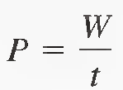
ENERGY AND POWER
Energy is the ability to do work.
Power is the rate at which energy is used.
Where
P = power in watts (W)
W = energy in joules (J)
t = time in seconds (s)
One watt (W) is the amount of power when one joule of energy is used in one second.
1hp = 746 W.

Slide 13
An amount of energy equal to 100 J is used in 5 s. What is the power in watts?
P=20W

Slide 14
The Kilowatt-hour (kWh) Unit of Energy
W = Pt
Determine the number of kilowatt-hours (kWh) for each of the following energy consumptions:
(a) 1400 W for 1 h (b) 2500 W for 2 h (c) 100,000 W for 5 h
1.4 kWh ,5 kWh ,500 kWh

Slide 15
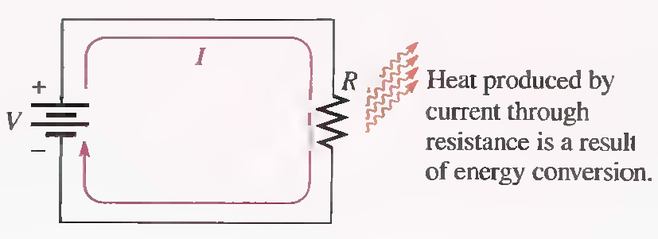
POWER IN AN ELECTRIC CIRCUIT
The amount of power dissipated in an electric circuit is dependent on the amount of resistance and on the amount of current, expressed as follows:
P=I²R
Power dissipation in an electric circuit results in heat energy given off by the resistance.

Slide 16
POWER IN AN ELECTRIC CIRCUIT
Watt’s Laws

Slide 17
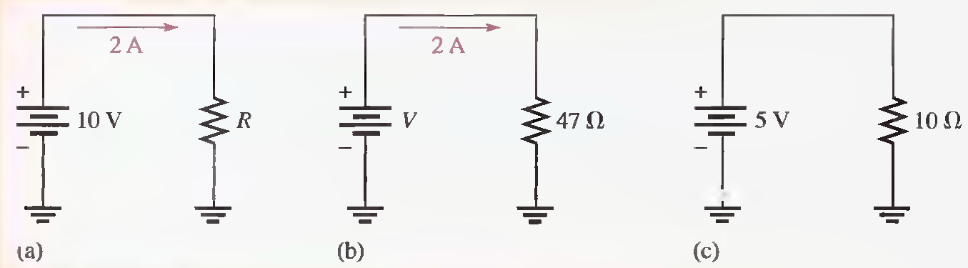
Calculate the power in each of the following three circuits.
20W, 188W, 2.5W

Slide 18
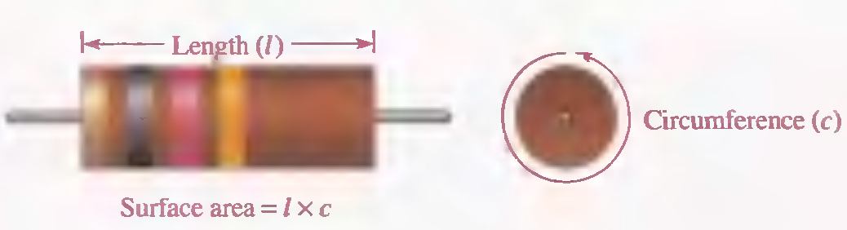
RESISTOR POWER RATINGS
The power rating is the maximum amount of power that a resistor can dissipate without being damaged by excessive heat buildup.
The power rating of a resistor is directly related to its surface area.

Slide 19
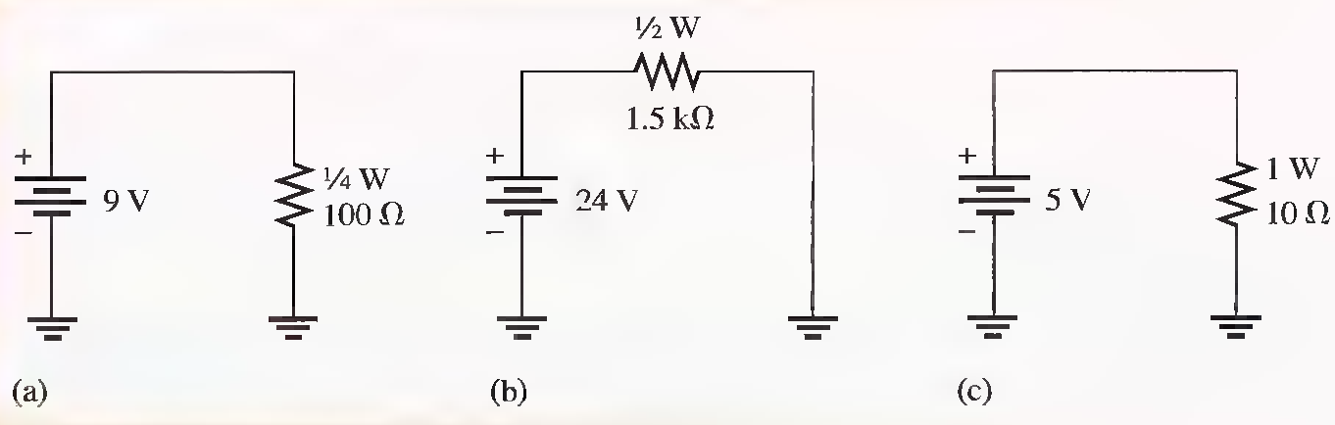
Determine whether the resistor in each circuit of following has possibly been damaged by overheating.
0.810W, 0.384 W, 2.5W

Slide 20
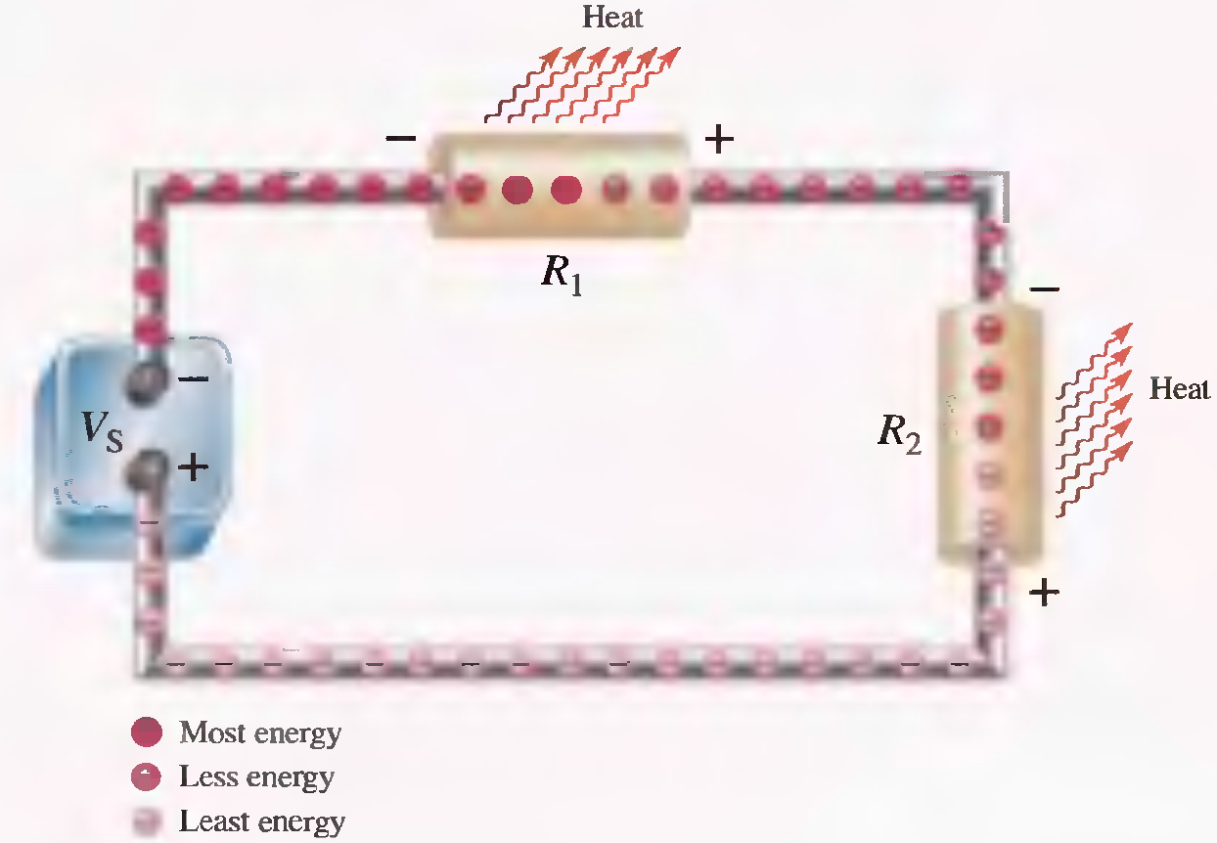
ENERGY CONVERSION AND VOLTAGE DROP IN RESISTANCE

Slide 21
POWER SUPPLIES
Ampere-hour Ratings of Batteries
Batteries convert chemical energy into electrical energy. Because of their limited source of chemical energy, batteries have a certain capacity that limits the amount of time over which they can produce a given power level. This capacity is measured in ampere-hours.

Slide 22
Ampere-hour Ratings of Batteries
The ampere-hour (Ah) rating determines the length of time that a battery can deliver a certain amount of average current to a load at the rated voltage.
For example, a 12 V automobile battery may be rated
for 70 Ah at 3.5 A. This means that it can produce an average of 3.5 A for 20 h at the rated voltage.

Slide 23
Summary
Energy and Power
Power in an Electric Circuit
Resistor Power Ratings
Energy Conversion and Voltage Drop
Power Supplies

