Slide 1
Previous Lecture 2
Review of V, I, and R
Voltage The amount of energy per charge available to move electrons from one point to another in an electric circuit. The unit is the volt (V)
Current The rate of flow of charges (electrons). The unit is the Ampere (A)
Resistance Opposition to current flow. The unit is the ohm (Ω)

Slide 2
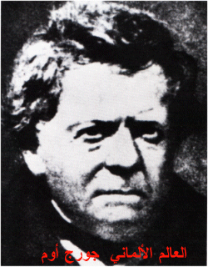
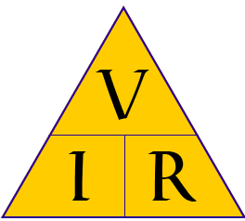
OHM’S LAW
Lecture 4
Lecture Objective
The Relationship of Current, Voltage, and Resistance
Calculating Current
Calculating Voltage
Calculating Resistance

Slide 3
OHM’s LAW
The most important fundamental law in electronics is Ohm’s law, which relates voltage, current, and resistance.
Georg Simon Ohm (1787-1854) studied the relationship between voltage, current, and resistance and formulated the equation that bears his name. In terms of current, Ohm’s law states

Slide 4
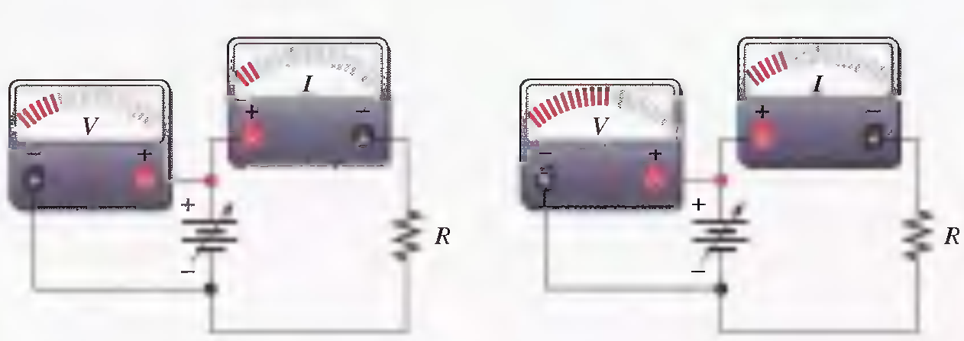
THE RELATIONSHIP OF CURRENT, VOLTAGE, AND RESISTANCE
I α V Constant Resistance
Less V, less I
More V, More I
Effect on the current of changing the voltage with the resistance at a constant value.

Slide 5
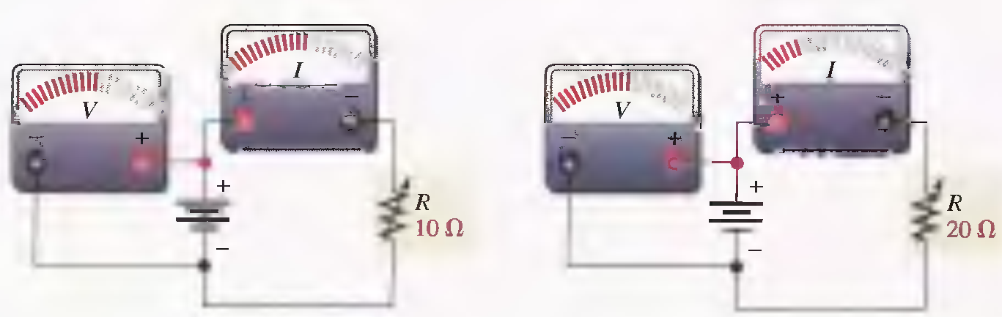
THE RELATIONSHIP OF CURRENT, VOLTAGE, AND RESISTANCE
I α 1/R Constant Voltage
Less R, more I
More R, less I
Effect on the current of changing the resistance with the
voltage at a constant value.

Slide 6
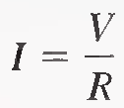
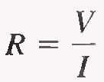

OHM’s LAW
Ohm's law states that current is directly proportional to voltage and inversely proportional to resistance.
I α V Constant Resistance
I α 1/R Constant Voltage
where:
I = current in amperes (A)
V = voltage in volts (V)
R = resistance in ohms (Ω)

Slide 7
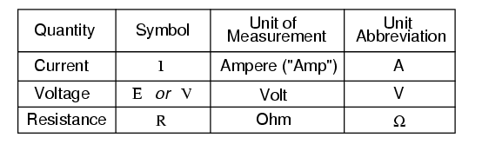

Slide 8
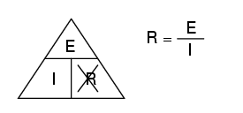
If you know E and I, and wish to determine R, just eliminate R from the picture and see what's left:

Slide 9
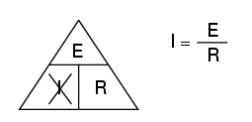
If you know E and R, and wish to determine I, eliminate I and see what's left:

Slide 10
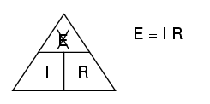
if you know I and R, and wish to determine E, eliminate E and see what's left:

Slide 11
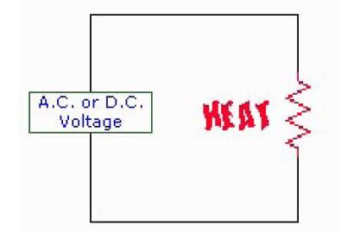
Ohm’s Law power consumption through a resistance
Some practical every day examples of this basic rule are: base board heaters, electric frying pans, toasters
and electric light bulbs. The heater consumes power producing heat for warmth, the frying pan consumes
power producing heat for general cooking, the toaster consumes power producing heat for cooking toast,
and the electric light bulb consumes power producing heat and more important light. A further example is
an electric hot water system. All are examples of Ohm’s Law.

Slide 12
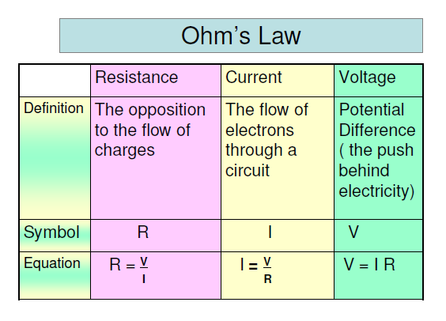

Slide 13
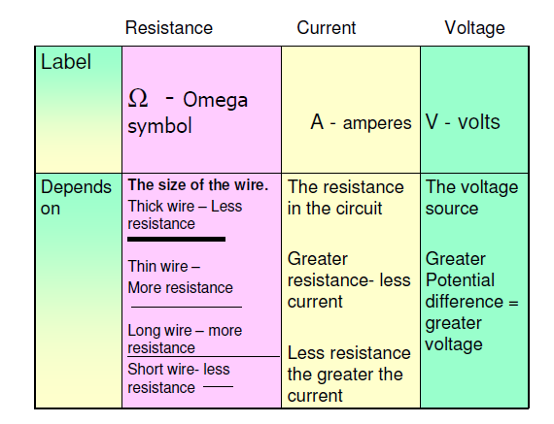

Slide 14
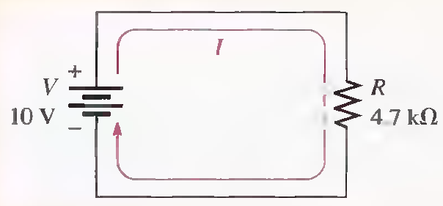
The Linear Relationship of Current and Voltage
In resistive circuits, current and voltage are linearly proportional. Linear means that if one of the quantities is increased or decreased by a certain percentage, the other will increase or decrease by the same percentage, assuming that the resistance is constant in value.
V= 10V, V=30V
2.13mA, 6.38mA

Slide 15
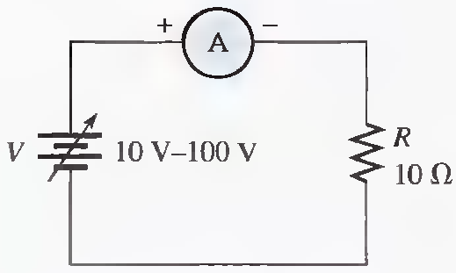
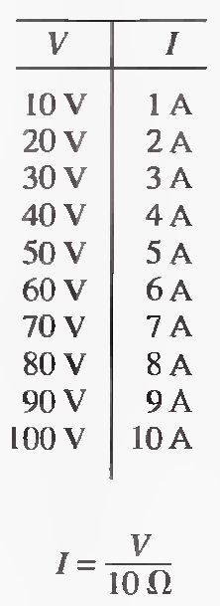
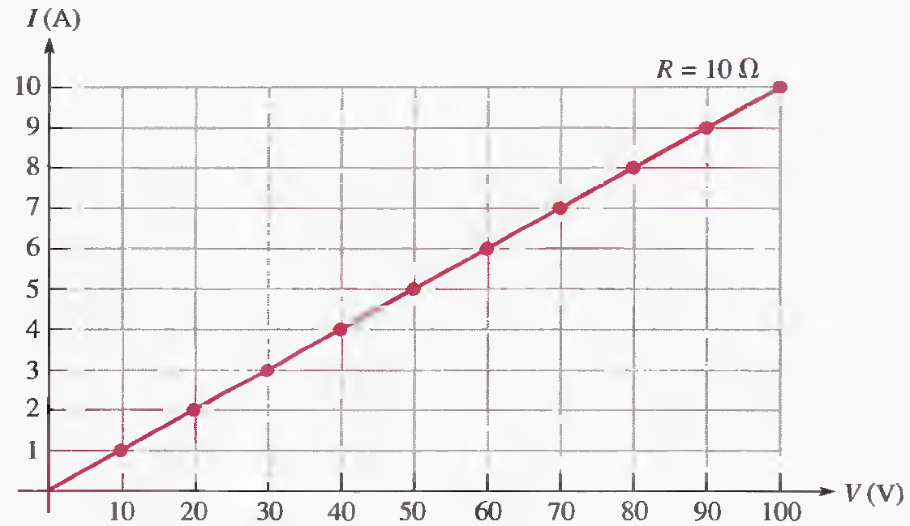
The Linear Relationship of Current and Voltage

Slide 16
Example
Assume that you are measuring the current in a circuit that is operating with 25 V. The ammeter reads 50 mA. Later, you notice that the current has dropped to 40 mA. Assuming that the resistance did not change, you must conclude that the voltage source has changed. How much has the voltage changed, and what is its new value?
R= 500Ω, 20V

Slide 17
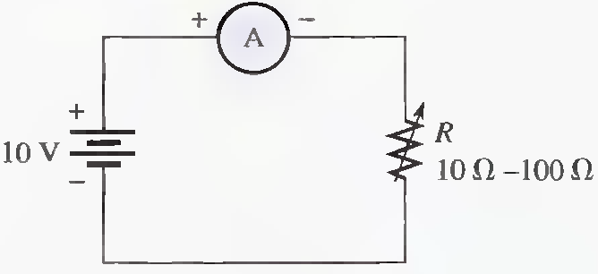
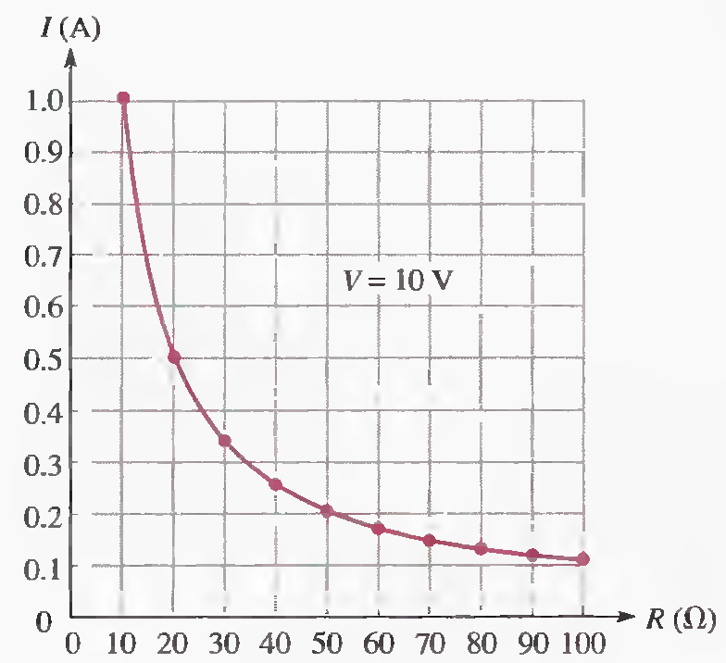
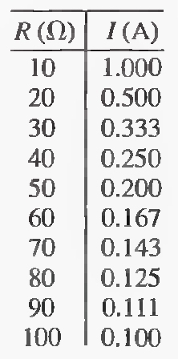
The Inverse Relationship of Current and Resistance
I=V/R

Slide 18
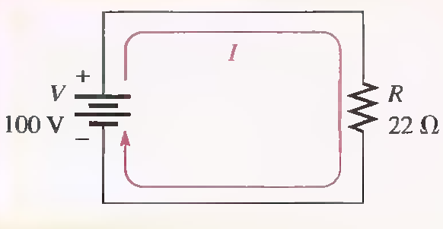
CALCULATING CURRENT
How many amperes of current are in the following circuit?
4.55 A

Slide 19
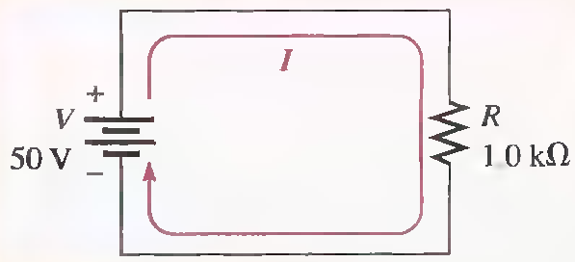
Units with Metric Prefixes
In electronics, resistance values of thousands of ohms or even millions of ohms are common.
Example
Calculate the current.
50 mA

Slide 20
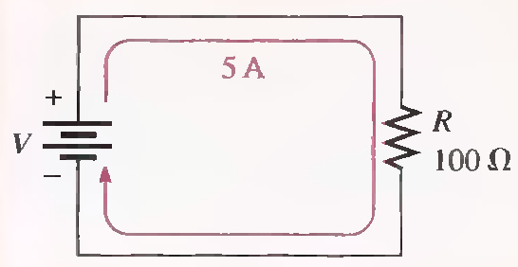
CALCULATING VOLTAGE
In the circuit of following Figure, how much voltage is needed to produce 5 A of current?
500V

Slide 21
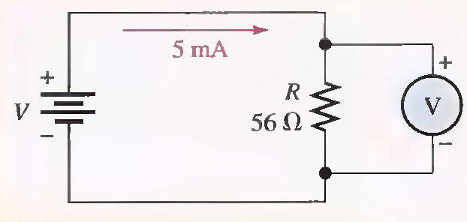
CALCULATING VOLTAGE
How much voltage will be measured across the resistor ?
280mV

Slide 22
CALCULATING VOLTAGE
If there is a current of 50 µA through a 4.7 MΩ resistor, what is the voltage?
235 V

Slide 23
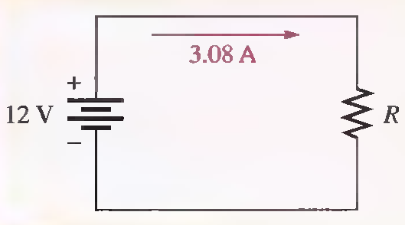
CALCULATING RESISTANCE
In the circuit of following Figure, how much resistance is needed to draw 3.08 A of current from the battery?
3.90Ω

Slide 24
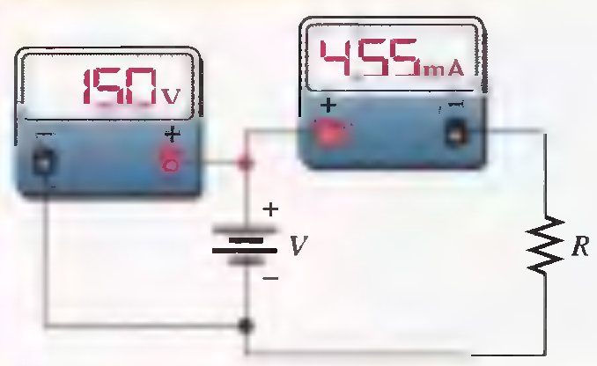
CALCULATING RESISTANCE
Suppose that the ammeter in Figure indicates 455 mA of current and the voltmeter reads 150 V. What is the value of R?
33 kΩ

