Slide 1
Previous Lecture 31
The Source Free Parallel RLC Circuit

Slide 2
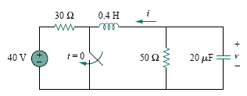
Example related to Source free Parallel RLC circuit
Lecture 32
Example
Find v(t) for t > 0 in the RLC circuit of following Fig.

Slide 3
Example
Find v(t) for t > 0 in the RLC circuit of following Fig.

Slide 4
Example
Find v(t) for t > 0 in the RLC circuit of following Fig.

Slide 5
Example
Find v(t) for t > 0 in the RLC circuit of following Fig.

Slide 6
Example
Find v(t) for t > 0 in the RLC circuit of following Fig.

Slide 7
Example
Find v(t) for t > 0 in the RLC circuit of following Fig.

Slide 8
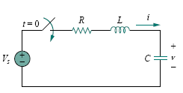

Step Response of a Series RLC Circuit

Slide 10

Thus, the complete solutions for the overdamped, underdamped, and critically damped cases are:
The values of the constants A1 and A2 are obtained from the initial conditions: v(0) and dv(0)/dt . Keep in mind that v and i are, respectively, the voltage across the capacitor and the current through the inductor. Therefore, the above Eq. only applies for finding v. But once the capacitor voltage v_{C} = v is known, we can determine i = C dv/dt, which is the same current through the capacitor, inductor, and resistor. Hence, the voltage across the resistor is v_{R} = iR, while the inductor voltage is v_{L} = L di/dt.

Slide 11

Example
For the circuit in Fig., find v(t) and i(t) for t > 0. Consider these cases: R = 5 ,R = 4 , andR = 1 .

Slide 12
Example
For the circuit in Fig., find v(t) and i(t) for t > 0. Consider these cases: R = 5 ,R = 4 , andR = 1 .

Slide 13
Example
For the circuit in Fig., find v(t) and i(t) for t > 0. Consider these cases: R = 5 ,R = 4 , andR = 1 .

Slide 14
Example
For the circuit in Fig., find v(t) and i(t) for t > 0. Consider these cases: R = 5 ,R = 4 , andR = 1 .

Slide 15
Example
For the circuit in Fig., find v(t) and i(t) for t > 0. Consider these cases: R = 5 ,R = 4 , andR = 1 .

Slide 16
Example
For the circuit in Fig., find v(t) and i(t) for t > 0. Consider these cases: R = 5 ,R = 4 , andR = 1 .

Slide 17
Example
For the circuit in Fig., find v(t) and i(t) for t > 0. Consider these cases: R = 5 ,R = 4 , andR = 1 .

Slide 18
Example
For the circuit in Fig., find v(t) and i(t) for t > 0. Consider these cases: R = 5 ,R = 4 , andR = 1 .

Slide 19
Example
For the circuit in Fig., find v(t) and i(t) for t > 0. Consider these cases: R = 5 ,R = 4 , andR = 1 .

Slide 20
Example
For the circuit in Fig., find v(t) and i(t) for t > 0. Consider these cases: R = 5 ,R = 4 , andR = 1 .

Slide 21
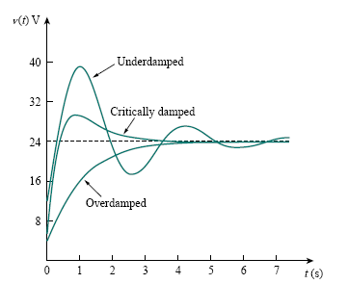
Figure plots the responses for the three cases. From this figure, we observe that the critically damped response approaches the step input of 24 V the fastest.
Response for three degrees of damping

Slide 22
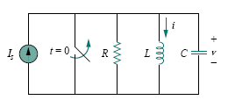
Step Response of a Parallel RLC Circuit

Slide 24

Thus, the complete solutions for the overdamped, underdamped, and critically damped cases are:
The constants A1 and A2 in each case can be determined from the initial conditions for i and di/dt . Again, we should keep in mind that above Eq. only applies for finding the inductor current i. But once the inductor current i_{L} = i is known, we can find v = L di/dt, which is the same voltage across inductor, capacitor, and resistor. Hence, the current through the resistor is i_{R} = v/R, while the capacitor current is i_{C} = C dv/dt.

Slide 25

Example
In the circuit in the following Fig., find i(t) and i_{R}(t) for t > 0.

Slide 26
Example
In the circuit in the following Fig., find i(t) and i_{R}(t) for t > 0.

Slide 27
Example
In the circuit in the following Fig., find i(t) and i_{R}(t) for t > 0.

Slide 28
Example
In the circuit in the following Fig., find i(t) and i_{R}(t) for t > 0.

Slide 29
Example
In the circuit in the following Fig., find i(t) and i_{R}(t) for t > 0.

Slide 30
Example
In the circuit in the following Fig., find i(t) and i_{R}(t) for t > 0.

Slide 31
Example
In the circuit in the following Fig., find i(t) and i_{R}(t) for t > 0.

Slide 32
Example
In the circuit in the following Fig., find i(t) and i_{R}(t) for t > 0.

Slide 33
Example
In the circuit in the following Fig., find i(t) and i_{R}(t) for t > 0.

Slide 34
Example
In the circuit in the following Fig., find i(t) and i_{R}(t) for t > 0.

Slide 35
Material of the Course ECA-1 (EEE121)
All the material for the 32 lectures have been taken and modified from the following two books
Principles of Electric Circuits 8th Edition
By FLOYD
(Chapter 1 to Chapter 9)
Basic Engineering Circuit Analysis 8th Edition
By J. David Irwin & R Mark Nelms
(Chapter 6 to Chapter 8)

Slide 36
Sr. No. | Main Topics covered during this course
1 | Quantities and Units
2 | Voltage, Current, and Resistance
3 | Ohm's Law
4 | Energy and Power
5 | Series Circuits
6 | Parallel Circuits
7 | Series-Parallel Circuits
8 | Circuit Theorems and Conversions
9 | Branch, Loop, and Node Analyses
10 | Capacitors , Inductors
11 | RL, RC, and RLC Circuits

Slide 37
Good Luck

