Slide 1
Example
Find i(t) in the circuit of following figure. Assume the circuit has reached steady state at t=0⁻
Lecture 31
Example related to The Source-Free Series RLC Circuit

Slide 7
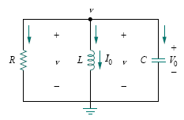
The Source Free Parallel RLC Circuit

Slide 12
Key Points
Having found the capacitor voltage v(t) for the parallel RLC circuit, we can readily obtain other circuit quantities such as individual element currents. For example, the resistor current is i_{R} =v/R and the capacitor voltage is v_{C} = C dv/dt. We have selected the capacitor voltage v(t) as the key variable to be determined first in order to take advantage of following Eq.
v(0⁺) = v(0⁻)
Because the capacitor voltage is always continuous.
Notice that we first found the inductor current i(t) for the RLC series circuit, whereas we first found the capacitor voltage v(t) for the parallel RLC circuit

Slide 13
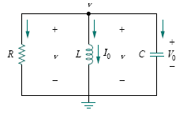
Example
In the parallel circuit of following Fig., find v(t) for t > 0, assuming v(0) = 5 V, i(0) = 0, L = 1 H, and C = 10 mF.
Consider these cases: R = 1.923 , R = 5 , and R = 6.25 .

Slide 14
Example
In the parallel circuit of following Fig., find v(t) for t > 0, assuming v(0) = 5 V, i(0) = 0, L = 1 H, and C = 10 mF.
Consider these cases: R = 1.923 , R = 5 , and R = 6.25 .

Slide 15
Example
In the parallel circuit of following Fig., find v(t) for t > 0, assuming v(0) = 5 V, i(0) = 0, L = 1 H, and C = 10 mF.
Consider these cases: R = 1.923 , R = 5 , and R = 6.25 .

Slide 16
Example
In the parallel circuit of following Fig., find v(t) for t > 0, assuming v(0) = 5 V, i(0) = 0, L = 1 H, and C = 10 mF.
Consider these cases: R = 1.923 , R = 5 , and R = 6.25 .

Slide 17
Example
In the parallel circuit of following Fig., find v(t) for t > 0, assuming v(0) = 5 V, i(0) = 0, L = 1 H, and C = 10 mF.
Consider these cases: R = 1.923 , R = 5 , and R = 6.25 .

Slide 18
Example
In the parallel circuit of following Fig., find v(t) for t > 0, assuming v(0) = 5 V, i(0) = 0, L = 1 H, and C = 10 mF.
Consider these cases: R = 1.923 , R = 5 , and R = 6.25 .

Slide 19
Example
In the parallel circuit of following Fig., find v(t) for t > 0, assuming v(0) = 5 V, i(0) = 0, L = 1 H, and C = 10 mF.
Consider these cases: R = 1.923 , R = 5 , and R = 6.25 .

Slide 20
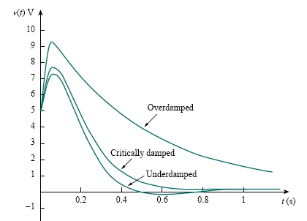
Notice that by increasing the value of R, the degree of damping decreases and the responses differ. Following Figure plots the three cases.

Slide 21
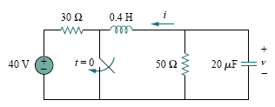
Example
Find v(t) for t > 0 in the RLC circuit of following Fig.

Slide 22
Example
Find v(t) for t > 0 in the RLC circuit of following Fig.

Slide 23
Example
Find v(t) for t > 0 in the RLC circuit of following Fig.

Slide 24
Example
Find v(t) for t > 0 in the RLC circuit of following Fig.

Slide 25
Example
Find v(t) for t > 0 in the RLC circuit of following Fig.

Slide 26
Example
Find v(t) for t > 0 in the RLC circuit of following Fig.

Slide 27
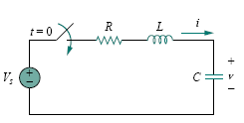

Step Response of a Series RLC Circuit

Slide 29

Thus, the complete solutions for the overdamped, underdamped, and critically damped cases are:
The values of the constants A1 and A2 are obtained from the initial conditions: v(0) and dv(0)/dt . Keep in mind that v and i are, respectively, the voltage across the capacitor and the current through the inductor. Therefore, the above Eq. only applies for finding v. But once the capacitor voltage v_{C} = v is known, we can determine i = C dv/dt, which is the same current through the capacitor, inductor, and resistor. Hence, the voltage across the resistor is v_{R} = iR, while the inductor voltage is v_{L} = L di/dt.

Slide 30

Example
For the circuit in Fig., find v(t) and i(t) for t > 0. Consider these cases: R = 5 ,R = 4 , andR = 1 .

Slide 31
Example
For the circuit in Fig., find v(t) and i(t) for t > 0. Consider these cases: R = 5 ,R = 4 , andR = 1 .

Slide 32
Example
For the circuit in Fig., find v(t) and i(t) for t > 0. Consider these cases: R = 5 ,R = 4 , andR = 1 .

Slide 33
Example
For the circuit in Fig., find v(t) and i(t) for t > 0. Consider these cases: R = 5 ,R = 4 , andR = 1 .

Slide 34
Example
For the circuit in Fig., find v(t) and i(t) for t > 0. Consider these cases: R = 5 ,R = 4 , andR = 1 .

Slide 35
Example
For the circuit in Fig., find v(t) and i(t) for t > 0. Consider these cases: R = 5 ,R = 4 , andR = 1 .

Slide 36
Example
For the circuit in Fig., find v(t) and i(t) for t > 0. Consider these cases: R = 5 ,R = 4 , andR = 1 .

Slide 37
Example
For the circuit in Fig., find v(t) and i(t) for t > 0. Consider these cases: R = 5 ,R = 4 , andR = 1 .

Slide 38
Example
For the circuit in Fig., find v(t) and i(t) for t > 0. Consider these cases: R = 5 ,R = 4 , andR = 1 .

Slide 39
Example
For the circuit in Fig., find v(t) and i(t) for t > 0. Consider these cases: R = 5 ,R = 4 , andR = 1 .

Slide 40
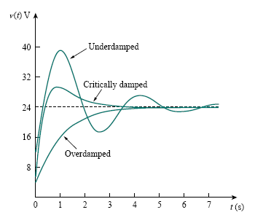
Figure plots the responses for the three cases. From this figure, we observe that the critically damped response approaches the step input of 24 V the fastest.
Response for three degrees of damping

Slide 41
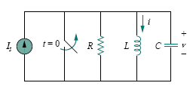
Step Response of a Parallel RLC Circuit

Slide 43

Thus, the complete solutions for the overdamped, underdamped, and critically damped cases are:
The constants A1 and A2 in each case can be determined from the initial conditions for i and di/dt . Again, we should keep in mind that above Eq. only applies for finding the inductor current i. But once the inductor current i_{L} = i is known, we can find v = L di/dt, which is the same voltage across inductor, capacitor, and resistor. Hence, the current through the resistor is i_{R} = v/R, while the capacitor current is i_{C} = C dv/dt.

Slide 44

Example
In the circuit in the following Fig., find i(t) and i_{R}(t) for t > 0.

Slide 45
Example
In the circuit in the following Fig., find i(t) and i_{R}(t) for t > 0.

Slide 46
Example
In the circuit in the following Fig., find i(t) and i_{R}(t) for t > 0.

Slide 47
Example
In the circuit in the following Fig., find i(t) and i_{R}(t) for t > 0.

Slide 48
Example
In the circuit in the following Fig., find i(t) and i_{R}(t) for t > 0.

Slide 49
Example
In the circuit in the following Fig., find i(t) and i_{R}(t) for t > 0.

Slide 50
Example
In the circuit in the following Fig., find i(t) and i_{R}(t) for t > 0.

Slide 51
Example
In the circuit in the following Fig., find i(t) and i_{R}(t) for t > 0.

Slide 52
Example
In the circuit in the following Fig., find i(t) and i_{R}(t) for t > 0.

Slide 53
Example
In the circuit in the following Fig., find i(t) and i_{R}(t) for t > 0.

