Slide 1
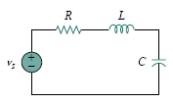



Previous Lecture 29
Second-Order Circuit
A second-order circuit is characterized by a second-order differential equation. It consists of resistors and the equivalent of two energy storage elements.

Slide 2
Finding Initial and Final Values
We have learnt , how to obtain the initial conditions for the circuit variables and their derivatives, as this is crucial to analyze second order circuits.
Perhaps the major problem students face in handling second-order circuits is finding the initial and final conditions on circuit variables. Students are usually comfortable getting the initial and final values of v and i but often have difficulty finding the initial values of their derivatives: dv/dt and di/dt .

Slide 3
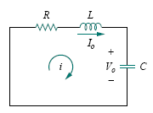
The Source-Free Series RLC Circuit
Lecture 30

Slide 12
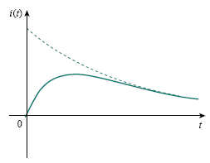
Overdamped Case (α > ω0)
The response is
which decays and approaches
zero as t increases.

Slide 13
Critically Damped Case (α = ω0)

Slide 17
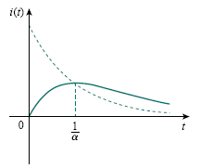
Critically Damped Case (α = ω0)
The natural response of the critically damped circuit is a sum of two terms: a negative exponential and a negative exponential multiplied by a linear term, or
A typical critically damped response is shown in Fig. In fact, it is a sketch of i(t) = te^{−αt} , which reaches a maximum value of e⁻¹/α at t = 1/α, one time constant, and then decays all the way to zero

Slide 18
Underdamped Case (α < ω0)

Slide 21
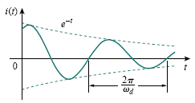
Underdamped Case (α < ω0)
With the presence of sine and cosine functions, it is clear that the natural response for this case is exponentially damped and oscillatory in nature.

Slide 22
Key Points
Once the inductor current i(t) is found for the RLC series circuit, other circuit quantities such as individual element voltages can easily be found. For example, the resistor voltage is v_{R} = Ri, and the inductor voltage is v_{L} = L di/dt. The inductor current i(t) is selected as the key variable to be determined first in order to take advantage of following Eq. because the inductor current is always continuous so that
i(0⁺) = i(0⁻)

Slide 23
Example
In the following Fig., R = 40Ω, L = 4 H, and C = 1/4 F. Calculate the characteristic roots of the circuit. Is the natural response overdamped, underdamped, or critically damped?

Slide 24
Example
In the following Fig., R = 40Ω, L = 4 H, and C = 1/4 F. Calculate the characteristic roots of the circuit. Is the natural response overdamped, underdamped, or critically damped?

Slide 25
Example
In the following Fig., R = 40Ω, L = 4 H, and C = 1/4 F. Calculate the characteristic roots of the circuit. Is the natural response overdamped, underdamped, or critically damped?

Slide 26
Example
In the following Fig., R = 40Ω, L = 4 H, and C = 1/4 F. Calculate the characteristic roots of the circuit. Is the natural response overdamped, underdamped, or critically damped?

Slide 27
Example
In the following Fig., R = 40Ω, L = 4 H, and C = 1/4 F. Calculate the characteristic roots of the circuit. Is the natural response overdamped, underdamped, or critically damped?

Slide 28
Example
In the following Fig., R = 40Ω, L = 4 H, and C = 1/4 F. Calculate the characteristic roots of the circuit. Is the natural response overdamped, underdamped, or critically damped?

Slide 29
Example
In the following Fig., R = 40Ω, L = 4 H, and C = 1/4 F. Calculate the characteristic roots of the circuit. Is the natural response overdamped, underdamped, or critically damped?

