Slide 1
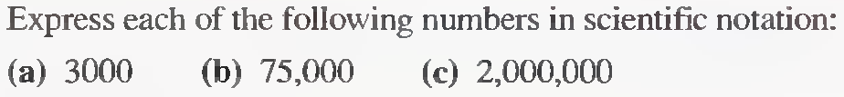
Some Problems and solutions related to Lecture 1
Lecture 3
Problems related to scientific notation
Q 1.

Slide 2

Problems related to scientific notation
Q 2.

Slide 3
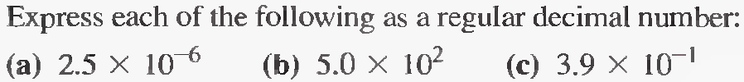
Problems related to scientific notation
Q 3.

Slide 4
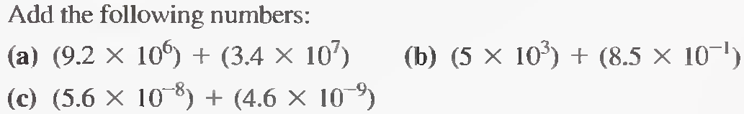
Problems related to scientific notation
Q 4.

Slide 5
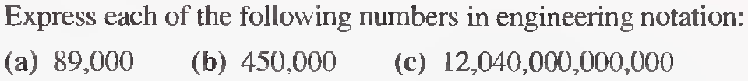
Problems related to Engineering notation
Q 1.

Slide 6
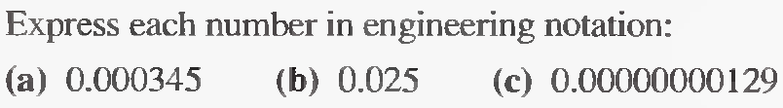
Problems related to Engineering notation
Q 2.

Slide 7
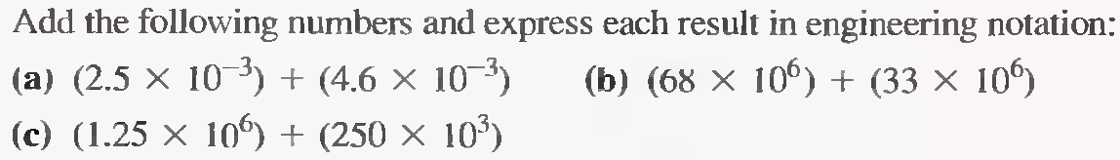
Problems related to Engineering notation
Q 3.

Slide 8
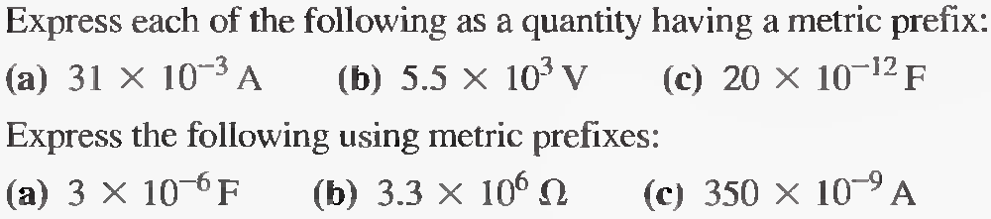
Problems related to Metric Prefix
Q 1.
Q 2.

Slide 9

Problems related to Metric Unit Conversion
Q 1.

Slide 10
Problems related to Metric Unit Conversion
Q 1.

Slide 11
Problems related to Metric Unit Conversion
Q 2.

Slide 12
Some Problems and solutions related to Lecture 2
Problems related to Electric Charge
Q 1.
5 × 10¹⁴ electrons

Slide 13
Problems related to Voltage, Current and Resistance
Q 2.
20 V

Slide 14
Problems related to Voltage, Current and Resistance
Q 3
33.3 V

Slide 15
Problems related to Voltage, Current and Resistance
Q 4
0.2 A

Slide 16
Problems related to Voltage and Current Sources
Q 1
200 mA.

Slide 17
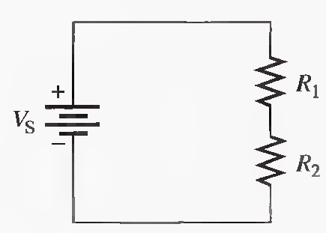
Problems related to Basic Circuit Measurement
Show the placement of an ammeter and a voltmeter to measure the current and the source voltage in the below Figure. Also show how to connect ohm-meter to measure R₂ ?
Q 1

Slide 18
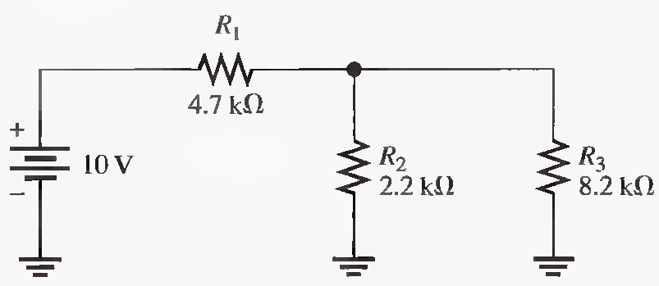
Problems related to Basic Circuit Measurement
Q 2
Indicate how you would connect the multimeter in the following to measure I₁, V₁ and R₁.

