Slide 1
Previous Lectures 26-28
  Source free RL and RC Circuits.
  Unit Step Function
  Step Response of RC circuit
  Step Response of RL Circuit

Slide 2
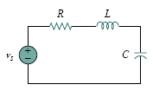



SECOND-ORDER CIRCUITS
Lecture 29
A second-order circuit is characterized by a second-order differential equation. It consists of resistors and the equivalent of two energy storage elements.

Slide 3
Circuit Excitation
Two ways of excitation
By initial conditions of the storage elements (These source free circuits will give natural responses as expected)
By step inputs: Circuits are excited by independent sources. These circuits will give both the natural response and the forced response

Slide 4
Finding Initial and Final Values
We begin our lecture by learning how to obtain the initial conditions for the circuit variables and their derivatives, as this is crucial to analyze second order circuits.
Perhaps the major problem students face in handling second-order circuits is finding the initial and final conditions on circuit variables. Students are usually comfortable getting the initial and final values of v and i but often have difficulty finding the initial values of their derivatives: dv/dt and di/dt .

Slide 5
There are two key points to keep in mind in determining the initial conditions.
First—as always in circuit analysis—we must carefully handle the polarity of voltage v(t) across the capacitor and the direction of the current i(t) through the inductor. Keep in mind that v and i are defined strictly according to the passive sign convention. One should carefully observe how these are defined and apply them accordingly.

Slide 6
Second, keep in mind that the capacitor voltage is always continuous so that
v(0 ⁺) = v(0 ⁻) (a)
and the inductor current is always continuous so that
i(0 ⁺) = i(0 ⁻) (b)
where t = 0 ⁻ denotes the time just before a switching event and t = 0 ⁺ is the time just after the switching event, assuming that the switching event takes place at t = 0. Therefore, in finding initial conditions, we first focus on those variables that cannot change abruptly, capacitor voltage and inductor current, by applying Eq. (a & b).

Slide 7
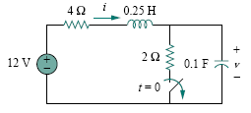
Example
The switch in the Fig. has been closed for a long time. It is open at t = 0. Find: (a) i(0⁺), v(0⁺), (b) di(0⁺)/dt , dv(0⁺)/dt , (c) i(∞), v(∞).

Slide 10
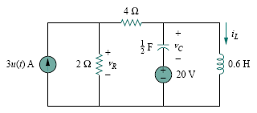
Example
In the circuit of following Fig. , calculate: (a) i_{L}(0⁺), v_{C}(0⁺), v_{R}(0⁺), (b) di_{L}(0⁺)/dt , dv_{C}(0⁺)/dt , dv_{R}(0⁺)/dt , (c) i_{L}(∞), v_{C}(∞), v_{R}(∞).

Slide 15
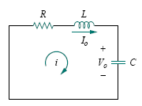
The Source-Free RLC Circuit

Slide 19
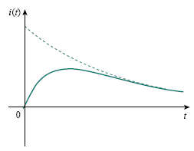
Overdamped Case (α > ω0)
The response is
which decays and approaches zero as t increases.

Slide 23
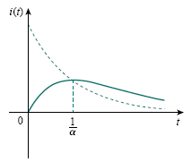
Critically Damped Case (α = ω0)
The natural response of the critically damped circuit is a sum of two terms: a negative exponential and a
negative exponential multiplied by a linear term, or
A typical critically damped response is shown in Fig. In fact, it is a sketch of i(t) = te^{−αt} , which reaches a maximum value of e⁻¹/α at t = 1/α, one time constant, and then decays all the way to zero

Slide 25
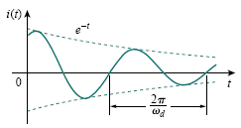
Underdamped Case (α < ω0)
With the presence of sine and cosine functions, it is clear that the natural response for this case is exponentially damped and oscillatory in nature.

Slide 26
Key Points
Once the inductor current i(t) is found for the RLC series circuit, other circuit quantities such as individual element voltages can easily be found. For example, the resistor voltage is v_{R} = Ri, and the inductor voltage is v_{L} = L di/dt. The inductor current i(t) is selected as the key variable to be determined first in order to take advantage of following Eq. because the inductor current is always continuous so that
i(0⁺) = i(0⁻)

Slide 27
Example
In the following Fig., R = 40Ω, L = 4 H, and C = 1/4 F. Calculate the characteristic roots of the circuit. Is the natural response overdamped, underdamped, or critically damped?

Slide 28
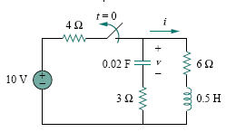
Example
Find i(t) in the circuit in the following Fig. Assume that the circuit has reached steady state at t = 0⁻.

Slide 31
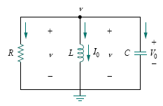
The Source Free Parallel RLC Circuit

Slide 34
Key Points
Having found the capacitor voltage v(t) for the parallel RLC circuit, we can readily obtain other circuit quantities such as individual element currents. For example, the resistor current is i_{R} =v/R and the capacitor voltage is v_{C} = C dv/dt. We have selected the capacitor voltage v(t) as the key variable to be determined first in order to take advantage of following Eq.
v(0⁺) = v(0⁻)
Because the capacitor voltage is always continuous.
Notice that we first found the inductor current i(t) for the RLC series circuit, whereas we first found the capacitor voltage v(t) for the parallel RLC circuit

Slide 35
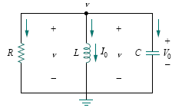
Example
In the parallel circuit of following Fig., find v(t) for t > 0, assuming v(0) = 5 V, i(0) = 0, L = 1 H, and C = 10 mF.
Consider these cases: R = 1.923 , R = 5 , and R = 6.25 .

Slide 39
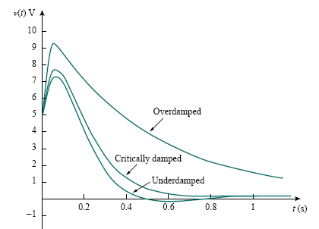
Notice that by increasing the value of R, the degree of damping decreases and the responses differ. Following Figure plots the three cases.

Slide 40
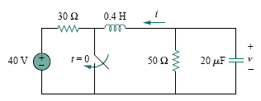
Example
Find v(t) for t > 0 in the RLC circuit of following Fig.

Slide 44
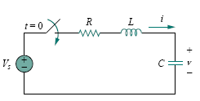
Step Response of a Series RLC Circuit

Slide 46

Thus, the complete solutions for the overdamped, underdamped, and critically damped cases are:
The values of the constants A1 and A2 are obtained from the initial conditions: v(0) and dv(0)/dt . Keep in mind that v and i are, respectively, the voltage across the capacitor and the current through the inductor. Therefore, the above Eq. only applies for finding v. But once the capacitor voltage v_{C} = v is known, we can determine i = C dv/dt, which is the same current through the capacitor, inductor, and resistor. Hence, the voltage across the resistor is v_{R} = iR, while the inductor voltage is v_{L} = L di/dt.

Slide 47
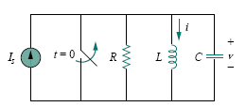
STEP RESPONSE OF A PARALLEL RLC CIRCUIT

Slide 48

Thus, the complete solutions for the overdamped, underdamped, and critically damped cases are:
The constants A1 and A2 in each case can be determined from the initial conditions for i and di/dt . Again, we should keep in mind that above Eq. only applies for finding the inductor current i. But once the inductor current i_{L} = i is known, we can find v = L di/dt, which is the same voltage across inductor, capacitor, and resistor. Hence, the current through the resistor is i_{R} = v/R, while the capacitor current is i_{C} = C dv/dt.

