Slide 1
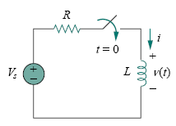
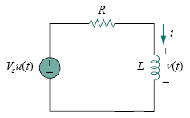
Step Response of an RL Circuit
Lecture 28
Our goal is to find the inductor current i as the circuit response.
An RL circuit with a step input voltage.

Slide 3

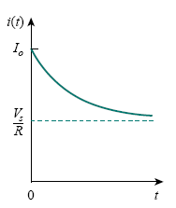
This is the complete response of the RL circuit
Total response of the RL circuit with initial
inductor current Io.

Slide 4

Thus, to find the step response of an RL circuit requires three things:
1. The initial inductor current i(0) at t = 0⁺.
2. The final inductor current i(∞).
3. The time constant τ .
if the switching takes place at time t = t0 instead of t = 0,then above Eq. becomes

Slide 7


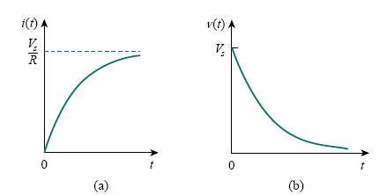
Step responses of an RL circuit with no initial inductor current:
(a) current response, (b) voltage response

Slide 8
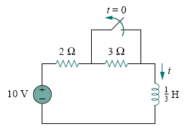
Example 3
Find i(t) in the circuit in following Fig. for t > 0. Assume that the switch has been closed for a long time.

Slide 11
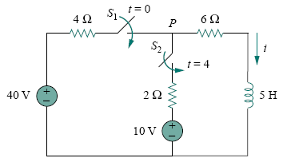
Example 4
At t = 0, switch 1 in the following circuit is closed, and switch 2 is closed 4 s later. Find i(t) for t > 0. Calculate i for t = 2 s and t = 5 s.

