Slide 1
Previous Lecture 26
  Source free RL and RC Circuits.
Today's Lecture 27
  Unit Step Function
  Step Response of RC circuit
  Step Response of RL Circuit

Slide 2
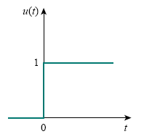

Unit step function u(t)
Lecture 27
The unit step function u(t) is 0 for negative values of t and 1 for positive values of t.
In mathematical terms,
Undefined at t = 0, where it changes abruptly from 0 to 1
The unit step function.

Slide 3

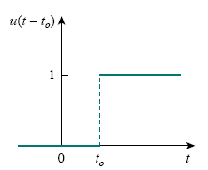
If the abrupt change occurs at t = to (where to > 0) instead of t = 0, the unit step function becomes
The unit step function delayed is by to.

Slide 4

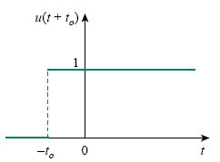
If the change is at t = −to, the unit step function becomes
The unit step function is advanced by to.

Slide 5


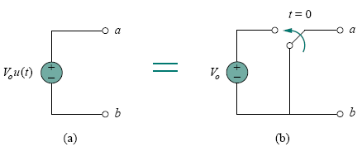
We use the step function to represent an abrupt change in voltage or current, like the changes that occur in the circuits of control systems and digital computers. For example, the voltage
(a) Voltage source of Vou(t), (b) its equivalent circuit.

Slide 6
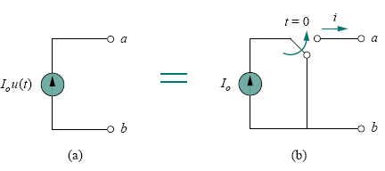
(a) Current source of Iou(t), (b) its equivalent circuit

Slide 7
Step Response of an RC Circuit
When the dc source of an RC circuit is suddenly applied, the voltage or current source can be modeled as a step function, and the response is known as a step response.
The step response of a circuit is its behavior when the excitation is the step function, which may be a voltage or a current source.

Slide 8
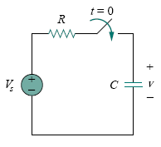
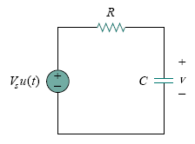
Our goal is to find capacitor voltage as the circuit response.
An RC circuit with voltage step input.

Slide 11

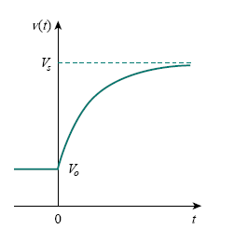
This is known as the complete response of the RC circuit to a sudden application of a dc voltage source, assuming the capacitor is initially charged.
Response of an RC circuit with initially charged capacitor.

Slide 12
If we assume that the capacitor is uncharged initially, we set V₀= 0

Slide 13
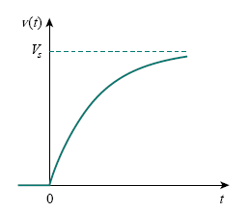
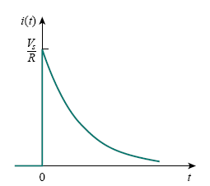
Figure shows the plots of capacitor voltage v(t) and capacitor current i(t).
Step response of circuit with initially uncharged capacitor:
(a) voltage response, (b) current response.

Slide 14

Systematic approach or, a short-cut method for finding the step response of an RC or RL circuit

Slide 15
The natural response or transient response is the circuit’s temporary response that will die out with time.
The forced response or steady-state response is the behavior of the circuit a long time after an external excitation is applied.

Slide 16


To find the step response of an RC circuit requires three things:
1. The initial capacitor voltage v(0).
2. The final capacitor voltage v(∞).
3. The time constant τ .
If the switch changes position at time t = to instead of at t = 0, there is a time delay in the response so that above Eq. becomes
where v(to) is the initial value at t = t⁺

Slide 17
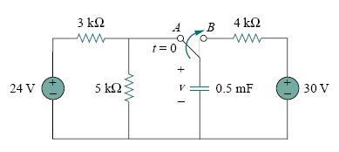
Example 1
The switch in Fig. 7.43 has been in position A for a long time. At t = 0, the switch moves to B. Determine v(t) for t > 0 and calculate its value at t = 1 s and 4 s.

Slide 19
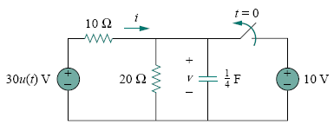
Example 2
In the following Fig., the switch has been closed for a long time and is opened at t = 0. Find i and v for all time.

Slide 22
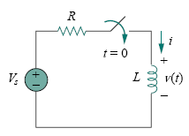
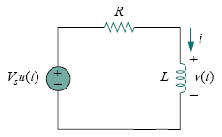
Step Response of an RL Circuit
Our goal is to find the inductor current i as the circuit response.
An RL circuit with a step input voltage.

Slide 24

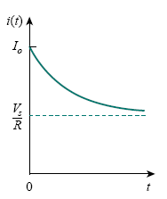
This is the complete response of the RL circuit
Total response of the RL circuit with initial
inductor current Io.

Slide 25

Thus, to find the step response of an RL circuit requires three things:
1. The initial inductor current i(0) at t = 0⁺.
2. The final inductor current i(∞).
3. The time constant τ .
if the switching takes place at time t = t0 instead of t = 0,then above Eq. becomes

Slide 28


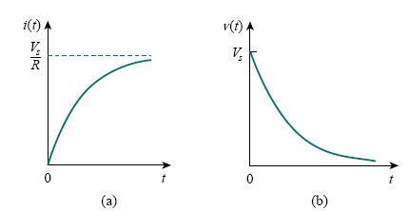
Step responses of an RL circuit with no initial inductor current:
(a) current response, (b) voltage response

Slide 29
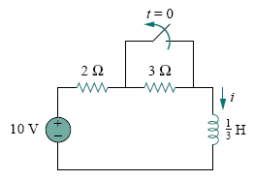
Example 3
Find i(t) in the circuit in following Fig. for t > 0. Assume that the switch has been closed for a long time.

Slide 32
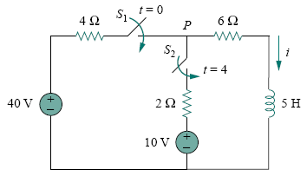
Example 4
At t = 0, switch 1 in the following circuit is closed, and switch 2 is closed 4 s later. Find i(t) for t > 0. Calculate i for t = 2 s and t = 5 s.

