Slide 1
FIRST-ORDER CIRCUIT
Lecture 26
Three passive elements (resistors, capacitors, and inductors) individually,
Circuits having various combinations of two or three of the passive elements.
RC and RL circuits.
Analysis of RC and RL circuits by applying Kirchhoff’s laws.
The differential equations resulting from analyzing RC and RL circuits are of the first order. Hence, the circuits are collectively known as first-order circuits.

Slide 2
Circuit Excitation
Source-free circuits (free of independent sources)
DC Source excitation (independent sources)

Slide 3
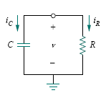
The Source-Free RC Circuit

Slide 5
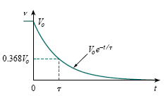
The natural response of a circuit refers to the behavior (in terms of voltages and currents) of the circuit itself, with no external sources of excitation.
The voltage response of the RC circuit.

Slide 6
The time constant of a circuit is the time required for the response to decay by a factor of 1/e or 36.8 percent of its initial value.
The voltage response of the RC circuit.

Slide 7

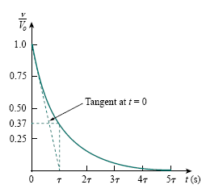
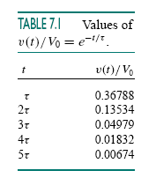
capacitor is fully discharged (or charged) after five time constants
To find τ from the response curve, draw the tangent to the curve. The tangent intercepts with the time axis at t = τ .

Slide 8
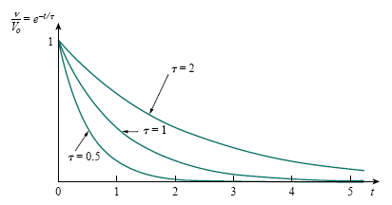
Plot of v/V₀ = e^{−t/τ} for various values of the time constant

Slide 10
The Key to Working with a Source - free RC Circuit is
Findin g :
1. The initial voltage v(0) = V₀ across the capacitor.
2. The time constant τ .
v_{C}(t) = v(t) = v(0)e^{−t/τ}
other variables
Capacitor current i_{C}
Resistor voltage v_{R}
Resistor current i_{R}
can be determined.

Slide 11
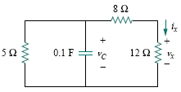
Example 1
In the Fig., let v_{C}(0) = 15 V. Find v_{C} , v_{x} , and i_{x} for t >0.

Slide 13
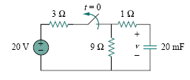
Example 2
The switch in the following circuit has been closed for a long time, and it is opened at t = 0. Find v(t) for t ≥ 0. Calculate the initial energy stored in the capacitor.

Slide 15
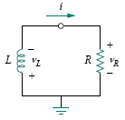
THE SOURCE FREE RL CIRCUIT

Slide 17
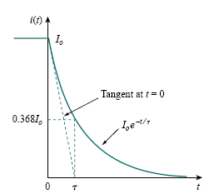
The smaller the time constant τ of a circuit, the faster the rate of decay of the response. The larger the time constant, the slower the rate of decay of the response. At any rate, the response decays to less than 1 percent of its initial value (i.e., reaches steady state) after 5τ .
The current response of the RL circuit

Slide 20
The Key to Working with a Source - free RL Circuit is to Find :
1. The initial current i(0) = I₀ through the inductor.
2. The time constant τ of the circuit.
i_{L}(t) =i(t) = i(0)e^{−t/τ} .
other variables
Inductor voltage v_{L}
Resistor voltage v_{R}
Resistor current i_{R}
can be obtained.

Slide 21
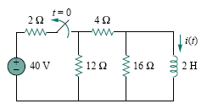
Example 3
The switch in the circuit has been closed for a long time. At t = 0, the switch is opened. Calculate i(t) for t > 0.

Slide 23
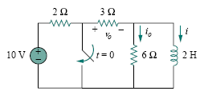
Example 4
In the circuit shown in the following Fig., find i_{o}, v_{o}, and i for all time, assuming that the switch was open for a long time.

Slide 25
