Slide 1
Capacitors and Inductors
Lecture 25
Introduction
Capacitors
Series and Parallel Capacitors
Inductors
Series and Parallel Inductors

Slide 2
Introduction
Resistor: a passive element which dissipates energy only
Two important passive linear circuit elements:
  Capacitor
  Inductor
Capacitor and inductor can store energy only and they can neither generate nor dissipate energy.

Slide 3
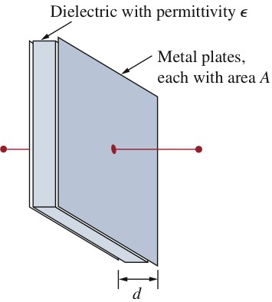
Capacitors
A capacitor consists of two conducting plates separated by an insulator (or dielectric).

Slide 4
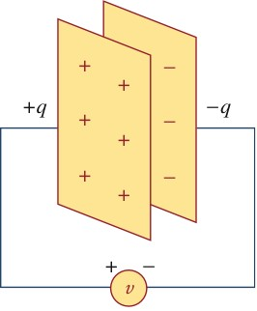
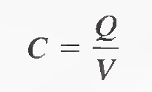
When a voltage source v is connected to the capacitor, the source deposits a positive charge q on one plate and a negative charge −q on the other. The capacitor is said to store the electric charge.
Capacitance
The amount of charge that a capacitor can store per unit of voltage across its plates is its capacitance, designated C. That is, capacitance is a measure of a capacitor's ability to store charge. The more charge per unit of voltage that a capacitor can store, the greater its capacitance, as expressed by the following formula:

Slide 5
By rearranging the terms C=Q/V, we can obtain two other formulas.
Q= CV
V= Q /C
The Unit of Capacitance
The farad (F) is the basic unit of capacitance. Recall that the coulomb (C) is the unit of electrical charge.
One farad is the amount of capacitance when one coulomb (C) of charge is stored with one volt across the plates.

Slide 6
Although the capacitance C of a capacitor is the ratio of the charge per plate to the applied voltage v, it does not depend on q or v.
Three factors affecting the value of capacitance:
  Area: the larger the area, the greater the capacitance.
  Spacing between the plates: the smaller the spacing, the greater the capacitance.
  Material permittivity: the higher the permittivity, the greater the capacitance.

Slide 7
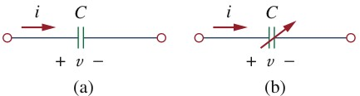
Circuit symbols for capacitor
According to the passive sign convention, current is considered to flow into the positive terminal of the capacitor when the capacitor is being charged, and out of the positive terminal when the capacitor is discharging.

Slide 8
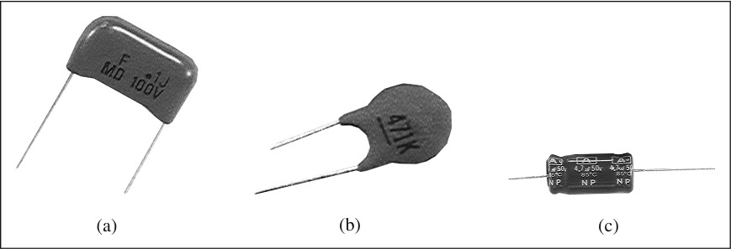
Polyester capacitors are light in weight, stable, and their change with temperature is predictable. Instead of polyester, other dielectric materials such as mica and polystyrene may be used. Film capacitors are rolled and housed in metal or plastic films. Electrolytic capacitors produce very high capacitance.
Fixed-value capacitors
(a) Polyester capacitor, (b) Ceramic capacitor, (c) Electrolytic capacitor

Slide 9
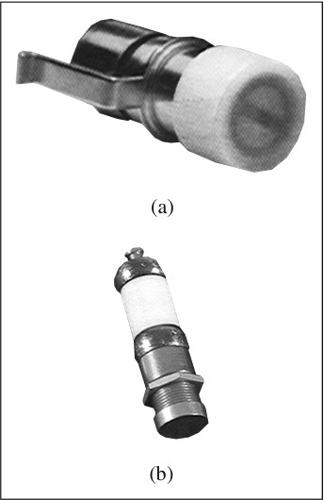
Variable Capacitors
The capacitance of a trimmer capacitor is varied by turning the screw. The trimmer capacitor is often placed in parallel with another capacitor so that the equivalent capacitance can be varied slightly.
Variable capacitors are used in radio receivers allowing one to tune to various stations. In addition, capacitors are used to block dc, pass ac, shift phase, store energy, start motors, and suppress noise.
Variable capacitors:
(a) trimmer capacitor, (b) filmtrim
capacitor.

Slide 10
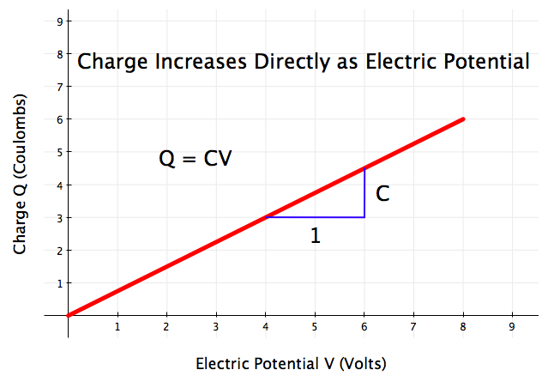
Charge in Capacitors
The relation between the charge in plates and the voltage across a capacitor is given below.

Slide 11
Voltage Rating
Since q=Cv, the plate charge increases as the voltage increases. The electric field intensity between two plates increases. If the voltage across the capacitor is so large that the field intensity is large enough to break down the insulation of the dielectric, the capacitor is out of work. Hence, every practical capacitor has a maximum limit on its operating voltage.

Slide 12
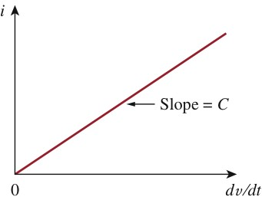
I-V Relation of Capacitor
+
i
v
C
-

Slide 13
+
capacitor voltage depends on the past history
of the capacitor current. Hence, the capacitor has memory—a property that is often exploited.
i
v
C
-

Slide 14
Power and Energy Storing in Capacitor
+
i
v
C
V=q/c
-

Slide 15
important properties of a capacitor
+
i
v
C
when v is a constant voltage, then i=0; a constant voltage across a capacitor creates no current through the capacitor, the capacitor in this case is the same as an open circuit.
A capacitor is an open circuit to dc.
However, if a battery (dc voltage) is connected across a capacitor, the capacitor charges.
-

Slide 16
The derivative of a time-varying quantity is the instantaneous rate of change of that quantity.
The voltage on the capacitor must be continuous
The voltage on a capacitor cannot change abruptly.
If v is abruptly changed, then the current will have an infinite value that is practically impossible. Hence, a capacitor is impossible to have an abrupt change in its voltage except an infinite current is applied.

Slide 17
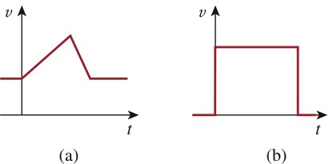
For example, the voltage across a capacitor may take the form shown in Fig (a), whereas it is not physically possible for the capacitor voltage to take the form shown in Fig. (b) because of the abrupt change. Conversely, the current through a capacitor can change instantaneously.
Abrupt change

Slide 18
An alternative way of looking at this is using Eq.
which indicates that energy is proportional to voltage squared. Since injecting or extracting energy can only be done over some finite time, voltage cannot change instantaneously across a capacitor.

Slide 19
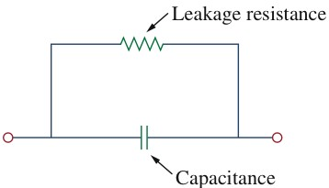
The ideal capacitor does not dissipate energy. It takes power from the circuit when storing energy in its field and returns previously stored energy when delivering power to the circuit.
A real, non ideal capacitor has a parallel-model leakage resistance, as shown in Fig. The leakage resistance may be as high as 100 M and can be neglected for most practical applications.

Slide 20
Example 1
Calculate the charge stored on a 3-pF capacitor with 20V across it.
Find the energy stored in the capacitor.

Slide 21
Example 1
Solution:
(a) Since
(b) The energy stored is

Slide 22
Example 2
The voltage across a 5- μF capacitor is
Calculate the current through it.
Solution:
By definition, the current is

Slide 23
Example 3
Determine the voltage across a 2-μF capacitor if the current through it is
Assume that the initial capacitor voltage is zero.
Solution:
Since

Slide 24
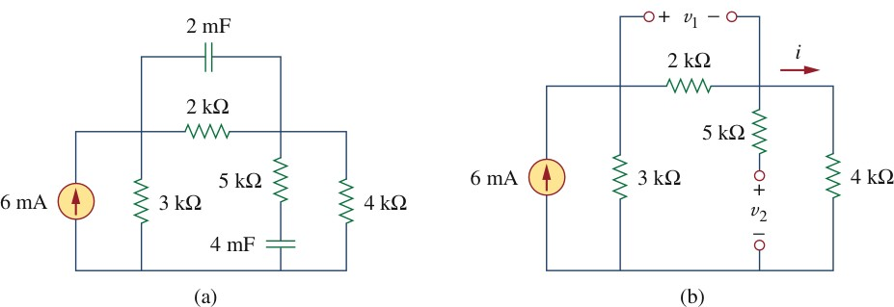
Example 4
Obtain the energy stored in each capacitor in the shown Fig. under dc condition.

Slide 25
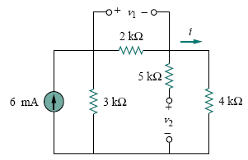
Example 4
Solution:
Under dc condition, we replace each capacitor with an open circuit. By current division,

Slide 26
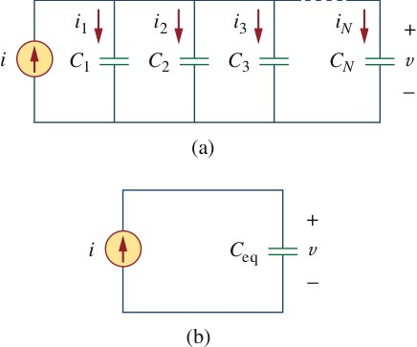
Parallel Capacitors

Slide 27
Parallel Capacitors
The equivalent capacitance of N parallel-connected capacitors is the sum of the individual capacitance.

Slide 28
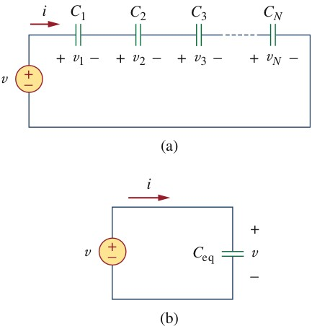
Series Capacitors

Slide 29
Series Capacitors
The equivalent capacitance of series-connected capacitors is the reciprocal of the sum of the reciprocals of the individual capacitances.

Slide 30
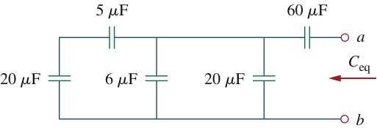
Example 5
Find the equivalent capacitance seen between terminals a and b of the circuit in the Fig.

Slide 31
Example 5
Solution:

Slide 32
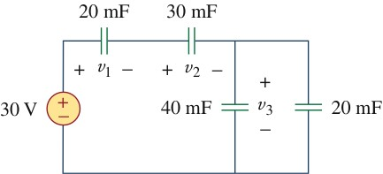
Example 6
For the circuit in Fig, find the voltage across each capacitor.

Slide 33
Example 6
Solution:
Two parallel capacitors:
Total charge
This is the charge on the 20-mF and 30-mF capacitors, because they are in series with the 30-v source. ( A crude way to see this is to imagine that charge acts like current, since i = dq/dt)

Slide 34
Example 6
Therefore,
Having determined v₁ and v₂, we now use KVL to determine v₃ by
Alternatively, since the 40-mF and 20-mF capacitors are in parallel, they have the same voltage v₃ and their combined capacitance is 40+20=60mF.

Slide 35
Inductor
An inductor is a passive element designed to store energy in its magnetic field.
Inductors find numerous applications in electronic and power systems. They are used in power supplies, transformers, radios, TVs, radars and electric motors.
Any conductor of electric current has inductive properties and may be regarded as an inductor. But in order to enhance the inductive effect, a practical inductor is usually formed into a cylindrical coil with many turns of conducting wire.

Slide 36
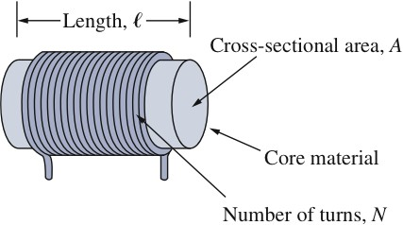
Inductor
An inductor is made of a coil of conducting wire
Inductors are formed with wire tightly wrapped around a solid central core

Slide 37
Inductance
Inductance (or electric inductance) is a measure of the amount of magnetic flux produced for a given electric current.
The inductance has the following relationship:
L= Φ/i
where
  L is the inductance in henrys,
  i is the current in amperes,
  Φ is the magnetic flux in webers

Slide 38

If current is allowed to pass through an inductor, it is found that the voltage across the inductor is directly proportional to the time rate of change of the current. Using the passive sign convention,
where L is the constant of proportionality called the inductance of the inductor. The unit of inductance is the henry (H), named in honor of the American inventor Joseph Henry (1797–1878).

Slide 39
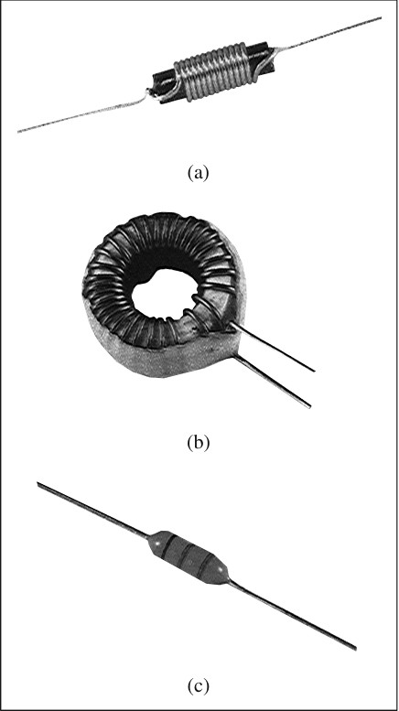
Various types of inductors: (a) solenoidal wound inductor, (b) toroidal inductor (c) chip inductor.
The inductance of an inductor depends on its physical dimension and construction

Slide 40
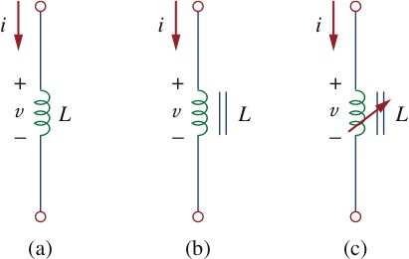
Like capacitors, commercially available inductors come in different values and types. Typical practical inductors have inductance values ranging from a few microhenrys (μH), as in communication systems, to tens of henrys (H) as in power systems. Inductors may be fixed or variable. The core may be made of iron, steel, plastic, or air. The terms coil and choke are also used for inductors. The circuit symbols for inductors are shown below following the passive sign convention.
air-core
(b) iron-core
(c) variable iron-core

Slide 41
Flux in Inductors
The relation between the flux in inductor and the current through the inductor is given below.
φ
Linear
Nonlinear
i

Slide 42
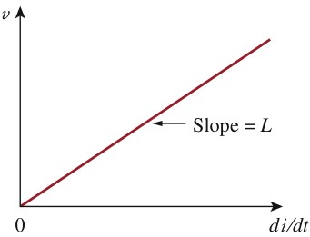
I-V Relation of Inductors
An inductor consists of a coil of conducting wire.
i
+
v
L
Figure shows this relationship graphically for an inductor whose inductance is independent of current. Such an inductor is known as a linear inductor. For a nonlinear inductor, the plot of Eq. will not be a straight line because its inductance varies with current.
-

Slide 43
+
v
L
-
where i(t₀) is the total current for −∞ < t < t₀ and i(−∞) = 0. The idea of making i(−∞) = 0 is practical and reasonable, because there must be a time in the past when there was no current in the inductor.

Slide 44
The inductor is designed to store energy in its magnetic field
The energy stored in an inductor
+
v
L
-

Slide 45
important properties of inductor
When the current through an inductor is a constant, then the voltage across the inductor is zero, same as a short circuit.
An inductor acts like a short circuit to dc.
The current through an inductor cannot change instantaneously.

Slide 46

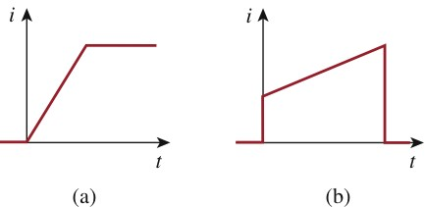
According to Eq. a discontinuous change in the current through an inductor requires an infinite voltage, which is not physically possible. Thus, an inductor opposes an abrupt change in the current through it. For example, the current through an inductor may take the form shown in Fig.(a), whereas the inductor current cannot take the form shown in Fig. (b) in real-life situations due to the discontinuities. However, the voltage across an inductor can change abruptly.

Slide 47
Like the ideal capacitor, the ideal inductor does not dissipate energy. The energy stored in it can be retrieved at a later time. The inductor takes power from the circuit when storing energy and delivers power to the circuit when returning previously stored energy.
The inductor can be used to generate a high voltage, for example, used as an igniting element.

Slide 48
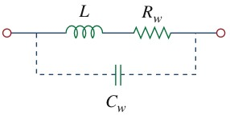
Model of a Practical Inductor
A practical, non ideal inductor has a significant resistive Component. This is due to the fact that the inductor is made of a conducting material such as copper, which has some resistance. This resistance is called the winding resistance Rw, and it appears in series with the inductance of the inductor. The presence of Rw makes it both an energy storage device and an energy dissipation device. Since Rw is usually very small, it is ignored in most cases. The Non ideal inductor also has a winding capacitance Cw due to the capacitive coupling between the conducting coils. Cw is very small and can be ignored in most cases, except at high frequencies.

Slide 49
Example 1
The current through a 0.1-H inductor is i(t) = 10te^{-5t} A. Find the voltage across the inductor and the energy stored in it.
Solution:

Slide 50
Example 2
Find the current through a 5-H inductor if the voltage across it is
Also find the energy stored within 0 < t < 5s. Assume i(0)=0.
Solution:

Slide 51
Example 2

Slide 52
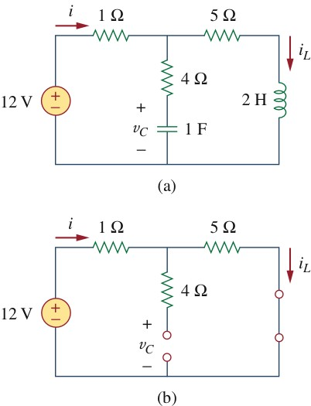
Example 3
Consider the circuit in Fig (a). Under dc conditions, find:
(a) i, v_{C}, and i_{L}.
(b) the energy stored in the capacitor and inductor.

Slide 53
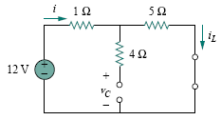
Example 3
Solution:

Slide 54
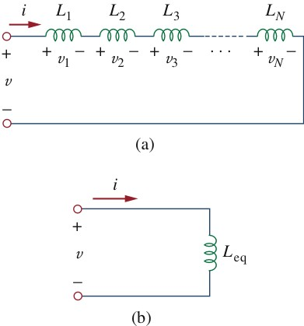
Inductors in Series

Slide 55
Series Inductor
Applying KVL to the loop,
Substituting v_{k} = L_{k} di/dt results in

Slide 56
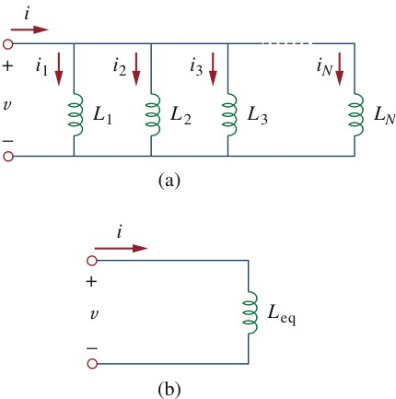
Inductors in Parallel

Slide 57
Parallel Inductors
Using KCL,
But

Slide 58
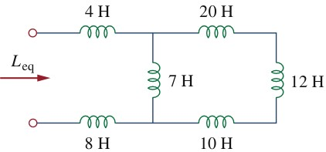
Example 5
Find the equivalent inductance of the circuit shown in Fig.

Slide 59
Example 5
Solution:

Slide 60
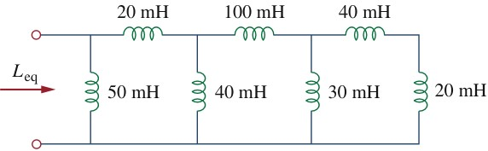
Practice Problem

Slide 61
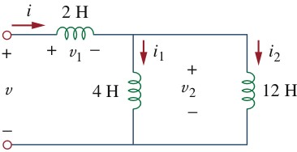
Example 6
For the circuit in Fig,
If find :

Slide 62
Example 6
Solution:

Slide 63
Example 6

Slide 64
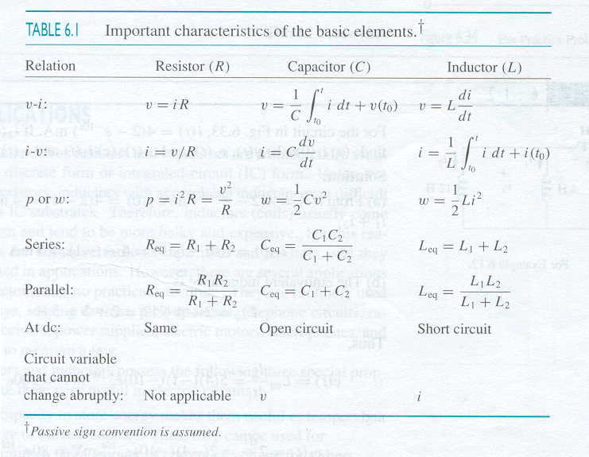
Table

Slide 65
Applications of Capacitors and Inductors
Circuit elements such as resistors and capacitors are commercially available in either discrete form or integrated-circuit (IC) form. Unlike capacitors and resistors, inductors with appreciable inductance are difficult to produce on IC substrates. Therefore, inductors (coils) usually come in discrete form and tend to be more bulky and expensive. For this reason, inductors are not as versatile as capacitors and resistors, and they are more limited in applications. However, there are several applications in which inductors have no practical substitute. They are routinely used in relays, delays, sensing devices, pick-up heads, telephone circuits, radio and TV receivers, power supplies, electric motors, microphones, and loudspeakers, to mention a few.

Slide 66
Capacitors and inductors possess the following three special properties that make them very useful in electric circuits:
1. The capacity to store energy makes them useful as temporary voltage or current sources. Thus, they can be used for generating a large amount of current or voltage for a short
period of time.
2. Capacitors oppose any abrupt change in voltage, while
inductors oppose any abrupt change in current. This property makes inductors useful for spark or arc suppression and for converting pulsating dc voltage into relatively smooth dc voltage.

Slide 67
3. Capacitors and inductors are frequency sensitive. This property makes them useful for frequency discrimination.
The first two properties are put to use in dc circuits, while the third one is taken advantage of in ac circuits.

Slide 68


Summary
The current through a capacitor is directly proportional to the time rate of change of the voltage across it.
The current through a capacitor is zero unless the voltage is changing. Thus, a capacitor acts like an open circuit to a dc source.
2. The voltage across a capacitor is directly proportional to the time integral of the current through it.
The voltage across a capacitor cannot change instantly.

Slide 69

Summary
3. Capacitors in series and in parallel are combined in the same way as conductances.
4. The voltage across an inductor is directly proportional to the time rate of change of the current through it.
The voltage across the inductor is zero unless the current is changing. Thus an inductor acts like a short circuit to a dc source.

Slide 70

Summary
5. The current through an inductor is directly proportional to the time integral of the voltage across it.
The current through an inductor cannot change instantly.
6. Inductors in series and in parallel are combined in the same way resistors in series and in parallel are combined

Slide 71
Summary
7. At any given time t , the energy stored in a capacitor is
while
the energy stored in an inductor is .

