Slide 1
Previous Lectures 22 & 23
Branch Current Method
Loop Current Method
Node Voltage Method

Slide 2
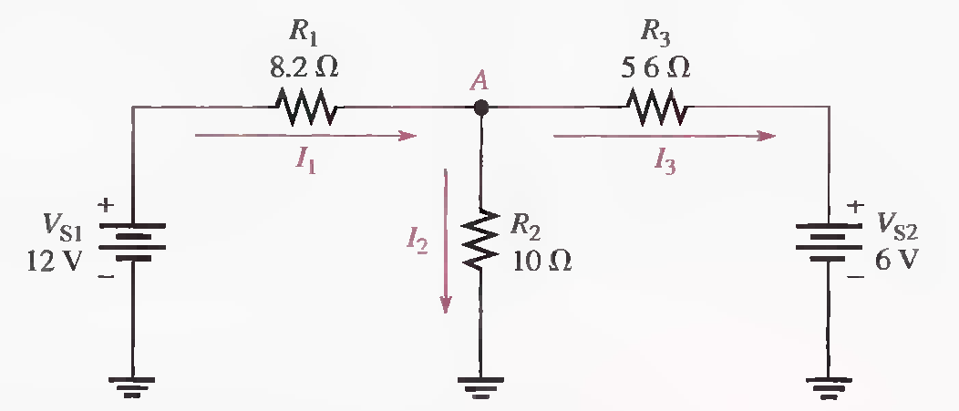
Problems Solving related to Branch Current Method
Lecture 24
Q.1 Write the Kirchhoff current equation for the current assignment shown at node A in Figure.

Slide 3
Q.2 Solve for each of the branch currents.

Slide 5
Q.3 Find the Voltage drop across each resistor and indicate its actual polarity.

Slide 6
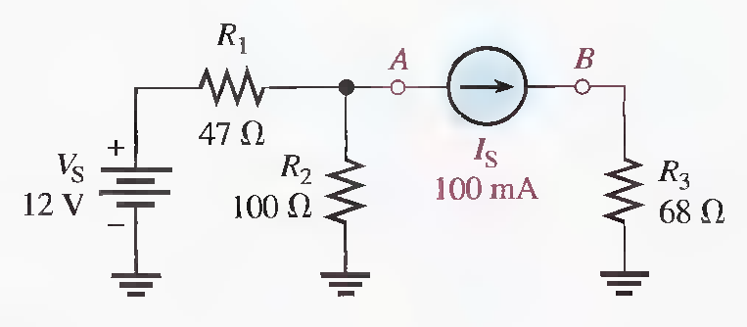
Q.4 Find the current through each resistor in the following Figure.

Slide 7
Q.5 Determine the voltage across the current source (points A and B)

Slide 9
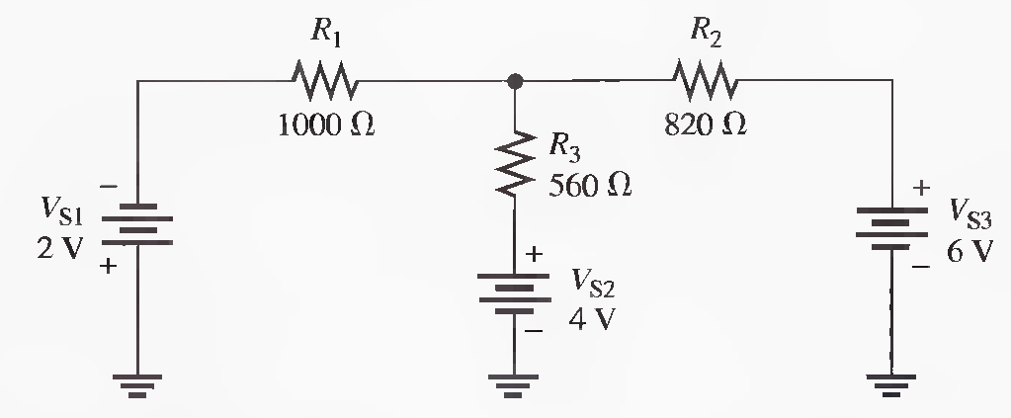
Problems related to Loop Current Method
Q.6 Using the loop current method, find the loop currents in the circuit shown in Figure.

Slide 11
Q.7 Find the branch currents.

Slide 12
Q.8 Determine the voltages and their proper polarities for each resistor.

Slide 13
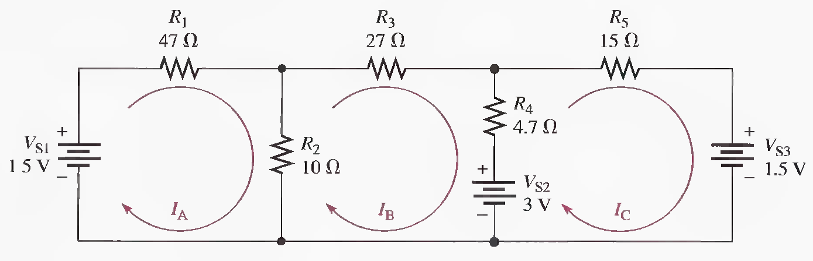
Q.9 Write the loop equations for the circuit shown in Figure. Also Solve for the loop currents.

Slide 16
Q.10 Find the current through each resistor in the following Figure.

Slide 17
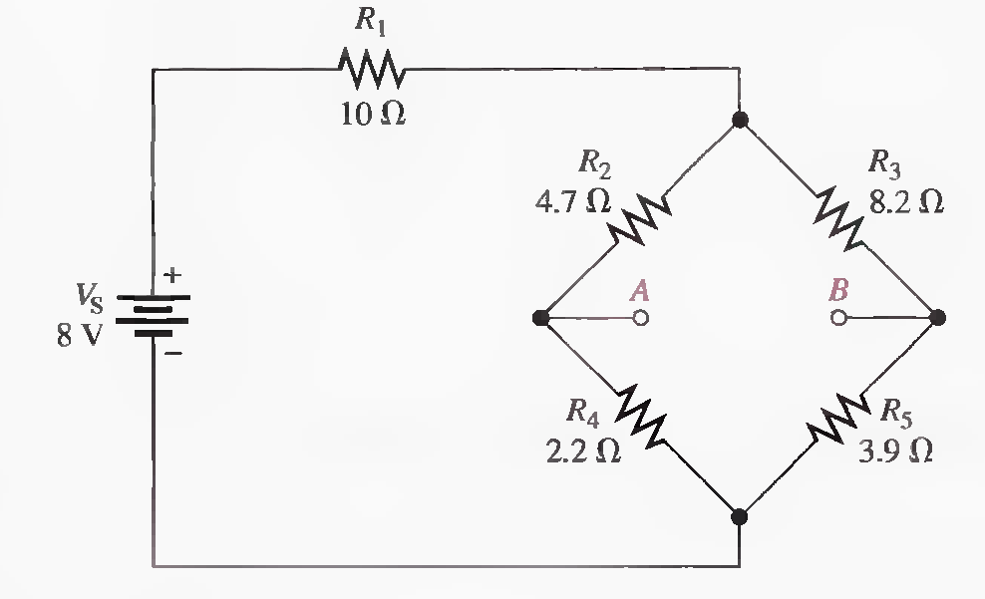
Q.11 Determine the voltage across the open bridge terminals, A and B.

Slide 19
Q.12 When a 10 Ω resistor is connected from terminal A to terminal B , what is the current through it?

Slide 22
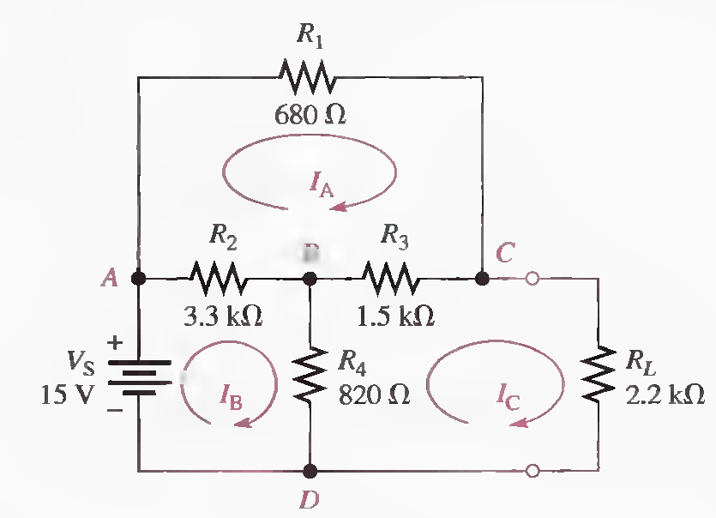
Q.13 Write the loop equations in standard form for the bridged- T circuit.

Slide 23
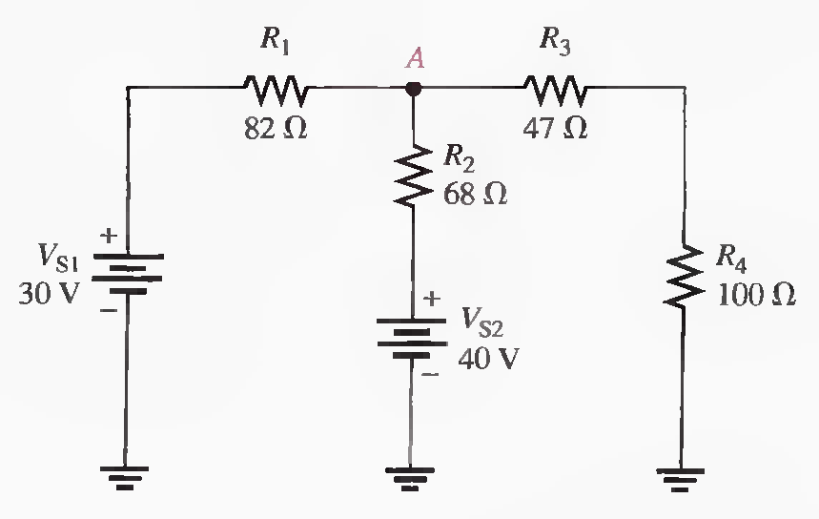
Problems related to Node Voltage Method
Q.14 Use the node voltage method to find the voltage at point A with respect to ground.

Slide 25
Q.15 What are the branch current values? Show the actual direction of current in each branch

Slide 26
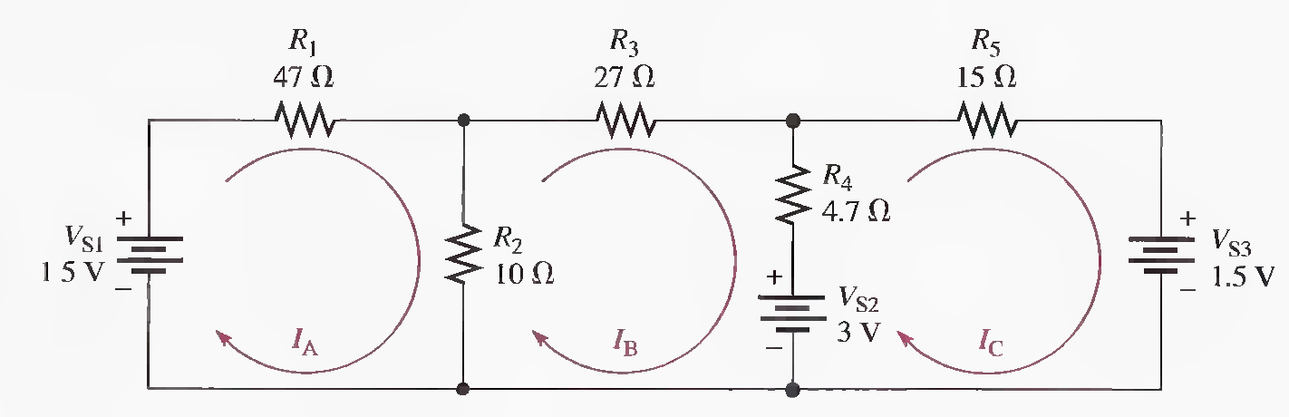
Q.16 Write the node voltage equations.

Slide 28
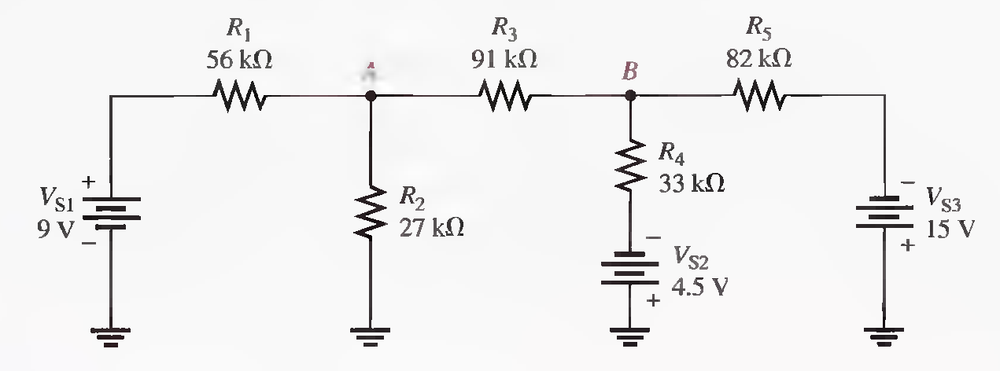
Q.17 Use node analysis to determine the voltage at points A and B with respect to ground.

Slide 31
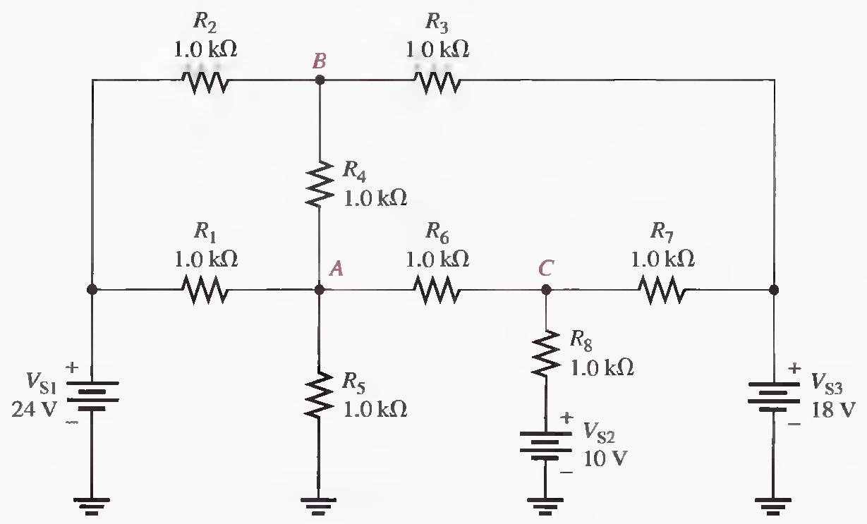
Q.18 Find the voltage at points A, B, and C using Node voltage method.

