Slide 1
Previous Lecture 22
Branch Current Method
Loop Current Method

Slide 2
NODE VOLTAGE METHOD
Lecture 22
Another method of analysis of multiple-loop circuits is called the node voltage method. It is based on finding the voltages at each node in the circuit using Kirchhoff's current law. Recall that a node is the junction of two or more components.

Slide 3
NODE VOLTAGE METHOD
The general steps for the node voltage method of circuit analysis are as follows:
Step 1.
Determine the number of nodes.
Step 2.
Select one node as a reference. All voltages will be relative to the reference node. Assign voltage designations to each node where the voltage is unknown.

Slide 4
NODE VOLTAGE METHOD
Step 3.
Assign currents at each node where the voltage is unknown, except at the reference node. The directions are arbitrary.
Step 4.
Apply Kirchhoff's current law to each node where currents are assigned.
Step 5.
Express the current equations in terms of voltages, and solve the equations for the unknown node voltages using Ohm's law.

Slide 5
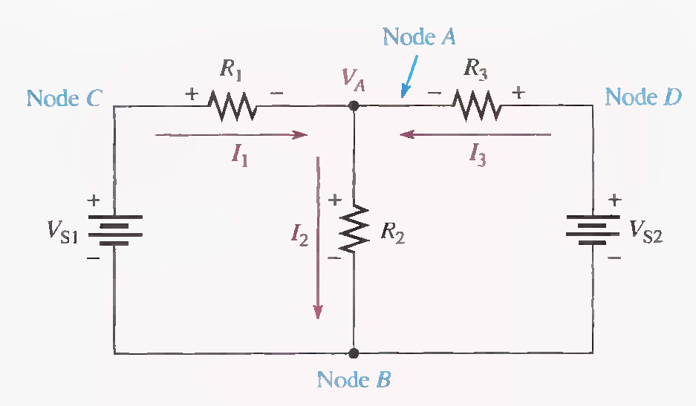

Slide 6
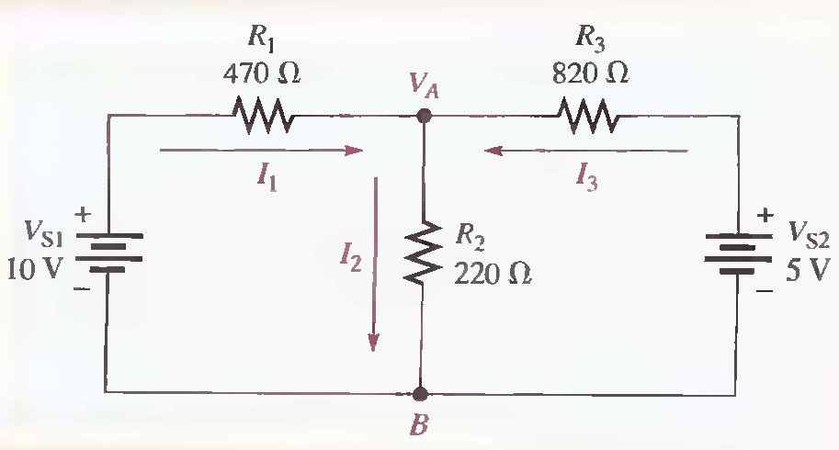
Find the node voltage VA in the following Figure and determine the branch currents.

Slide 8
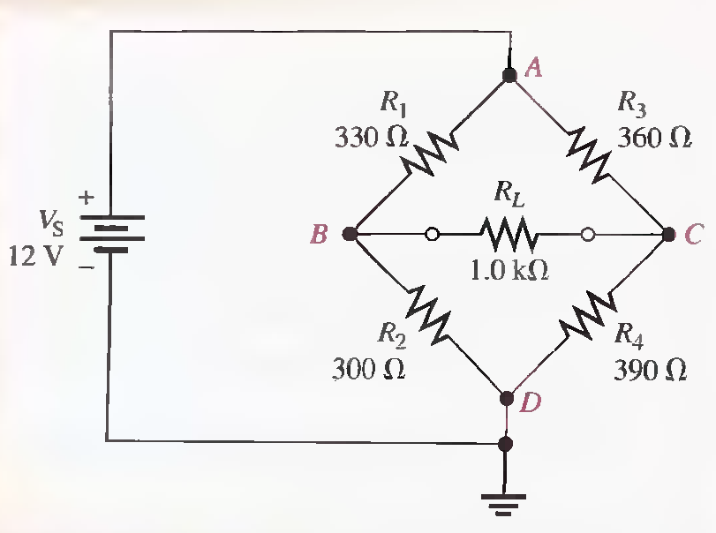
For the circuit in the following Figure, find the node voltages at node B and node C. Node D is the reference, and node A has the same voltage as the source. Use the results to calculate the current in each resistor.

Slide 11
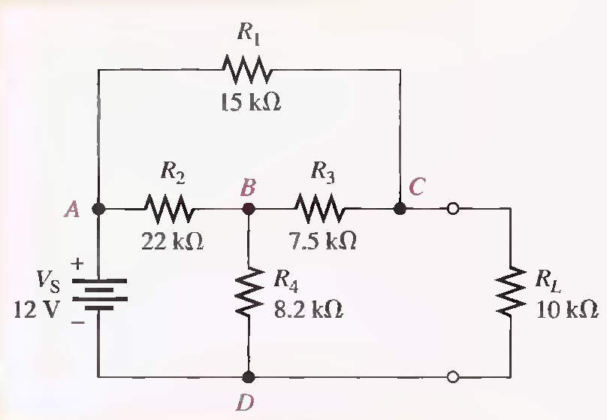
The circuit in the following Figure has already solved with Loop Current Method.
(a) Solve for the voltage across R L using node analysis.
(b) Find the effect on the load voltage when the load resistor is changed to 15 kΩ

