Slide 1
Previous Lecture 21
Delta-to-Wye (∆-to-Y) and Wye-to-Delta (Y-to-∆) conversions
Simultaneous Equations in Circuit Analysis
Solutions of Simultaneous Equations
  Solving by Substitution
  Solving by Determinants

Slide 2
BRANCH, LOOP, AND NODE ANALYSES
Lecture 22
Branch Current Method
Loop Current Method
Node Voltage Method

Slide 3
BRANCH CURRENT METHOD
The branch current method is a circuit analysis method using Kirchhoff's voltage and current laws to find the current in each branch of a circuit by generating simultaneous equations. Once you know the branch currents, you can determine voltages.

Slide 4
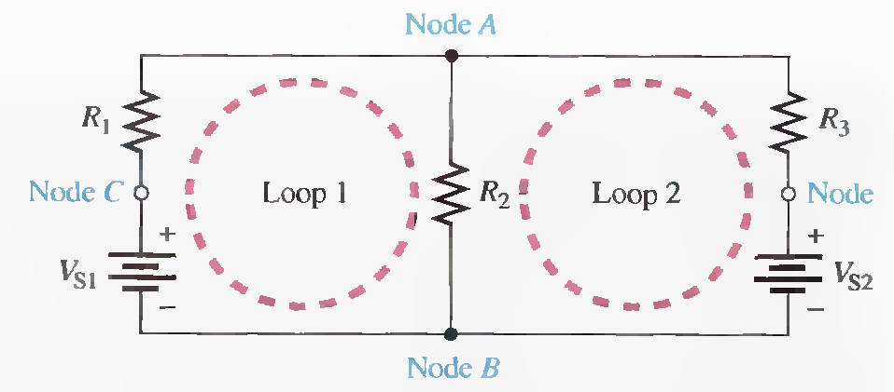
Electric Circuit Terminologies
Branch A branch is a path that connects two nodes.
Loop A closed current path in a circuit.
Node A node is a point where two or more components are connected.

Slide 5
BRANCH CURRENT METHOD
The following are the general steps used in applying the branch current method.
Step 1. Assign a current in each circuit branch in an arbitrary direction.
Step 2. Show the polarities of the resistor voltages according to the assigned branch current directions.
Step 3. Apply Kirchhoff's voltage law around each closed loop (algebraic sum of voltages is equal to zero).
Step 4. Apply Kirchhoff's current law at the minimum number of nodes so that all branch currents are included (algebraic sum of currents at a node equals zero).
Step 5. Solve the equations resulting from Steps 3 and 4 for the branch current values.

Slide 6
Third-order determinants can be evaluated by the expansion method.
1I₁ + 3l₂ – 2I₃ = 7
0l₁ + 4l₂ + 1I₃ = 8
-5I₁ + 1l₂ + 6I₃ = 9
C.D=9 - 41 = -32, For I₁ : Determinant = 179 - 79 = 100 , I₁=-3.125 A

Slide 7
1I₁ + 3l₂ – 2I₃ = 7
0l₁ + 4l₂ + 1I₃ = 8
-5I₁ + 1l₂ + 6I₃ = 9

Slide 8
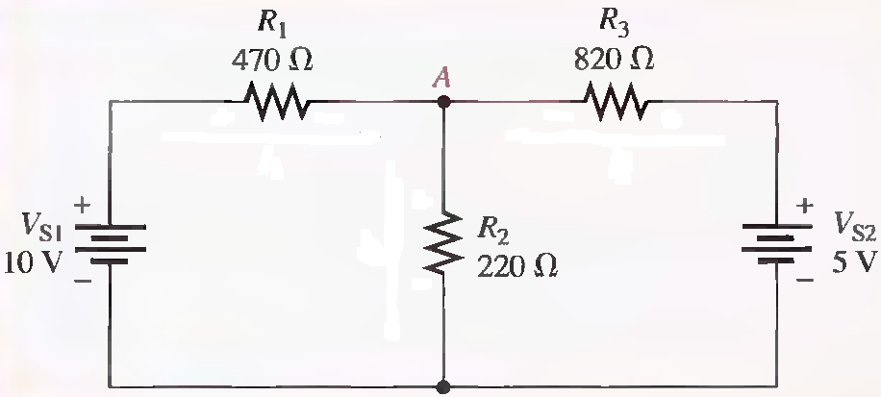
Use the branch current method to find each branch current.
I1 = 13.9 mA, I2= 15.8 mA, I3= 1.87 mA

Slide 9
I1 = 13.9 mA, I2= 15.8 mA, I3= 1.87 mA

Slide 11
LOOP CURRENT METHOD
In the loop current method (also known as the mesh current method), we will work with loop currents instead of branch currents. An ammeter placed in a given branch will measure the branch current. Unlike branch currents, loop currents are mathematical quantities, rather than actual physical currents, that are used to make circuit analysis somewhat easier than with the branch current method.

Slide 12
LOOP CURRENT METHOD
The following are the general steps used in applying the branch current method
Step 1.
Although direction of an assigned loop current is arbitrary, we will assign a current in the clockwise (CW) direction around each nonredundant closed loop, for consistency. This may not be the actual current direction, but it does not matter. The number of loop-current assignments must be sufficient to include current through all components in the circuit.
Step 2.
Indicate the voltage drop polarities in each loop based on the assigned current directions.

Slide 13
LOOP CURRENT METHOD
Step 3.
Apply Kirchhoff's voltage law around each closed loop. When more than one loop current passes through a component, include its voltage drop. This results in one equation for each loop.
Step 4.
Using substitution or determinants, solve the resulting equations for the loop currents.

Slide 14
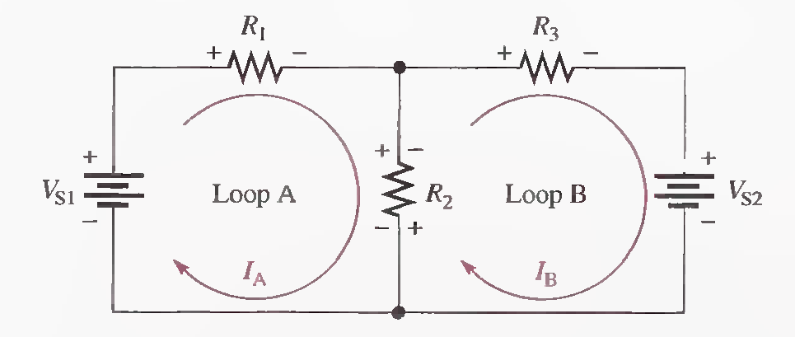

Slide 15
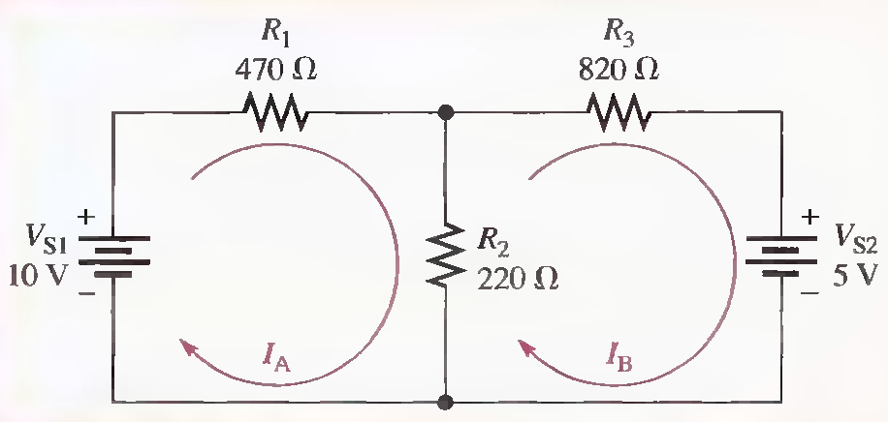
Using the loop current method, find the branch currents in the following Figure.

Slide 17
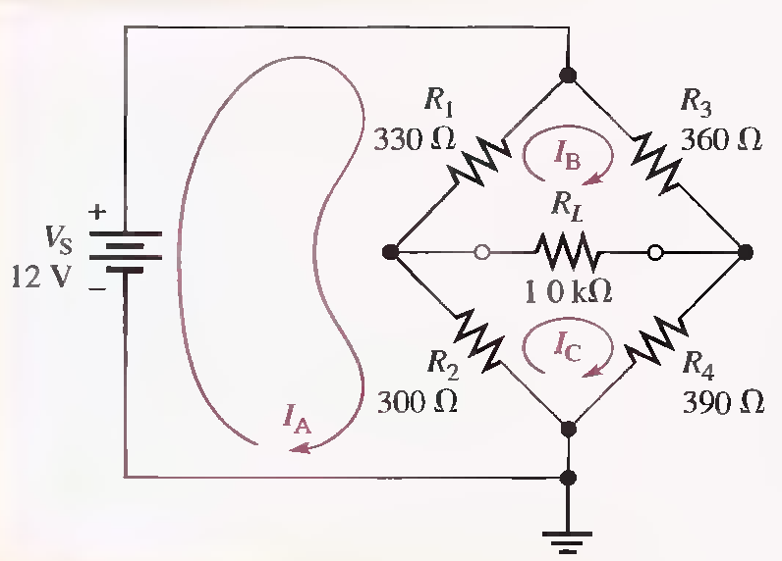
For the circuit in the Figure , find the loop currents. Use the loop currents to solve for the current in each resistor (branch current).

Slide 20
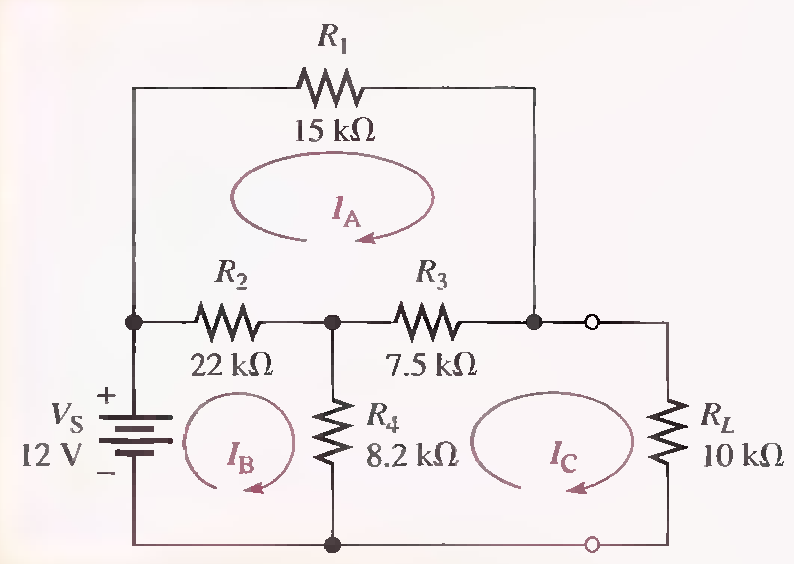
For the circuit in the Figure , find the loop currents. Use the loop currents to solve for the current in each resistor (branch current).

Slide 22
NODE VOLTAGE METHOD
Another method of analysis of multiple-loop circuits is called the node voltage method. It is based on finding the voltages at each node in the circuit using Kirchhoff's current law. Recall that a node is the junction of two or more components.

Slide 23
NODE VOLTAGE METHOD
The general steps for the node voltage method of circuit analysis are as follows:
Step 1.
Determine the number of nodes.
Step 2.
Select one node as a reference. All voltages will be relative to the reference node. Assign voltage designations to each node where the voltage is unknown.

Slide 24
NODE VOLTAGE METHOD
Step 3.
Assign currents at each node where the voltage is unknown, except at the reference node. The directions are arbitrary.
Step 4.
Apply Kirchhoff's current law to each node where currents are assigned.
Step 5.
Express the current equations in terms of voltages, and solve the equations for the unknown node voltages using Ohm's law.

Slide 25
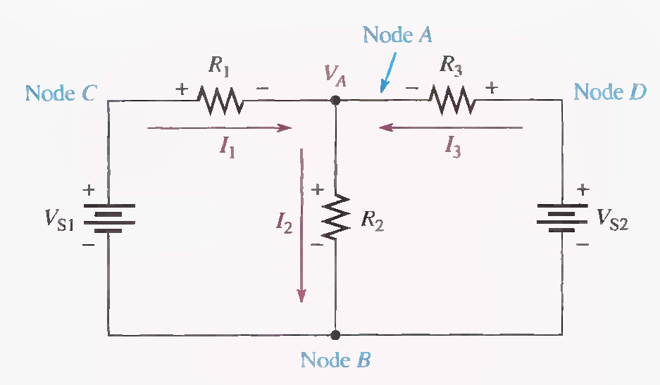

Slide 26
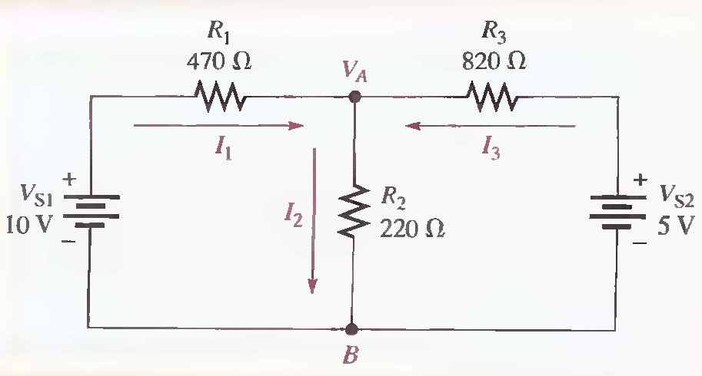
Find the node voltage VA in the following Figure and determine the branch currents.

Slide 28
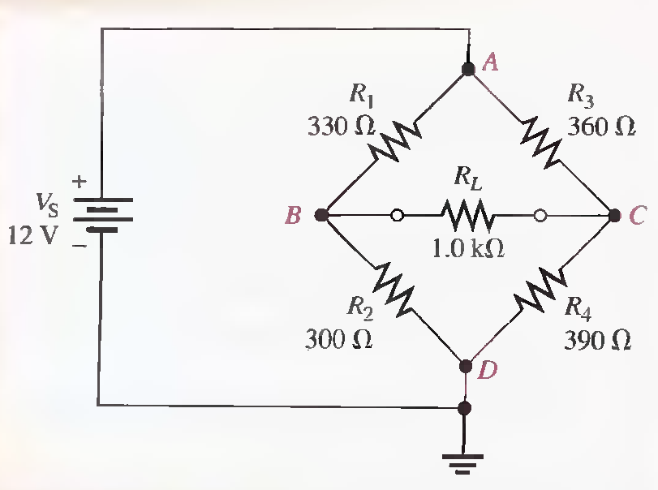
For the circuit in the following Figure, find the node voltages at node B and node C. Node D is the reference, and node A has the same voltage as the source. Use the results to calculate the current in each resistor.

Slide 31
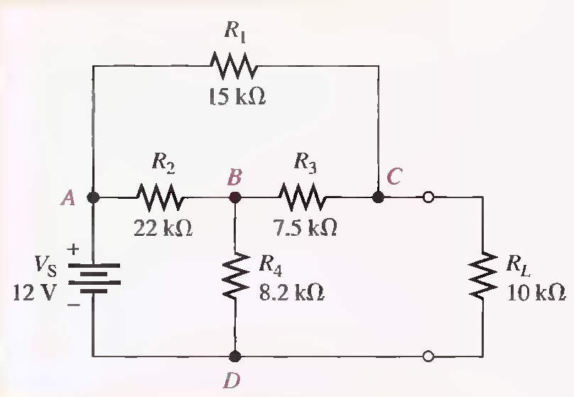
The circuit in the following Figure has already solved with Loop Current Method.
(a) Solve for the voltage across R L using node analysis.
(b) Find the effect on the load voltage when the load resistor is changed to 15 kΩ

