Slide 1
Previous Lectures 16-20
Source Conversions
The Superposition Theorem
Thevenin's Theorem
Norton's Theorem
Maximum Power Transfer Theorem

Slide 2
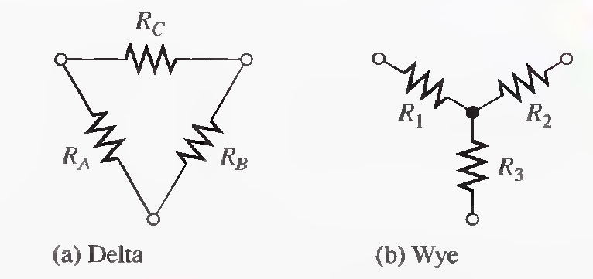
DELTA-TO-WYE (∆-TO-Y) AND WYE-TO-DELTA (Y-TO-∆) CONVERSIONS
Lecture 21
Conversions between delta-type and wye-type circuit arrangements are useful in certain specialized three-terminal applications.

Slide 3
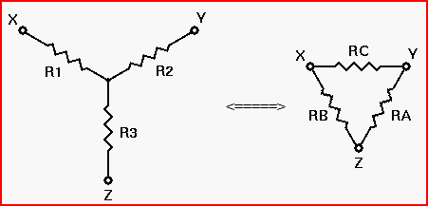
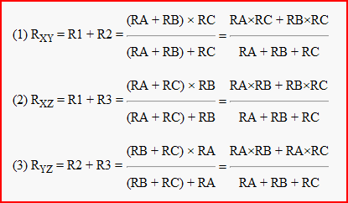
Deriving the Initial Equations

Slide 4
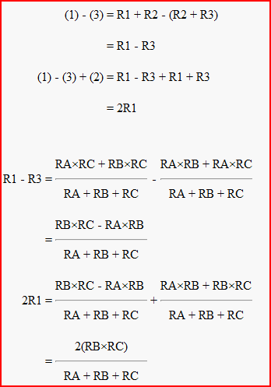
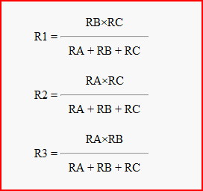
Solving For R1, R2, and R3
(4)
(5)

Slide 5
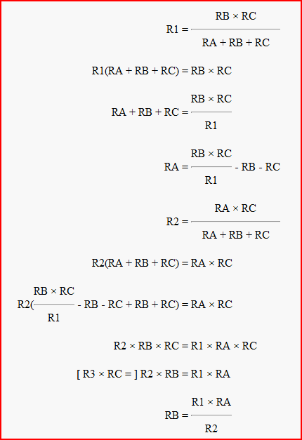

Solving for RA, RB, and RC
(6)
(7)

Slide 6
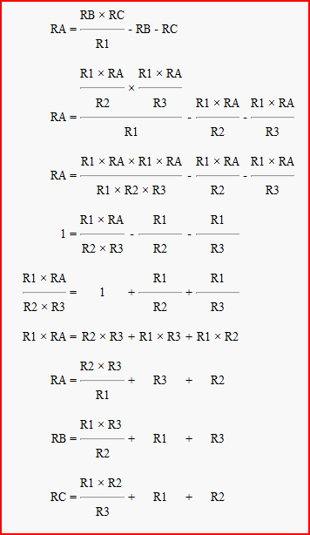
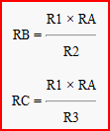
From Equation (6)
You don't really need to know these derivations, although understanding them will help you with your understanding of electronics in general. However, you should know the conversion formulas themselves, and be able to apply them when designing or analyzing electronic circuits.

Slide 7
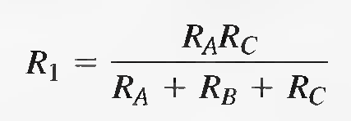
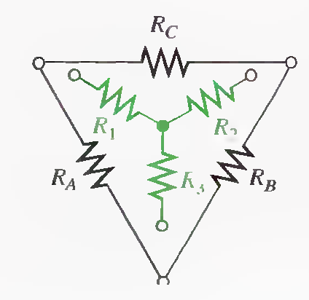
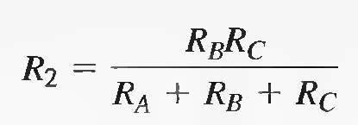
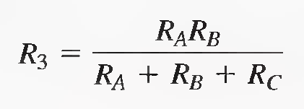
∆-to-Y Conversion
Each resistor in the wye is equal to the product of the resistors in two adjacent delta branches, divided by the sum of all three delta resistors.

Slide 8
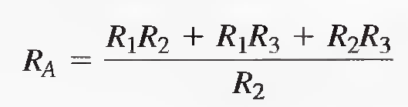
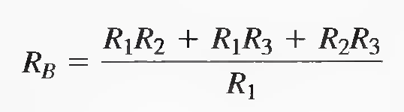
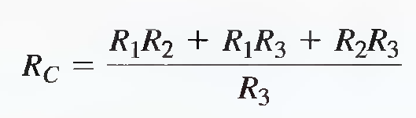
Y-to-∆ Conversion
Each resistor in the delta is equal to the sum of all possible products of wye resistors taken two at a time, divided by the opposite wye resistor.

Slide 9
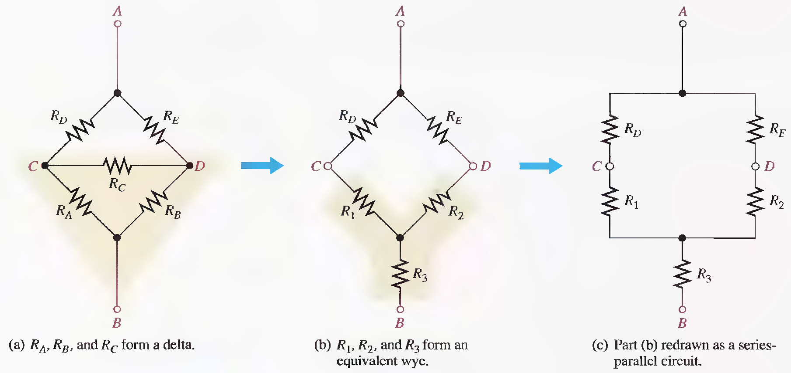
Application of ∆-to-Y Conversion to a Bridge Circuit

Slide 10
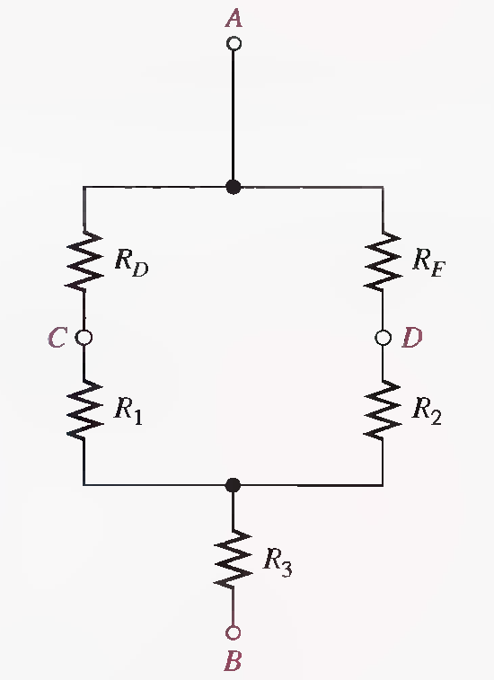

Slide 12
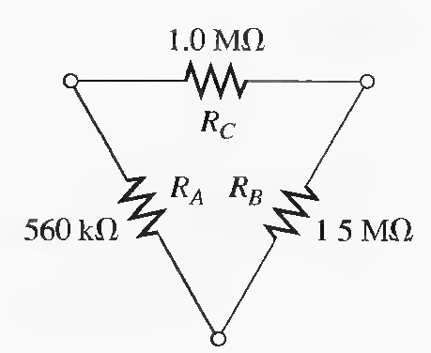
Q.1 Convert each delta network to a wye network.
R1=183 kΩ, R2=490 kΩ, R3=275 kΩ

Slide 13
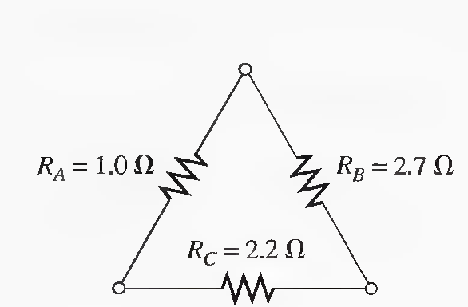
Q.2 Convert each delta network to a wye network
R1=373 mΩ R2=1.01 Ω, R3=4.58 mΩ

Slide 14
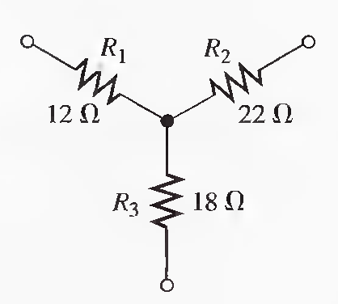
Q.3 Convert each wye network to a delta network.
RA= 39.8 Ω, RB= 73 Ω, RC= 48.7 Ω

Slide 15
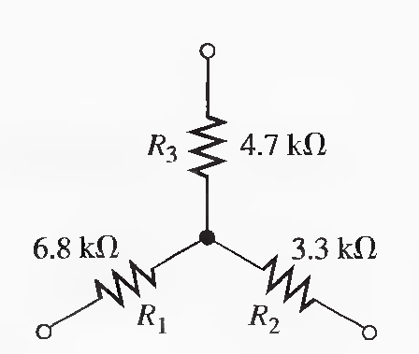
Q.4 Convert each wye network to a delta network.
RA= 21.2 kΩ, RB= 10.3 kΩ, RC= 14.9 kΩ

Slide 16
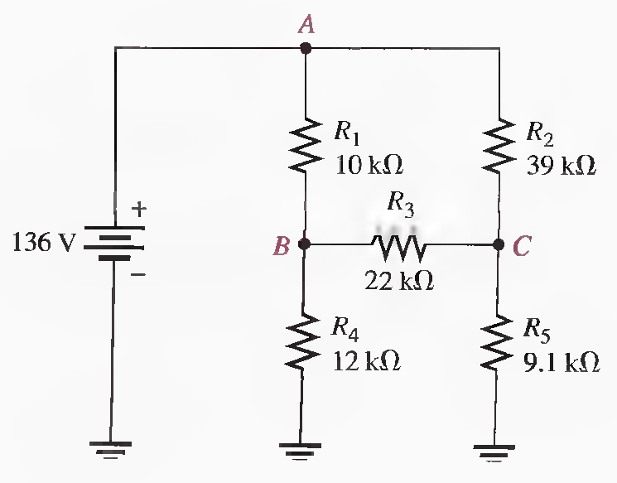
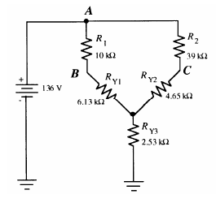
Q.5 Find all currents in the circuit of following Figure.
RT=14.3 kΩ, IT=9.5 mA, IR1 = IRY1=6.94 mA, IR2 = IRY2 = 2.56 mA, VB = VA − IR1.R1 =66.6 V,
VC=36.16 V, IR4 =5.55 mA, IR5 =3.97 mA, IR3=1.38 mA

Slide 17
RT=14.3 kΩ, IT=9.5 mA, IR1 = IRY1=6.94 mA, IR2 = IRY2 = 2.56 mA, VB=66.6 V, VC=36.16 V
IR4 =5.55 mA, IR5 =3.97 mA, IR3=1.38 mA

Slide 18
RT=14.3 kΩ, IT=9.5 mA, IR1 = IRY1=6.94 mA, IR2 = IRY2 = 2.56 mA, VB=66.6 V, VC=36.16 V
IR4 =5.55 mA, IR5 =3.97 mA, IR3=1.38 mA

Slide 19
BRANCH, LOOP, AND NODE ANALYSES
So for (In the previous lectures 16-20), you have learned about the superposition theorem, Thevenin's theorem, Norton's theorem, maximum power transfer theorem, and several types of conversion methods. These theorems and conversion methods are useful in solving some types of circuit problems for both dc and ac. In future lectures, three more circuit analysis methods are introduced. These methods, based on Ohm's law and Kirchhoff's laws, are particularly useful in the analysis of multiple-loop circuits having two or more voltage or current sources. These methods can be used alone or in conjunction with the techniques covered in the previous Lectures. With experience, you will learn which method is best for a particular problem or you may develop a preference for one of them.

Slide 20
BRANCH, LOOP, AND NODE ANALYSES
Simultaneous Equations in Circuit Analysis
Branch Current Method
Loop Current Method
Node Voltage Method

Slide 21
SIMULTANEOUS EQUATIONS IN CIRCUIT ANALYSIS
The circuit analysis methods allow you to find two or more unknown currents or voltages by solving simultaneous equations. These analysis methods, which include branch current, loop current, and node voltage methods, result in a number of equations equal to the number of unknowns. Coverage is limited to equations with two unknowns (2nd order) and equations with three unknowns (3rd order). These equations can then be solved simultaneously for the unknown quantities.

Slide 22
Simultaneous equations
Simultaneous equations consist of a set of n equations containing n unknowns, where n is a number with a value of 2 or more. The number of equations in the set must equal the
number of unknowns. For example, to solve for two unknown variables, you must have two equations; to solve for three unknowns you must have three equations, and so on.
Solutions of Simultaneous Equations
Solving by Substitution
Solving by Determinants

Slide 23
Solving by Substitution
2_{Xl} + 6_{X2} = 8 …………….(Eq. l)
3_{Xl} + 6_{X2} = 2 …………….(Eq.2)
X₂ = 3.33, X₁ =-5.99

Slide 24
Solving by Determinants
2_{Xl} + 6_{X2} = 8 …………….(Eq. l)
3_{Xl} + 6_{X2} = 2 …………….(Eq.2)

Slide 25
Third-order determinants can be evaluated by the expansion method.
1I₁ + 3l₂ – 2I₃ = 7
0l₁ + 4l₂ + 1I₃ = 8
-5I₁ + 1l₂ + 6I₃ = 9
C.D=9 - 41 = -32, For I₁ : Determinant = 179 - 79 = 100 , I₁=-3.125 A

Slide 26
BRANCH CURRENT METHOD
The branch current method is a circuit analysis method using Kirchhoff's voltage and current laws to find the current in each branch of a circuit by generating simultaneous equations. Once you know the branch currents, you can determine voltages.

Slide 27
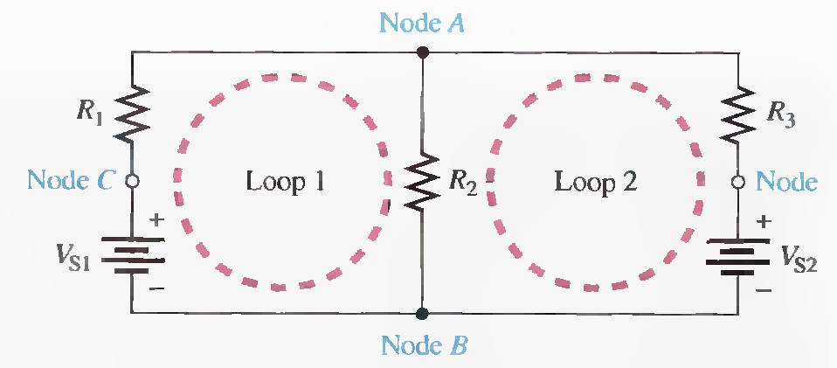
Electric Circuit Terminologies
Branch A branch is a path that connects two nodes.
Loop A closed current path in a circuit.
Node A node is a point where two or more components are connected.

Slide 28
BRANCH CURRENT METHOD
The following are the general steps used in applying the branch current method.
Step 1. Assign a current in each circuit branch in an arbitrary direction.
Step 2. Show the polarities of the resistor voltages according to the assigned branch current directions.
Step 3. Apply Kirchhoff's voltage law around each closed loop (algebraic sum of voltages is equal to zero).
Step 4. Apply Kirchhoff's current law at the minimum number of nodes so that all branch currents are included (algebraic sum of currents at a node equals zero).
Step 5. Solve the equations resulting from Steps 3 and 4 for the branch current values.

Slide 29
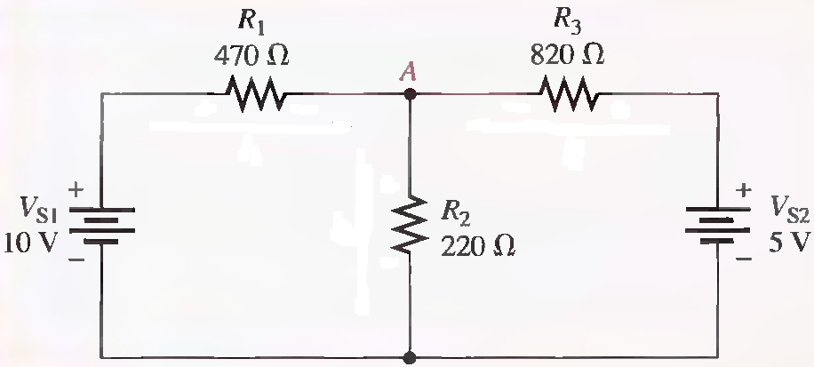
Q.1 Use the branch current method to find each branch current.
I1 = 13.9 mA, I2= 15.8 mA, I3= 1.87 mA

Slide 30
I1 = 13.9 mA, I2= 15.8 mA, I3= 1.87 mA

