Slide 1
Previous Lecture 1
International system of units.
Scientific notation
Engineering notation
Metric prefixes

Slide 2
Voltage , Current and Resistor
Lecture 2
Lecture Objective
Atomic Structure
Electrical Charge
Voltage, Current, and Resistance
Voltage and Current Sources
Resistors
The Electric Circuit
Basic Circuit Measurements

Slide 3
Atomic Structure
All matter is made of atoms; and all atoms consist of electrons, protons, and neutrons.
An atom is the smallest particle of an element that retains the characteristics of that element.
Know elements so far - 118

Slide 4
The Bohr atom is a tool for visualizing atomic structure.
The nucleus is positively charged and has the protons and neutrons.
Electrons are negatively charged and in discrete shells.
The atomic number is the number of protons and determines the particular element.
In the neutral atom, the number of electrons is equal to the number of protons.

Slide 5
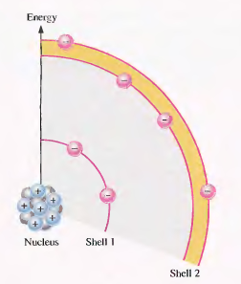
Electron Shells, Orbits and Energy Level
Orbits: Discrete distance from the nucleus
Shell: Orbits are grouped into energy level. Each shell have different energy level. Shells are represented by either 1,2,3...or K,L,M...
Number of electrons in each shell=2n^2
Valance Shell and Valence Electrons
Ionization: positive & negative ions
If an electron absorbs a photon with
sufficient energy, it escapes from the
atom and becomes a free electron.

Slide 6
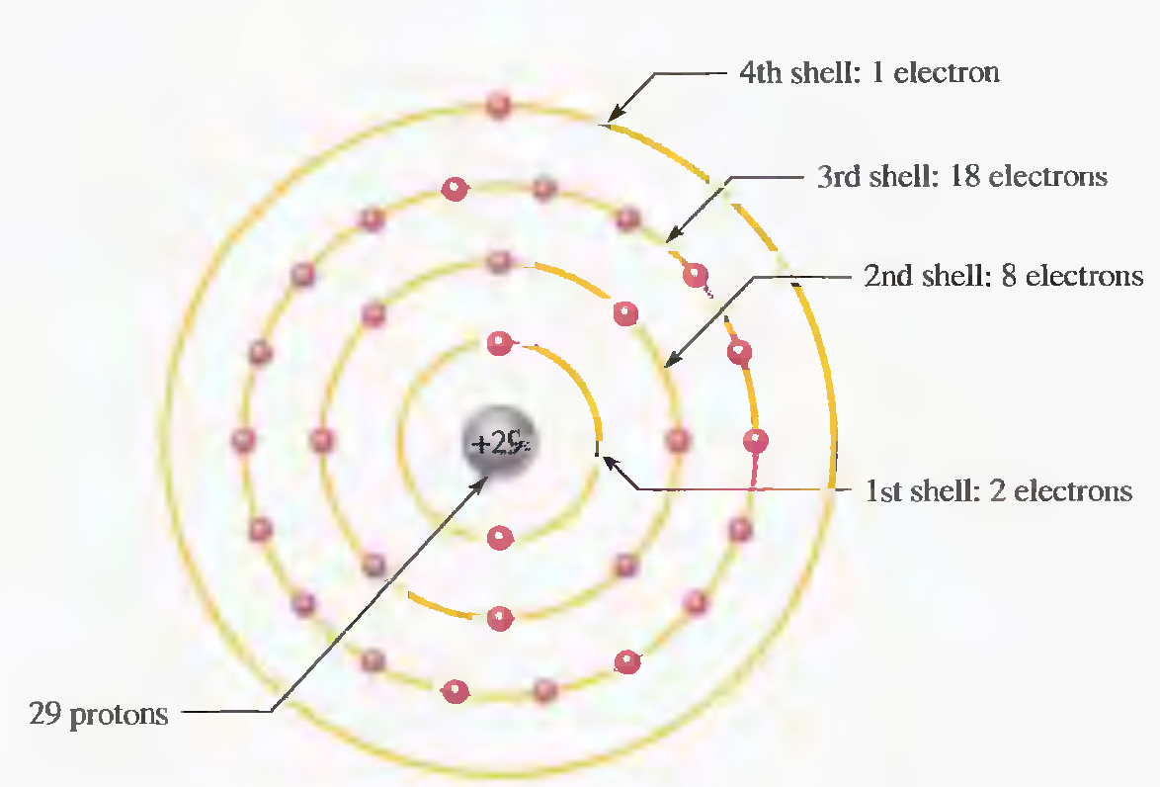
The Copper Atom
Copper is the most commonly used metal in electrical applications.
Atomic number = 29

Slide 7
Conductor, Semiconductor and Insulator
Conductor: Conductive materials have many free electrons and are capable to conduct electric current easily.
Insulator: Insulator materials do not conduct electrical current under normal conduction. It is difficult to make the free electrons into conduction band while the physical characteristic of the material remain unchanged.
Semiconductor: Conductivity of Semiconductors is in between conductor and insulator.

Slide 8
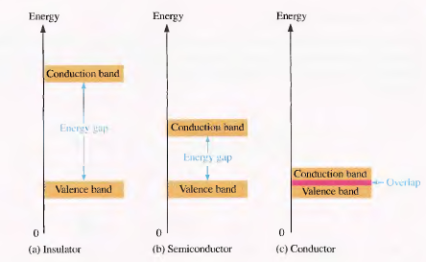
Energy Bands

Slide 9
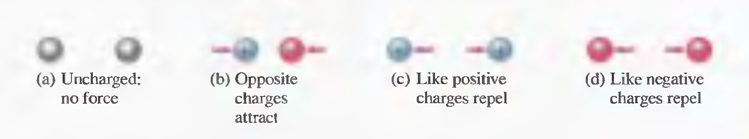
Electrical Charge
Electrical charge, an electrical property of matter that exists because of an excess or deficiency of electrons, is symbolized by Q.
Static charge-presence of a net positive or negative charge
Attraction and repulsion of electrical charges.

Slide 10
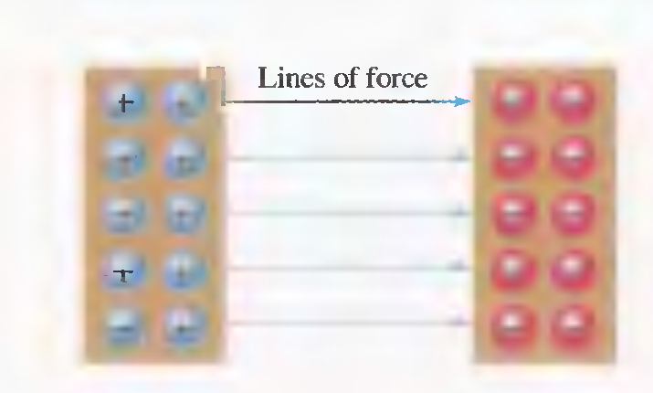
Electrical Charge
Electric field between two oppositely charged surfaces.
A force acts between charges. This force is called an electric field which consists of invisible lines of force.

Slide 11
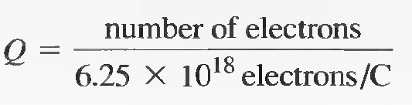
Electrical Charge
Electrical charge (Q) is measured in coulombs, symbolized by C.
One coulomb is the total charge possessed by 6.25 X 10¹⁸ electrons.
A single electron has a charge of 1.6 X 10⁻ ¹⁹ C. The total charge Q, can be found by following formula

Slide 12
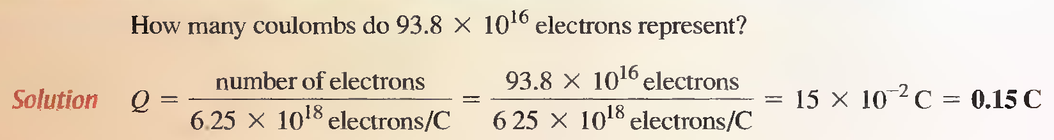
Example

Slide 13
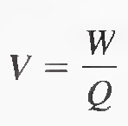
VOLTAGE, CURRENT, AND RESISTANCE
Voltage
The difference in potential energy per charge is the potential difference or voltage. Voltage is the driving force in electric circuits and is what establishes current.
Voltage, symbolized by V, is defined as energy or work per unit charge.
where:
V = voltage in volts (V)
W = energy in joules (J)
Q = charge in coulombs (C)

Slide 14
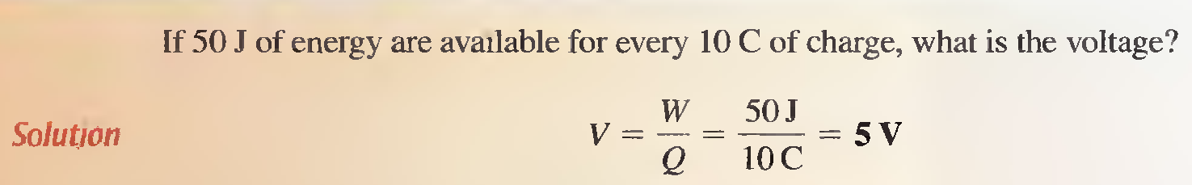
Definition of Voltage
One volt is the potential difference (voltage) between two points when one joule of energy is used to move one coulomb of charge from one point to the other.

Slide 15
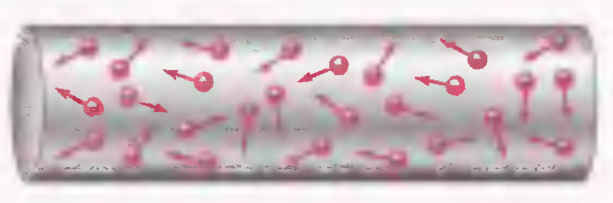
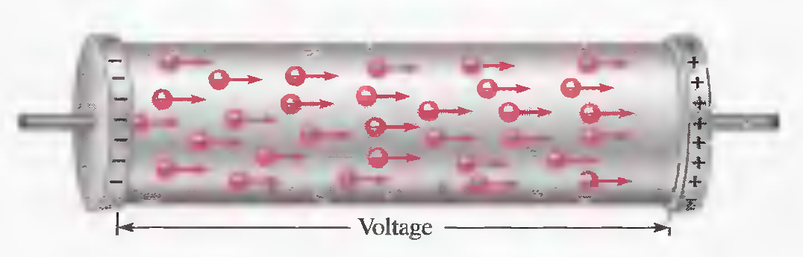
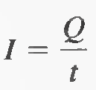
Current (I)
Electrical current is the rate of flow of charges
where: I = current in amperes (A)
Q = charge in coulombs (C)
t = time in seconds (s) the rate of flow of charge.
Random motion of free electrons in a material.
Electrons flow from negative to positive when a voltage is applied across a conductive or semiconductive material.

Slide 16
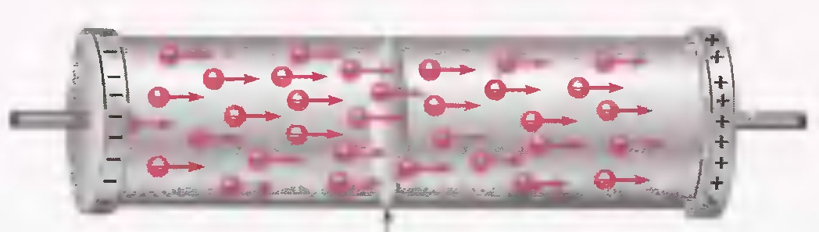
Definition of Current
One ampere (1 A) is the amount of current that exists when a number of electrons having a total charge of one coulomb (1 C) move through a given cross-sectional area in one second (1 s).

Slide 17
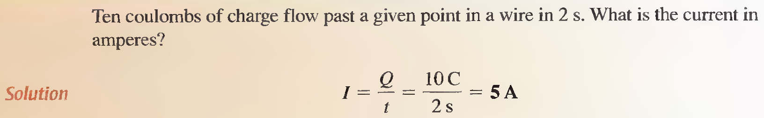
Example

Slide 18

Resistance (R)
Resistance is the opposition to current.
Definition of resistance
One ohm (1 Ω) of resistance exists if there is one ampere (1 A) of current in a material when one volt (1 V) is applied across the material.

Slide 19
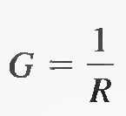
Conductance (G)
The reciprocal of resistance is conductance, symbolized by G. It is a measure of the ease with which current is established.
The formula is
Unit is siemens.

Slide 20
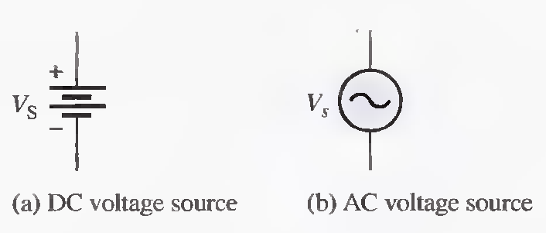
Voltage and Current Sources
A voltage source provides electrical energy or electromotive force (emf) more commonly known as voltage.

Slide 21
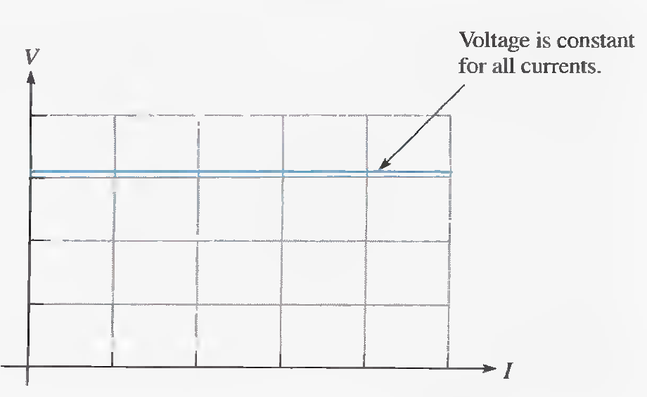
The Voltage Source
The Ideal Voltage Source
VI characteristic of an ideal voltage source.

Slide 22
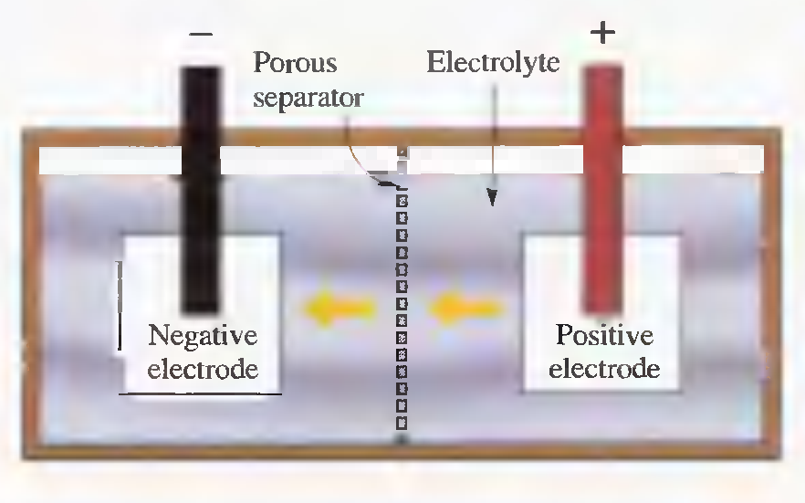
Types of DC Voltage Sources
Batteries A battery is a type of voltage source that converts chemical energy into electrical energy.
Diagram of a battery cell.

Slide 23
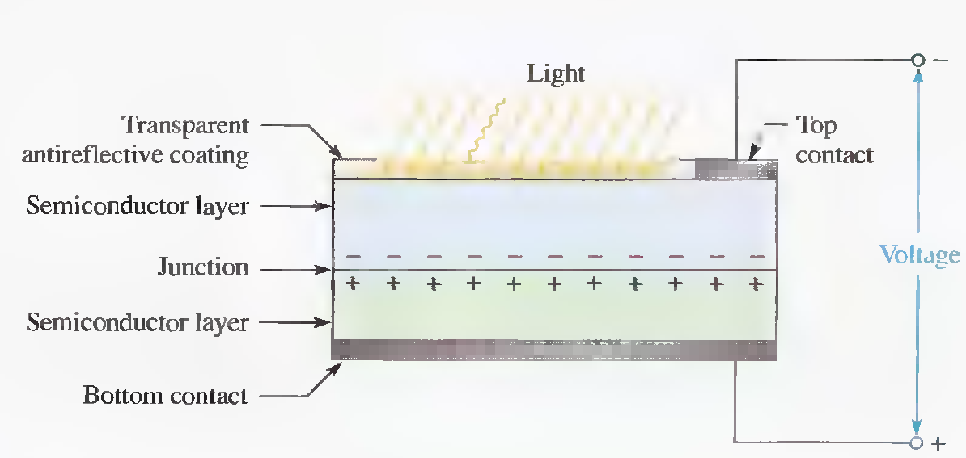
Types of DC Voltage Sources
Solar Cells The operation of solar cells is based on the photovoltaic effect, which is the process whereby light energy is converted directly into electrical energy.
Construction of a basic solar cell.

Slide 24
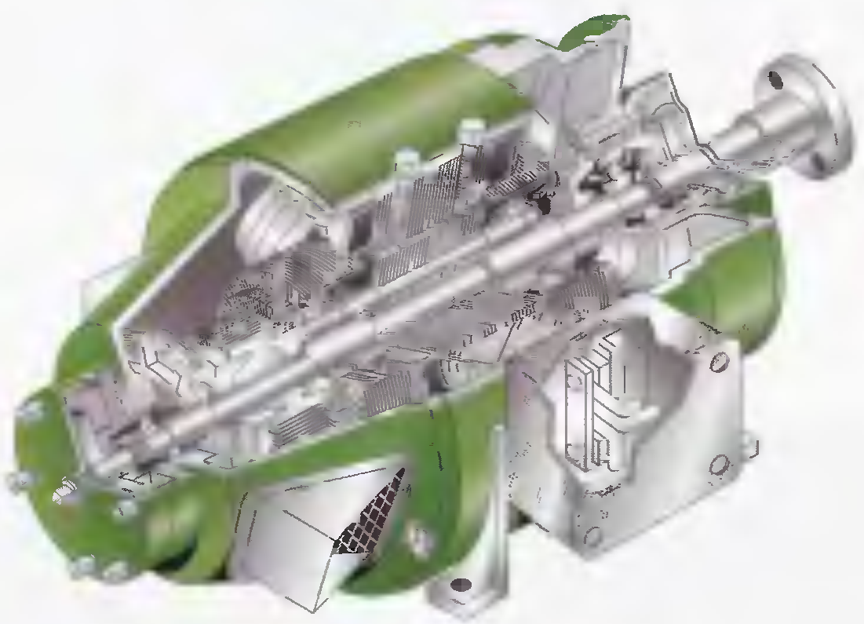
Types of DC Voltage Sources
Generator Electrical generators convert mechanical energy into electrical energy using
a principle called electromagnetic induction
Cutaway view of a dc voltage generator.

Slide 25
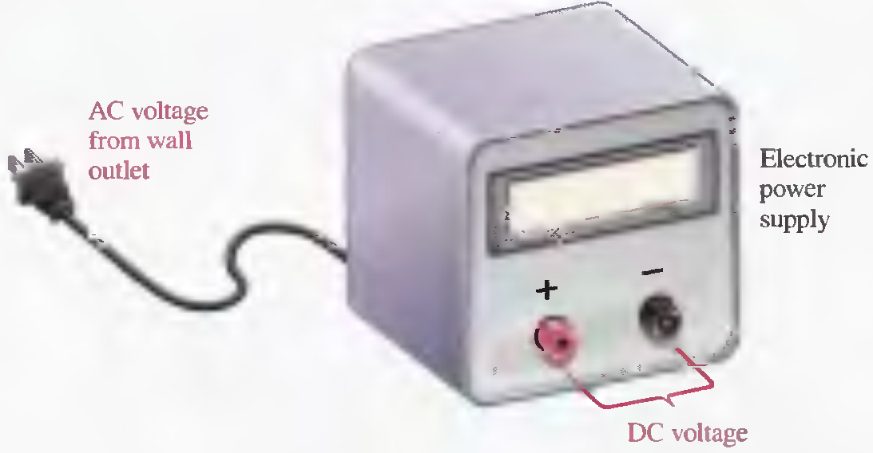
Types of DC Voltage Sources
The Electronic Power Supply
Electronic power supplies convert the ac voltage from a wall outlet to a constant (dc) voltage that is available across two terminals.

Slide 26
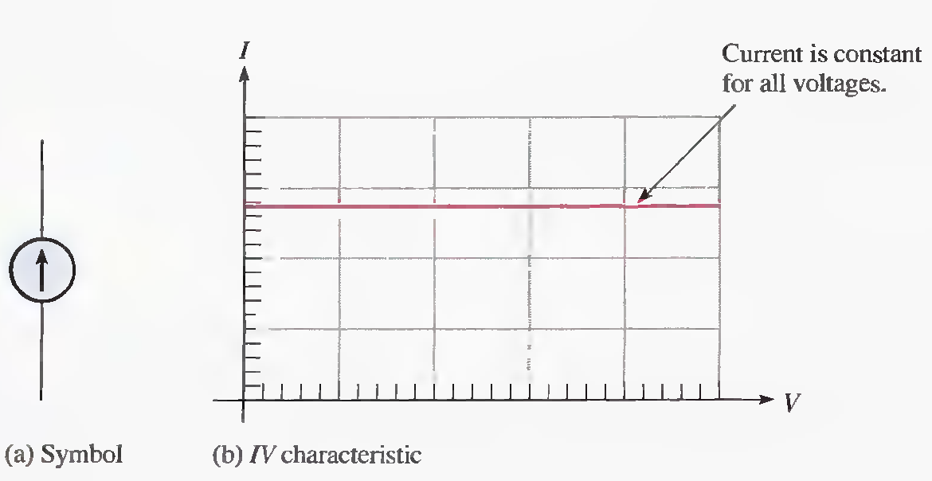
The Current source
The Ideal Current Source

Slide 27
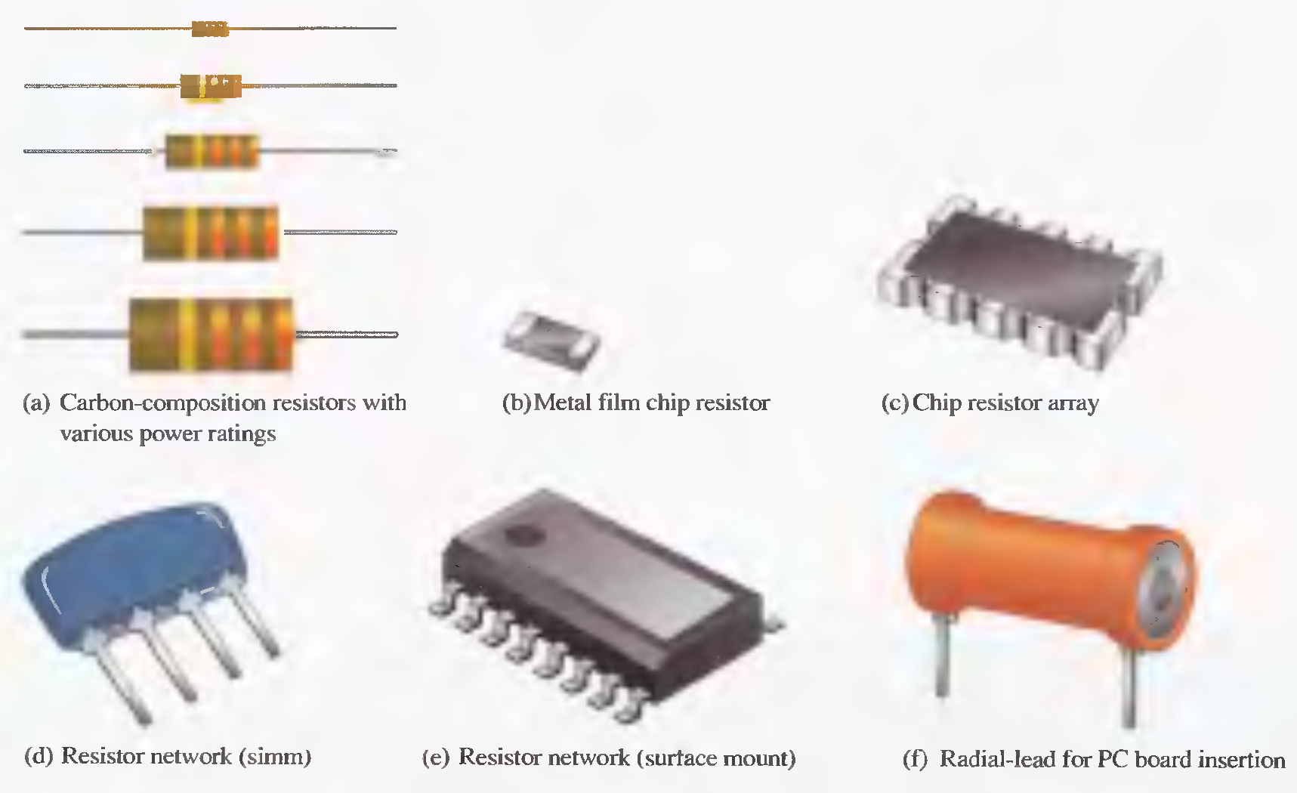
Types of Resistor
Fixed Resistor

Slide 28
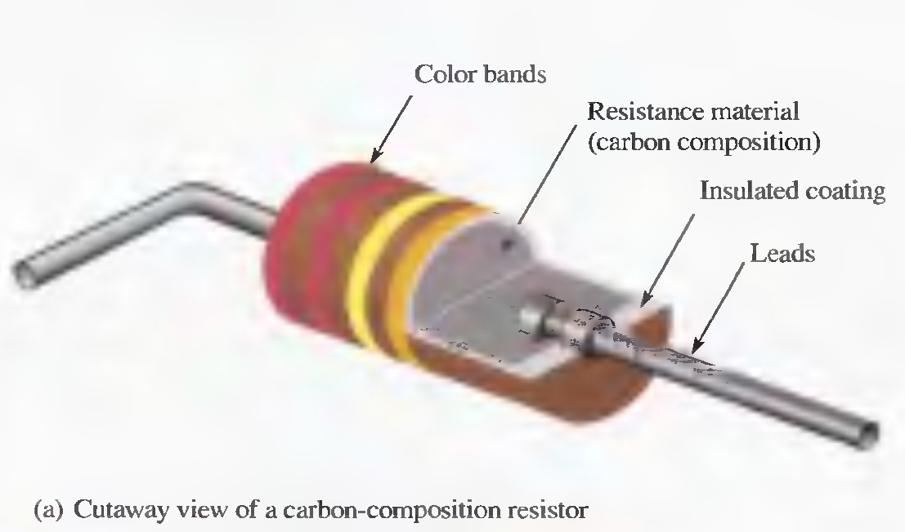
Carbon-composition resistor
This resistor is made with a mixture of finely ground carbon, insulating filler, and a resin binder. The ratio of carbon to insulating filler sets the resistance value.

Slide 29
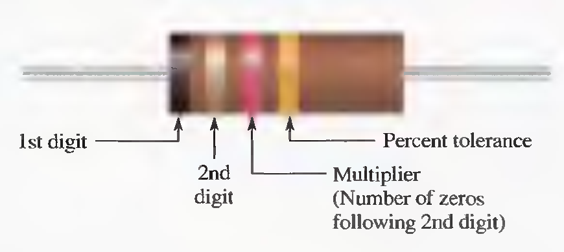
Resistor Color Code

Slide 30
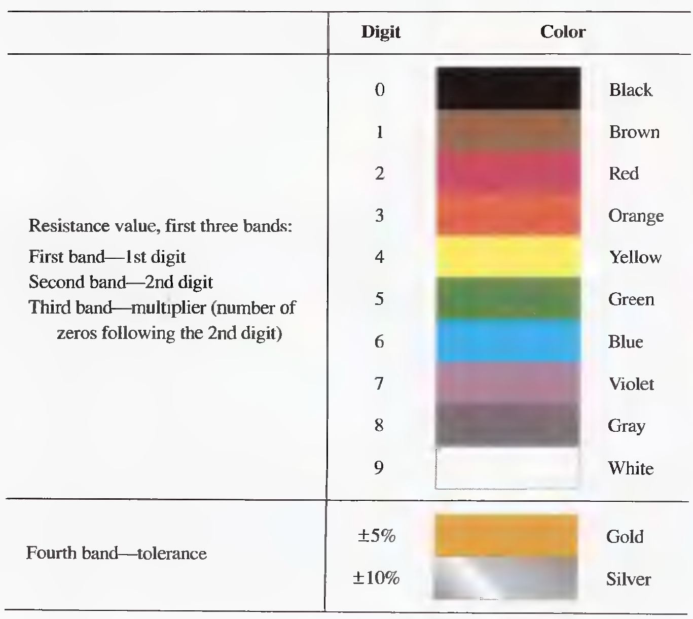
Resistor 4-band color code

Slide 31
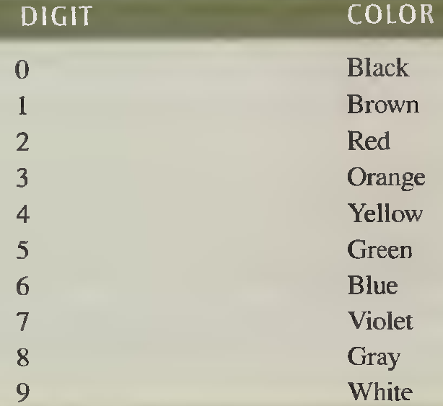
Example
What is the resistance and tolerance of each of the four-band resistors?
Tolerance= 0.255KΩ
4.845------------5.355
5.1 kΩ ± 5%
820 kΩ ± 5%
47 Ω ± 10%
1.0 Ω ± 5%

Slide 32
Variable Resistor
Variable resistors include the potentiometer and rheostat. A potentiometer can be connected as a rheostat
The center terminal is connected to the wiper

Slide 33
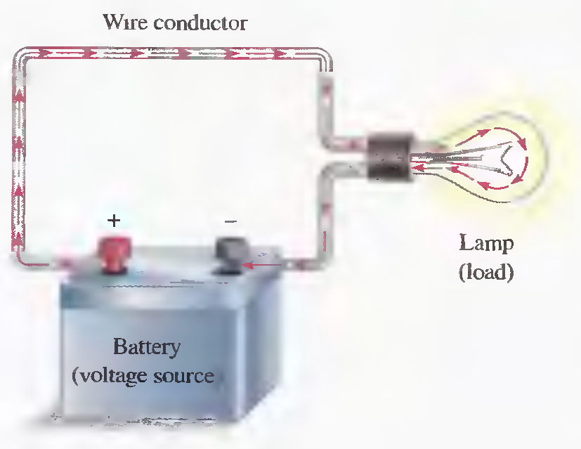
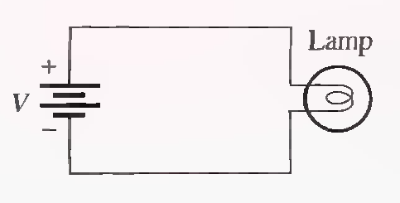
The Electric Circuit
Electron flow direction.
Conventional current direction
A basic electric circuit
Schematic of electric circuit

Slide 34
Basic Circuit Measurement
An important multipurpose instrument is the DMM, which can measure voltage, current, and resistance. Many include other measurement options.

Slide 35
Basic Circuit Measurement
How to Properly measure voltage in a circuit?

Slide 36
Basic Circuit Measurement
How to Properly measure current in a circuit?

Slide 37
Basic Circuit Measurement
How to Properly measure resistance?

Slide 38
Summary
An atom is the smallest particle of an element that retains the characteristics of that element.
When electrons in the outer orbit of an atom (valence electrons) break away, they become free
electrons.
Free electrons make current possible.
Like charges repel each other, and opposite charges attract each other.
Voltage must be applied to a circuit to produce current.
Resistance limits the current.
Basically, an electric circuit consists of a source, a load, and a current path.

Slide 39
Summary
An open circuit is one in which the current path is broken.
A closed circuit is one which has a complete current path.
An ammeter is connected in line with the current path.
A voltmeter is connected across the current path.
An ohmmeter is connected across a resistor (resistor must be disconnected from circuit)
One coulomb is the charge of 6.25 X 10¹⁸ electrons.

Slide 40
Summary
One volt is the potential difference (voltage) between two points when one joule of energy is used to move one coulomb from one point to the other.
One ampere is the amount of current that exists when one coulomb of charge moves through a given cross-sectional area of a material in one second.
One ohm is the resistance when there is one ampere of current in a material with one volt applied across the material.

Slide 41
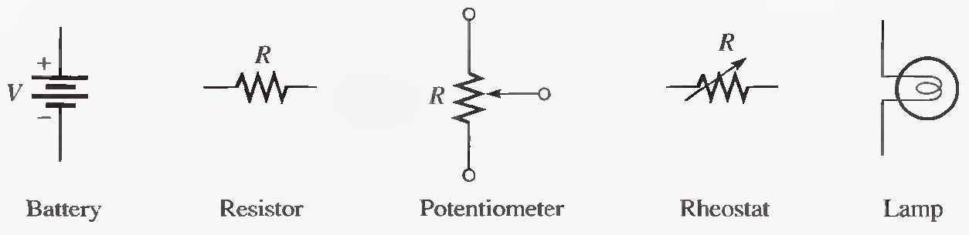

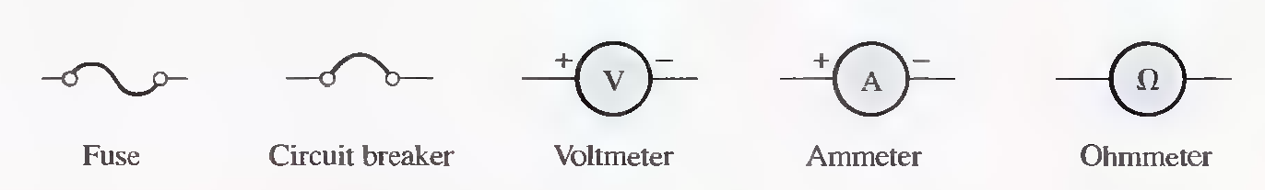
Important Electrical symbols
Ground

Slide 42
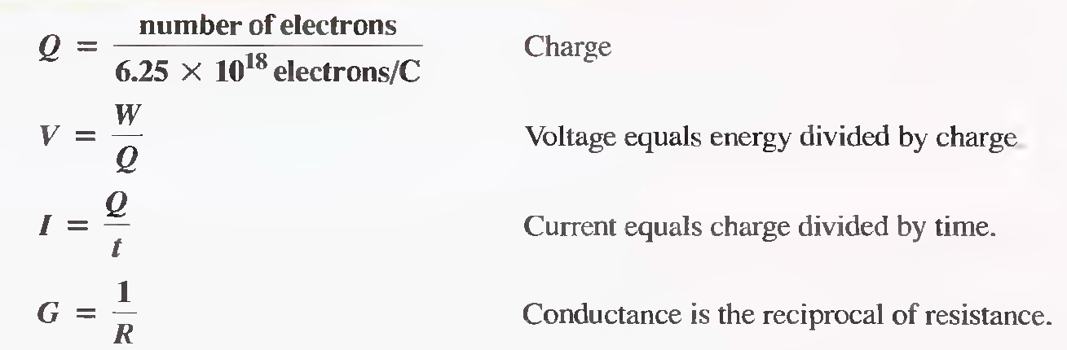
Important Formulas

