Slide 1
Lecture 19
Problems Solving related to Thevenin's theorem
Norton’s Theorem

Slide 2
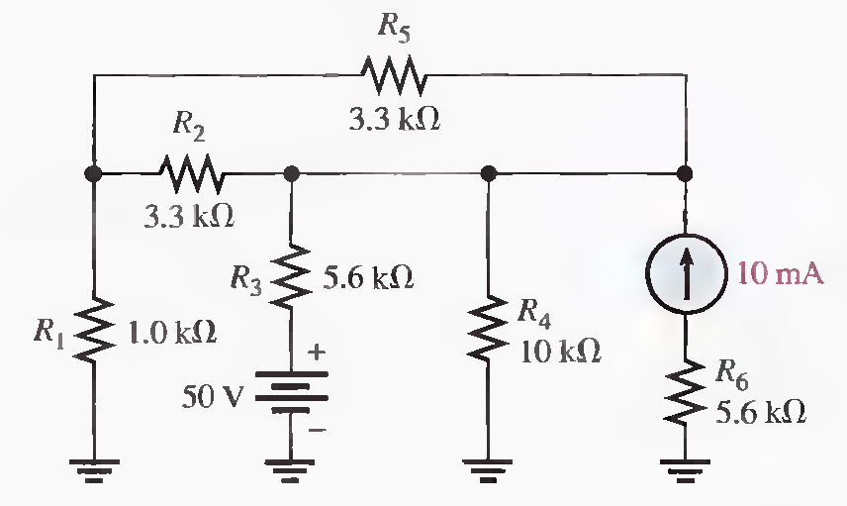
Problems Solving-Thevenin's theorem
Q.7 Using Thevenin's theorem, find the voltage across R4. (Solved on 3 slides)
For Vs: RTH=1.8 kΩ, VTH=16.1 V, V4=13.6 V, For IS: RTH=1.8 kΩ , I3=3.2 mA, VTH=17.9 V, V4=15.2 V, V4(total)=28.8 V

Slide 3
For Vs: RTH=1.8 kΩ, VTH=16.1 V, V4=13.6 V, For IS: RTH=1.8 kΩ , I3=3.2 mA, VTH=17.9 V, V4=15.2 V, V4(total)=28.8 V

Slide 4
For Vs: RTH=1.8 kΩ, VTH=16.1 V, V4=13.6 V, For IS: RTH=1.8 kΩ , I3=3.2 mA, VTH=17.9 V, V4=15.2 V, V4(total)=28.8 V

Slide 5
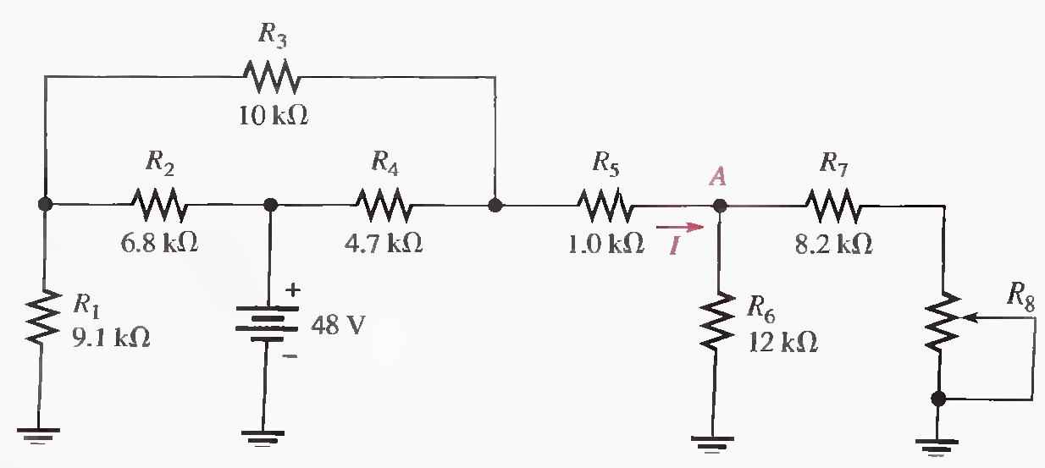
Q.8 Determine the current into point A when R 8 is 1.0 kΩ, 5 k Ω, and 10 k Ω. (Solved on 3 slides)
RTH=4.51 kΩ, RT=13.8 kΩ, IT=3.48 mA, I4= 1.1 mA, V4=5.17 V, Vx= 42.8 V, VTH=VA=VX = 42.8 V,
For R8 = 1 kΩ: IA= 4.41 mA, For R8 = 15kΩ: IA= 3.97 mA, For R8 = 1 kΩ: IA= 3.66 mA

Slide 6
RTH=4.51 kΩ, RT=13.8 kΩ, IT=3.48 mA, I4= 1.1 mA, V4=5.17 V, Vx= 42.8 V, VTH=VA=VX = 42.8 V,
For R8 = 1 kΩ: IA= 4.41 mA, For R8 = 15kΩ: IA= 3.97 mA, For R8 = 1 kΩ: IA= 3.66 mA

Slide 7
RTH=4.51 kΩ, RT=13.8 kΩ, IT=3.48 mA, I4= 1.1 mA, V4=5.17 V, Vx= 42.8 V, VTH=VA=VX = 42.8 V,
For R8 = 1 kΩ: IA= 4.41 mA, For R8 = 15kΩ: IA= 3.97 mA, For R8 = 1 kΩ: IA= 3.66 mA

Slide 8
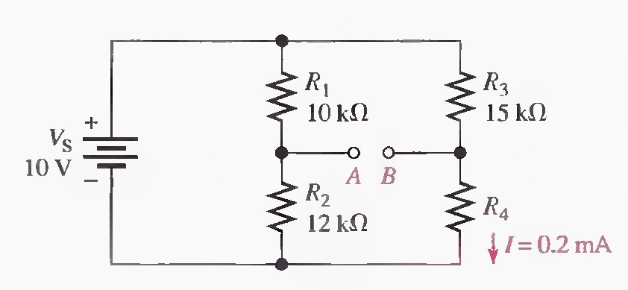
Q.9 Determine the Thevenin equivalent looking from terminals A and B for the given circuit. (Solved on 2 slides)
VR3 = 3 V, V4=7V, R4=35 kΩ, VA=5.46 V, VB=7V, VTH=1.54 V, RTH=15.96 kΩ

Slide 9
VR3 = 3 V, R4=35 kΩ, VA=5.46 V, VB=7V, VTH=1.54 V, RTH=15.96 kΩ

Slide 10
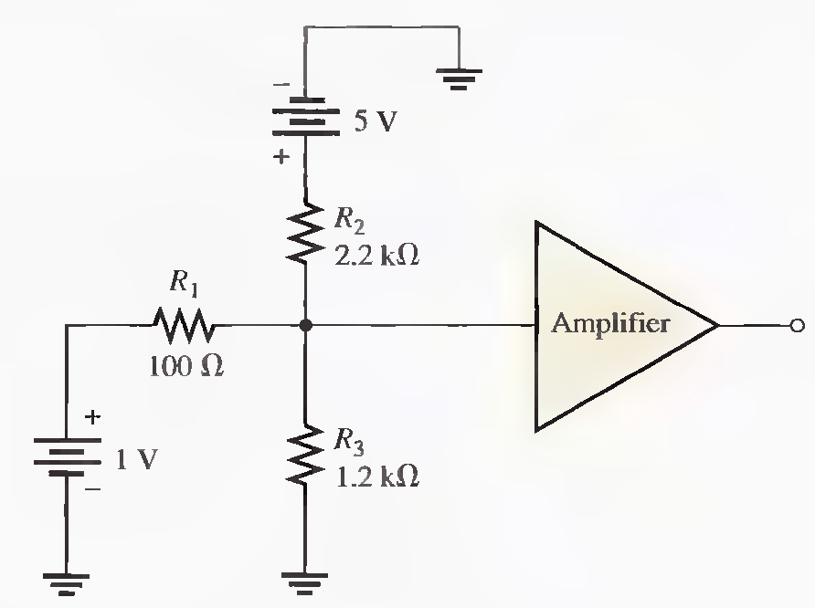
Q.10 Find the Thevenin equivalent for the circuit external to the amplifier in the following figure. (Solved on 2 slides)
Looking back from the amplifier input
RTH = 88.6 Ω, For 1 V : VA= 886 mV, For 5V: VA= 200 mV, VTH = 886 mV + 200 mV = 1.09 V

Slide 11
RTH = 88.6 Ω, For 1 V : VA= 886 mV, For 5V: VA= 200 mV, VTH = 886 mV + 200 mV = 1.09 V

Slide 12
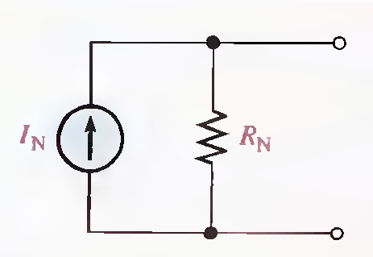
NORTON'S THEOREM
Like Thevenin's theorem, Norton's theorem provides a method of reducing a more complex circuit to a simpler equivalent form. The basic difference is that Norton's theorem results in an equivalent current source in parallel with an equivalent resistance.
General form of Norton's equivalent circuit.

Slide 13
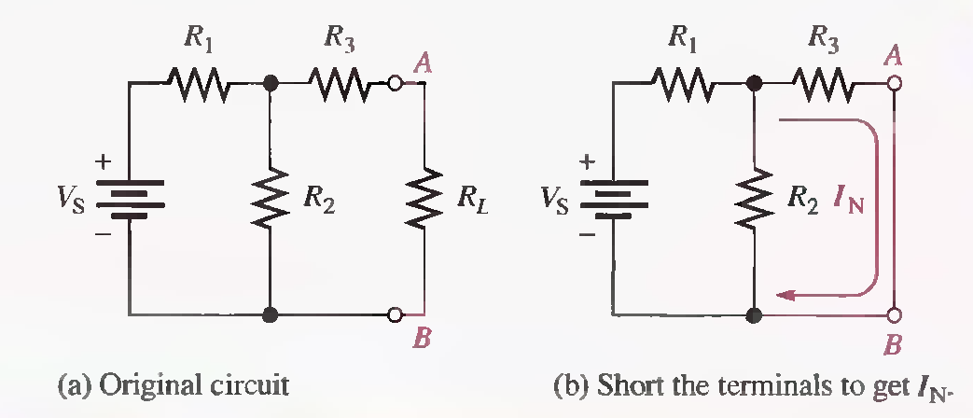
Norton's Equivalent Current (IN)
Norton's equivalent current (IN) is the short-circuit current between two output terminals in a circuit.
Norton's Equivalent Resistance (RN )
The Norton equivalent resistance, RN , is the total resistance appearing between two output terminals in a given circuit with all sources replaced by their internal resistances.

Slide 14
A summary of steps for theoretically applying Norton's theorem is as follows:
Step 1. Short the two terminals between which you want to find the Norton equivalent circuit.
Step 2. Determine the current (IN) through the shorted terminals.
Step 3. Determine the resistance (RN ) between the two open terminals with all sources replaced with their internal resistances (ideal voltage sources shorted and ideal current sources opened). RN = RTH .
Step 4. Connect IN and RN in parallel to produce the complete Norton equivalent for the original circuit.

Slide 15
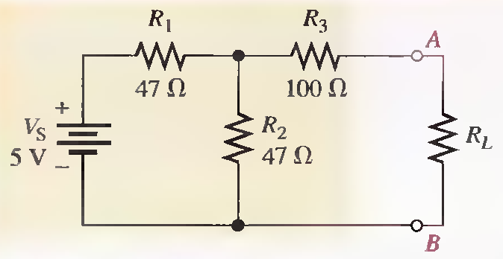
Q.1 Determine IN and RN for the circuit within the beige area in the given Figure.
RT=79Ω, IT=63.3 mA, IN=20.2mA, RN=124Ω

Slide 16
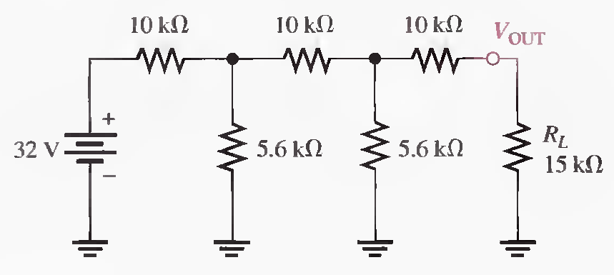
Q.2 Using Norton's theorem, find the current through the load resistor RL. (Solved on 2 slides)
RN = 14.0 kΩ, RT = 14.0 kΩ, IT=2.29 mA, I1=668 μA, IN=240 μA, IL=116 μA

Slide 17
RN = 14.0 kΩ, RT = 14.0 kΩ, IT=2.29 mA, I1=668 μA, IN=240 μA, IL=116 μA

Slide 18
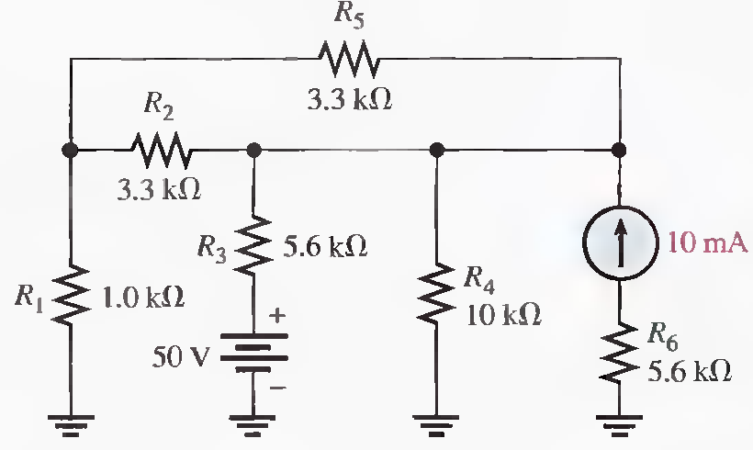
Q.3 Using Norton's theorem, find the voltage across R5 in the following Figure. (Solved on 3 slides)
For 50 V: RT = R3 + R1 || R4 = 6.51 kΩ, IT= 7.68 mA, IN= 6.98 mA, RN = 1.92 kΩ, IR5= 2.57 mA
For 10mA: IN= 7.82 mA, RN=1.92 kΩ, IR5= 2.85 mA , IR5(tot)= 5.42mA, V5=17.9 V

Slide 19
For 50 V: RT = R3 + R1 || R4 = 6.51 kΩ, IT= 7.68 mA, IN= 6.98 mA, RN = 1.92 kΩ, IR5= 2.57 mA
For 10mA: IN= 7.82 mA, 1.92 kΩ, IR5= 2.85 mA , IR5(tot)= 5.42mA, V5=17.9 V

Slide 20
For 50 V: RT = R3 + R1 || R4 = 6.51 kΩ, IT= 7.68 mA, IN= 6.98 mA, RN = 1.92 kΩ, IR5= 2.57 mA
For 10mA: IN= 7.82 mA, 1.92 kΩ, IR5= 2.85 mA , IR5(tot)= 5.42mA, V5=17.9 V

Slide 21
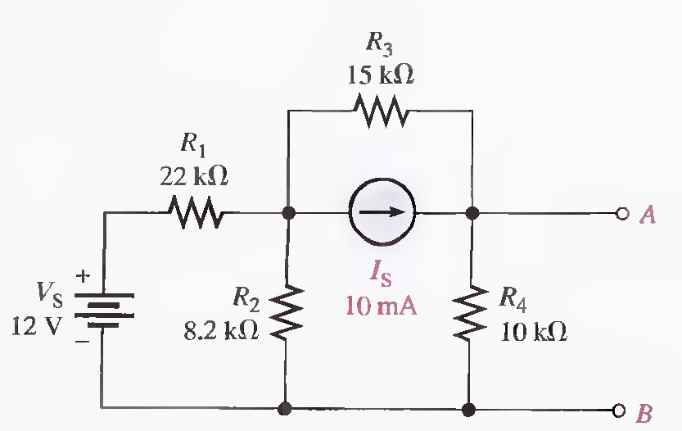
Q.4 Reduce the circuit between terminals A and B in the following Figure to its Norton equivalent. (Solved on 2 slides)
RN = 6.77 kΩ, For VS: RT=27.3 kΩ, IT= 440 μA, IN1 = 156 μA down, For IS: IN2=7.15 mA down,
IN = IN1 + IN2 = 156 μA + 7.15 mA = 7.31 mA

Slide 22
RN = 6.77 kΩ, For VS: RT=27.3 kΩ, IT= 440 μA, IN1 = 156 μA down, For IS: IN2=7.15 mA down,
IN = IN1 + IN2 = 156 μA + 7.15 mA = 7.31 mA

Slide 23
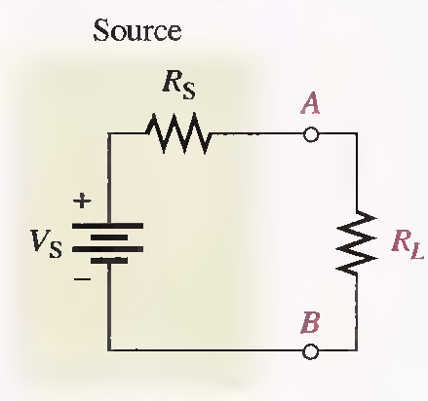
MAXIMUM POWER TRANSFER THEOREM
The maximum power transfer theorem is important when you need to know the value of the load at which the most power is delivered from the source.
For a given source voltage, maximum power is transferred from a source to a load when the load resistance is equal to the internal source resistance.
Maximum power is transferred to the load when R L = R s

Slide 24
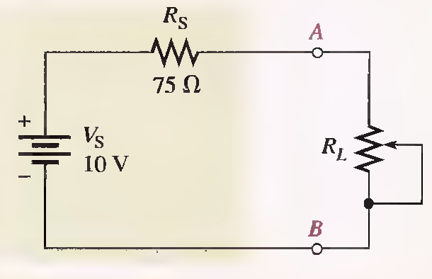
Q.1 The source in the following Figure has an internal source resistance of 75Ω. Determine the load power for each of the following values of load resistance:
(a) 0 Ω (b) 25 Ω (c) 50 Ω (d) 75 Ω (e) 100 D (f) 125 Ω
Draw a graph showing the load power versus the load resistance. (Solved on 2 slides)
a) IL=133mA, PL= 0mW, b) IL=100mA , PL= 250mW, c) IL=80mA, PL= 320mW ,
d) IL=66.7 mA, PL= 334mW , e) IL=57.1mA, PL=326mW f) IL=50mA, PL=313mW

Slide 25
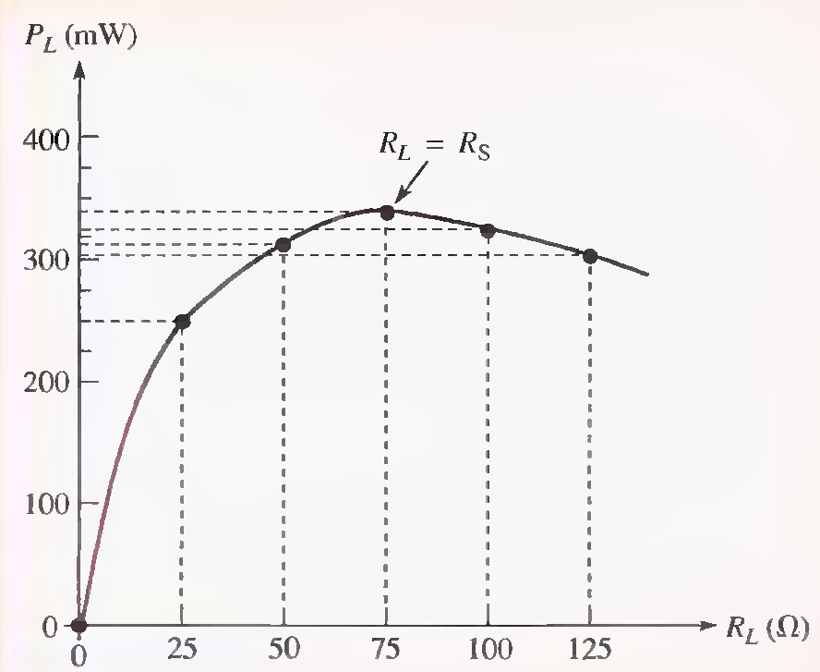
a) IL=133mA, PL= 0mW, b) IL=100mA , PL= 250mW, c) IL=80mA, PL= 320mW ,
d) IL=66.7 mA, PL= 334mW , e) IL=50mA, PL=313mW

Slide 26
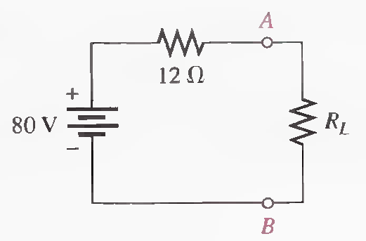
Q.2 In the following circuit, maximum power is to be transferred to the load R L . Determine the appropriate value for RL.
RL = RS = 12 Ω

Slide 27
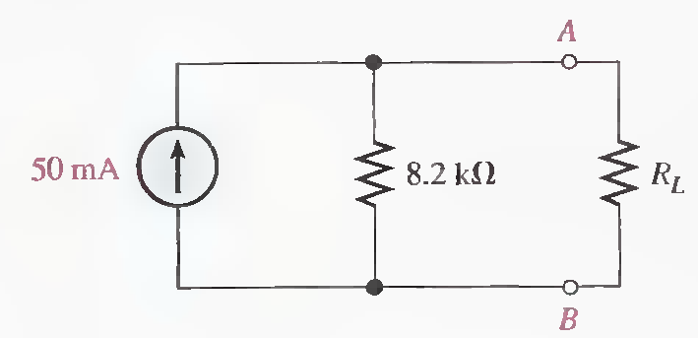
Q.3 In the following circuit, maximum power is to be transferred to the load R L . Determine the appropriate value for RL.
RL = RS = 8.2 kΩ

Slide 28
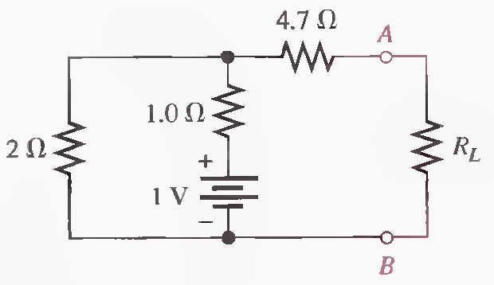
Q.4 In the following circuit, maximum power is to be transferred to the load R L . Determine the appropriate value for RL.
RL = RS =RTH= 4.7 Ω + 1 Ω || 2 Ω = 6.37 Ω

Slide 29
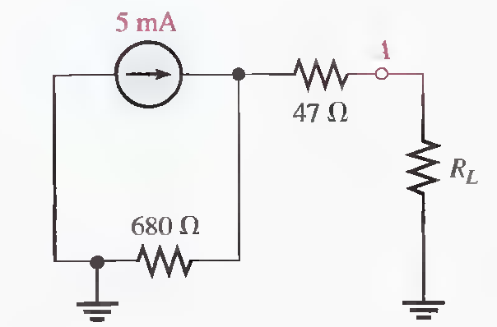
Q.5 In the following circuit, maximum power is to be transferred to the load R L . Determine the appropriate value for RL.
RL = RS = 47 Ω + 680 Ω = 727 Ω

Slide 30
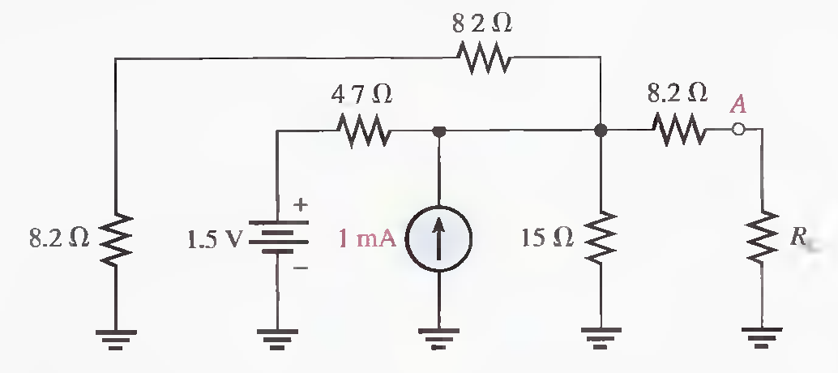
Q.6 Determine the value of RL for maximum power.
RS = 8.2 Ω + 2.94 Ω = 11.1 Ω, For maximum power transfer: RL = RS = 11.1 Ω

Slide 31
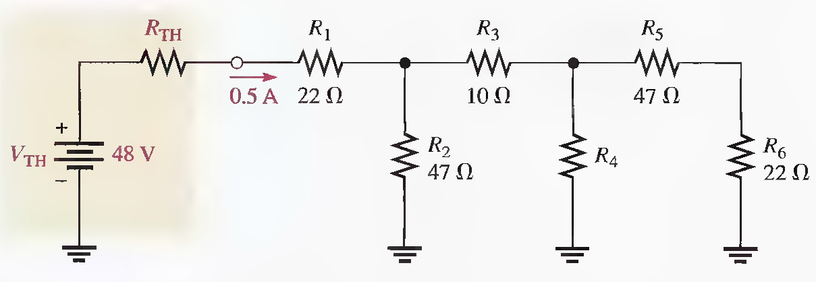
Q.7 What are the values of R4 and RTH when the maximum power is transferred from the thevenized source to the ladder network. (Solved on 2 slides)
RTH = RLADDER, VRTH = 24 V, RTH = 48 Ω, RLADDER = 48 Ω, R4=160 Ω

Slide 32
RTH = RLADDER, VRTH = 24 V, RTH = 48 Ω, RLADDER = 48 Ω, R4=160 Ω

Slide 33
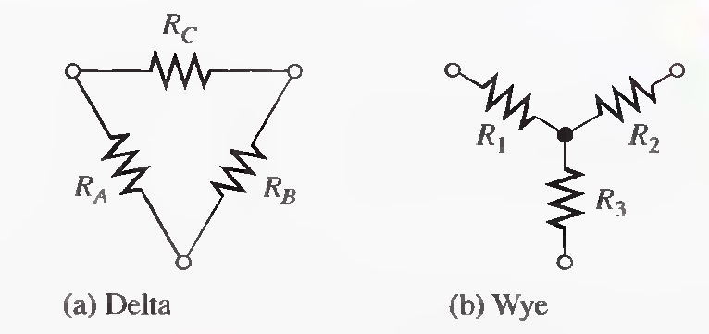
DELTA-TO-WYE (∆-TO-Y) AND WYE-TO-DELTA (Y-TO-∆) CONVERSIONS
Conversions between delta-type and wye-type circuit arrangements are useful in certain specialized three-terminal applications.

Slide 34
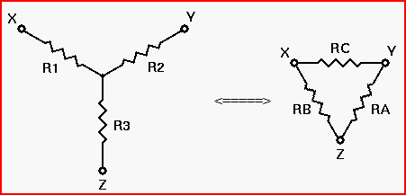
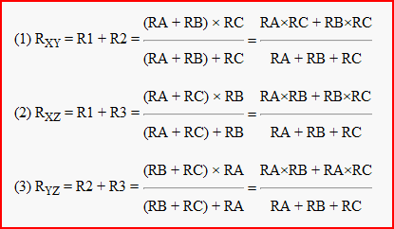
Deriving the Initial Equations

Slide 35
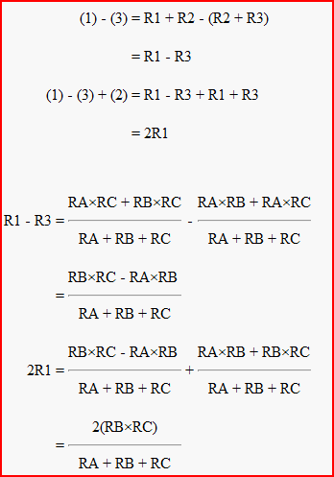
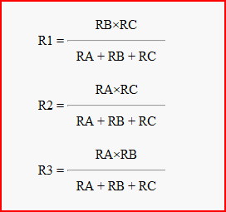
Solving For R1, R2, and R3

Slide 36
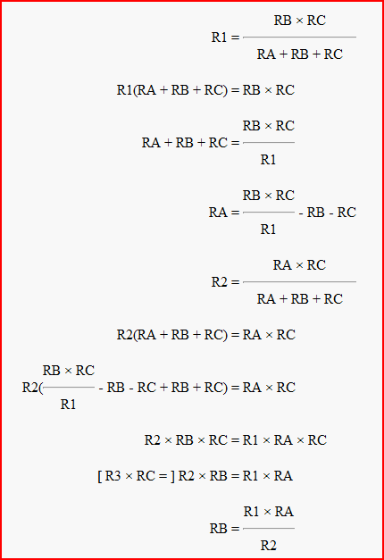

Solving for RA, RB, and RC

Slide 37
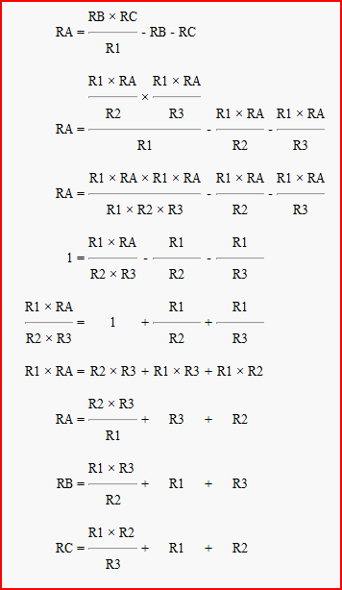
You don't really need to know these derivations, although understanding them will help you with your understanding of electronics in general. However, you should know the conversion formulas themselves, and be able to apply them when designing or analyzing electronic circuits.

Slide 38
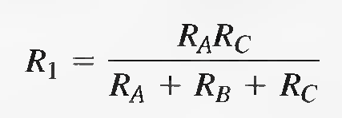
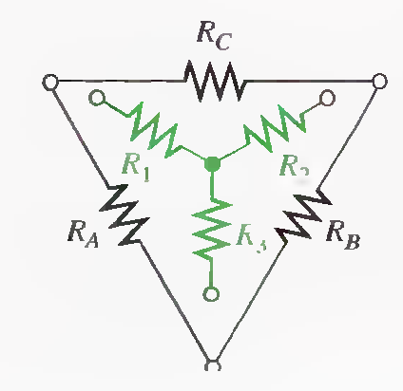
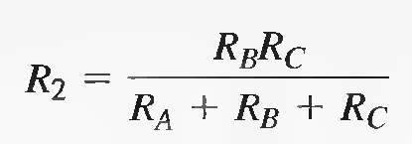
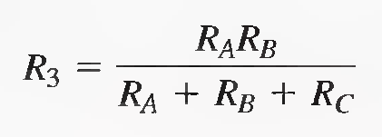
∆-to-Y Conversion
Each resistor in the wye is equal to the product of the resistors in two adjacent delta branches, divided by the sum of all three delta resistors.

Slide 39
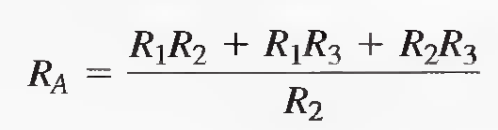
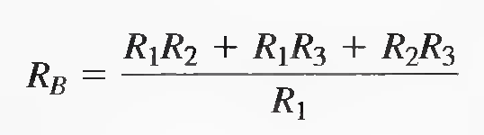
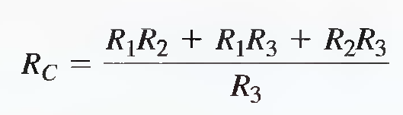
Y-to-∆ Conversion
Each resistor in the delta is equal to the sum of all possible products of wye resistors taken two at a time, divided by the opposite wye resistor.

Slide 40
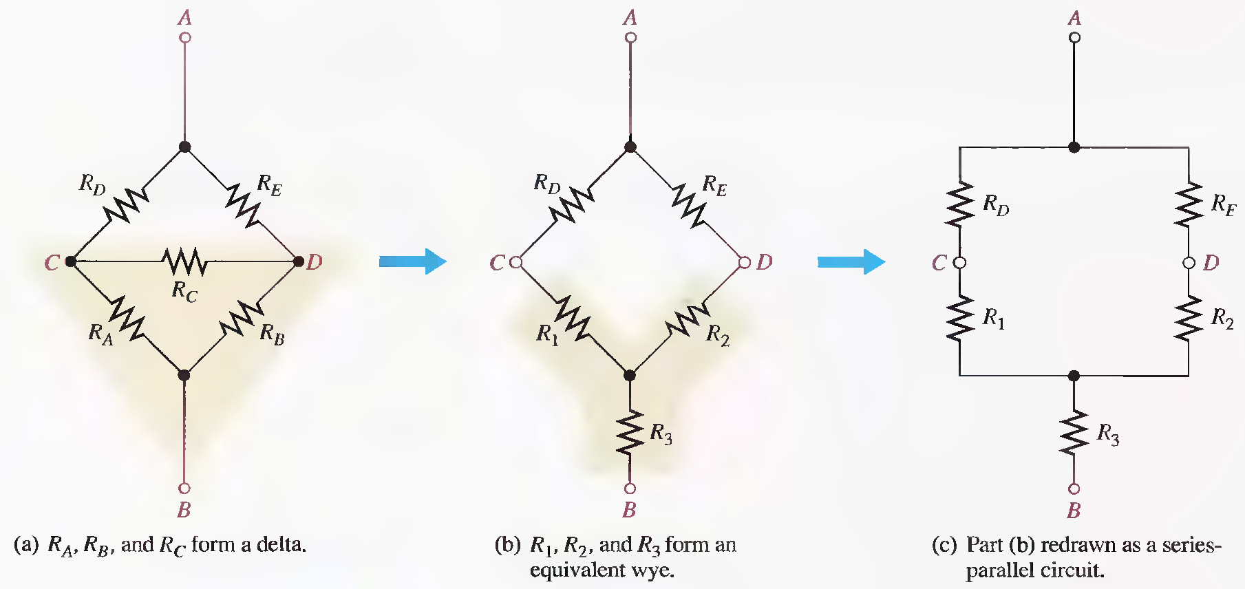
Application of ∆-to-Y Conversion to a Bridge Circuit

Slide 41
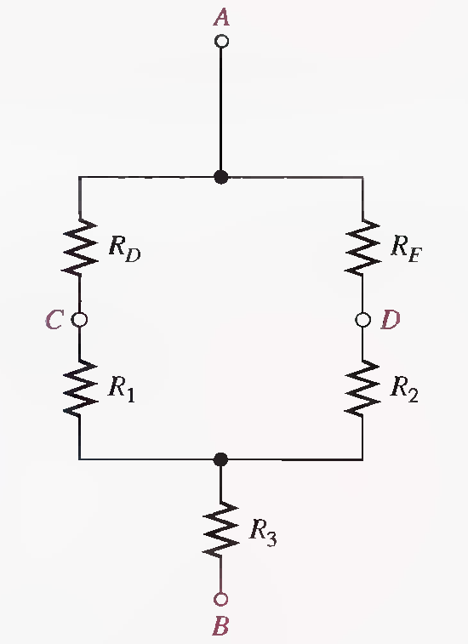

Slide 43
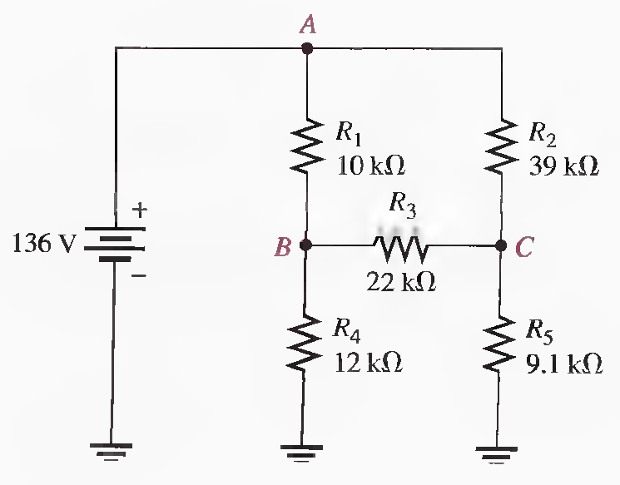
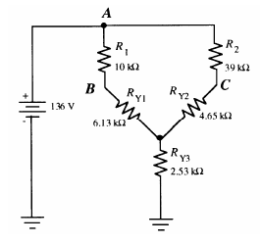
Q.1 Find all currents in the circuit of following Figure.
RT=14.3 kΩ, IT=9.5 mA, IR1 = IRY1=6.94 mA, IR2 = IRY2 = 2.56 mA, VB = VA − IR1.R1 =66.6 V,
VC=36.16 V, IR4 =5.55 mA, IR5 =3.97 mA, IR3=1.38 mA

Slide 44
RT=14.3 kΩ, IT=9.5 mA, IR1 = IRY1=6.94 mA, IR2 = IRY2 = 2.56 mA, VB=66.6 V, VC=36.16 V
IR4 =5.55 mA, IR5 =3.97 mA, IR3=1.38 mA

Slide 45
RT=14.3 kΩ, IT=9.5 mA, IR1 = IRY1=6.94 mA, IR2 = IRY2 = 2.56 mA, VB=66.6 V, VC=36.16 V
IR4 =5.55 mA, IR5 =3.97 mA, IR3=1.38 mA End

