Slide 1
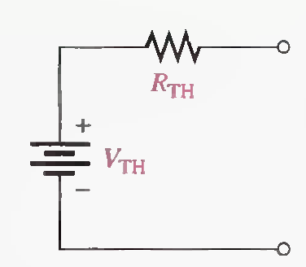
THEVENIN'S THEOREM
Lecture 18
Thevenin's theorem provides a method for simplifying a circuit to a standard equivalent form. This theorem can be used to simplify the analysis of complex circuits.
The general form of a Thevenin equivalent circuit .
The Thevenin equivalent voltage (VTH) is the open circuit (no-load) voltage between two output terminals in a circuit.
The Thevenin equivalent resistance (RTH) is the total resistance appearing between two terminals in a given circuit with all sources replaced by their internal resistances.

Slide 2
THEVENIN'S THEOREM
A summary of steps for applying Thevenin's theorem is as follows:
Step 1.Open the two terminals (remove any load) between which you want to find the Thevenin equivalent circuit.
Step 2. Determine the voltage (VTH) across the two open terminals.
Step 3.Determine the resistance (RTH) between the two open terminals with all sources replaced with their internal resistances (ideal voltage sources shorted and ideal current sources opened).

Slide 3
THEVENIN'S THEOREM
Step 4. Connect VTH and RTH in series to produce the complete Thevenin equivalent for the original circuit.
Step 5. Replace the load removed in Step 1 across the terminals of the Thevenin equivalent circuit.
You can now calculate the load current and load voltage using
only Ohm's law. They have the same value as the load current and load voltage in the original circuit.

Slide 4
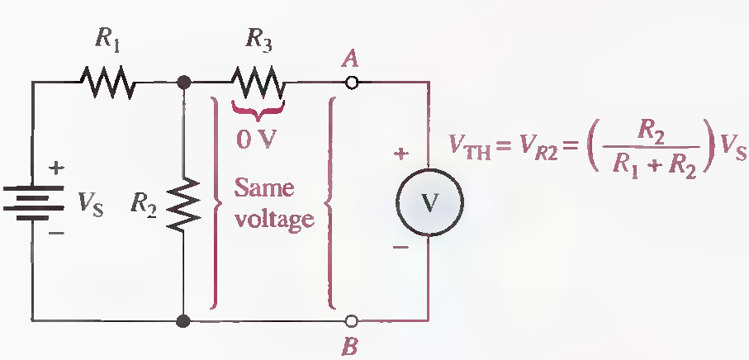
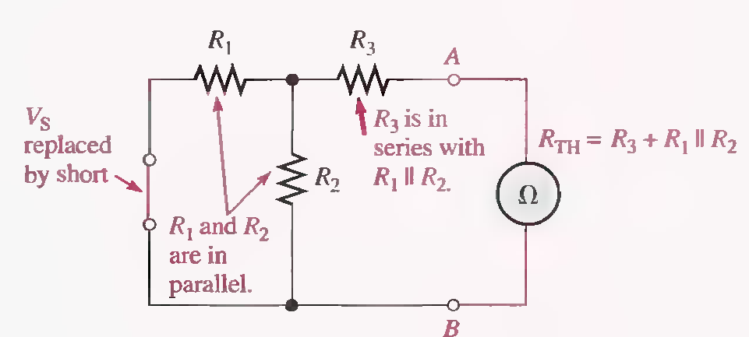
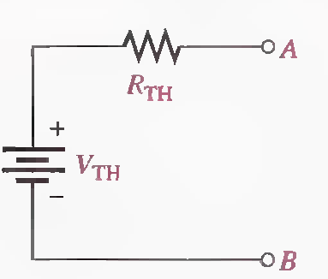
How to find the Thevenin equivalent of any circuit?

Slide 5
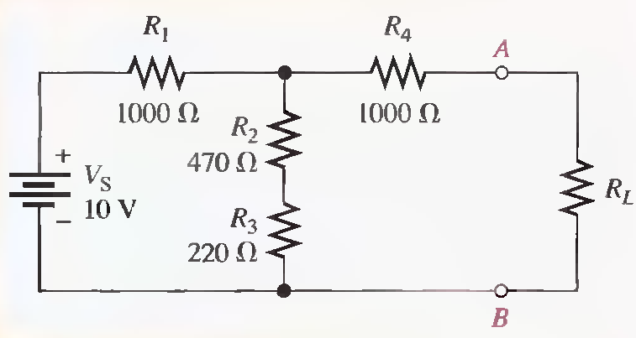
Q.1 Find the Thevenin equivalent circuit between A and B of the following circuit.
VTH=4.08 V, RTH=1410Ω

Slide 6
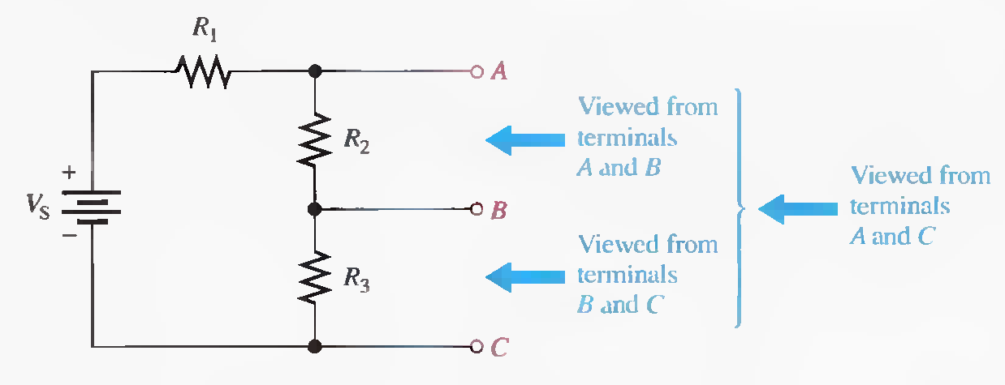
Thevenin Equivalency Depends on the Viewpoint
The Thevenin equivalent for any circuit depends on the location of the two output terminals from which the circuit is "viewed."

Slide 7
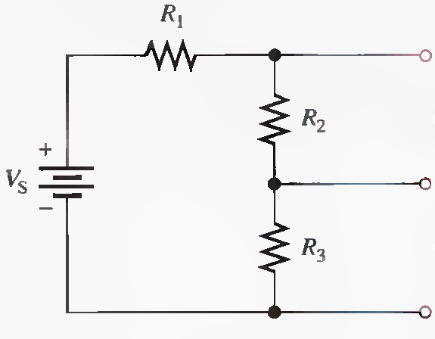

Slide 10
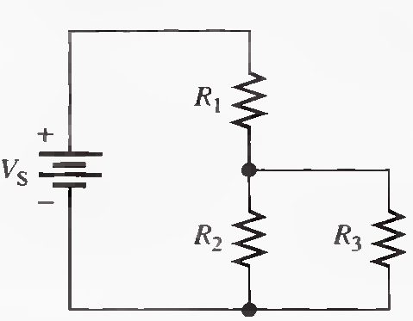
Thevenizing a Portion of a Circuit
In many cases, it helps to thevenize only a portion of a circuit. For example, when you need to know the equivalent circuit as viewed by one particular resistor in the circuit, you can remove the resistor and apply Thevenin's theorem to the remaining part of the circuit as viewed from the points between which that resistor was connected.

Slide 11
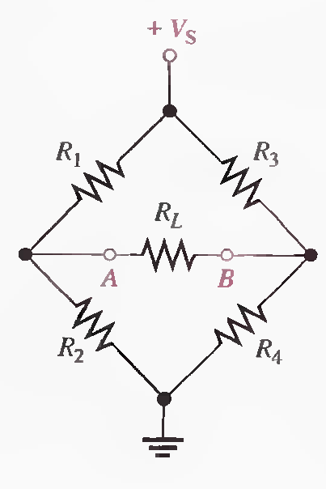
Thevenizing a Bridge Circuit
(Solved on 3 slides)

Slide 14
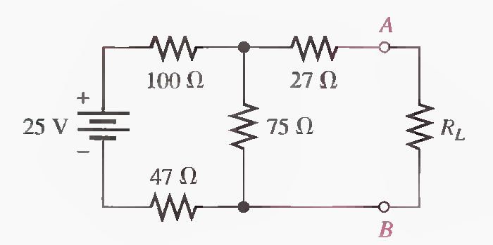
Q.2 Determine the Thevenin equivalent as seen from terminals A and B.
RTH=76.7 Ω, VTH=8.45 V

Slide 15
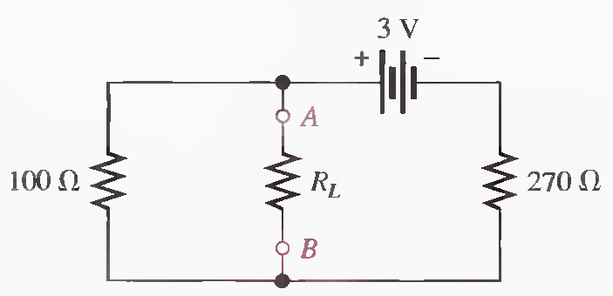
Q.3 Determine the Thevenin equivalent as seen from terminals A and B.
RTH=73 Ω, VTH=811 mV

Slide 16
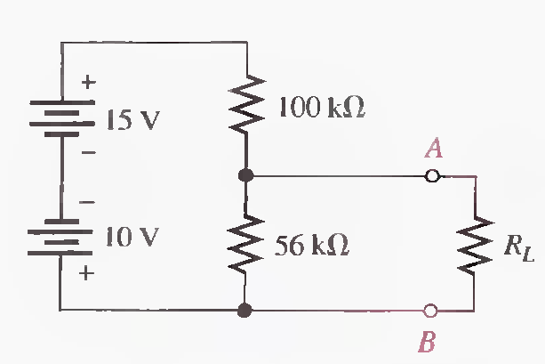
Q.4 Determine the Thevenin equivalent as seen from terminals A and B.
RTH=35.9 kΩ, VTH=1.79 V

Slide 17
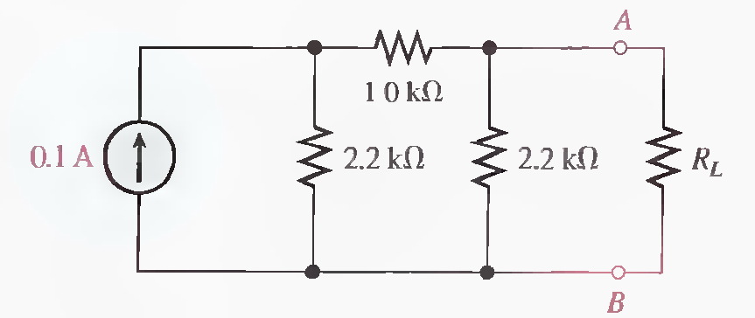
Q.5 Determine the Thevenin equivalent as seen from terminals A and B. (Solved on 2 slides)
VS= 220V, RTH=1.3 kΩ, VTH=89.6 V

Slide 18
VS= 220V, RTH=1.3 kΩ, VTH=89.6 V

Slide 19
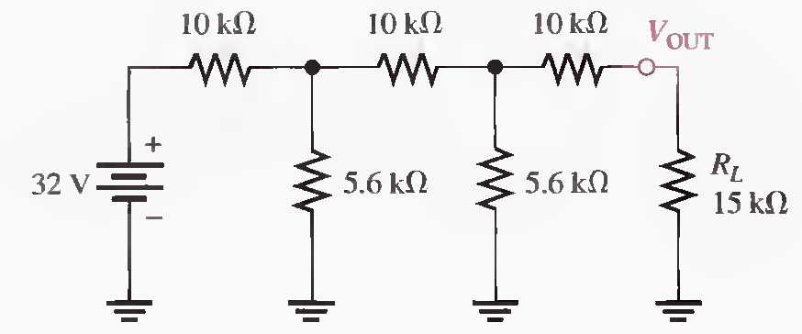
Q.6 Using Thevenin's theorem, determine the current through the load RL. (Solved on 2 slides)
A
RTH = 13.97 kΩ, RA=4.12 kΩ, VA= 9.34 V, VTH=3.35 V, IL= 116 μA

Slide 20
RTH = 13.97 kΩ, RA=4.12 kΩ, VA= 9.34 V, VTH=3.35 V, IL= 116 μA

