Slide 1
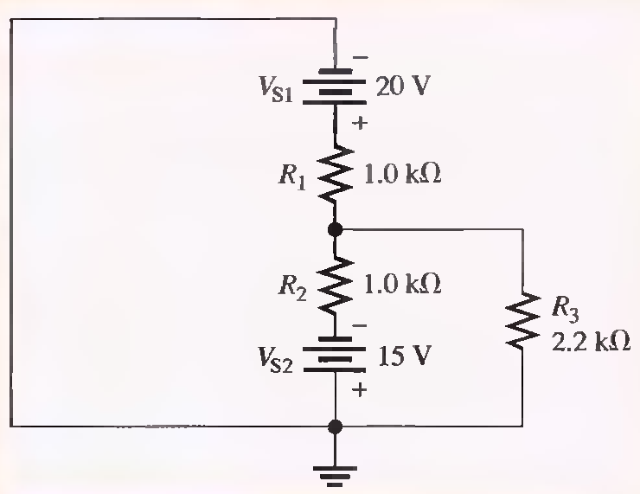
Problems Solving-Superposition Theorem
Lecture 17
Q.1 Find the total Current through R3
RT(SI)=1.69KΩ, IT(S1)=11.8mA, I3(S1)= 3.69mA RT(S2)=1.69KΩ, IT(S2)=8.88mA, I3(S2)=2.78mA.
I3(tot)=910µA

Slide 2
RT(SI)=1.69KΩ, IT(S1)=11.8mA, I3(S1)= 3.69mA RT(S2)=1.69KΩ, IT(S2)=8.88mA, I3(S2)=2.78mA.
I3(tot)=910µA

Slide 3
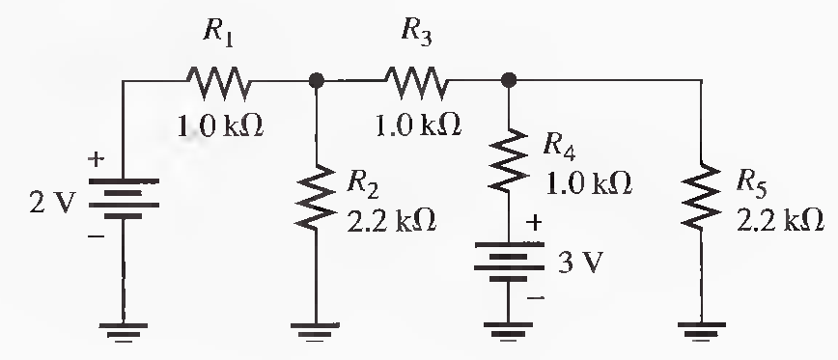
Q.2 Using the superposition method, calculate the current through R 5. (Solved on 2 slides)
RT(2V) = 1.955 kΩ, IT=1.02 mA, I3= 577 μA, I5= 180 μA , RT(3V) = 1.955 kΩ, IT= 1.53 mA,
I5= 655 μA, I5(total) = 180 μA + 665 μA = 845 μA

Slide 4
RT(2V) = 1.955 kΩ, IT=1.02 mA, I3= 577 μA, I5= 180 μA , RT(3V) = 1.955 kΩ, IT= 1.53 mA,
I5= 655 μA, I5(total) = 180 μA + 665 μA = 845 μA

Slide 5
Q.3 Use the superposition theorem to find the current in and the voltage across the R2 branch of the circuit. (Solved on 2 slides)
RT(2V) = 1.955 kΩ, IT=1.02 mA,I2= 443 μA, RT(3V) = 1.955 kΩ, IT= 1.53 mA, I3= 865 μA,
I2= 270 μA, I2 = 443 μA + 270 μA = 713 μA

Slide 6
RT(2V) = 1.955 kΩ, IT=1.02 mA,I2= 443 μA, RT(3V) = 1.955 kΩ, IT= 1.53 mA, I3= 865 μA,
I2= 270 μA, I2 = 443 μA + 270 μA = 713 μA

Slide 7
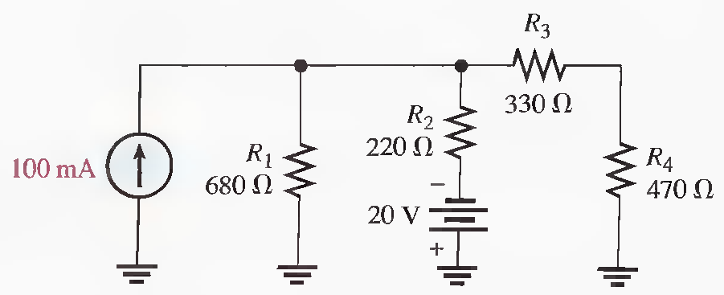
Q.4 Using the superposition theorem, solve for the current through R3. (Solved on 2 slides)
For Is: RT=137.6Ω, I3=17.2 mA For Vs:RT = 587.6 Ω, IT=34.0 mA, I3= 15.6 mA, I3(total) =1.6 mA

Slide 8
For Is: RT=137.6Ω, I3=17.2 mA For Vs:RT = 587.6 Ω, IT=34.0 mA, I3= 15.6 mA, I3(total) =1.6 mA

Slide 9
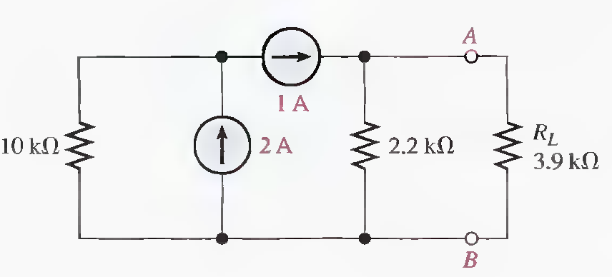
Q.5 Using the superposition theorem, find the load current.
IL = 361 mA, I(tot)=362mA

Slide 10
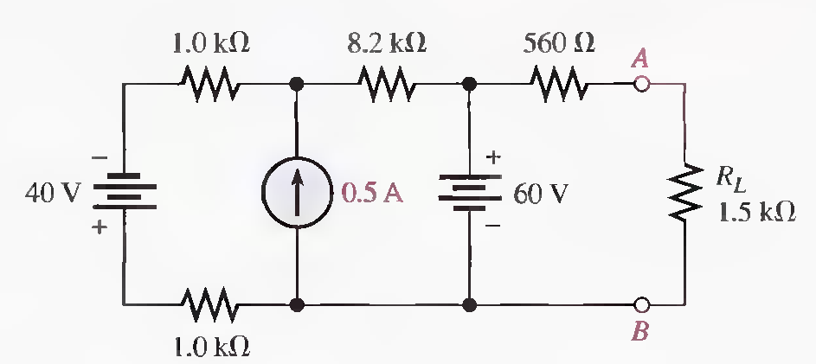
Q.6 Using the superposition theorem, find the load current. (Solved on 2 slides)
For 40V: IL = 0 A, For .5A: IL=0A, For 60V: VL=43.7V, IL=29.1 mA, IL(tot) = 29.1 mA

Slide 11
For 40V: IL = 0 A, For .5A: IL=0A, For 60V: VL=43.7V, IL=29.1 mA, IL(tot) = 29.1 mA

Slide 12
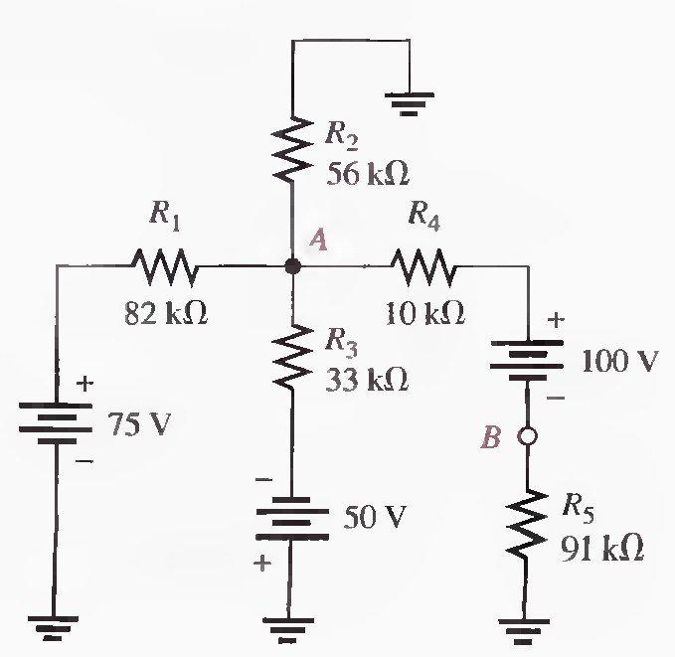
Q.7 Determine the voltage from point A to point B in the following Figure. (Solved on 3 slides)
For 75 V: R2345= 17.2 kΩ, VA=13V, VB=11.7V For 50V: R1245= 25 kΩ, VA=−21.6 V, VB=−19.5V
For 100V: R123=16.6kΩ, RT=117.6kΩ, IT=850μA, VA=14.1 V, VB=−77.4 V ,VA= 5.5 V, VB =−85.2 V, VAB = 90.7 V

Slide 13
For 75 V: R2345= 17.2 kΩ, VA=13V, VB=11.7V For 50V: R1245= 25 kΩ, VA=−21.6 V, VB=−19.5V
For 100V: R123=16.6kΩ, RT=117.6kΩ, IT=850μA, VA=14.1 V, VB=−77.4 V ,VA= 5.5 V, VB =−85.2 V, VAB = 90.7 V

Slide 14
For 75 V: R2345= 17.2 kΩ, VA=13V, VB=11.7V For 50V: R1245= 25 kΩ, VA=−21.6 V, VB=−19.5V
For 100V: R123=16.6kΩ, RT=117.6kΩ, IT=850μA, VA=14.1 V, VB=−77.4 V ,VA= 5.5 V, VB =−85.2 V, VAB = 90.7 V

Slide 15
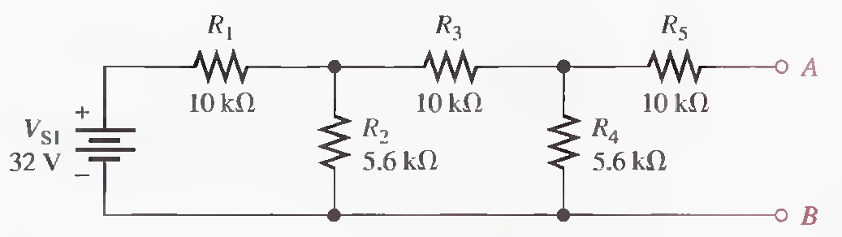
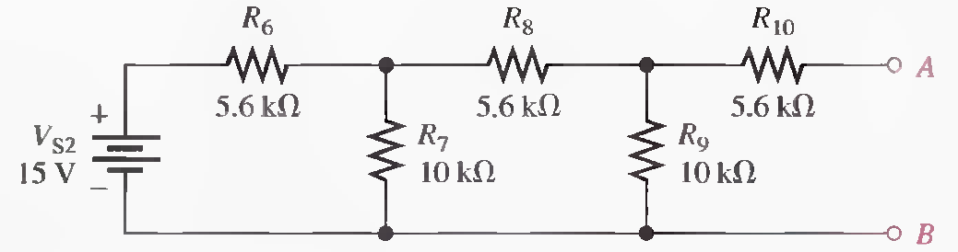
Q.8 In the following figure two ladder networks are shown. Determine the current provided by each of the batteries when terminals A are connected (A to A) and terminals B are connected (B to B). (Solved on 2 slides)
For Vs1: RT=14.0 kΩ, IT=2.28mA For Vs2: RT= 11.1 kΩ, IT= 1.35 mA

Slide 16
For Vs1: RT=14.0 kΩ, IT=2.28mA For Vs2: RT= 11.1 kΩ, IT= 1.35 mA

