Slide 1
Previous Lectures 13 ,14 & 15
Problem Solving-Series Parallel Circuits
Identifying Series-Parallel Relationships
Analysis of Series-Parallel Resistive Circuits
Voltage Dividers with Resistive loads
Ladder Networks

Slide 2
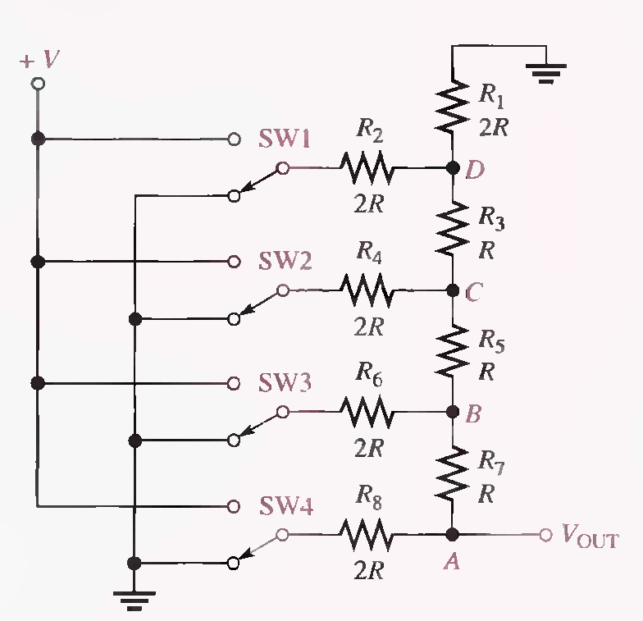
Analysis of R/2R Ladder network with SW1 is connected to a positive voltage (V) while others are connected to ground (0 V). (Solved on 3 slides)
Lecture 16
Problem Solving - Series Parallel Circuits

Slide 5
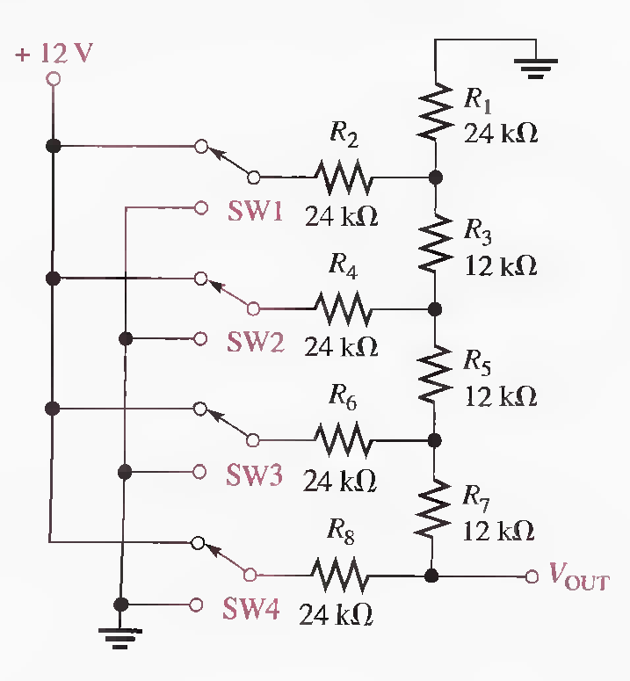
Q.27 Determine V_{OUT} for the R/2R ladder network in the following Figure for the following conditions:
(a) SW3 and SW4 to + 12 V, SWI and SW2 to ground
(b) SW3 and SWI to + 12 V, SW2 and SW4 to ground
(c) All switches to + 12 V
9 V, 3.75 V, 11.25 V End

Slide 6
Summary (11-15 Lectures)
A series-parallel circuit is a combination of both series and parallel current paths.
To determine total resistance in a series-parallel circuit, identify the series and parallel relationships, and then apply the formulas for series resistance and parallel resistance.
To find the total current, apply Ohm's law and divide the total voltage by the total resistance.
To determine branch currents, apply the current-divider formula, Kirchhoff's current law, or Ohm's law. Consider each circuit problem individually to determine the most appropriate method.

Slide 7
Summary
To determine voltage drops across any portion of a series-parallel circuit, use the voltage-divider formula, Kirchhoff's voltage law, or Ohm's law. Consider each circuit problem individually to determine the most appropriate method.
When a load resistor is connected across a voltage-divider output, the output voltage decreases.
The load resistor should be large compared to the resistance across which it is connected, in order that the loading effect may be minimized.
To find total resistance of a ladder network, start at the point farthest from the source and reduce the resistance in steps.

Slide 8
Summary
Opens and shorts are typical circuit faults.
Resistors normally open when they burn out.
Bleeder current: The current left after the total load current is subtracted from the total current into the circuit.

Slide 9
CIRCUIT THEOREMS AND CONVERSIONS
Till now, we have analyzed various types of circuits using Ohm's law and Kirchhoff's laws. Some types of circuits are difficult to analyze using only those basic laws and require additional methods in order to simplify the analysis.
The theorems and conversions in this lecture make analysis easier for certain types of circuits. These methods do not replace Ohm's law and Kirchhoff's laws, but they are normally used in conjunction with the laws in certain situations.

Slide 10
CIRCUIT THEOREMS AND CONVERSIONS
The DC Voltage Source
The Current Source
Source Conversions
The Superposition Theorem

Slide 11
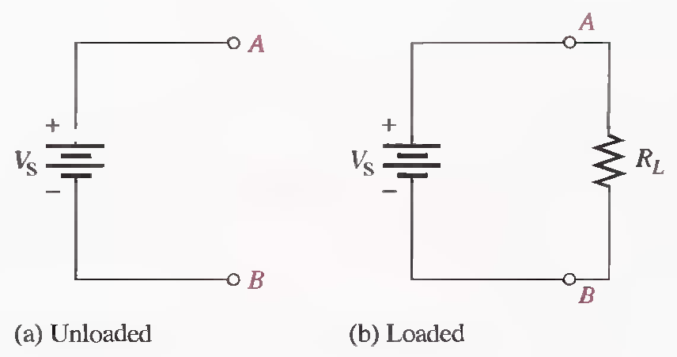
THE DC VOLTAGE SOURCE
The DC voltage source is one of the principal types of energy source in electronic applications, so it is important to understand its characteristics. The dc voltage source ideally provides constant voltage to a load even when the load resistance varies. The ideal voltage source has an internal resistance of zero. Rs=0Ω
Ideal dc voltage source.

Slide 12
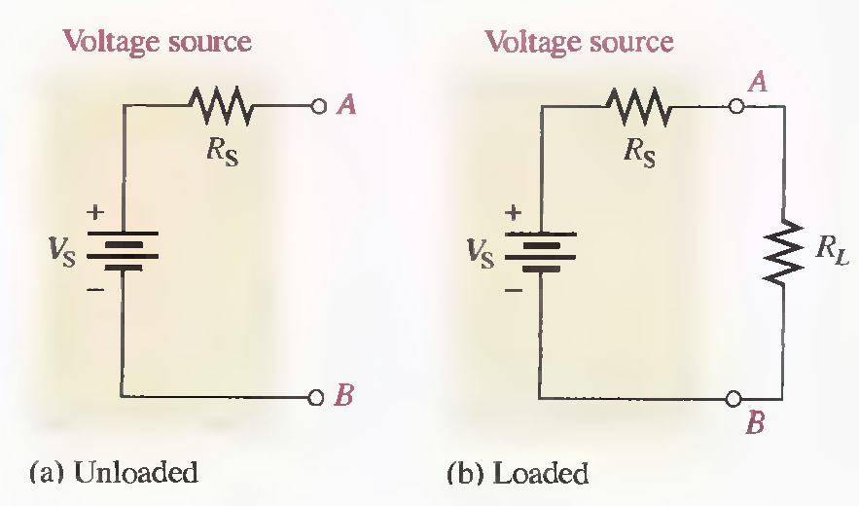
THE DC VOLTAGE SOURCE
All voltage sources have some inherent internal resistance as a result of their physical and/or chemical makeup, which can be represented by a resistor in series with an ideal source,
Practical voltage source.

Slide 13
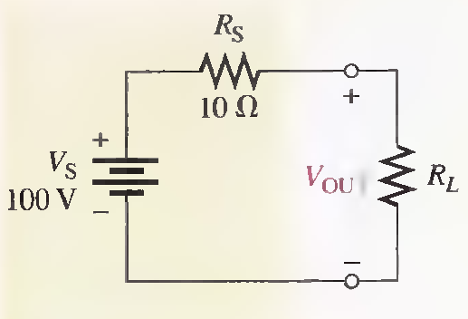
Example
Calculate the voltage output of the source in the following Figure for the following values of R L : 100Ω, 560Ω, and 1KΩ.
90.9 V, 98.2 V , 99.0 V

Slide 14
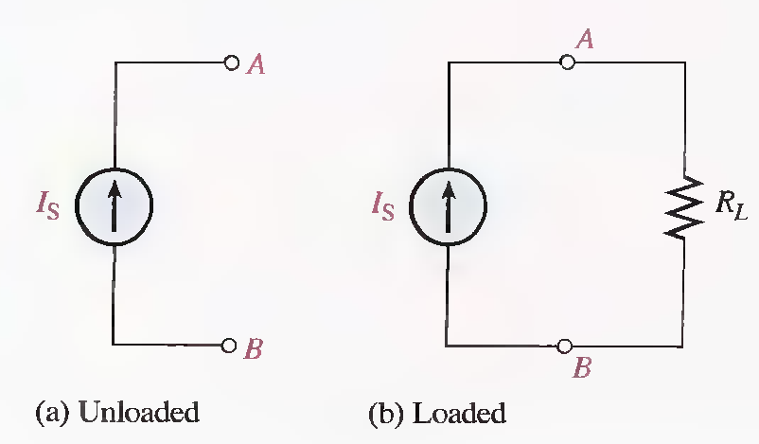
THE CURRENT SOURCE
The current source is another type of energy source that ideally provides a constant current to a load even when the resistance of the load varies. The ideal current source has an infinitely large internal parallel resistance.
Ideal current source.

Slide 15
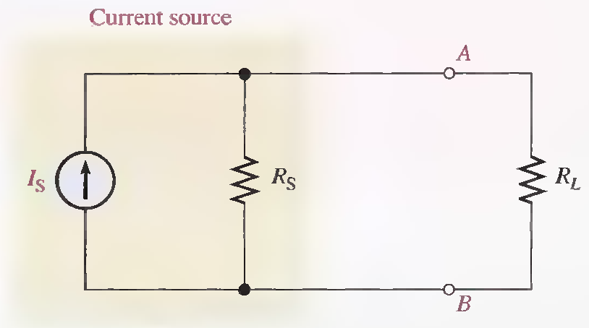
THE CURRENT SOURCE
Practical current source with load.

Slide 16
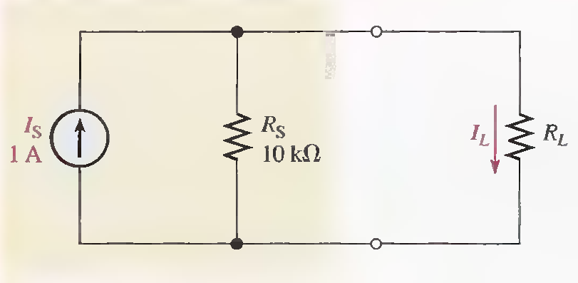
Example
Calculate the load current (IL) in the following Figure for the following values of R L : 100Ω,, 560Ω, and 1KΩ.
990 mA, 947mA , 909 mA

Slide 17
SOURCE CONVERSIONS
In circuit analysis, it is sometimes useful to convert a voltage source to an equivalent current source, or vice versa.
Converting a Voltage Source to a Current Source

Slide 18
SOURCE CONVERSIONS
Terminal equivalency
Equivalency of two sources means that for any given load resistance connected to the two sources, the same load voltage and load current are produced by both sources. This concept is called Terminal equivalency.

Slide 19
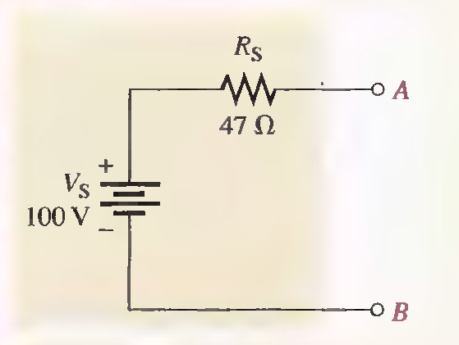
Example
Convert the voltage source in the Figure to an equivalent current source and show the equivalent circuit.
2.I3A

Slide 20
Converting a Current Source to a Voltage Source

Slide 21
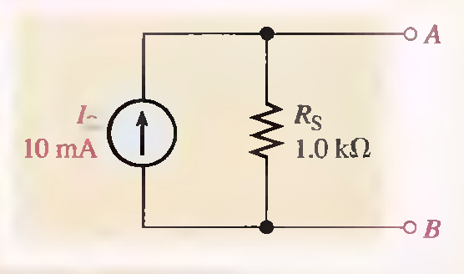
Example
Convert the current source in the Figure to an equivalent voltage source and show the equivalent circuit.
IOV

Slide 22
THE SUPERPOSITION THEOREM
Some circuits require more than one voltage or current source. For example, most amplifiers operate with two voltage sources: an ac and a dc source. Additionally, some amplifiers require both a positive and a negative dc voltage source for proper operation. When multiple sources are used in a circuit, the superposition theorem provides a method for analysis.
The superposition method is a way to determine currents in a circuit with multiple sources by leaving one source at a time and replacing the other sources by their internal resistances.
Recall that an ideal voltage source has a zero internal resistance and an ideal current source has infinite internal resistance. All sources will be treated as ideal in order to simplify the coverage.

Slide 23
THE SUPERPOSITION THEOREM
A general statement of the superposition theorem
‘’The current in any given branch of a multiple-source circuit can be found by determining the currents in that particular branch produced by each source acting alone, with all other sources replaced by their internal resistances. The total current in the branch is the algebraic sum of the individual currents in that branch.’’

Slide 24
THE SUPERPOSITION THEOREM
The steps in applying the superposition method are as follows:
Step 1. Leave one voltage (or current) source at a time in the circuit and replace each of the other voltage (or current) sources with its internal resistance. For ideal sources a short represents zero internal resistance and an open represents infinite internal resistance.
Step 2. Determine the particular current (or voltage) that you want just as if there were only one source in the circuit.
Step 3. Take the next source in the circuit and repeat Steps 1 and 2. Do this for each source.

Slide 25
THE SUPERPOSITION THEOREM
Step 4. To find the actual current in a given branch, algebraically sum the currents due to each individual source. (If the currents are in the same direction, they are added. If the currents are in opposite directions, they are subtracted with the direction of the resulting current the same as the larger of the original quantities.) Once you find the current, you can determine the voltage using Ohm's law

Slide 26
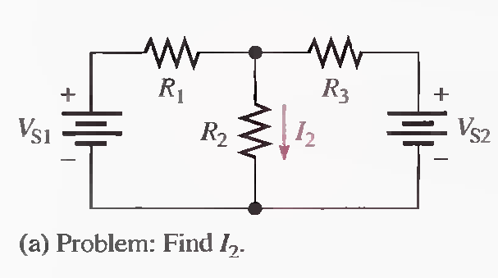
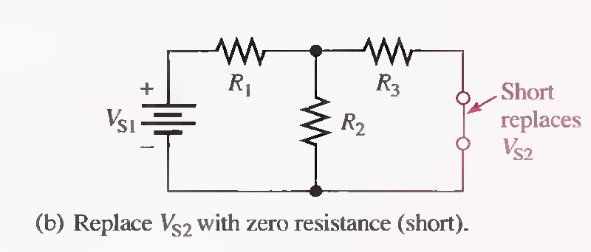
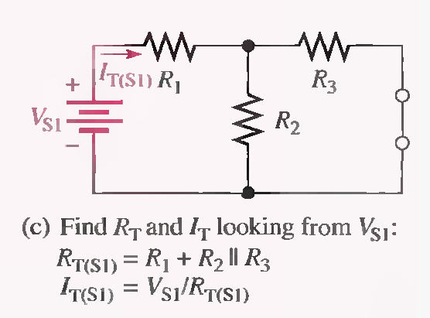
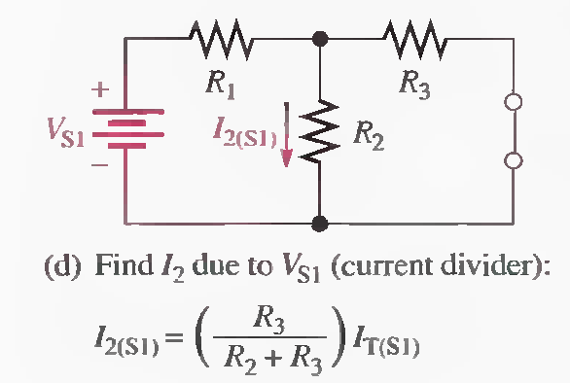
The approach to superposition is demonstrated in the following Figure for a series-parallel circuit with two ideal voltage sources.

Slide 27
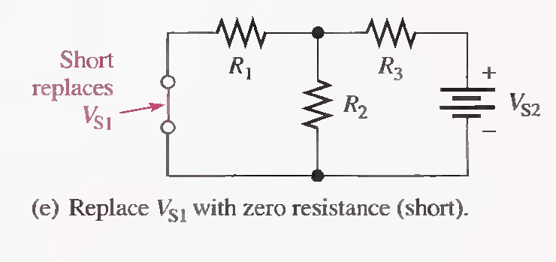
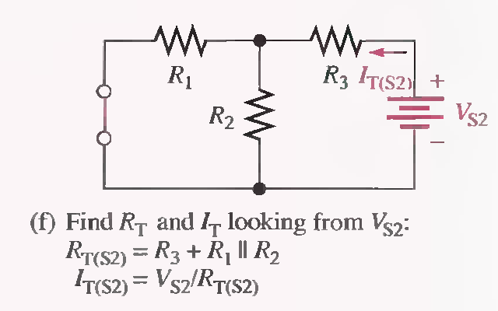
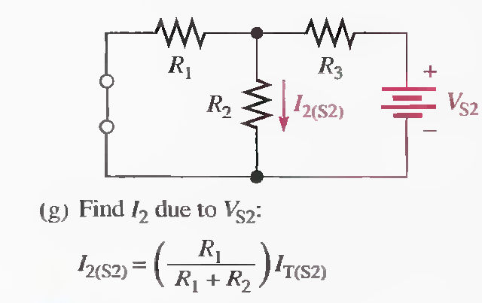
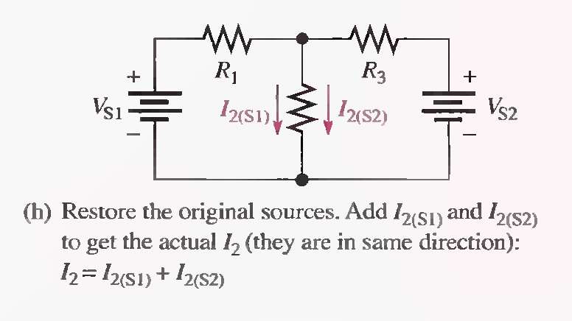

Slide 28
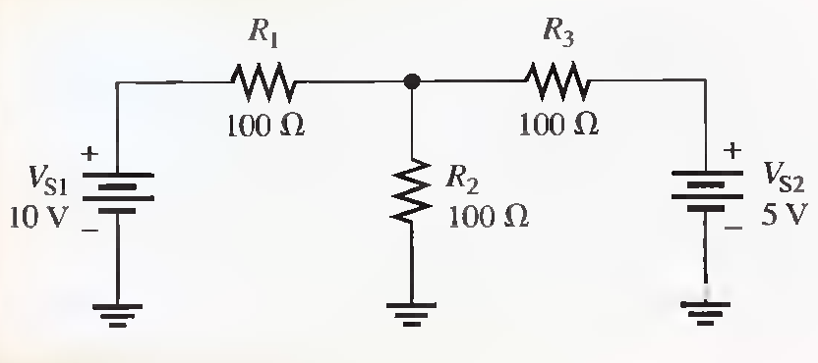
Example
Use the superposition theorem to find the current through R2.(Solved on 2 slides)
RT (S1)=150Ω, IT(S1)=66.7mA, I2(S1) =33.3 mA RT (S2)=150Ω, IT(S2)=33.3mA, I2(S2) =16.7 mA
I2(tot)=50mA

Slide 29
RT (S1)=150Ω, IT(S1)=66.7mA, I2(S1) =33.3 mA RT (S2)=150Ω, IT(S2)=33.3mA, I2(S2) =16.7 mA
I2(tot)=50mA

Slide 30
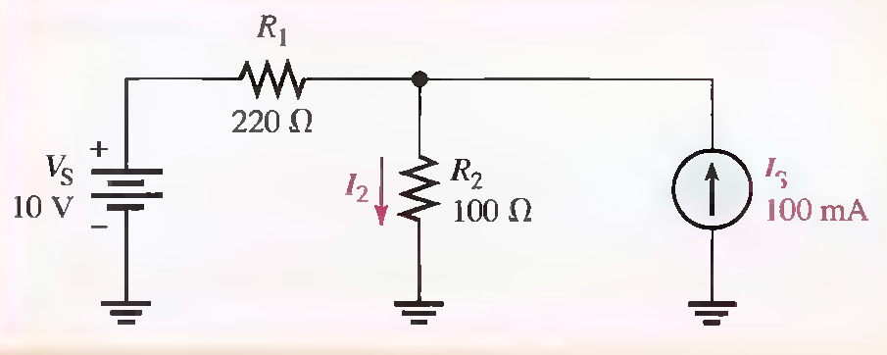
Example
Find the current through R2 in the circuit.
R T = 320Ω, I2(Vs)=31.2mA, I2(Is)=68.8mA, I2(tot)=100mA

Slide 31
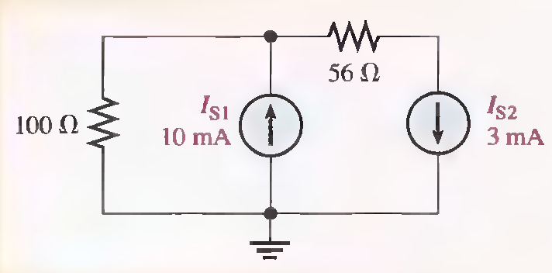
Example
Find the Current through the 100 Ω resistor in the given circuit.
7mA

Slide 32
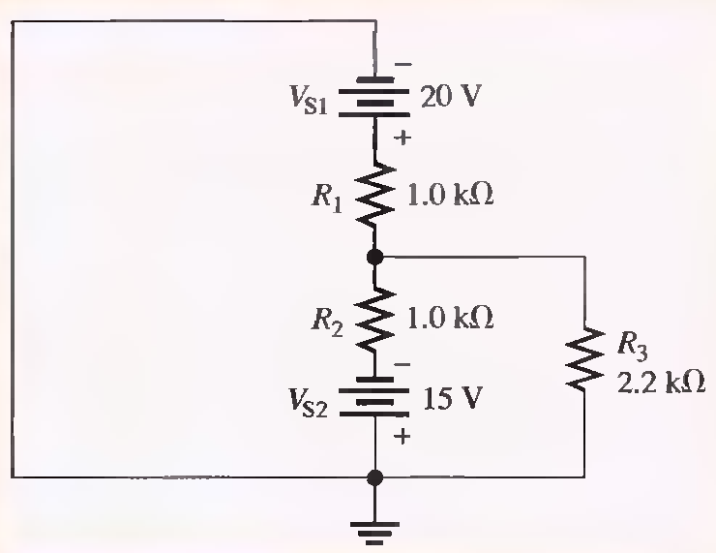
Example
Find the total Current through R3.
RT(SI)=1.69KΩ, IT(S1)=11.8mA, I3(S1)= 3.69mA RT(S2)=1.69KΩ, IT(S2)=8.88mA, I3(S2)=2.78mA.
I3(tot)=910µA

Slide 33
RT(SI)=1.69KΩ, IT(S1)=11.8mA, I3(S1)= 3.69mA RT(S2)=1.69KΩ, IT(S2)=8.88mA, I3(S2)=2.78mA.
I3(tot)=910µA

Slide 34
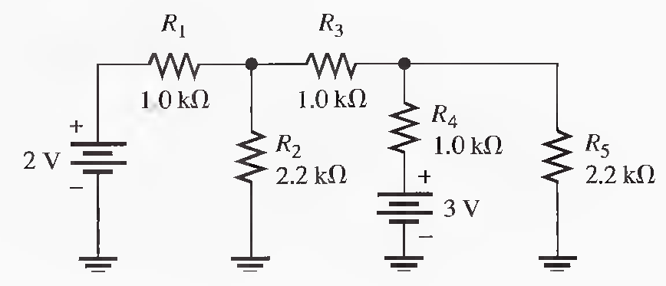
Using the superposition method, calculate the current through R 5. (Solved on 2 slides)
RT(2V) = 1.955 kΩ, IT=1.02 mA, I3= 577 μA, I5= 180 μA , RT(3V) = 1.955 kΩ, IT= 1.53 mA,
I5= 655 μA, I5(total) = 180 μA + 665 μA = 845 μA

Slide 35
RT(2V) = 1.955 kΩ, IT=1.02 mA, I3= 577 μA, I5= 180 μA , RT(3V) = 1.955 kΩ, IT= 1.53 mA,
I5= 655 μA, I5(total) = 180 μA + 665 μA = 845 μA

Slide 36
Use the superposition theorem to find the current in and the voltage across the R2 branch of the circuit.
RT(2V) = 1.955 kΩ, IT=1.02 mA,I2= 443 μA, RT(3V) = 1.955 kΩ, IT= 1.53 mA, I3= 865 μA,
I2= 270 μA, I2 = 443 μA + 270 μA = 713 μA

Slide 37
RT(2V) = 1.955 kΩ, IT=1.02 mA,I2= 443 μA, RT(3V) = 1.955 kΩ, IT= 1.53 mA, I3= 865 μA,
I2= 270 μA, I2 = 443 μA + 270 μA = 713 μA

