Slide 1
Previous Lectures 13 & 14
Problem Solving-Series Parallel Circuits
Identifying Series-Parallel Relationships
Analysis of Series-Parallel Resistive Circuits
Voltage Dividers with Resistive loads
Ladder Networks

Slide 2
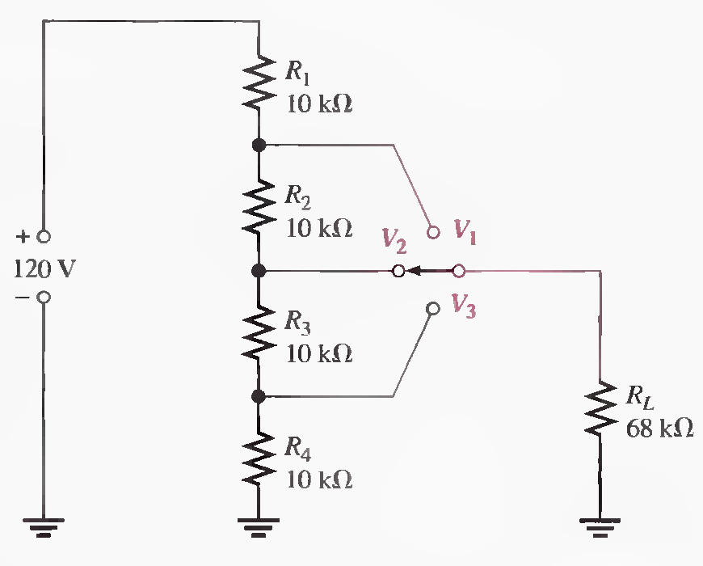
Problem Solving_Series Parallel Circuits
Lecture 15
Q.21 The voltage divider in the following Figure has a switched load. Determine the voltage at each tap (V1, V2 , and V3 ) for each position of the switch. (Solved on 3 slides)
Position 1: RT=30.8 kΩ, V1 = 81.0 V, V2 = 54.0 V, V3 = 27.0V

Slide 3
Position 2 :RT=35.5 kΩ, R34//RL=15.5K Ω , V1=86.2V, V2=52.4 V, V3=26.2V

Slide 4
Position 3:RT=38.7 kΩ, V1=89V, V2=58 V, V3=27V

Slide 5
Q.22 Design a voltage divider to provide a 6V output with no load and a minimum of 5.5 V across a 1.0 kΩ load. The source voltage is 24 V, and the unloaded current drain is not to exceed 100 mA.
RT=240 Ω, R2=60 Ω, R1= 180 Ω, R2 || RL = 56.6 Ω, VOUT = 5.74 V

Slide 6
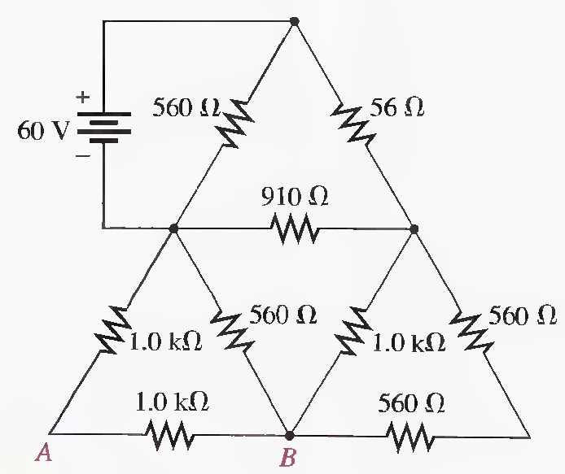
Problems related to Ladder Networks
Q.23 For the circuit shown in the following Figure, calculate the following:
(a) Total resistance across the source (b) Total current from the source
(c) Current through the 910Ω resistor (d) Voltage from A to point B
(Solved on 3 slides)
RT = 271 Ω, IT=221 mA, I2= 114 mA, I₉₁₀ = 58.7 mA, I4 = = 55 mA , V437.5 Ω = 24.06 V,VAB = 12 V

Slide 7
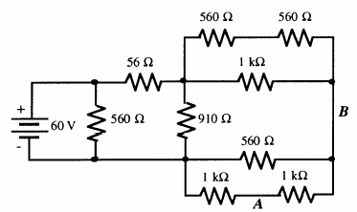
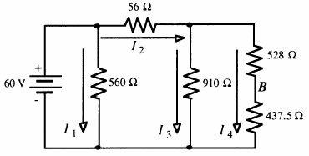
RT = 271 Ω, IT=221 mA, I2= 114 mA, I₉₁₀ = 58.7 mA, I4 = = 55 mA , V437.5 Ω = 24.06 V,VAB = 12 V

Slide 8
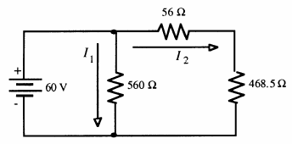
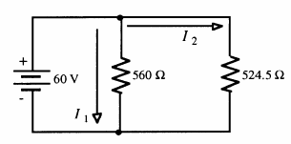
RT = 271 Ω, IT=221 mA, I2= 114 mA, I₉₁₀ = 58.7 mA, I4 = = 55 mA , V437.5 Ω = 24.06 V,VAB = 12 V

Slide 9
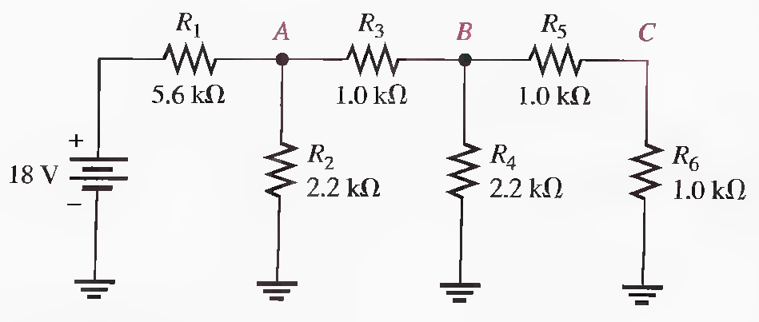
Q.24 Determine the total resistance and the voltage at nodes A, B, and C in the ladder network of the following Figure. (Solved on 2 slides)
RT = 6.66 kΩ, RC= 1 kΩ, RB= 1.05 kΩ, RA= 1.06 kΩ, VA = 2.86 V, VB = 1.47 V,VC = 35 mV

Slide 10
RT = 6.66 kΩ, RC= 1 kΩ, RB= 1.05 kΩ, RA= 1.06 kΩ, VA = 2.86 V, VB = 1.47 V,VC = 35 mV

Slide 11
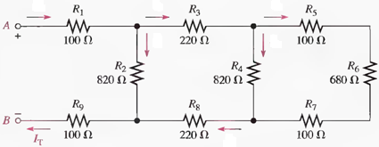
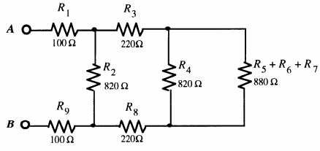
Q.25 Determine the total resistance between terminals A and B of the ladder network in the given Figure. Also calculate the voltage across each resistor and current in each branch with 10 V between A and B. (Solved on 3 slides)
RT = 621 Ω, IT=I9= 16.1 mA, I2= 8.27 mA, I3 = I8 =7.84mA, I4= 4.06 mA, I5 = I6 = I7 = 3.78 mA, V1 =1.61 V,
V2 = 6.78 V, V3 = 1.73 V, V4 = 3.33 V, V5 = 0.378 V, V6 = 2.57 V, V7 =.378 V, V8 = 1.73 V, V9 = 1.61 V

Slide 12
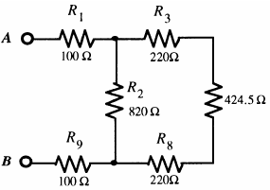
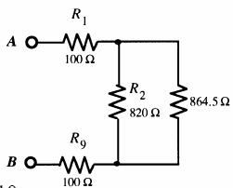
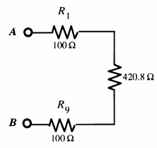
RT = 621 Ω, IT=I1=I9= 16.1 mA, I2= 8.27 mA, I3 = I8 =7.84mA, I4= 4.06 mA, I5 = I6 = I7 = 3.78 mA, V1 =1.61 V,
V2 = 6.78 V, V3 = 1.73 V, V4 = 3.33 V, V5 = 0.378 V, V6 = 2.57 V, V7 =.378 V, V8 = 1.73 V, V9 = 1.61 V

Slide 13
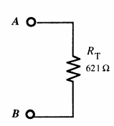
RT = 621 Ω, IT=I9= 16.1 mA, I2= 8.27 mA, I3 = I8 =7.84mA, I4= 4.06 mA, I5 = I6 = I7 = 3.78 mA, V1 =1.61 V,
V2 = 6.78 V, V3 = 1.73 V, V4 = 3.33 V, V5 = 0.378 V, V6 = 2.57 V, V7 =.378 V, V8 = 1.73 V, V9 = 1.61 V

Slide 14
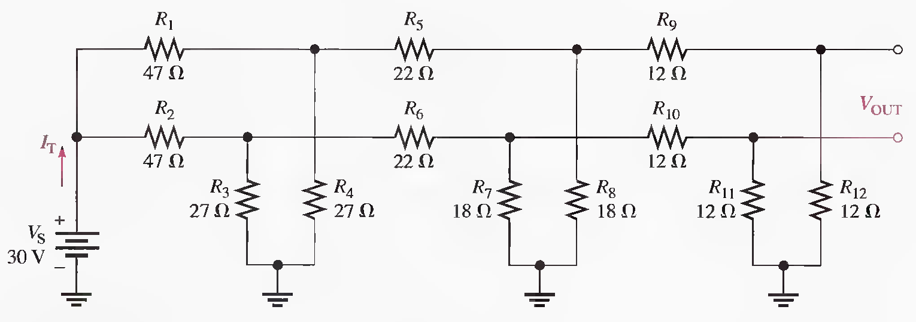
Q.26 Find I_{T} and V_{OUT} in the following Figure.
RT1 = 61.7 Ω, RT(both) = 30.9 Ω, IT = 971 mA, VOUT=0V

Slide 15
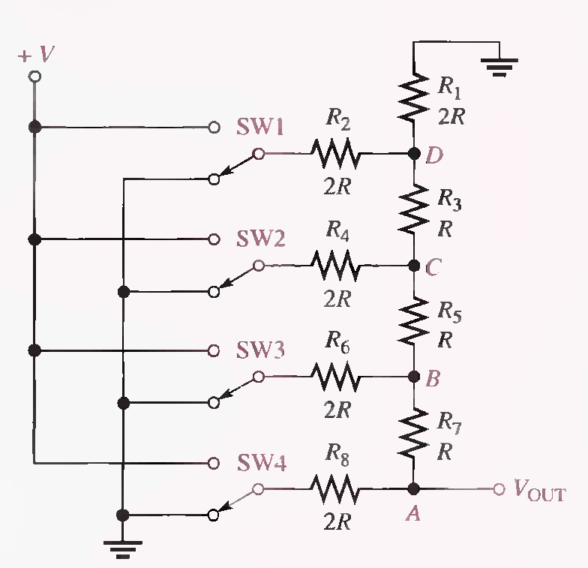
Analysis of R/2R Ladder network with SW1 is connected to a positive voltage (V) while others are connected to ground (0 V). (Solved on 3 slides)

Slide 18
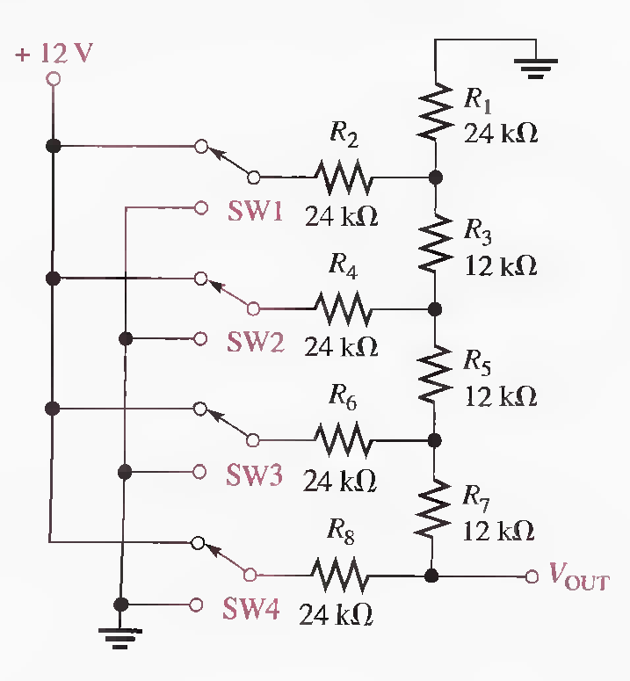
Q.27 Determine V_{OUT} for the R/2R ladder network in the following Figure for the following conditions:
(a) SW3 and SW4 to + 12 V, SWI and SW2 to ground
(b) SW3 and SWI to + 12 V, SW2 and SW4 to ground
(c) All switches to + 12 V
9 V, 3.75 V, 11.25 V End

Slide 19
Summary
A series-parallel circuit is a combination of both series and parallel current paths.
To determine total resistance in a series-parallel circuit, identify the series and parallel relationships, and then apply the formulas for series resistance and parallel resistance.
To find the total current, apply Ohm's law and divide the total voltage by the total resistance.
To determine branch currents, apply the current-divider formula, Kirchhoff's current law, or Ohm's law. Consider each circuit problem individually to determine the most appropriate method.

Slide 20
Summary
To determine voltage drops across any portion of a series-parallel circuit, use the voltage-divider formula, Kirchhoff's voltage law, or Ohm's law. Consider each circuit problem individually to determine the most appropriate method.
When a load resistor is connected across a voltage-divider output, the output voltage decreases.
The load resistor should be large compared to the resistance across which it is connected, in order that the loading effect may be minimized.
To find total resistance of a ladder network, start at the point farthest from the source and reduce the resistance in steps.

Slide 21
Summary
Opens and shorts are typical circuit faults.
Resistors normally open when they burn out.
Bleeder current: The current left after the total load current is subtracted from the total current into the circuit.

