Slide 1
Previous Lecture 13
Identifying Series-Parallel Relationships
Analysis of Series-Parallel Resistive Circuits
Voltage Dividers with Resistive loads
Ladder Networks

Slide 2
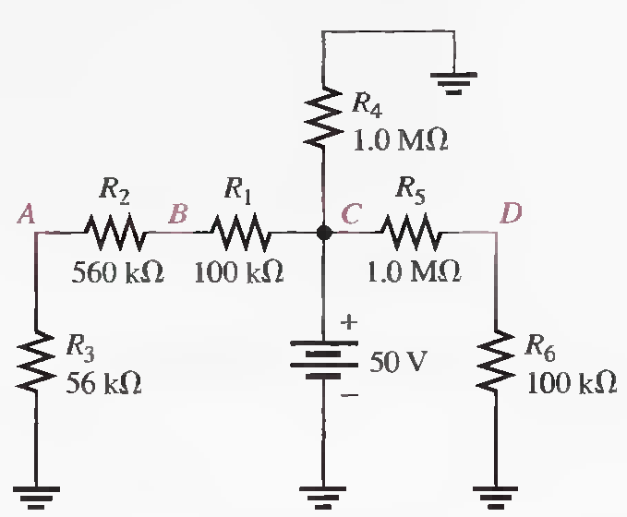
Problem Solving - Series Parallel Circuits
Lecture 14
Q.11 Determine the voltage at each node with respect to ground in the following circuit.
VA = 3.91V, VB=43.0V, VC=50V, VD=4.55V

Slide 3
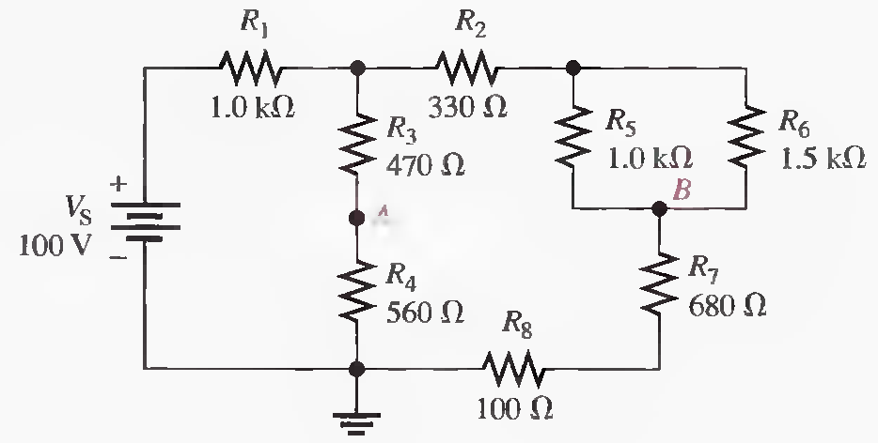
Q.12 Determine the voltage, V AB, in the given circuit (Solved on 2 slides).
Rright= 1710 Ω, Rleft= 1030 Ω, RT = 1.64 kΩ, IT = 60.9 mA, IR = 22.9 mA, IL = 38.0 mA, VA = 21.3 V
VB = 17.9 V, VAB = 3.4 V

Slide 4
Rright= 1710 Ω, Rleft= 1030 Ω, RT = 1.64 kΩ, IT = 60.9 mA, IR = 22.9 mA, IL = 38.0 mA, VA = 21.3 V
VB = 17.9 V, VAB = 3.4 V

Slide 5
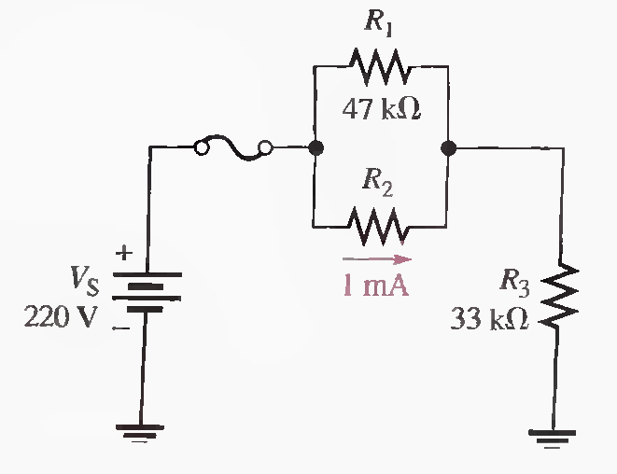
Q.13 Find the value of R2 in the given Figure. Also determine the power in R2 .
R2=110 kΩ, P2=110 mW

Slide 6
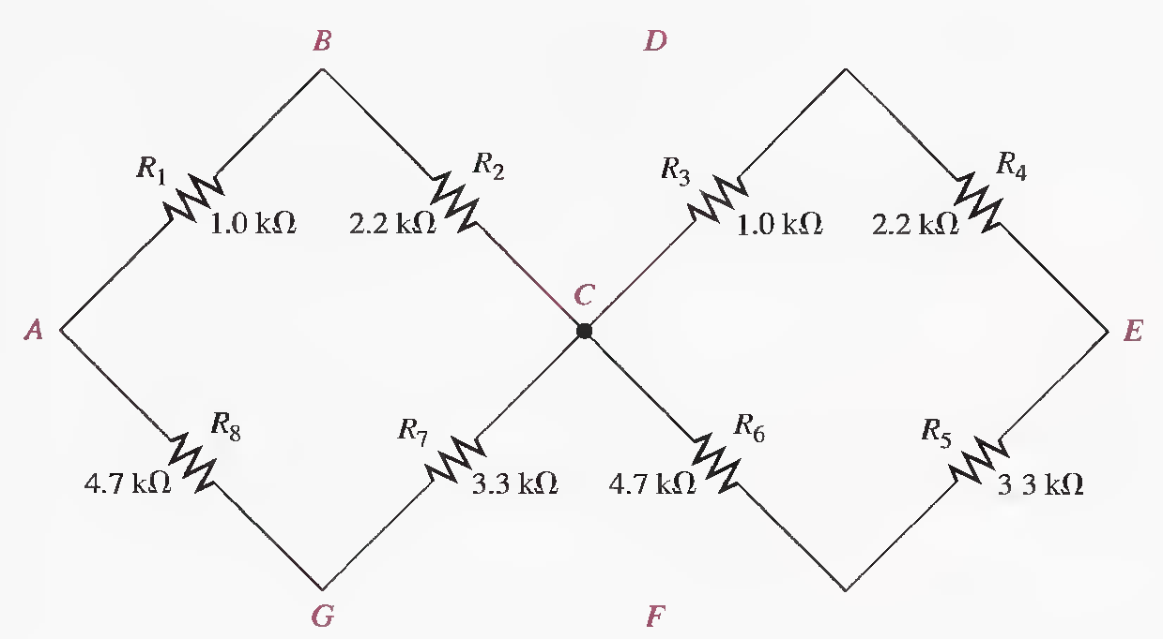
Q.14 Find the resistance between node A and each of the other nodes (R_{AB}, R _{AC} , R_{AD} , R_{AE}, R_{AF} , and R_{AG}) in the given Figure.
RAB = 911 Ω,RAG =2.73 kΩ,RAC = 2.29 kΩ,RAD = 3.20 kΩ,RAE = 4.58 kΩ,RAF = 5.02 kΩ

Slide 7
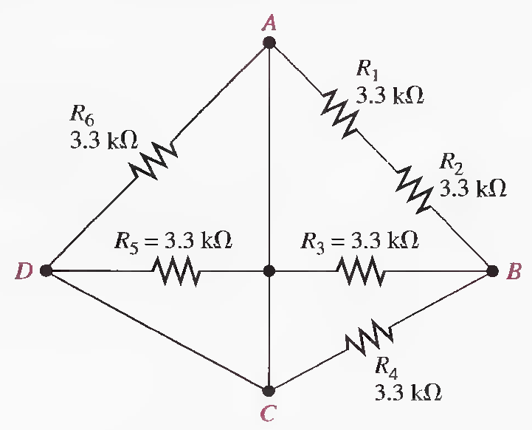
Q.15 Find the resistance between each of the following sets of nodes in the given Figure : AB, BC, and CD.
RAB = 1.32 kΩ, Note: R5 and R6 is shorted out (ACD) and is not a factor in the total resistance.
RBC = 1.32 kΩ, RCD = 0 Ω

Slide 8
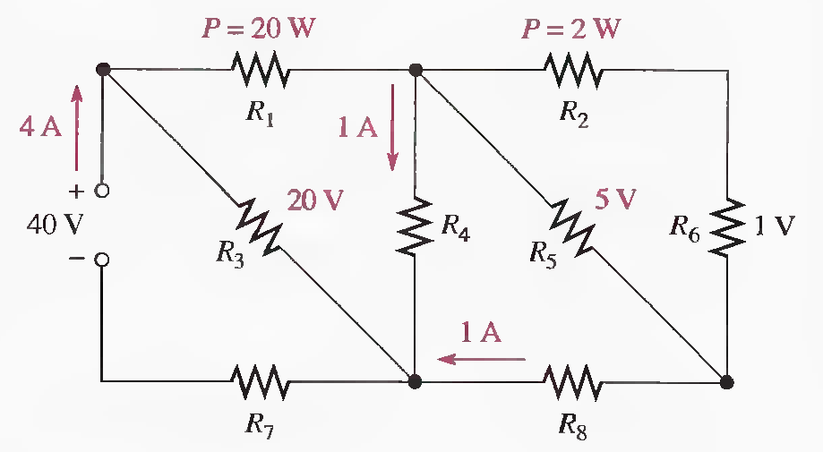
Q.16 Determine the value of each resistor in the following circuit. (Solved on 2 slides)

Slide 10
Problems related to Voltage divider with resistive loads
Q.17 A voltage divider consists of two 56 kΩ resistors and a 15 V source. Calculate the unloaded output voltage. What will the output voltage be if a load resistor of 1.0 MΩ is connected to the output?
VOUT(unloaded)=7.5V, Req=53 kΩ, VOUT(loaded) = 7.29 V

Slide 11
Q.18 A 12 V battery output is divided down to obtain two output voltages. Three 3.3 kΩ resistors are used to provide the two taps. Determine the output voltages. If a 10 kΩ load is connected to the higher of the two outputs, what will its loaded value be?
VA=8V, VB=4V, RA = 3.98 kΩ, VA(loaded) = 6.56 V

Slide 12
Q.19 Which will cause a smaller decrease in output voltage for a given voltage divider, a 10 kΩ load or a 47 k Ω load?
Answer
The 47 kΩ will result in a smaller decrease in output voltage because it has less effect on the circuit resistance than does the smaller resistance.
If 1000Ω//10 Ω =9.9 Ω

Slide 13
Q.20 Determine the resistance values for a voltage divider that must meet the following specifications: The current drawn from the source under unloaded condition is not to exceed 5 mA. The source voltage is to be 10 V, and the required outputs are to be 5 V and 2.5 V. Sketch the circuit. Determine the effect on the output voltages if a 1.0 kΩ load is connected to each tap one at a time. (Solved on 2 slides)
RT =2 kΩ, R1 = R2 + R3, R2 = R3=500Ω, R1=1000Ω, Req(lower)= 333 Ω, IT= 5.46 mA, V
lower tap = 1.82 V, Vupper tap = 4.55 V, IT = 6.67 mA, Vupper tap 3.33 V,Vlower tap =1.67 V

Slide 14
RT =2 kΩ, R1 = R2 + R3, R2 = R3=500Ω, R1=1000Ω, Req(lower)= 333 Ω, IT= 5.46 mA, V
lower tap = 1.82 V, Vupper tap = 4.55 V, IT = 6.67 mA, Vupper tap 3.33 V,Vlower tap =1.67 V

Slide 15
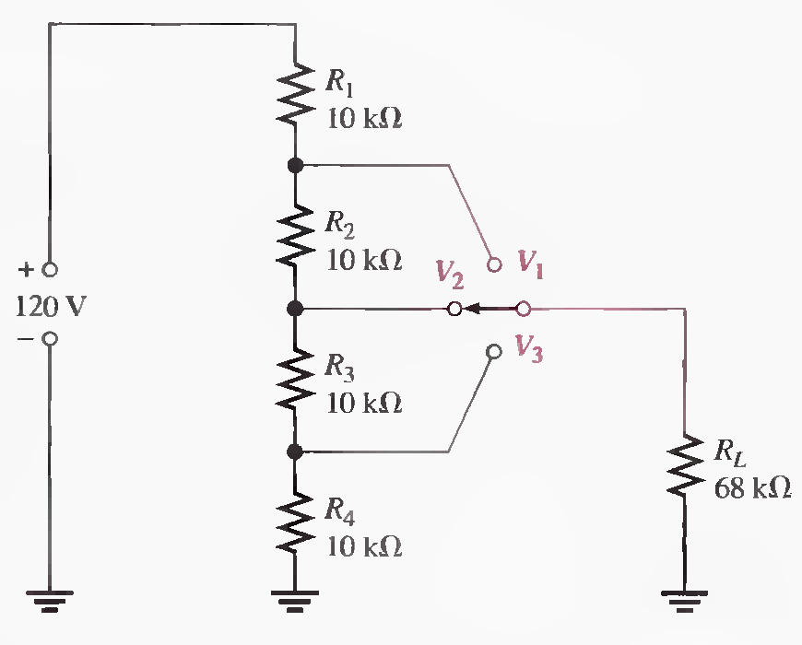
Q.21 The voltage divider in the following Figure has a switched load. Determine the voltage at each tap (V1, V2 , and V3 ) for each position of the switch. (Solved on 2 slides)
Position: RT=30.8 kΩ, V1 = 81.0 V, V2 = 54.0 V, V3 = 27.0 V……Position 2:RT=35.5 kΩ, V1=86.2V, V2=52.4 V, V3=26.2V…… Position 3:RT=38.7 kΩ, V1=89V, V2=58 V, V3=27V……

Slide 16
Position: RT=30.8 kΩ, V1 = 81.0 V, V2 = 54.0 V, V3 = 27.0 V……Position 2:RT=35.5 kΩ, V1=86.2V, V2=52.4 V, V3=26.2V…… Position 3:RT=38.7 kΩ, V1=89V, V2=58 V, V3=27V……

Slide 17
Q.22 Design a voltage divider to provide a 6 V output with no load and a minimum of 5.5 V across a 1.0 kΩ load. The source voltage is 24 V, and the unloaded current drain is not to exceed 100 mA.
RT=240 Ω, R2=60 Ω, R1= 180 Ω, R2 || RL = 56.6 Ω, VOUT = 5.74 V

Slide 18
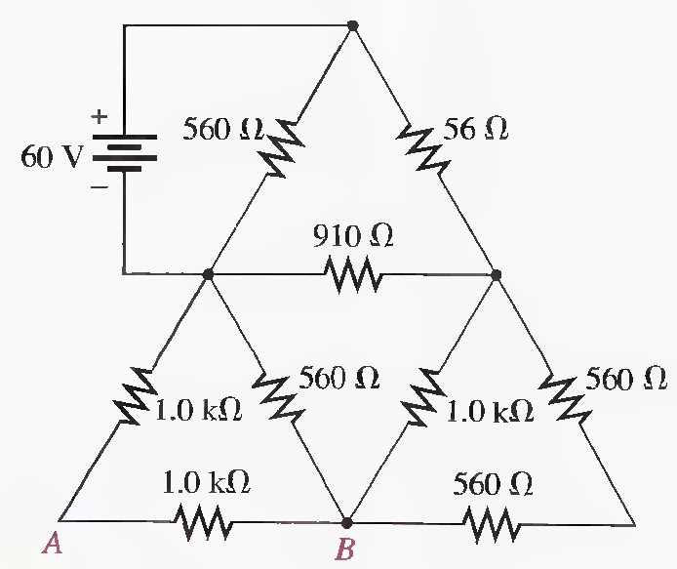
Problems related to Ladder Networks
Q.23 For the circuit shown in the following Figure, calculate the following:
(a) Total resistance across the source (b) Total current from the source
(c) Current through the 910Ω resistor (d) Voltage from A to point B
(Solved on 2 slides)
RT = 271 Ω, IT=221 mA, I2= 114 mA, I₉₁₀ = 58.7 mA, I4 = 55 mA , V437.5 Ω = 24.06 V,VAB = 12 V

Slide 20
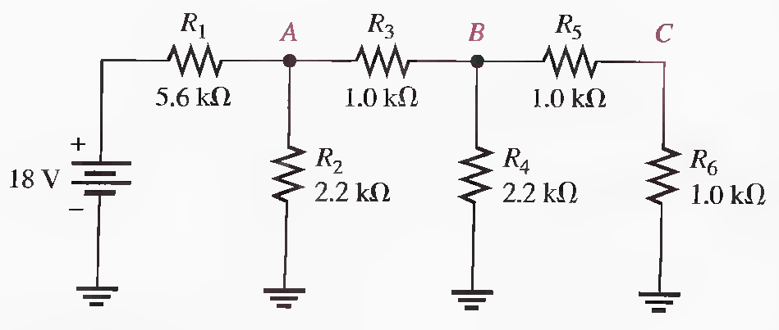
Q.24 Determine the total resistance and the voltage at nodes A, B, and C in the ladder network of following Figure.(Solved on 2 slides)
RT = 6.66 kΩ, RA= 1.06 kΩ,RB= 1.05 kΩ, RC= 1 kΩ, VA = 2.86 V, VB = 1.47 V,VC = 35 mV

Slide 21
RT = 6.66 kΩ, RA= 1.06 kΩ,RB= 1.05 kΩ, RC= 1 kΩ, VA = 2.86 V, VB = 1.47 V,VC = 35 mV

Slide 22
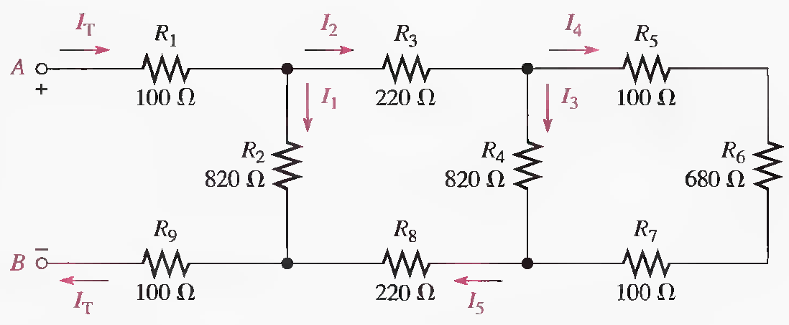
Q.25 Determine the total resistance between terminals A and B of the ladder network in the given Figure. Also calculate the voltage across each resistor and current in each branch with 10 V between A and B. .(Solved on 2 slides)
RT = 621 Ω, IT= 16.1 mA, I2= 8.27 mA, I3 = I8 ==7.84mA, I4= 4.06 mA, I5 = I6 = I7 = 3.78 mA,
V1 =1.61 V, V2 = 6.78 V, V3 = 1.73 V, V4 = 3.33 V, V5 = 0.378 V, V6 = 2.57 V, V7 =.378 V, V8 = 1.73 V
V9 = 1.61 V

Slide 23
RT = 621 Ω, IT= 16.1 mA, I2= 8.27 mA, I3 = I8 ==7.84mA, I4= 4.06 mA, I5 = I6 = I7 = 3.78 mA,
V1 =1.61 V, V2 = 6.78 V, V3 = 1.73 V, V4 = 3.33 V, V5 = 0.378 V, V6 = 2.57 V, V7 =.378 V, V8 = 1.73 V
V9 = 1.61 V

Slide 24
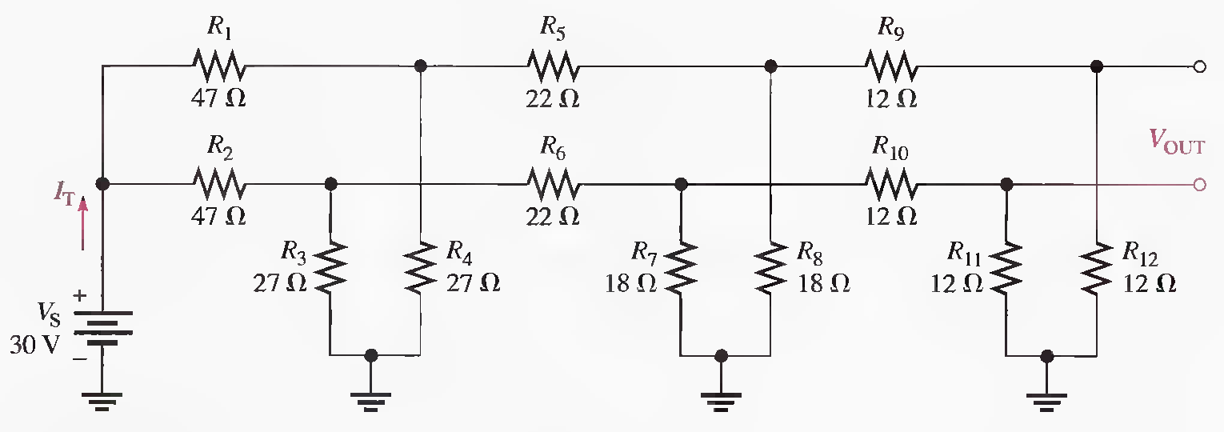
Q.26 Find I_{T} and V_{OUT} in the following Figure.
RT1 = 61.7 Ω, RT(both) = 30.9 Ω, IT = 971 mA

Slide 25
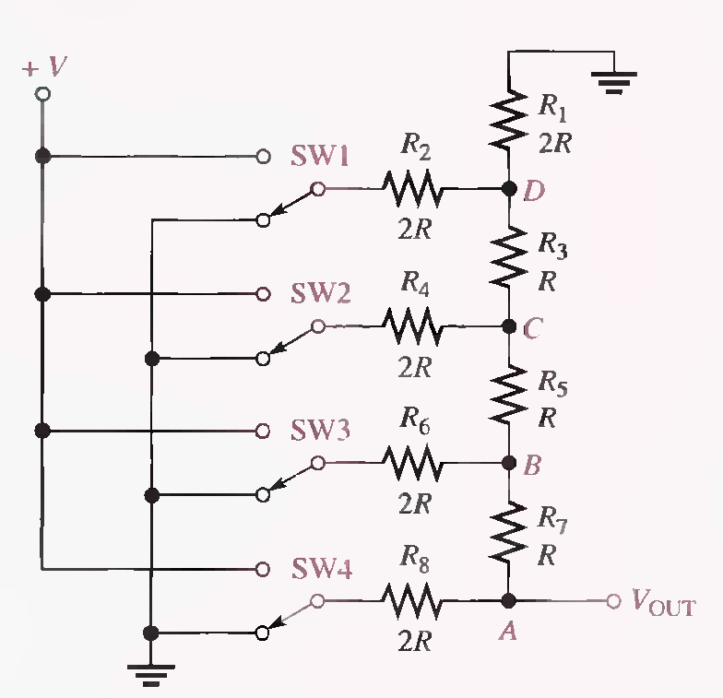
The switches used in this illustration simulate the digital (two-level) inputs. One switch position is connected to ground (0 V), and the other position is connected to a positive voltage (V).(Solved on 2 slides)

Slide 27
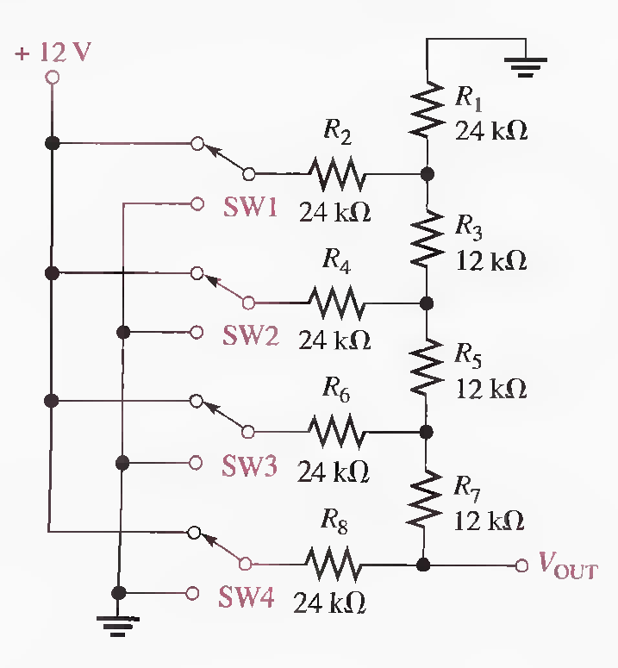
Q.27 Determine VO UT for the R/2R ladder network in the following Figure for the following conditions:
(a) SW3 and SW4 to + 12 V, SWI and SW2 to ground
(b) SW3 and SWI to + 12 V, SW2 and SW4 to ground
(c) All switches to + 12 V
9 V, 3.75 V, 11.25 V

