Slide 1
Previous Lecture 12
Voltage Dividers with Resistive loads

Slide 2
SERIES-PARALLEL CIRCUITS
Lecture 13
Ladder Networks

Slide 3
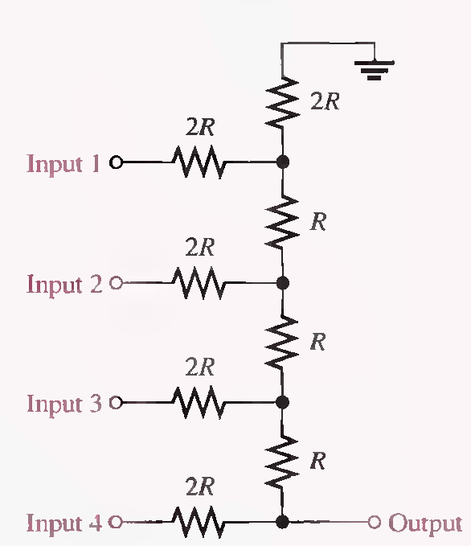
The R/2R Ladder Network
Lecture 13
A basic R/2R ladder network is shown in following Figure. The name comes from the relationship of the resistor values. R represents a common value, and one set of resistors has twice the value of the others. The R/2R ladder network is commonly used to scale down voltages to certain weighted values for digital-to-analog conversion.

Slide 4
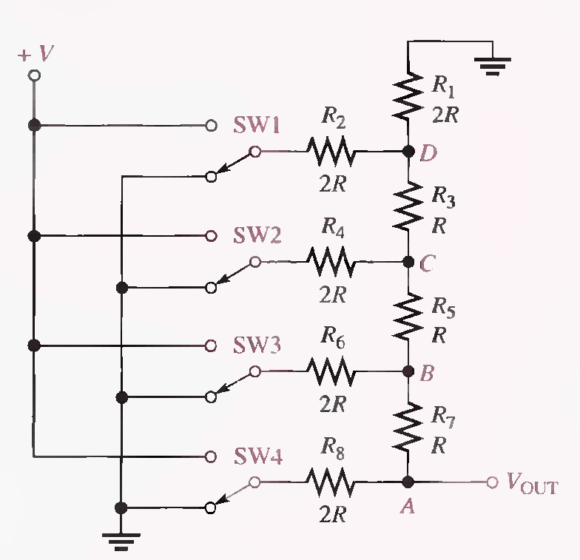
The switches used in this illustration simulate the digital (two-level) inputs. One switch position is connected to ground (0 V), and the other position is connected to a positive voltage (V).

Slide 5
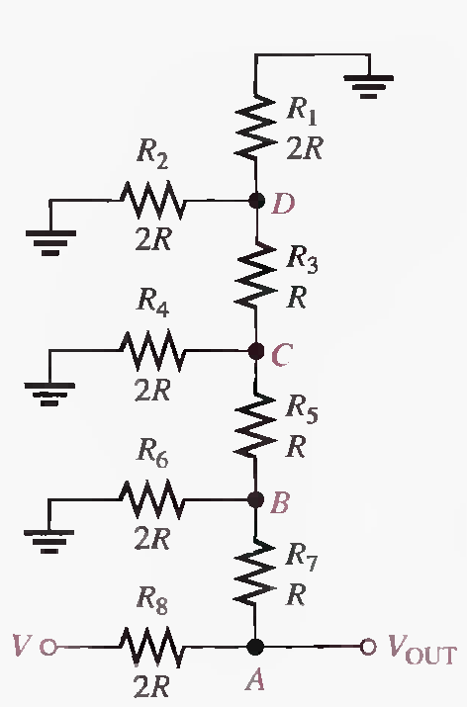
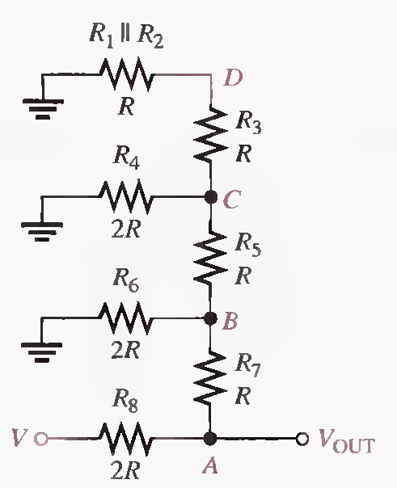
Analysis of R/2R Ladder Network
Switch SW4 is at the V position and the others are at ground

Slide 6
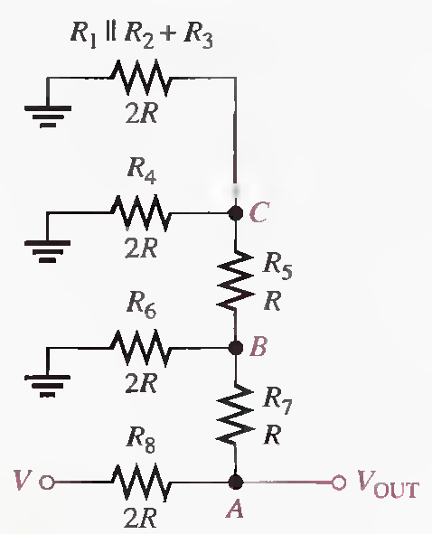
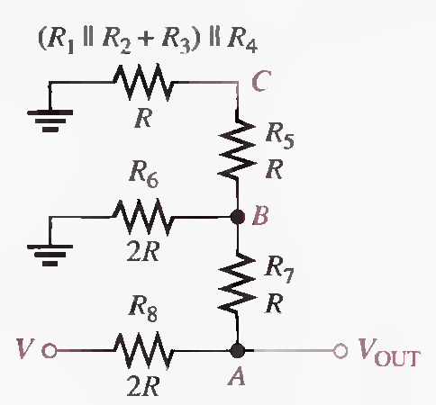
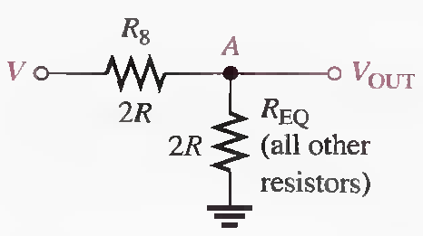

Slide 7
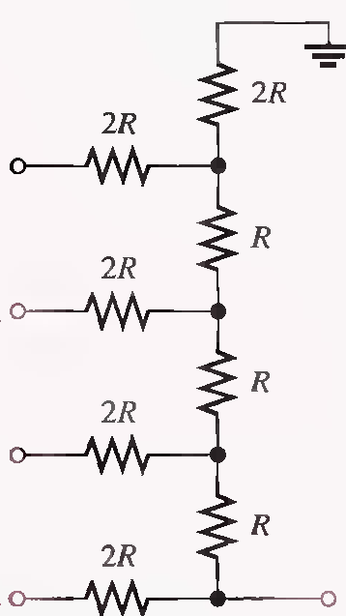
Switch SW3 is at the V position and the others are at ground

Slide 9
Switch SW2 is at the V position and the others are at ground

Slide 11
Switch SW1 is at the V position and the others are at ground

