Slide 1
Previous Lecture 11
Identifying Series-Parallel Relationships
Analysis of Series-Parallel Resistive Circuits

Slide 2
SERIES-PARALLEL CIRCUITS
Lecture 12
Voltage Dividers with Resistive loads

Slide 3
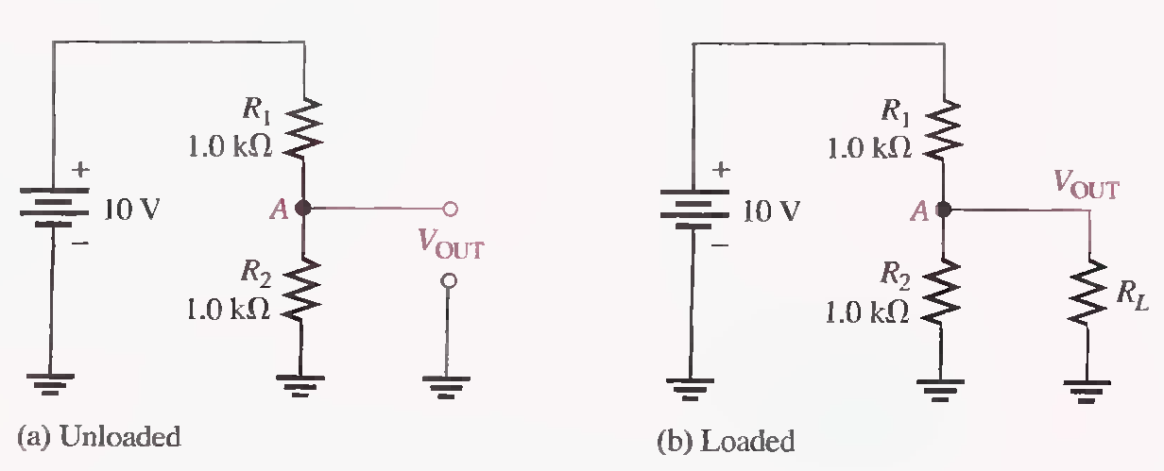
VOLTAGE DIVIDERS WITH RESISTIVE LOADS
We have studied Voltage dividers in Series circuits. Now we see how resistive loads affect the operation of voltage-divider circuits.
Effect of Load resistors
Reduces resistance from Point A to ground So Voltage too
More current is drawn from the source because the total resistance of the circuit is reduced.

Slide 4
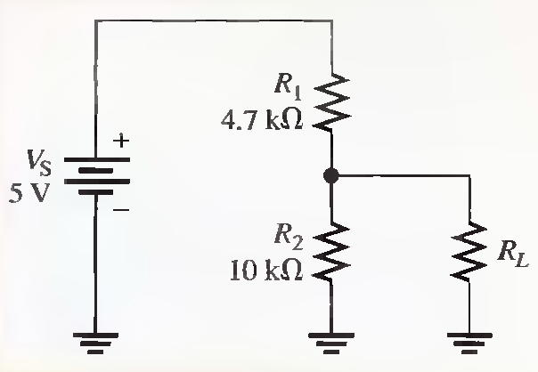
(a) Determine the unloaded output voltage of the voltage divider in the following Figure.
(b) Find the loaded output voltages of the voltage divider in the following Figure for the following two values of load resistance: RL = 10 kΩ and RL = 100 kΩ.
3.40V 5kΩ, 2.58 V 9.1kΩ, 3.30 V

Slide 5
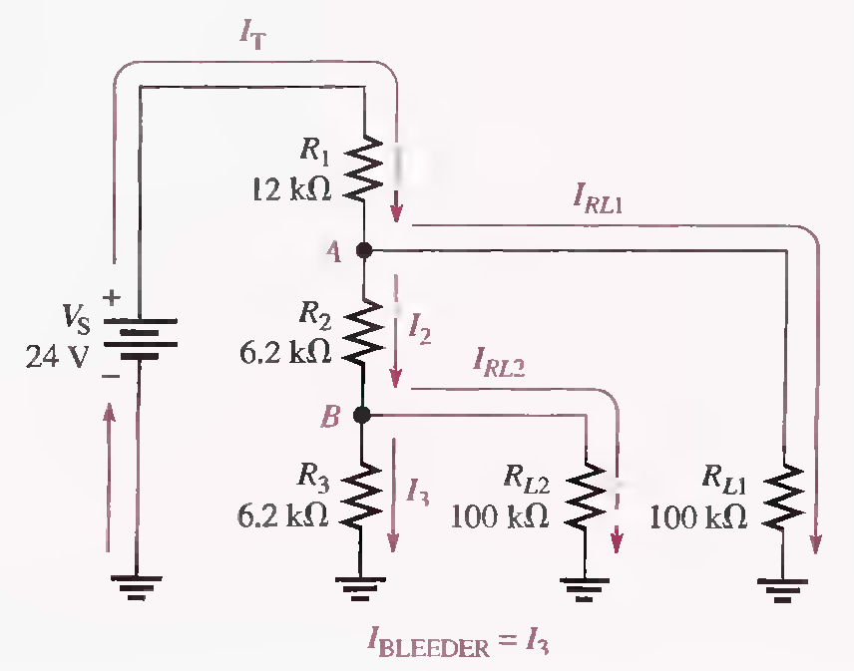

Load Current and Bleeder Current
In a multiple-tap loaded voltage-divider circuit, the total current drawn from the source consists of currents through the load resistors, called load currents, and the divider resistors.

Slide 6
Determine the load currents I_{RL1} and I_{RL2} and the bleeder current I₃ in the two-tap loaded voltage divider in the following Figure. (Solved on 2 slides).
R_{B}=5.84 kΩ, R_{2+B}=12 kΩ, R_{A}=12.7 kΩ, R_{T}=22.7 kΩ, V_{RL1} = 11.3 V, I_{RL1} =113 µA, V_{B}= 5.50V ,I_{RL2} =55µA I₃= 887 µA

Slide 7
R_{B}=5.84 kΩ, R_{2+B}=12 kΩ, R_{A}=12.7 kΩ, R_{T}=22.7 kΩ, V_{RL1} = 11.3 V, I_{RL1} =113 µA, V_{B}= 5.50V ,I_{RL2} =55µA, I₃= 887 µA

Slide 8
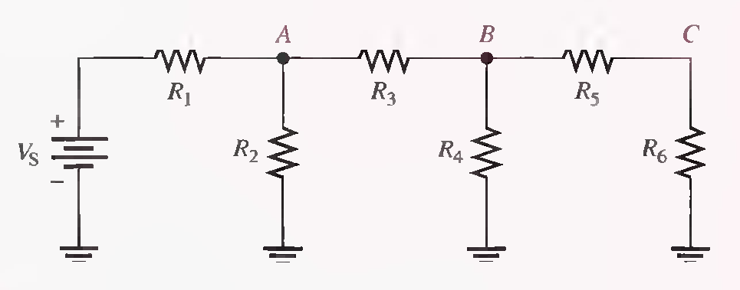
LADDER NETWORKS
A resistive ladder network is a special type of series-parallel circuit. (Pole and Rungs)

Slide 9
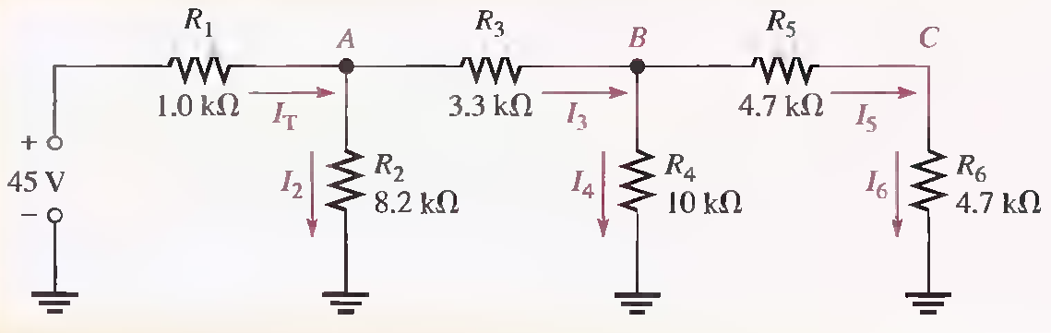
Determine the current through each resistor and the voltage at each labeled node with respect to ground in the ladder network of following Figure. (Solved on 3 slides)
RB=4.85kΩ , RA= 4.09k Ω , RT= 5.09k Ω , IT=8.84 mA , I2 = 4.42mA , I3 = 4.42mA , I4 = 2.14 mA
I5 = 16 =2.28mA, VA= 36.2 V, VB=21.4V, VC=10.7V

Slide 10
RB=4.85kΩ , RA= 4.09k Ω , RT= 5.09k Ω , IT=8.84 mA , I2 = 4.42mA , I3 = 4.42mA , I4 = 2.14 mA
I5 = 16 =2.28mA, VA= 36.2 V, VB=21.4V, VC=10.7V

Slide 11
RB=4.85kΩ , RA= 4.09k Ω , RT= 5.09k Ω , IT=8.84 mA , I2 = 4.42mA , I3 = 4.42mA , I4 = 2.14 mA
I5 = 16 =2.28mA, VA= 36.2 V, VB=21.4V, VC=10.7V
(End)

Slide 12
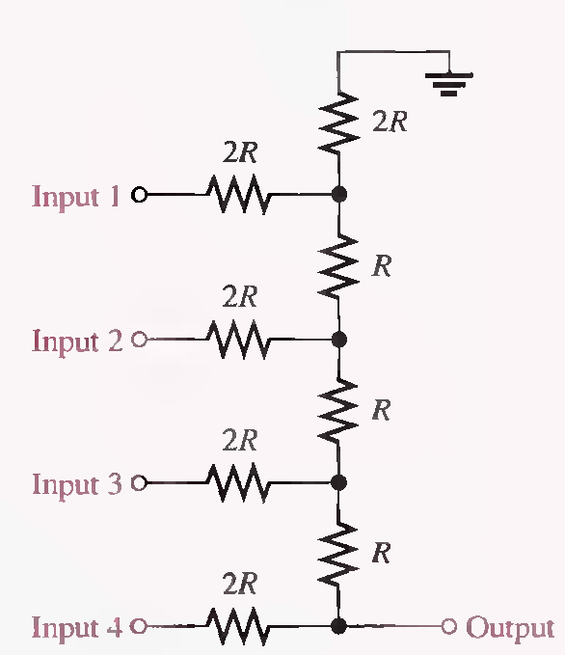
The R/2R Ladder Network
A basic R/2R ladder network is shown in following Figure. The name comes from the relationship of the resistor values. R represents a common value, and one set of resistors has twice the value of the others. The R/2R ladder network is commonly used to scale down voltages to certain weighted values for digital-to-analog conversion.

Slide 13
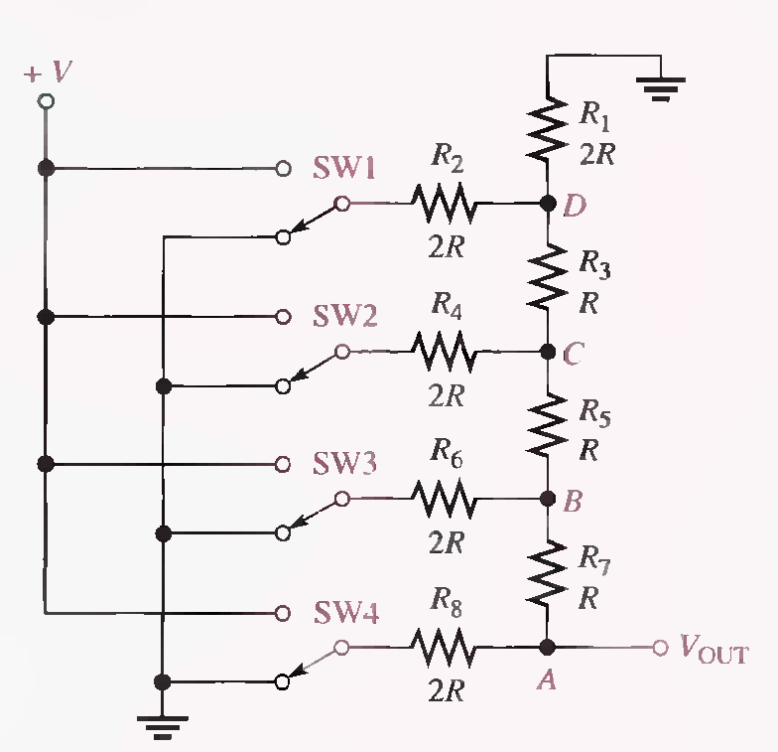
The switches used in this illustration simulate the digital (two-level) inputs. One switch position is connected to ground (0 V), and the other position is connected to a positive voltage (V).

Slide 14
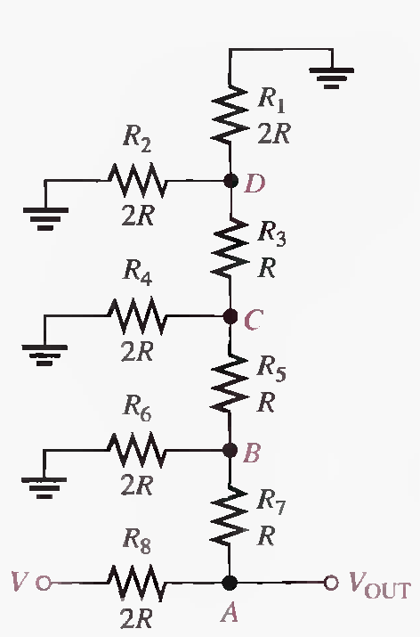
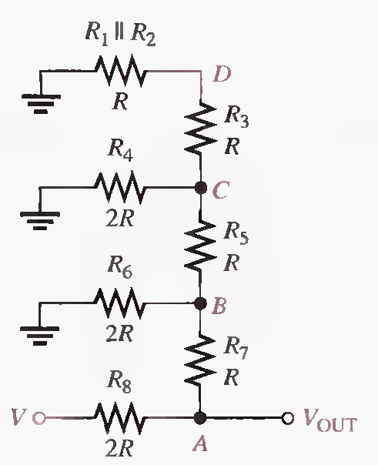
Analysis of R/2R Ladder Network
Switch SW4 is at the V position and the others are at ground

Slide 15
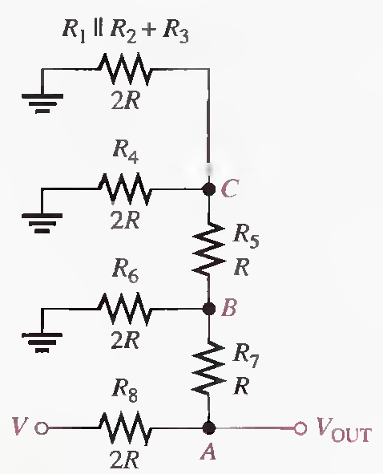
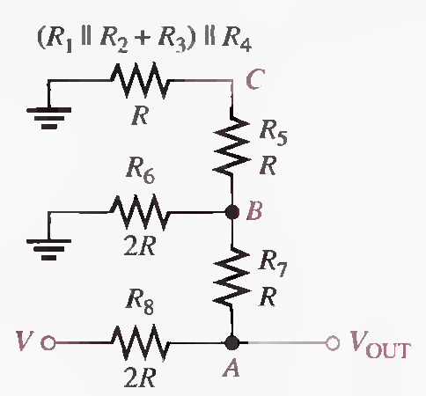
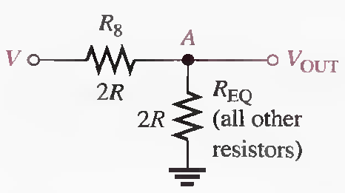

Slide 16
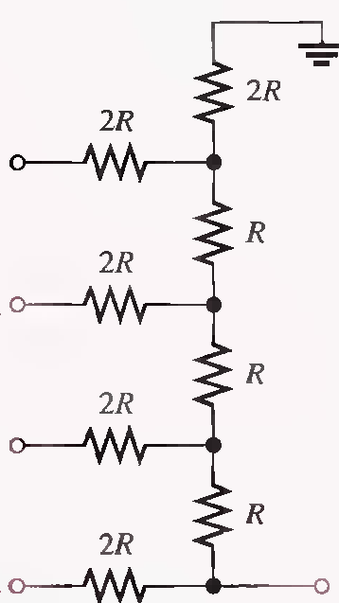
Switch SW3 is at the V position and the others are at ground

Slide 18
Switch SW2 is at the V position and the others are at ground

Slide 20
Switch SW1 is at the V position and the others are at ground

