Slide 1
Previous Lectures 6-10
Series Circuit
Parallel Circuits

Slide 2
SERIES-PARALLEL CIRCUITS
(will be covered in Lecture No 11 to 16)
Lecture 11
Identifying Series-Parallel Relationships
Analysis of Series-Parallel Resistive Circuits

Slide 3
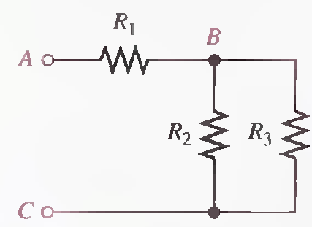
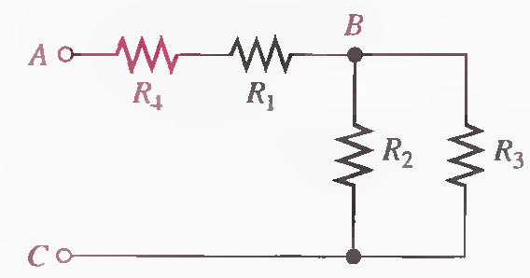
IDENTIFYING SERIES-PARALLEL RELATIONSHIPS
A series-parallel circuit consists of combinations of both series and parallel current paths. It is important to be able to identify how the components in a circuit are arranged in terms of their series and parallel relationships.

Slide 4
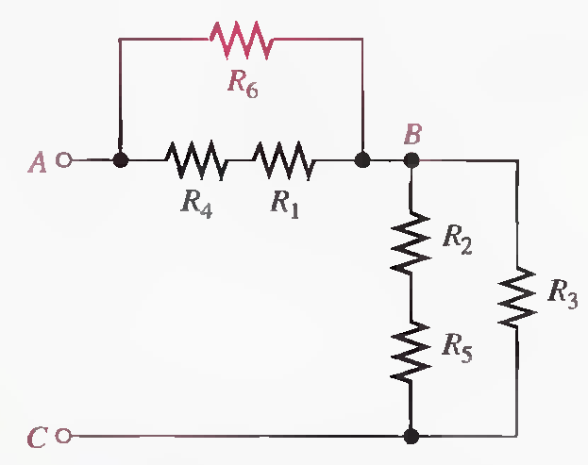
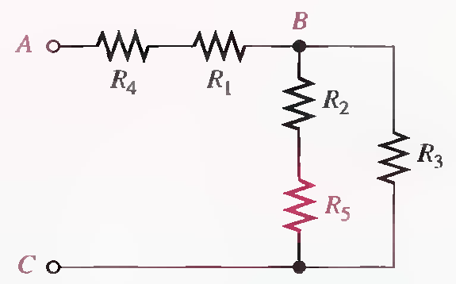
IDENTIFYING SERIES-PARALLEL RELATIONSHIPS

Slide 5
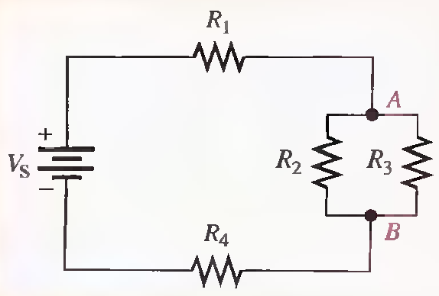
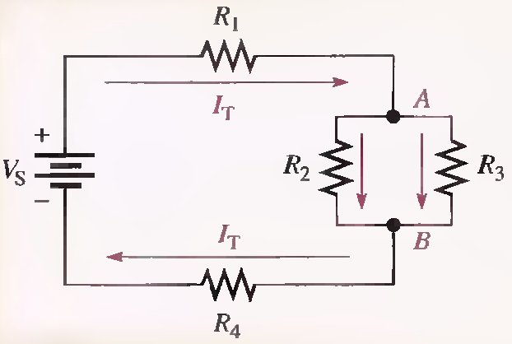
IDENTIFYING SERIES-PARALLEL RELATIONSHIPS

Slide 6
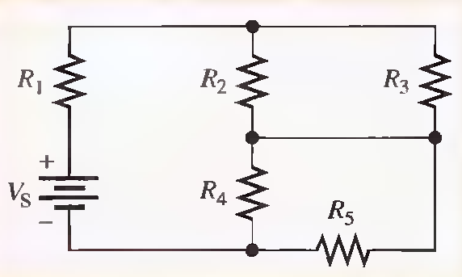
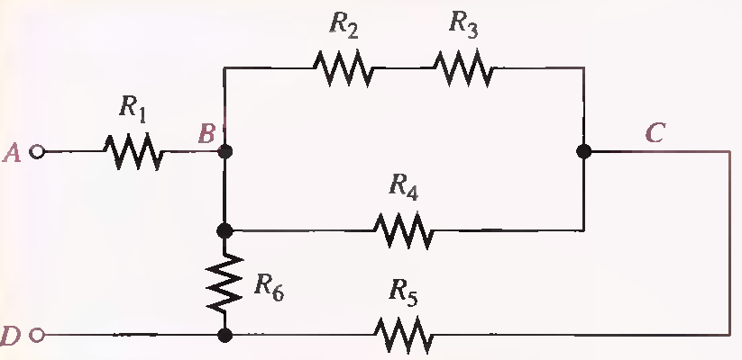
IDENTIFYING SERIES-PARALLEL RELATIONSHIPS

Slide 7
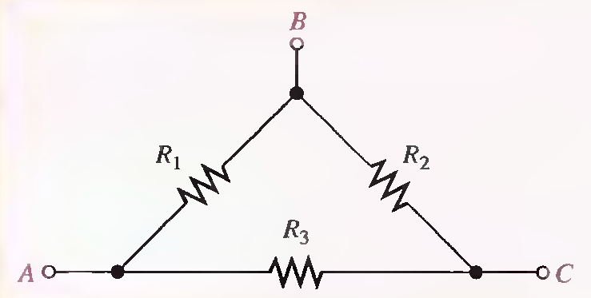
Describe the total resistance between each pair of terminals in the following Figure.

Slide 8
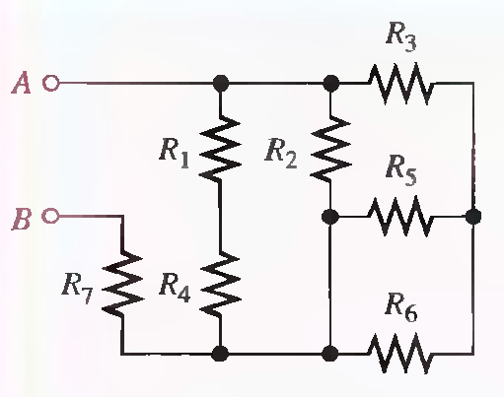
IDENTIFYING SERIES-PARALLEL RELATIONSHIPS

Slide 9
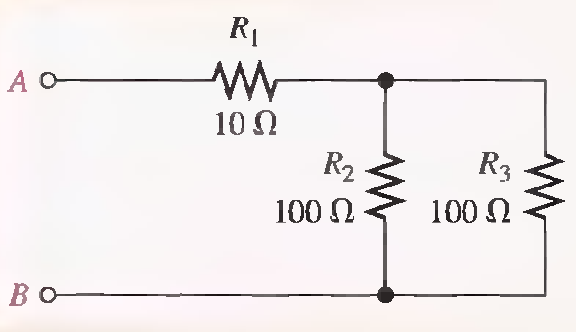
ANALYSIS OF SERIES-PARALLEL RESISTIVE CIRCUITS
If you know Ohm's law, Kirchhoff's laws, the voltage-divider formula, and the current divider formula, and if you know how to apply these laws, you can solve most resistive circuit analysis problems.

Slide 10
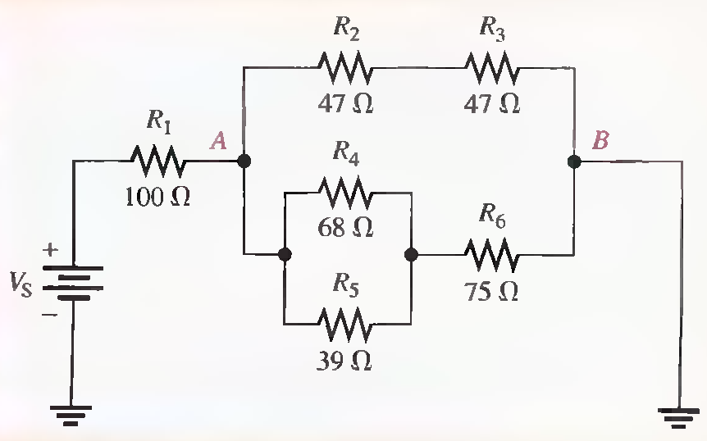
Find the total resistance between the positive and negative terminals of the battery in the following Figure. (Solved on 2 slides)
R₂₃=94Ω, R₄₅=24.8 Ω, R₄₅₆=99.8 Ω, R_{AB}=48.4 Ω,R_{T}=148.4 Ω

Slide 11
R₂₃=94Ω, R₄₅=24.8 Ω, R₄₅₆=99.8 Ω, R_{AB}=48.4 Ω,R_{T}=148.4 Ω

Slide 12
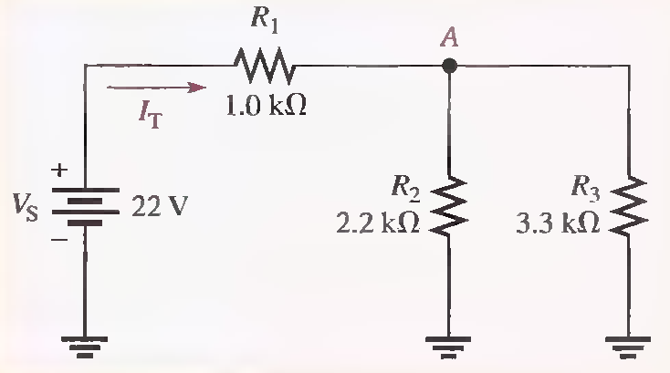
Find the current through R₂ and the current through R₃ in the following Figure.
R T=2.32KΩ, IT= 9.48 mA, I2=5.69 mA, I3= 3.79mA

Slide 13
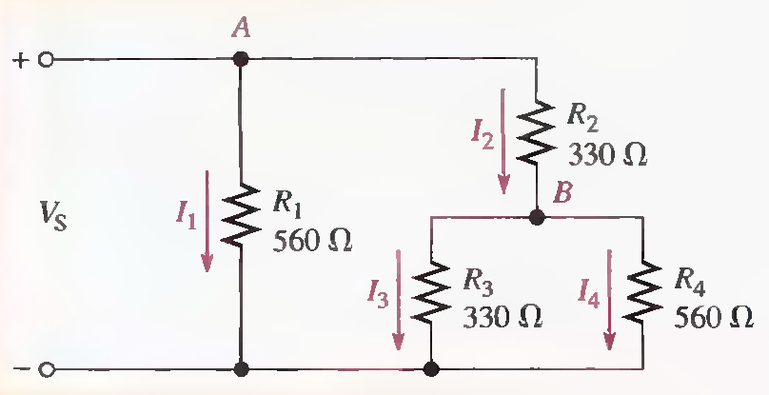
Determine the current through R4 in the following Figure. if Vs = 50 V.
R234=538 Ω, I2= 93mA, I4= 34.5mA

Slide 14
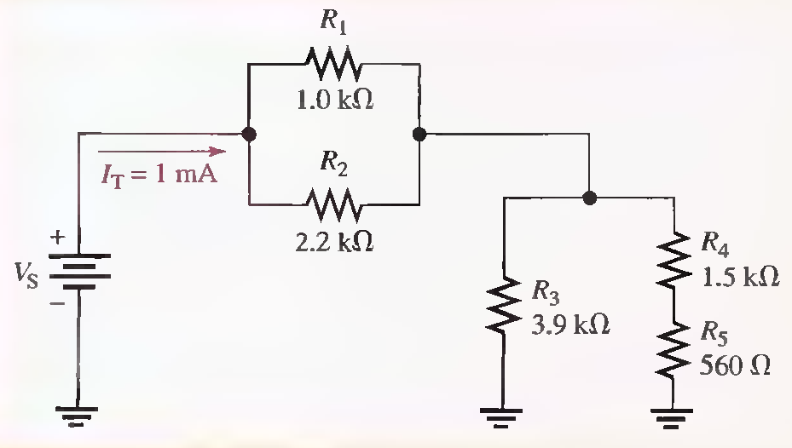
Determine the voltage drop across each resistor in the circuit of following Figure. (Solved on 2 slides)
I1=688µA, V1= 688 mV,V2= 688mV, I3= 346µA, V3= 1.35V, I4= 654µA, V4= 981mV, V5= 366mV

Slide 15
I1=688µA, V1= 688 mV,V2= 688mV, I3= 346µA, V3= 1.35V, I4= 654µA, V4= 981mV, V5= 366mV

Slide 16
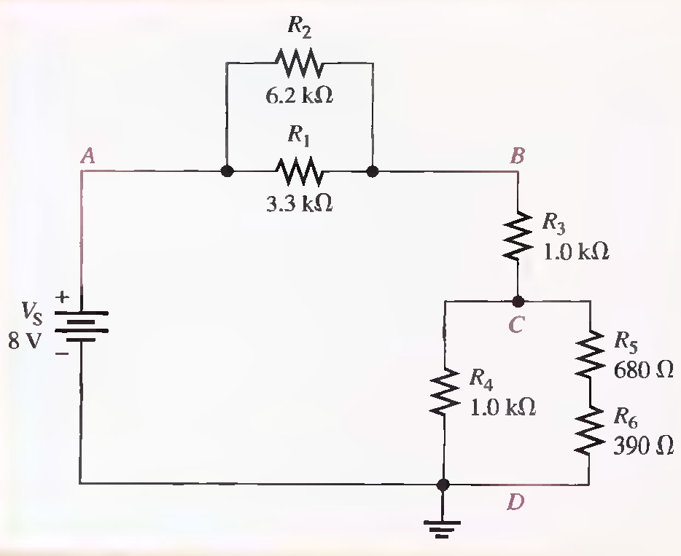
Determine the voltage drop across each resistor in the following Figure. (Solved on 2 slides)
RAB=2.15kΩ, RCD=517Ω, RT=3.67K Ω, VAB=4.69 V, VCD=1.13 V, V3=2.18 V, V1=V2= VAB = 4.69 V
V4 = VCD = I.8V, V5= 718mV, V6= 412mV

Slide 17
RAB=2.15kΩ, RCD=517Ω, RT=3.67K Ω, VAB=4.69 V, VCD=1.13 V, V3=2.18 V, V1=V2= VAB = 4.69 V
V4 = VCD = I.8V, V5= 718mV, V6= 412mV (End)

