Slide 1
Previous Lecture Parallel Circuits
Resistors in Parallel
Voltage in a Parallel Circuit
Kirchhoff's Current Law
Total Parallel Resistance
Application of Ohm's Law
Current Sources in Parallel
Current Dividers
Power in Parallel Circuits
Parallel Circuit Applications

Slide 2
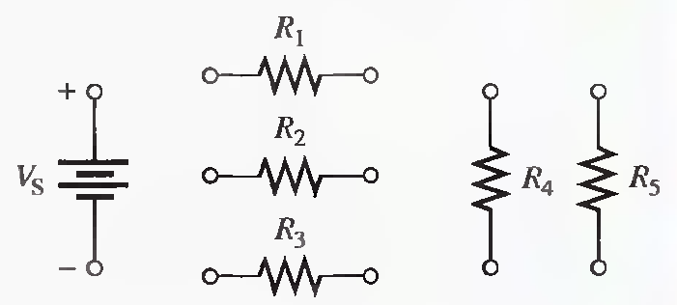
Problems Solving_Parallel Circuits
Lecture 10
Problem related to Resistors in Parallel
Q.1 Show how to connect the resistors in the following Figure in parallel across the battery.

Slide 3
Problem related to Voltage in a Parallel Circuit
Q.1 What is the voltage across and the current through each parallel resistor if the total voltage is 12 V and the total resistance is 550Ω? There are four resistors, all of equal value.
21.8 mA, 5.45 mA, 2.20K Ω

Slide 4
Problems related to Kirchhoff's Current Law
Q.1 There is a total of 500 mA of current into five parallel resistors. The currents through four of the resistors are 50 mA, 150 mA, 25 mA, and 100 mA. What is the current through the fifth resistor?
175 mA

Slide 5
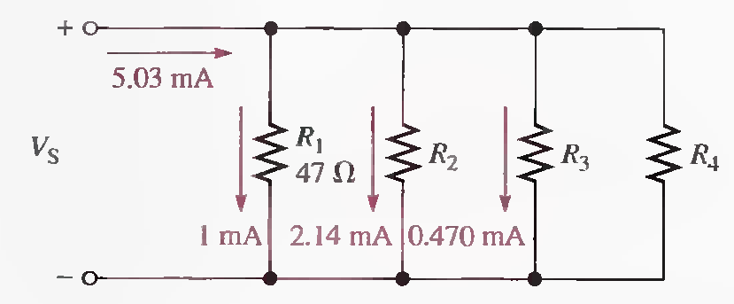
Q.2 In the circuit of following Figure, determine the resistance R₂ ,R₃ , and R₄ .
47 mV, 22 Ω, 100 Ω, 1.42 mA, 33 Ω

Slide 6
Q.3 The electrical circuit in a room has a ceiling lamp that draws 1.25 A and four wall outlets. Two table lamps that each draw 0.833 A are plugged into two outlets, and an electric heater that draws 1OA is connected to the third outlet. When all of these items are in use, how much current is in the main line serving the room? If the main line is protected by a 15 A circuit breaker, how much current can be drawn from the fourth outlet? Draw a schematic of this wiring.
12.92 A, 2.08 A

Slide 7
Q.4 The total resistance of a parallel circuit is 25Ω. What is the current through a 220Ω resistor that makes up part of the parallel circuit if the total current is 100 mA?
2.5 V, 11.4 mA

Slide 8
Problems related to Total Parallel Resistance
Q.1 What is the total resistance of twelve 6.8kΩ resistors in parallel?
567 Ω

Slide 9
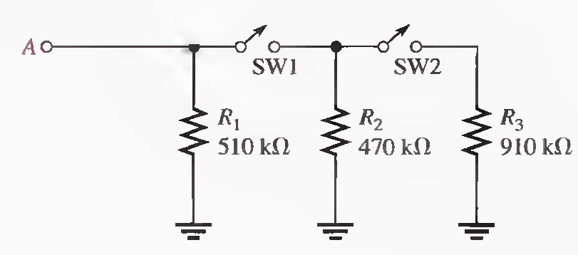
Q.2 What is the total resistance between point A and ground in the following Figure for the following conditions?
(a) SWI and SW2 open (b) SWI closed. SW2 open
(c) SWI open, SW2 closed (d) SWI and SW2 closed
510 kΩ, 245 kΩ, 510 kΩ, 193 kΩ

Slide 10
Problems related to Application of Ohm's Law
Q.1 Four equal-value resistors are connected in parallel. Five volts are applied across the parallel circuit, and 1.11 mA are measured from the source. What is the value of each resistor?
4.5 kΩ, 18 kΩ

Slide 11
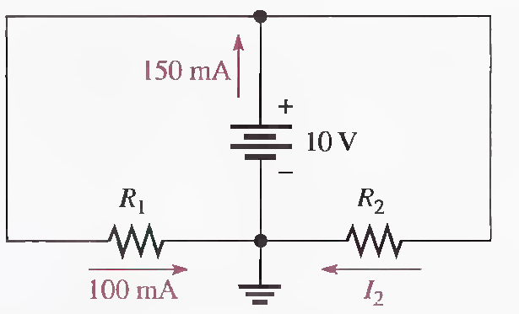
Q.2 Find the values of the unspecified labeled quantities in the following circuit.
50 mA, 100 Ω, 200 Ω

Slide 12
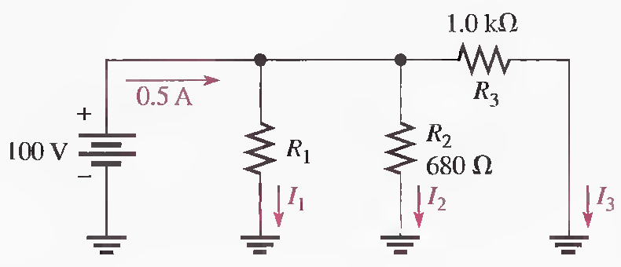
Q.3 Find the values of the unspecified labeled quantities in the following circuit.
I₃=100 mA, I₂=147 mA,I₁=253 mA, R₁=395 Ω

Slide 13
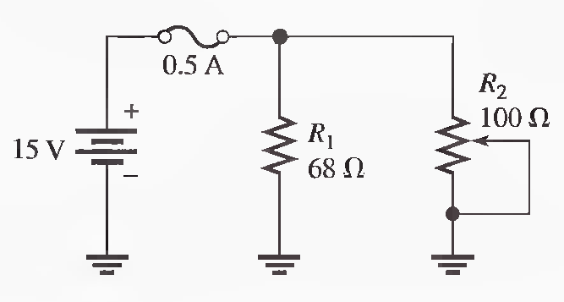
Q.4 To what minimum value can the 100Ω rheostat in the following Figure be adjusted before the 0.5 A fuse blows?
I₁=.22A, I₂=.28A, R₂= 53.7Ω

Slide 14
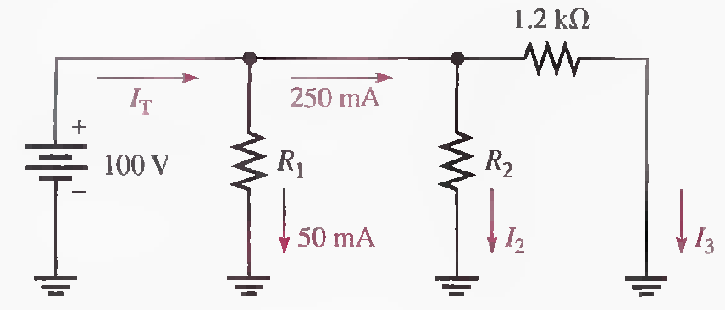
Q.5 Find the values of the unspecified quantities in the following Figure.
I₃=83.3 mA, I₂=166.7 mA, I_{T}=300 mA, R₁=2 kΩ, R₂=600 Ω

Slide 15
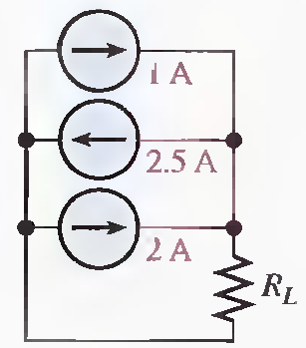
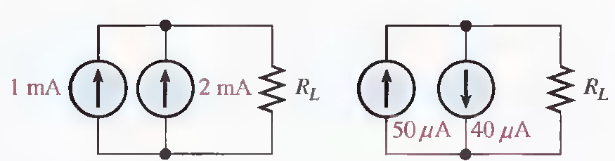
Problem related to Current Sources in Parallel
Q.1 Determine the current through R_{L} in each circuit in the following Figure.

Slide 16
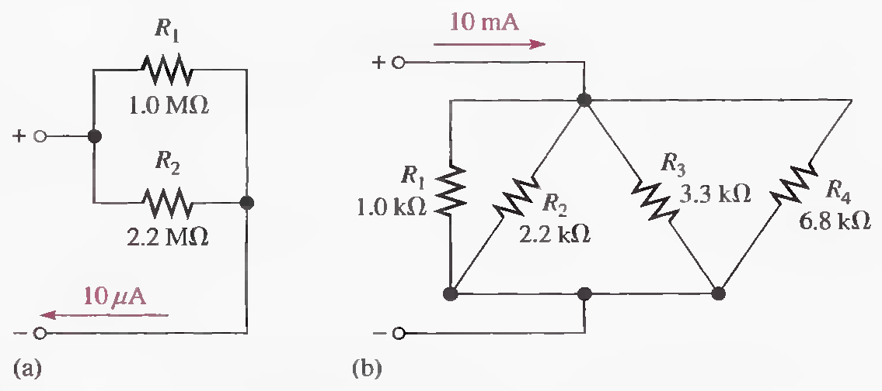
Problems related to Current Dividers
Q.1 Determine the current in each branch of the current dividers of following Figure.
6.88 μA, 3.12 μA 525 Ω, 5.25 mA, 2.39 mA, 1.59 mA, 0.772 mA

Slide 17
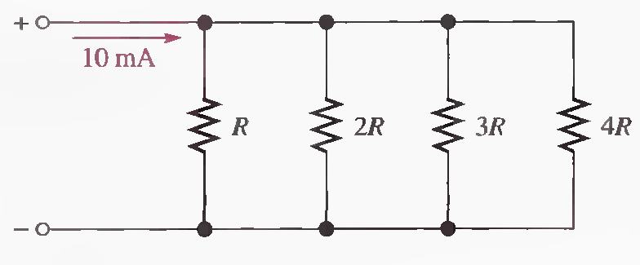
Q.2 What is the current through each resistor in the following Figure? R is the lowest-value resistor and all others are multiples of that value as indicated.
0.48R, 4.8 mA, 2.4 mA, 1.59 mA, 1.2 mA

Slide 18
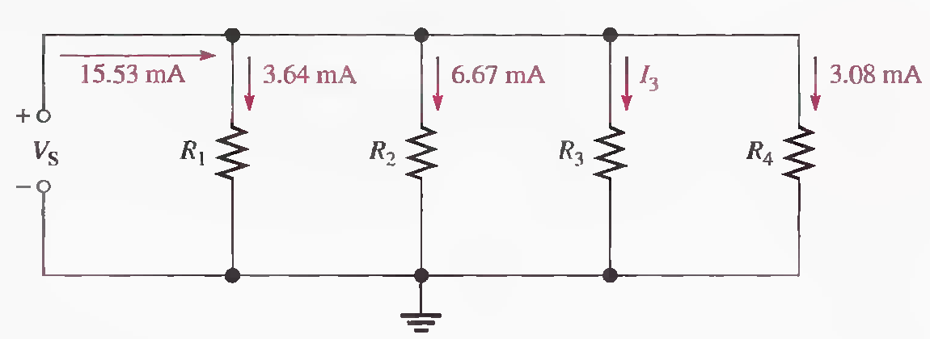
Q.3 Determine all of the resistor values in the following Figure. RT = 773Ω.
773 Ω, 2.14 mA, 3.3 kΩ, 1.8 kΩ, 5.6 kΩ, 3.9 kΩ

Slide 19
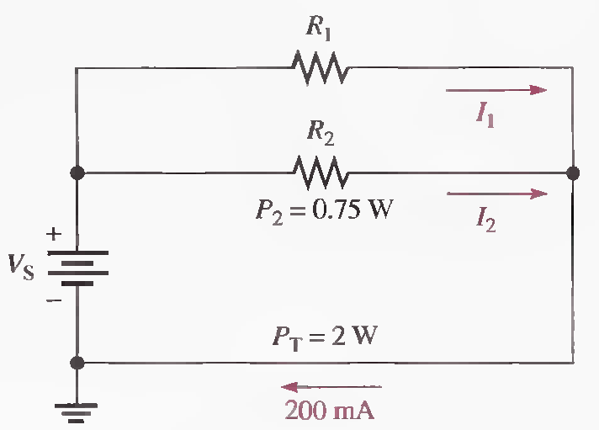
Problems related to Power in Parallel Circuits
Q.1 Find the values of the unspecified quantities in the following Figure.
P₁=1.25 W, Vs=10 V, I₂= 75 mA, R₂= 133 Ω, I₁=125 mA,R₁= 80 Ω

Slide 20
Q.2 A certain parallel circuit consists of only 1/2 W resistors. The total resistance is 1.0 kΩ, and the total current is 50 mA. If each resistor is operating at one-half its maximum power level, determine the following:
(a) The number of resistors (b) The value of each resistor
(c) The current in each branch (d) The applied voltage
(a)2.5 W, 10, (b) 10 kΩ, (c)5 mA, (d)50 V

