Slide 1
Course Title: Electric Circuits Analysis - I (EEE121)
Instructor: Aadil Raza
Text Book: Principles of Electric Circuits
By
Floyd
Reference Book: Basic Engineering Circuit Analysis
By
J. David Irwin, R. Mark Nelms

Slide 2
Electric Circuits Analysis - I (EEE121)
Introduction
This course is the first course in electrical engineering which gives the first insight of electrical circuits. Circuit variables, elements and analysis techniques are introduced for DC excitation. Capacitors and inductors are discussed in detail for steady-state and transient operation.
Course Objectives
The objective of the course is to introduce to the student, the working of electrical circuits in transient and steady states when excited from a DC (constant) source.

Slide 3
Electric Circuits Analysis - I (EEE121)
Course Outcomes
Upon successful completion of the course, the students should be able to:
1. Identify circuit variables.
2. Use circuit analysis techniques to solve circuits for the required variables.
3. Understand the behavior of capacitors and inductors in transient and steady-state.

Slide 4
Sr. No. | Main Topics to be covered
1 | Quantities and Units
2 | Voltage, Current, and Resistance
3 | Ohm's Law
4 | Energy and Power
5 | Series Circuits
6 | Parallel Circuits
7 | Series-Parallel Circuits
8 | Circuit Theorems and Conversions
9 | Branch, Loop, and Node Analyses
10 | Capacitors , Inductors
11 | RL, RC, and RLC Circuits

Slide 5
Quantities and Units
Lecture Objective
Lecture 1
Discuss the SI standard (International system of units)
Use Scientific notation to represent quantities
Use engineering notation and metric prefixes to represent large and small quantities
Convert from one unit with a metric prefix to another

Slide 6
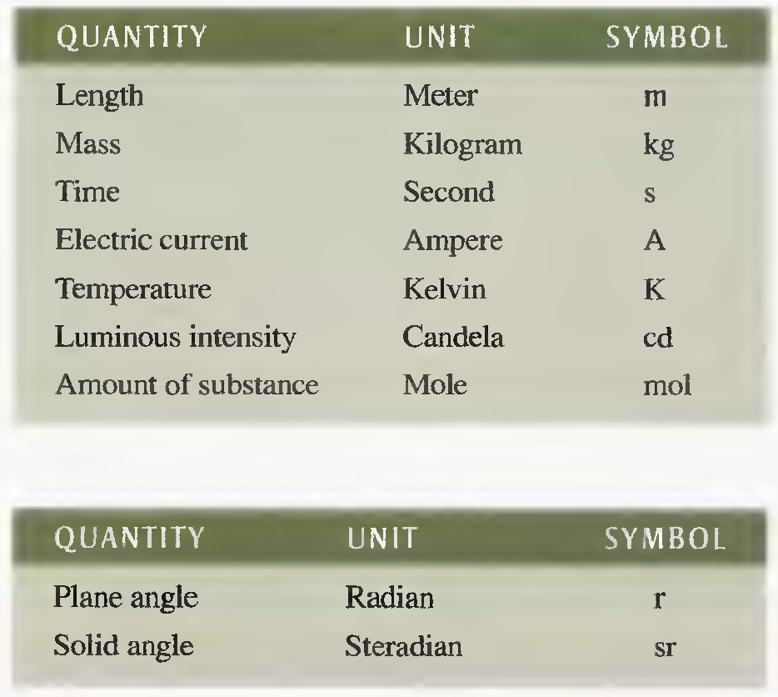
Units of measurement
SI fundamental units
SI supplementary units

Slide 7
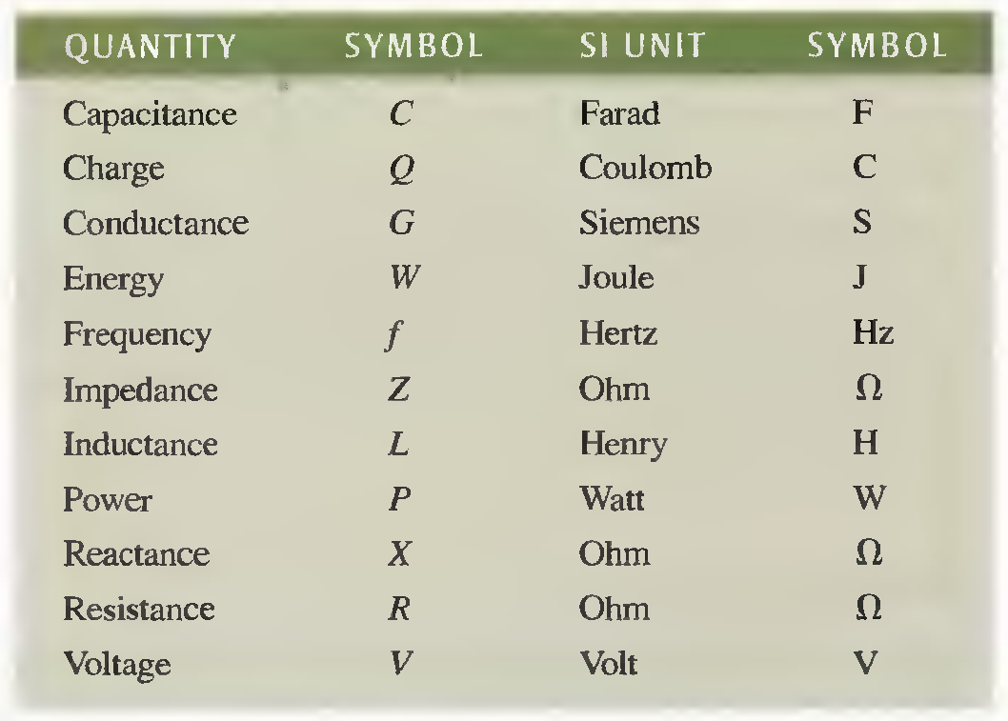
Units of measurement
Except for current which is a fundamental unit, all electrical and magnetic units are derived from the fundamental units.
Electric Quantities and Units
Electrical quantities and derived units with SI symbols.

Slide 8

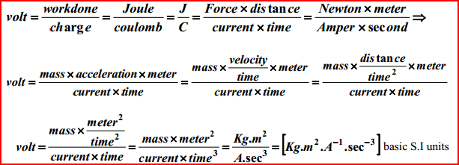
For example, the derived unit of voltage, which is the volt (V), is defined in terms of fundamental units as .
As you can see, this combination of fundamental units is very cumbersome and impractical. Therefore, volt is used as the derived unit
Derivation of volt (V) unit in fundamental units.

Slide 9
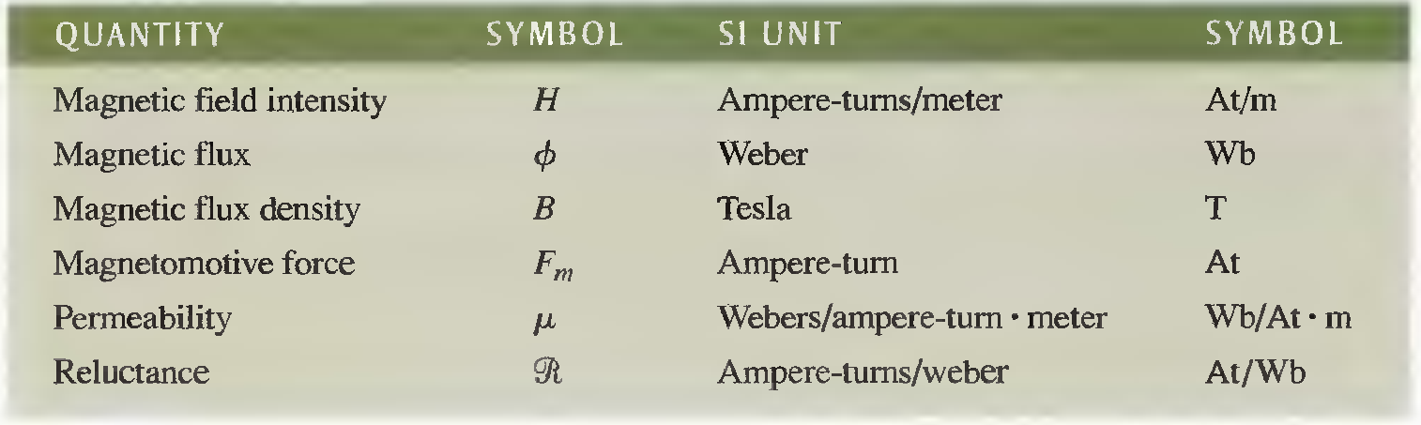
Units of measurement
Magnetic quantities and Units
Magnetic quantities and derived units with SI symbols.

Slide 10
Scientific Notation
Very large and very small numbers are represented with scientific Notation.
In scientific notation, a quantity is expressed as a product of a number between 1 and 10 and a power of ten (10^{x}).
For Example
47,000,0.0 = 4.7 x 10⁵
0.00022 = 2.2 x 10⁻⁴

Slide 11


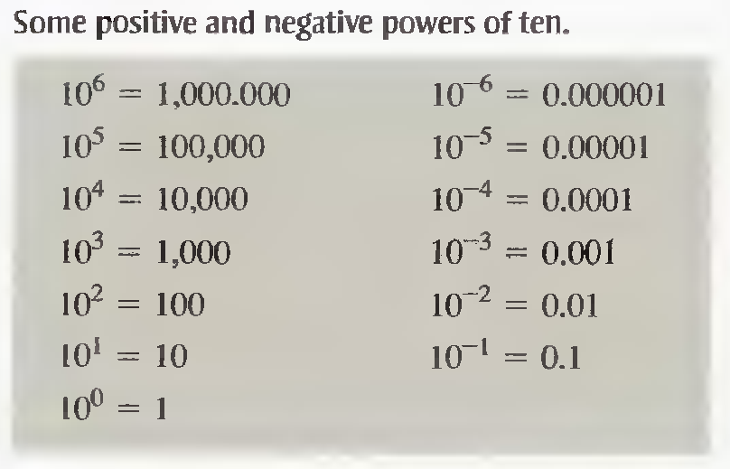
Power of Ten

Slide 12
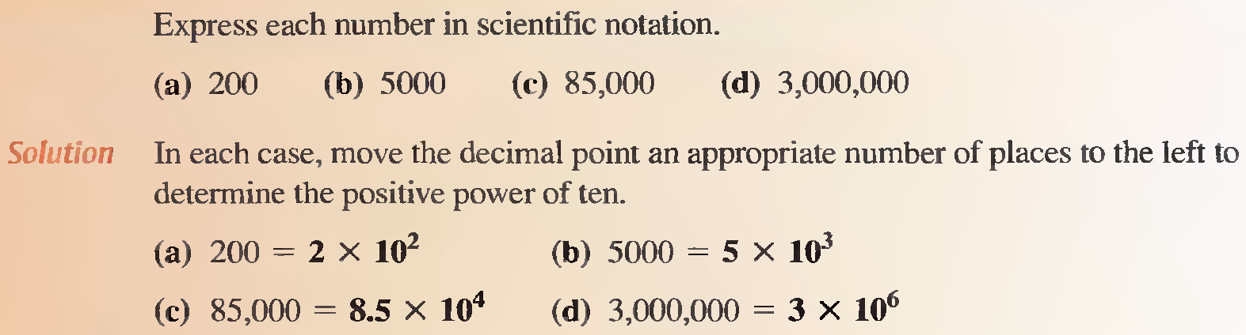
Examples
Q 1

Slide 13
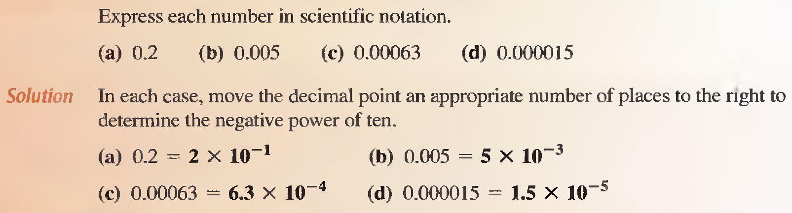
Examples
Q 2

Slide 14
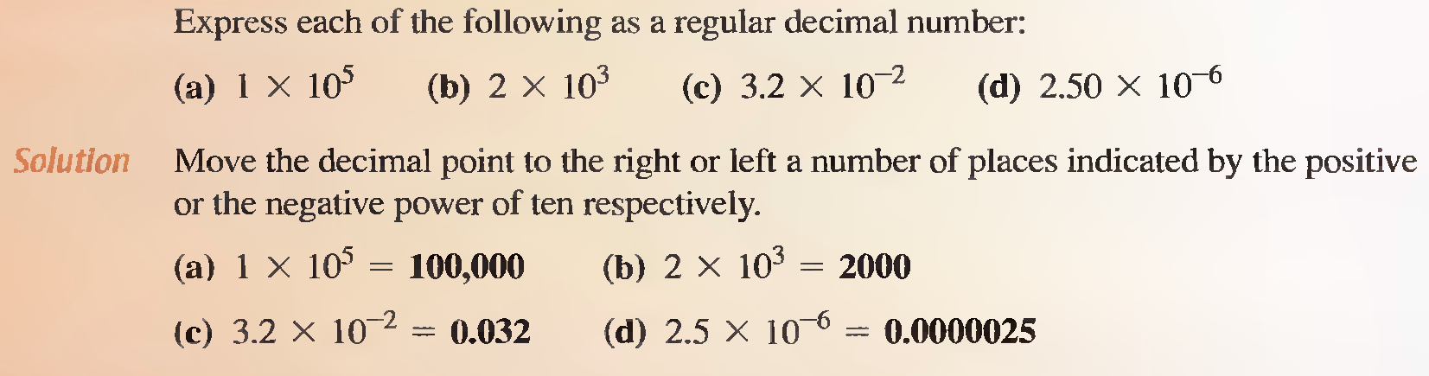
Examples
Q 3

Slide 15
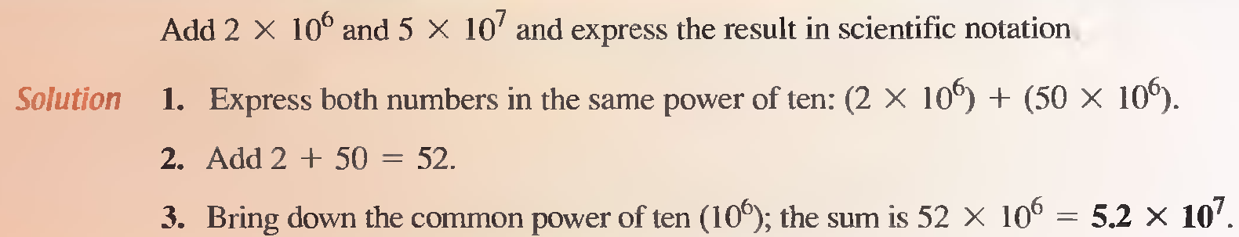
Examples
Q 4

Slide 16
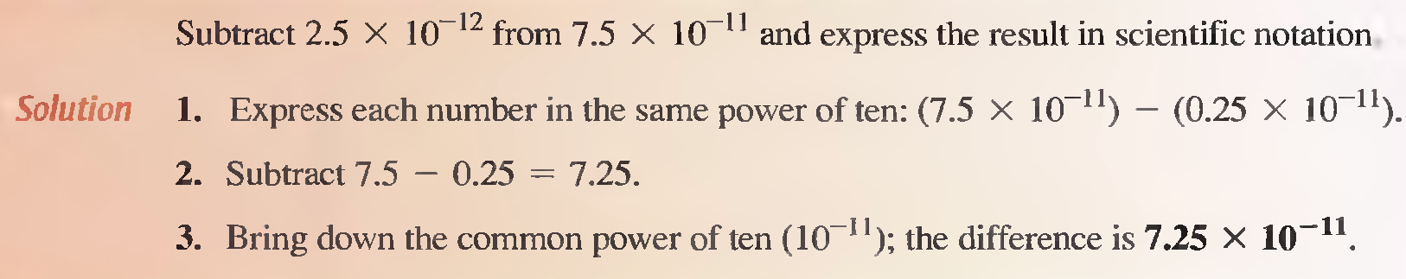
Examples
Q 5

Slide 17
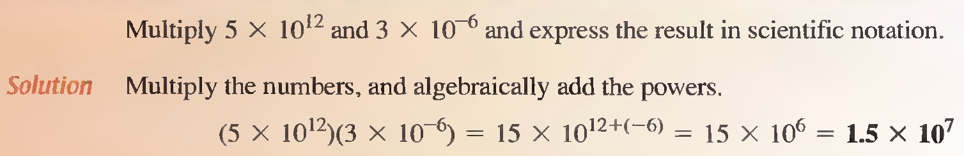
Examples
Q 6

Slide 18
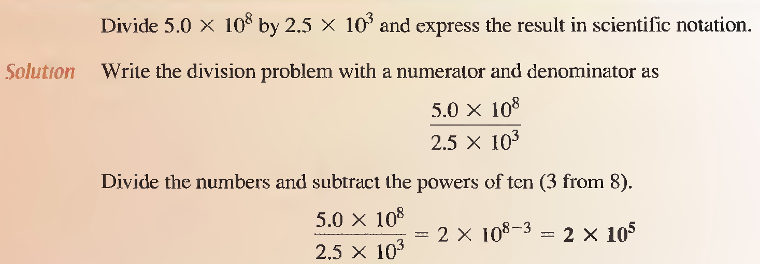
Examples
Q 7

Slide 19
Engineering Notation
Engineering notation is similar to scientific notation. However, in engineering notation a number can have from one to three digits to the left of the decimal point and the power-of-ten exponent must be a multiple of three.

Slide 20
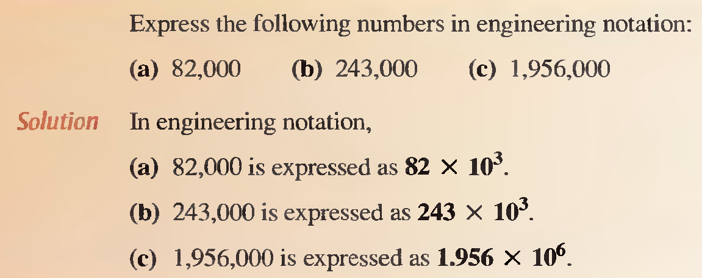
Examples
Q 1

Slide 21
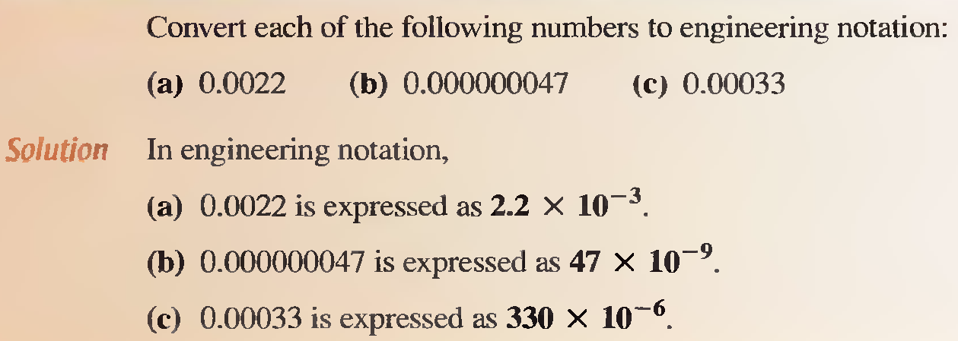
Examples
Q 2

Slide 22
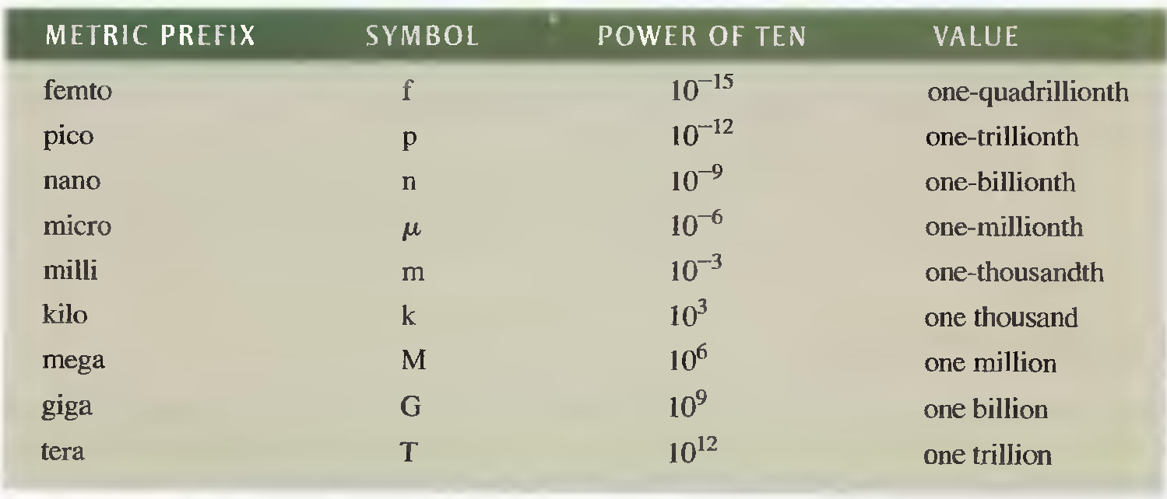
Metric Prefixes
In engineering notation metric prefixes represent each of the most commonly used powers of ten.
Metric prefixes with their symbols and corresponding powers of ten and values.

Slide 23
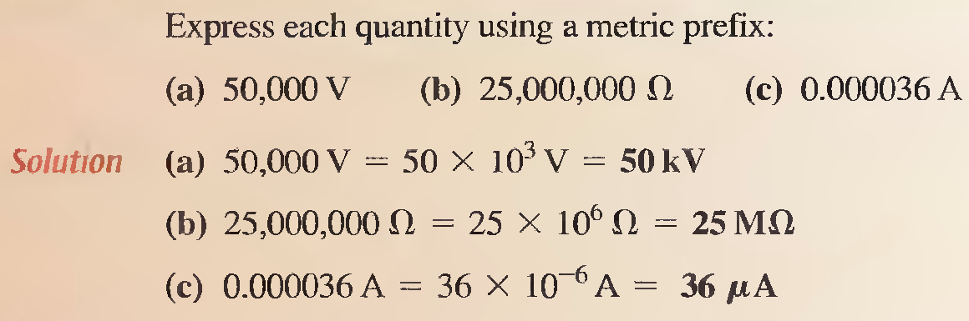
Examples
Q 1

Slide 24
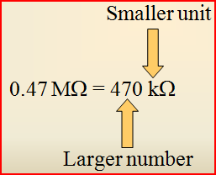
Metric Unit Conversion
When converting from a larger unit to a smaller unit, move the decimal point to the right. Remember, a smaller unit means the number must be larger.

Slide 25
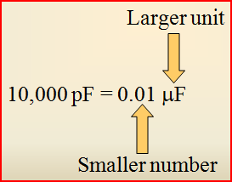
Metric Unit Conversion
When converting from a smaller unit to a larger unit, move the decimal point to the left. Remember, a larger unit means the number must be smaller.

Slide 26
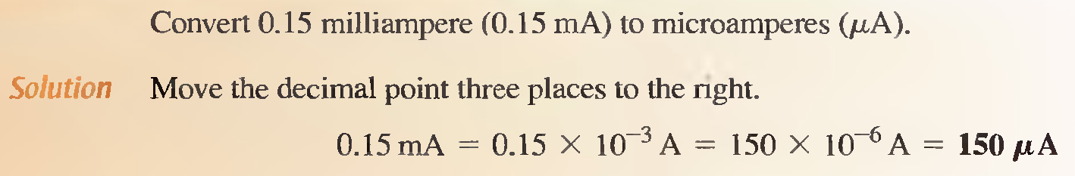
Metric Unit Conversion
Q 1

Slide 27
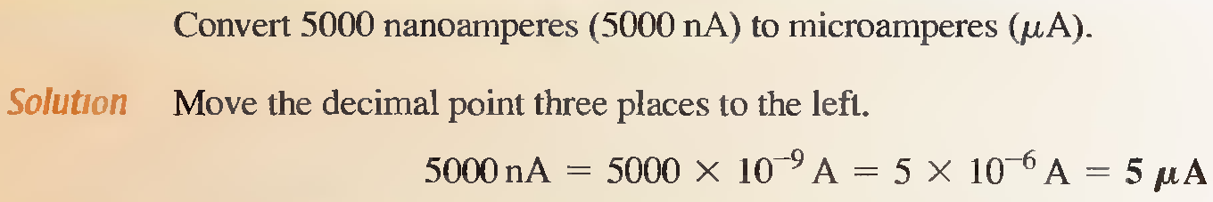
Examples
Q 2

Slide 28
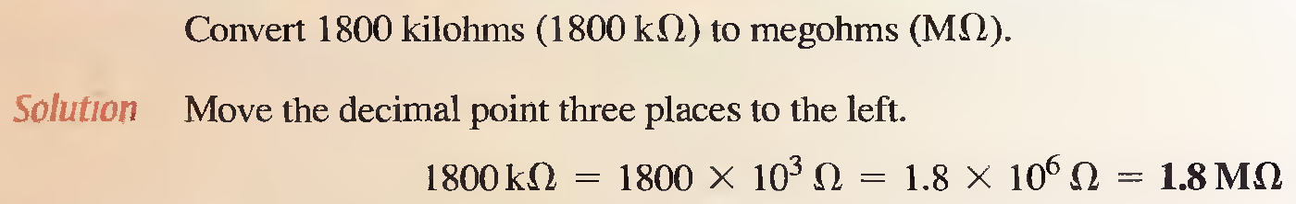
Examples
Q 3

Slide 29
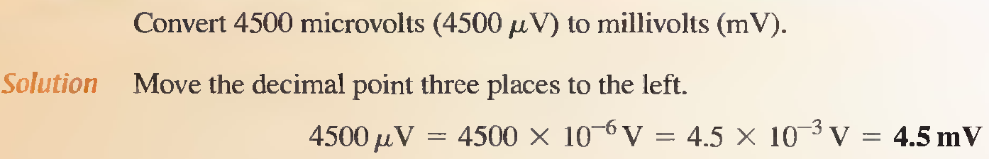
Metric Unit Conversion
Q 4

Slide 30
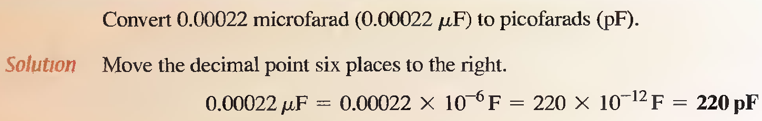
Examples
Q 5

Slide 31
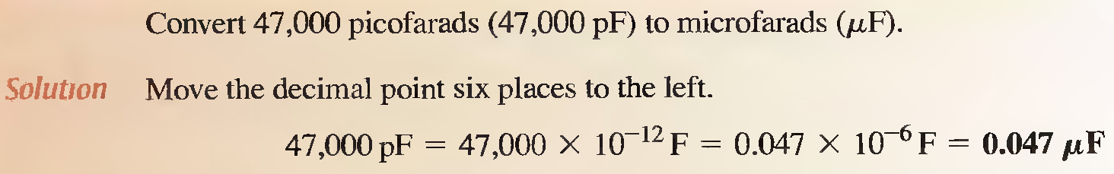
Examples
Q 6

Slide 32
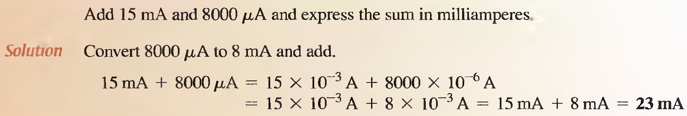
Metric Unit Conversion
When adding (or subtracting) quantities with different metric prefixes, first convert one of the quantities to the same prefix as the other quantity.
Q 7

Slide 33
Summary
SI is an abbreviation of the international system of units.
A fundamental unit is an SI unit from which other SI units are derived. There are seven fundamental units.
Scientific notation is a method for representing very large and very small numbers as a number between one and ten (one digit to left of decimal point) times a power of ten.
Engineering notation is a form of scientific notation in which quantities are represented with one, two, or three digits to the left of the decimal point times a power of ten that is a multiple of three.
Metric prefixes represent powers of ten in numbers expressed in engineering notation.

