Slide 1
Lecture 20
Problems Solving-Norton's theorem
Maximum Power Transfer Theorem

Slide 2
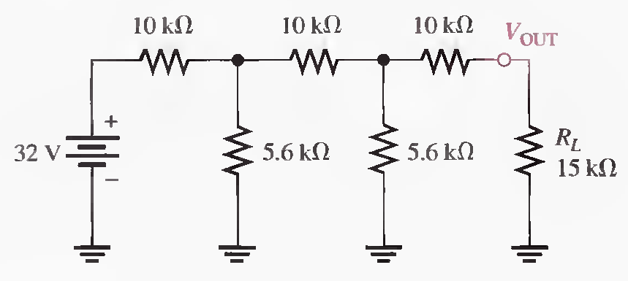
Q.2 Using Norton's theorem, find the current through the load resistor RL. (Solved on 2 slides)
RN = 14.0 kΩ, RT = 14.0 kΩ, IT=2.29 mA, I1=668 μA, IN=240 μA, IL=116 μA

Slide 3
RN = 14.0 kΩ, RT = 14.0 kΩ, IT=2.29 mA, I1=668 μA, IN=240 μA, IL=116 μA

Slide 4
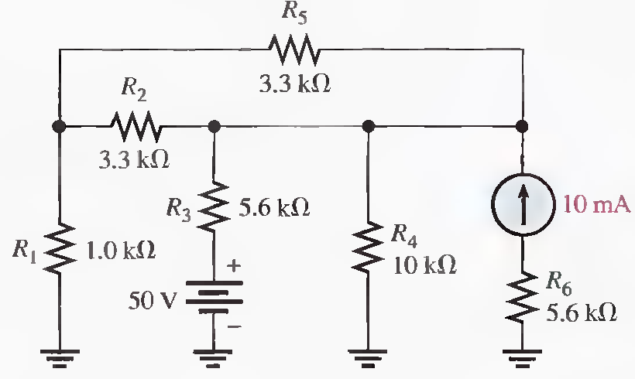
Q.3 Using Norton's theorem, find the voltage across R5 in the following Figure. (Solved on 3 slides)
For 50 V: RT = R3 + R1 || R4 = 6.51 kΩ, IT= 7.68 mA, IN= 6.98 mA, RN = 1.92 kΩ, IR5= 2.57 mA
For 10mA: IN= 7.82 mA, RN=1.92 kΩ, IR5= 2.85 mA , IR5(tot)= 5.42mA, V5=17.9 V

Slide 5
For 50 V: RT = R3 + R1 || R4 = 6.51 kΩ, IT= 7.68 mA, IN= 6.98 mA, RN = 1.92 kΩ, IR5= 2.57 mA
For 10mA: IN= 7.82 mA, 1.92 kΩ, IR5= 2.85 mA , IR5(tot)= 5.42mA, V5=17.9 V

Slide 6
For 50 V: RT = R3 + R1 || R4 = 6.51 kΩ, IT= 7.68 mA, IN= 6.98 mA, RN = 1.92 kΩ, IR5= 2.57 mA
For 10mA: IN= 7.82 mA, 1.92 kΩ, IR5= 2.85 mA , IR5(tot)= 5.42mA, V5=17.9 V

Slide 7
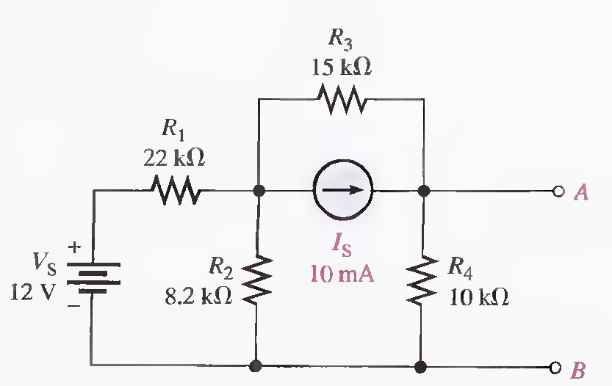
Q.4 Reduce the circuit between terminals A and B in the following Figure to its Norton equivalent. (Solved on 2 slides)
RN = 6.77 kΩ, For VS: RT=27.3 kΩ, IT= 440 μA, IN1 = 156 μA down, For IS: IN2=7.15 mA down,
IN = IN1 + IN2 = 156 μA + 7.15 mA = 7.31 mA

Slide 8
RN = 6.77 kΩ, For VS: RT=27.3 kΩ, IT= 440 μA, IN1 = 156 μA down, For IS: IN2=7.15 mA down,
IN = IN1 + IN2 = 156 μA + 7.15 mA = 7.31 mA

Slide 9
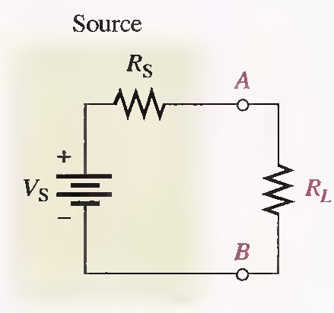
MAXIMUM POWER TRANSFER THEOREM
The maximum power transfer theorem is important when you need to know the value of the load at which the most power is delivered from the source.
For a given source voltage, maximum power is transferred from a source to a load when the load resistance is equal to the internal source resistance.
Maximum power is transferred to the load when R L = R s

Slide 10
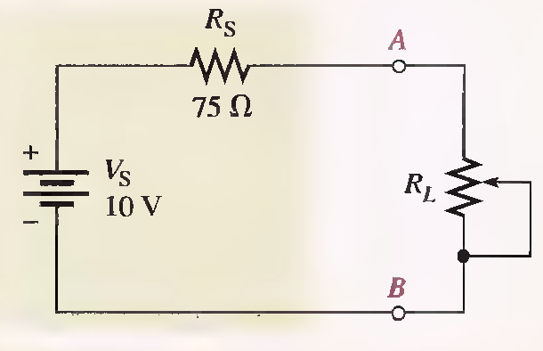
Q.1 The source in the following Figure has an internal source resistance of 75Ω. Determine the load power for each of the following values of load resistance:
(a) 0 Ω (b) 25 Ω (c) 50 Ω (d) 75 Ω (e) 100 D (f) 125 Ω
Draw a graph showing the load power versus the load resistance. (Solved on 2 slides)
a) IL=133mA, PL= 0mW, b) IL=100mA , PL= 250mW, c) IL=80mA, PL= 320mW ,
d) IL=66.7 mA, PL= 334mW , e) IL=57.1mA, PL=326mW f) IL=50mA, PL=313mW

Slide 11
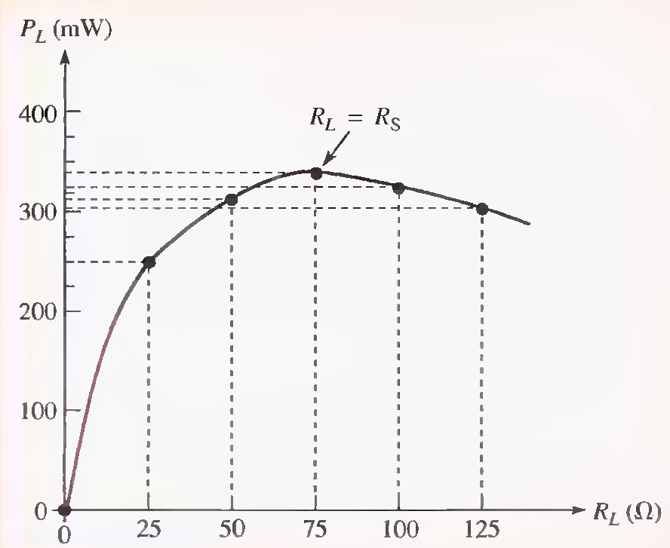
a) IL=133mA, PL= 0mW, b) IL=100mA , PL= 250mW, c) IL=80mA, PL= 320mW ,
d) IL=66.7 mA, PL= 334mW , e) IL=50mA, PL=313mW

Slide 12
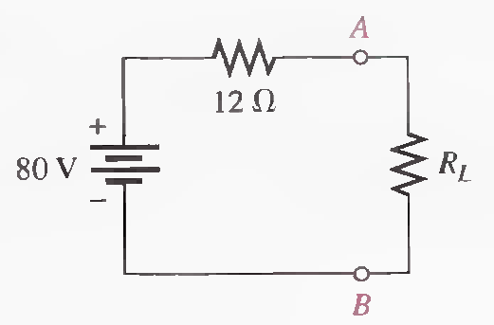
Q.2 In the following circuit, maximum power is to be transferred to the load R L . Determine the appropriate value for RL.
RL = RS = 12 Ω

Slide 13
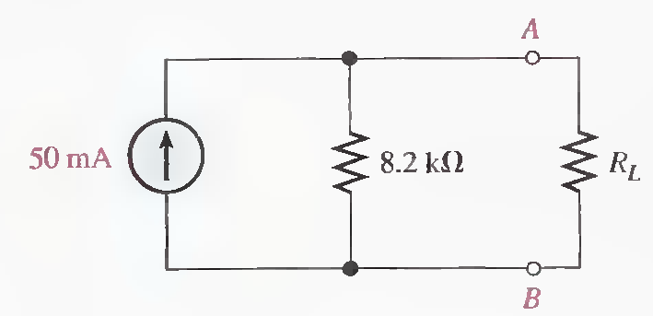
Q.3 In the following circuit, maximum power is to be transferred to the load R L . Determine the appropriate value for RL.
RL = RS = 8.2 kΩ

Slide 14
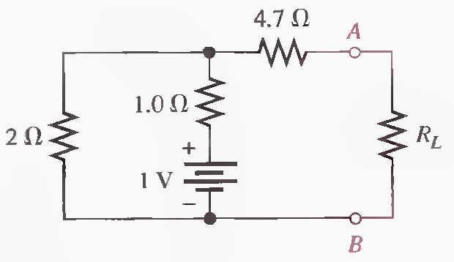
Q.4 In the following circuit, maximum power is to be transferred to the load R L . Determine the appropriate value for RL.
RL = RS =RTH= 4.7 Ω + 1 Ω || 2 Ω = 6.37 Ω

Slide 15
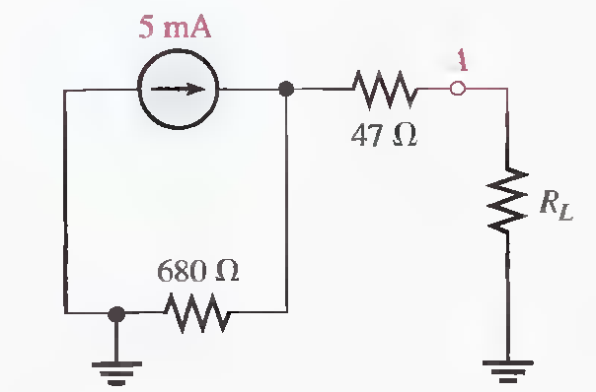
Q.5 In the following circuit, maximum power is to be transferred to the load R L . Determine the appropriate value for RL.
RL = RS = 47 Ω + 680 Ω = 727 Ω

Slide 16
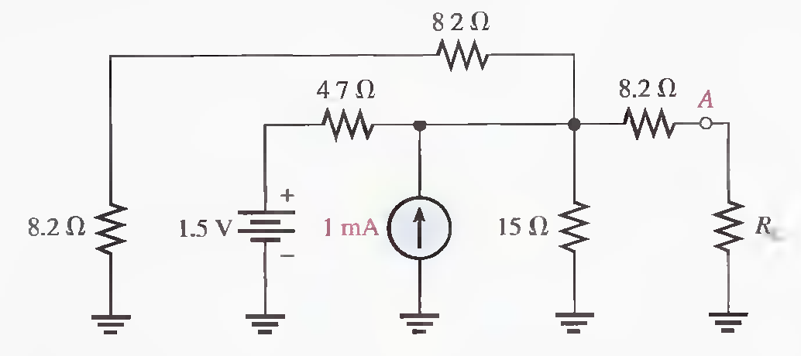
Q.6 Determine the value of RL for maximum power.
RS = 8.2 Ω + 2.94 Ω = 11.1 Ω, For maximum power transfer: RL = RS = 11.1 Ω

Slide 17
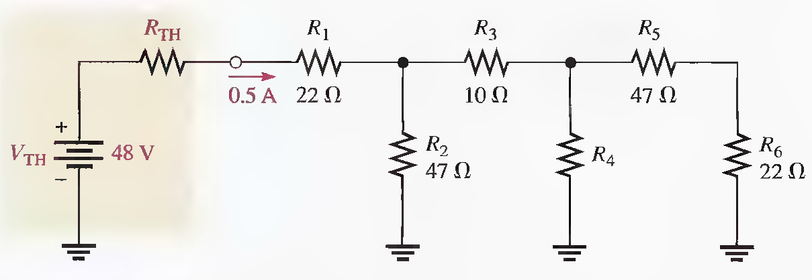
Q.7 What are the values of R4 and RTH when the maximum power is transferred from the thevenized source to the ladder network. (Solved on 2 slides)
RTH = RLADDER, VRTH = 24 V, RTH = 48 Ω, RLADDER = 48 Ω, R4=160 Ω

Slide 18
RTH = RLADDER, VRTH = 24 V, RTH = 48 Ω, RLADDER = 48 Ω, R4=160 Ω

Slide 19
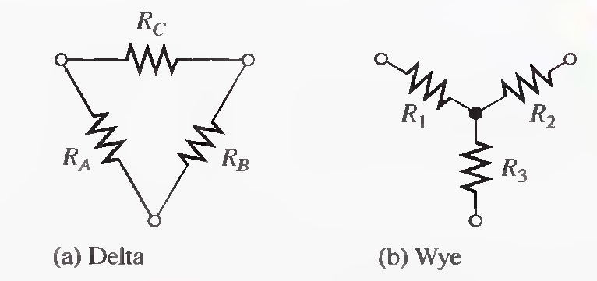
DELTA-TO-WYE (∆-TO-Y) AND WYE-TO-DELTA (Y-TO-∆) CONVERSIONS
Conversions between delta-type and wye-type circuit arrangements are useful in certain specialized three-terminal applications.

Slide 20
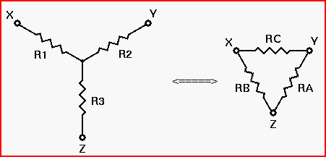
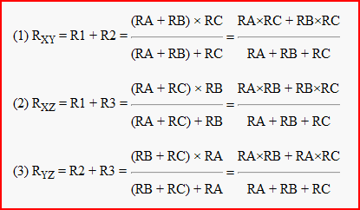
Deriving the Initial Equations

Slide 21
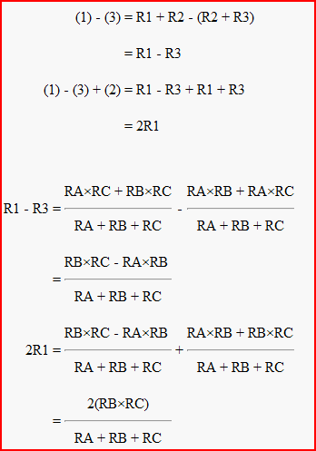
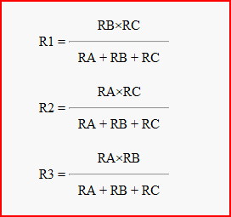
Solving For R1, R2, and R3

Slide 22
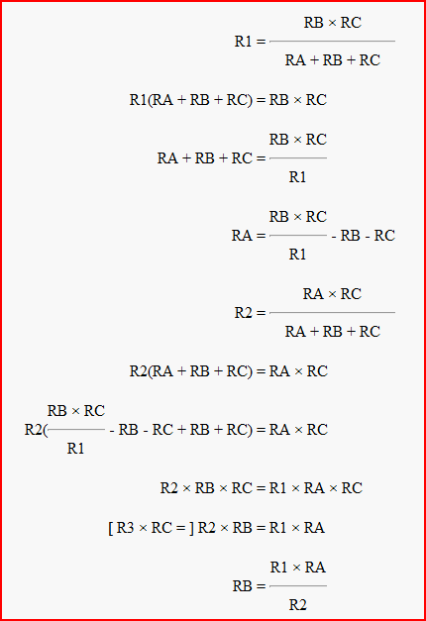

Solving for RA, RB, and RC

Slide 23
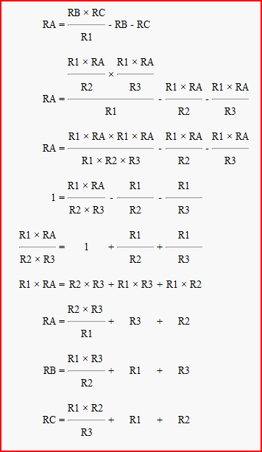
You don't really need to know these derivations, although understanding them will help you with your understanding of electronics in general. However, you should know the conversion formulas themselves, and be able to apply them when designing or analyzing electronic circuits.

Slide 24
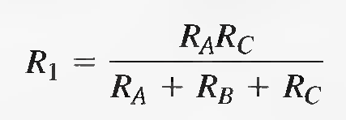
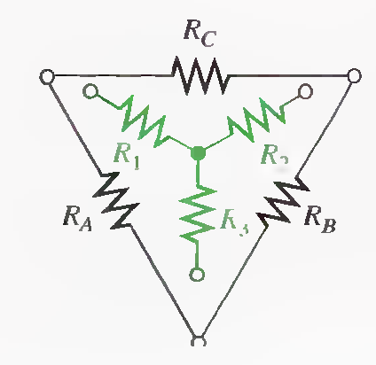
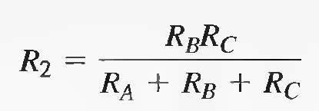
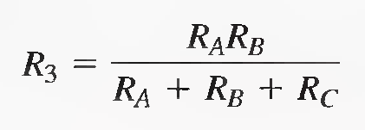
∆-to-Y Conversion
Each resistor in the wye is equal to the product of the resistors in two adjacent delta branches, divided by the sum of all three delta resistors.

Slide 25
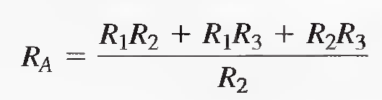
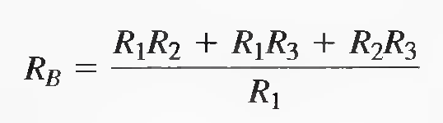
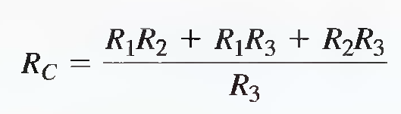
Y-to-∆ Conversion
Each resistor in the delta is equal to the sum of all possible products of wye resistors taken two at a time, divided by the opposite wye resistor.

Slide 26
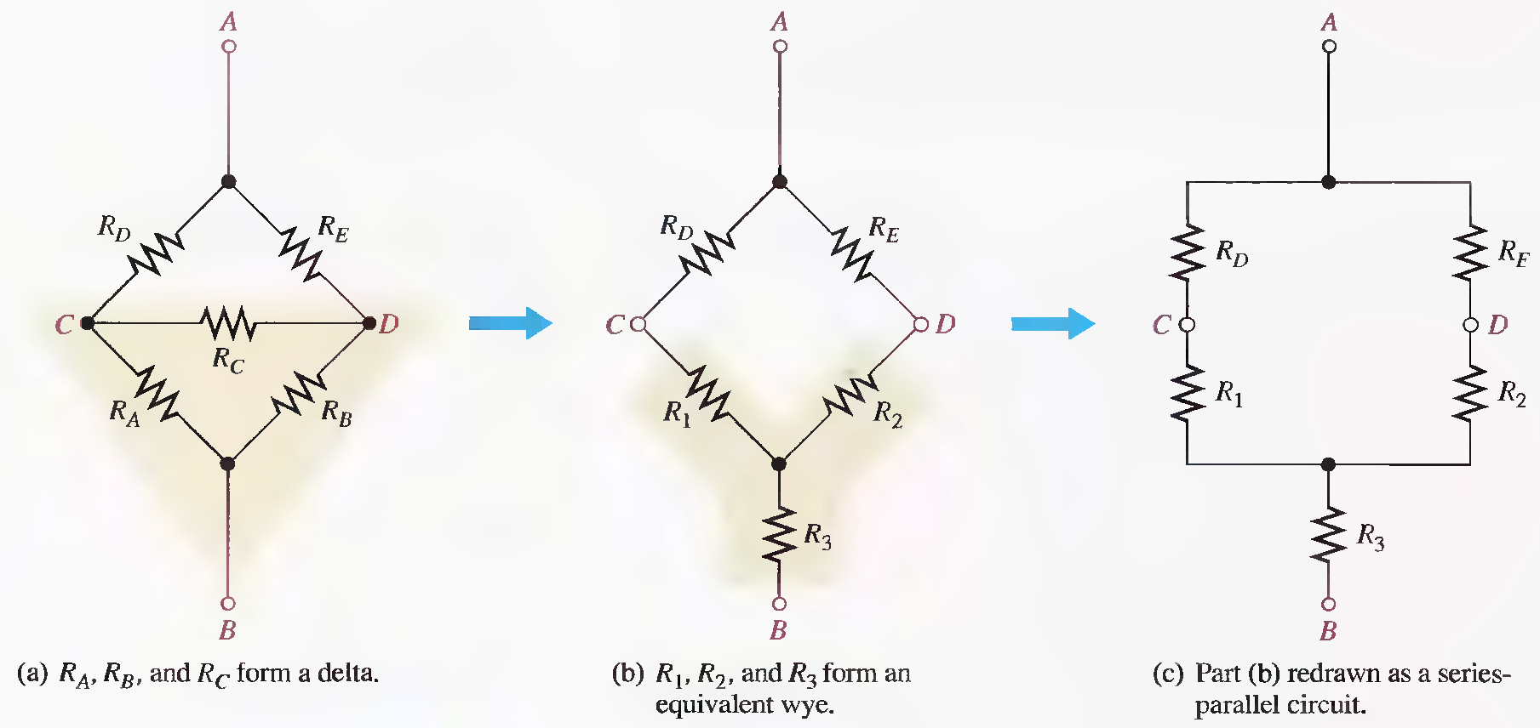
Application of ∆-to-Y Conversion to a Bridge Circuit

Slide 27
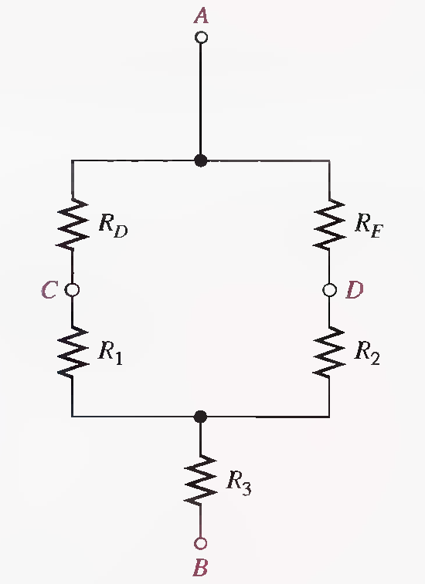

Slide 29
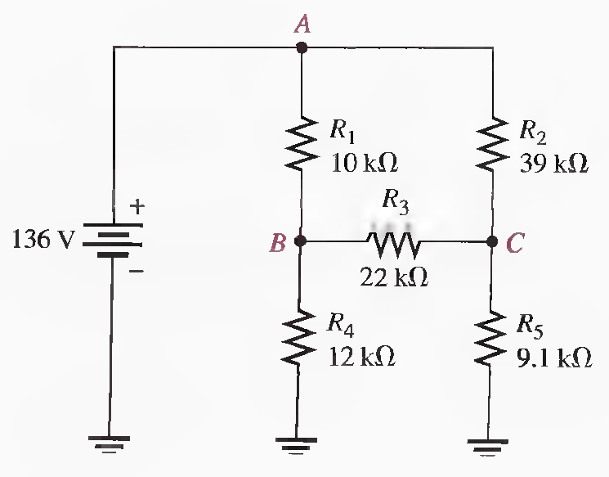
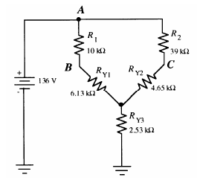
Q.1 Find all currents in the circuit of following Figure.
RT=14.3 kΩ, IT=9.5 mA, IR1 = IRY1=6.94 mA, IR2 = IRY2 = 2.56 mA, VB = VA − IR1.R1 =66.6 V,
VC=36.16 V, IR4 =5.55 mA, IR5 =3.97 mA, IR3=1.38 mA

Slide 30
RT=14.3 kΩ, IT=9.5 mA, IR1 = IRY1=6.94 mA, IR2 = IRY2 = 2.56 mA, VB=66.6 V, VC=36.16 V
IR4 =5.55 mA, IR5 =3.97 mA, IR3=1.38 mA

Slide 31
RT=14.3 kΩ, IT=9.5 mA, IR1 = IRY1=6.94 mA, IR2 = IRY2 = 2.56 mA, VB=66.6 V, VC=36.16 V
IR4 =5.55 mA, IR5 =3.97 mA, IR3=1.38 mA End

