Slide 1
Supply
Quantity supplied (Q_{s})
  Amount of a good or service offered for sale during a given period of time

Slide 2
Supply
Six variables that influence Q_{s}
  Price of good or service (P)
  Input prices (P_{I} )
  Prices of goods related in production (P_{r})
  Technological advances (T)
  Expected future price of product (P_{e})
  Number of firms producing product (F)
General supply function
  Q_{s} = f(P, P_{I}, P_{r}, T, P_{e}, F)

Slide 3
General Supply Function
  Q_{s} = h + kP + lP_{I} + mP_{r} + nT + rP_{e} + sF
k, l, m, n, r, & s are slope parameters
  Measure effect on Q_{s} of changing one of the variables while holding the others constant
Sign of parameter shows how variable is related to Q_{s}
  Positive sign indicates direct relationship
  Negative sign indicates inverse relationship

Slide 4
General Supply Function
Variable | Relation to Q_{s} | Sign of Slope Parameter
P
Direct
k = ΔQ_{s}/ΔP is positive
P_{I}
Inverse
l = ΔQ_{s}/ΔP_{I} is negative
Inverse for substitutes
m = ΔQ_{s}/ΔP_{r} is negative
P_{r}
Direct for complements
m = ΔQ_{s}/ΔP_{r} is positive
T
Direct
n = ΔQ_{s}/ΔT is positive
P_{e}
Inverse
r = ΔQ_{s}/ΔP_{e} is negative
F
Direct
s = ΔQ_{s}/ΔF is positive

Slide 5
Direct Supply Function

Slide 6
Inverse Supply Function
Traditionally, price (P) is plotted on the vertical axis & quantity supplied (Q_{s}) is plotted on the horizontal axis
  The equation plotted is the inverse supply function, P = f(Q_{s})

Slide 7
Inverse Supply Function

Slide 8
Graphing Supply Curves
A point on a direct supply curve shows either:
  Maximum amount of a good that will be offered for sale at a given price
  Minimum price necessary to induce producers to voluntarily offer a particular quantity for sale

Slide 9
Direct Supply Function

Slide 10
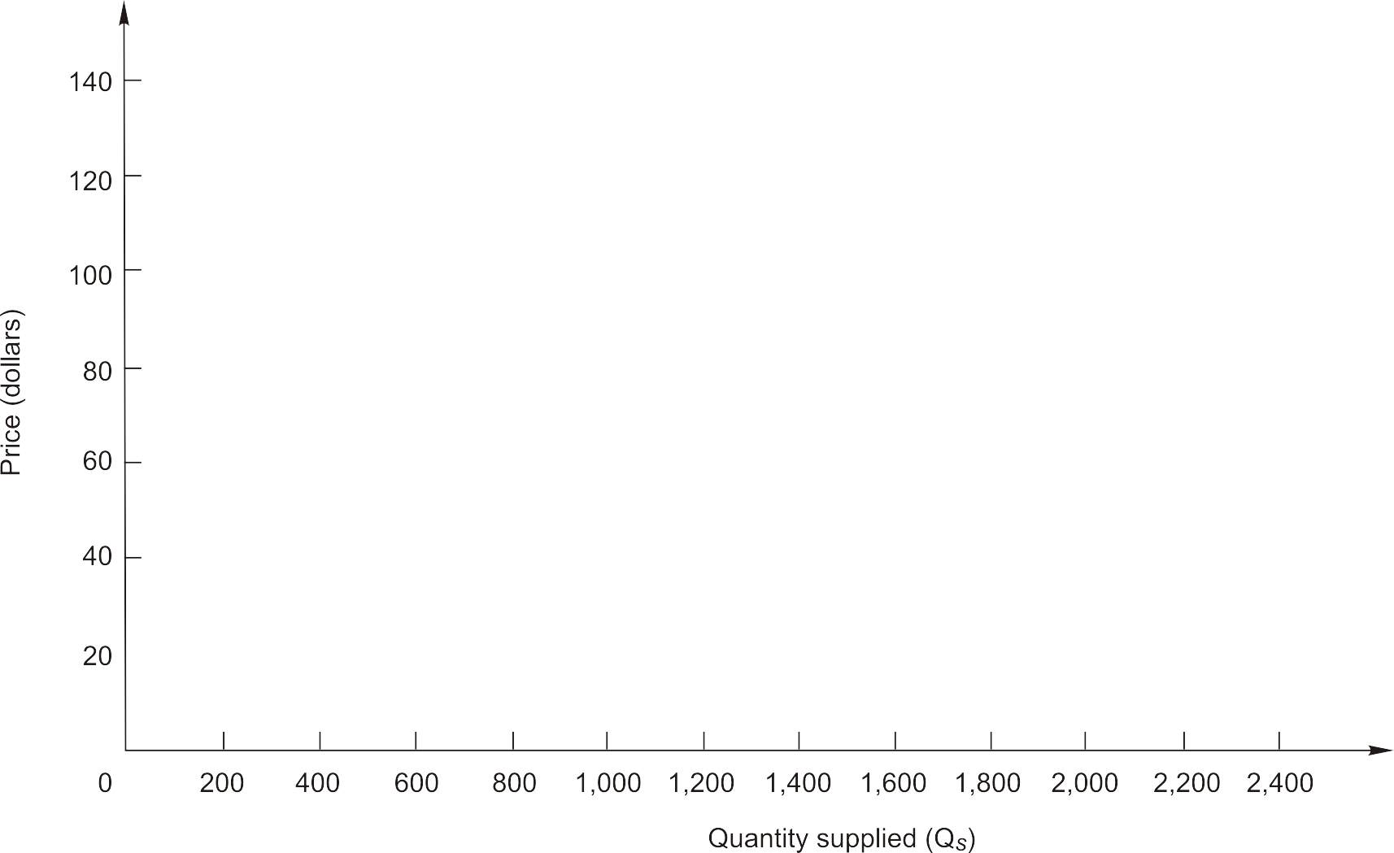
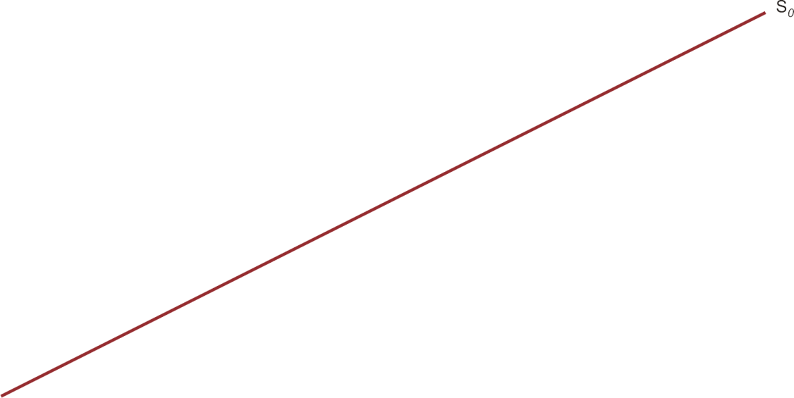
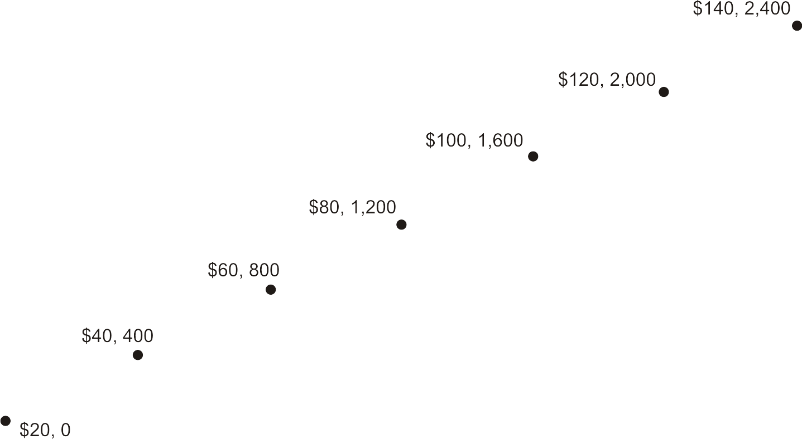
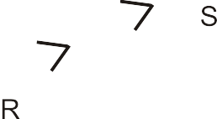
A Supply Curve (Figure 2.3)

Slide 11
Graphing Supply Curves
Change in quantity supplied
  Occurs when price changes
  Movement along supply curve
Change in supply
  Occurs when one of the other variables, or determinants of supply, changes
  Supply curve shifts rightward or leftward

Slide 12
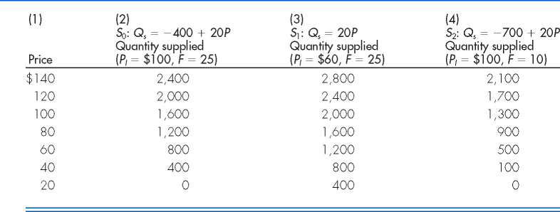
Three Supply Functions

Slide 13
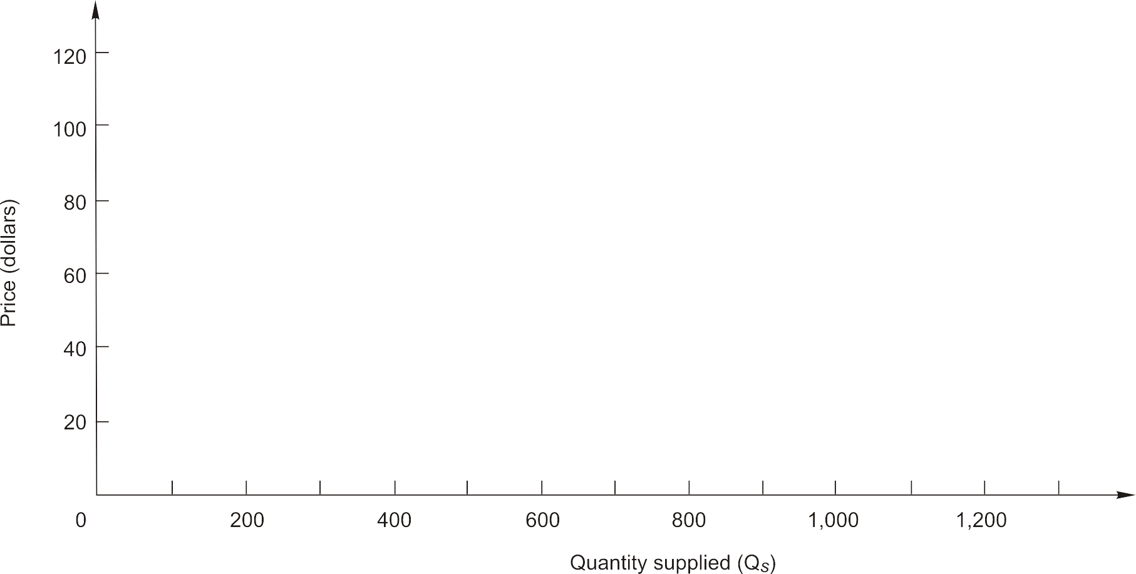
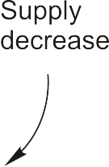
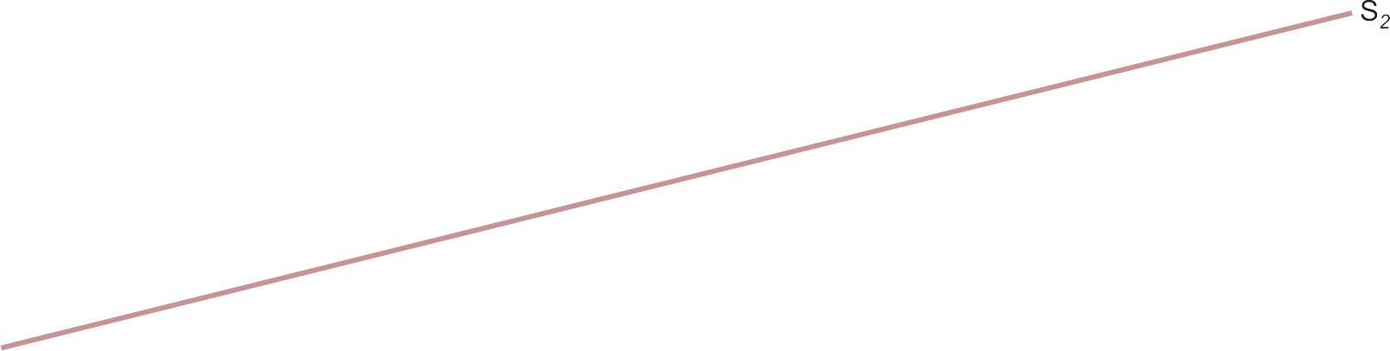
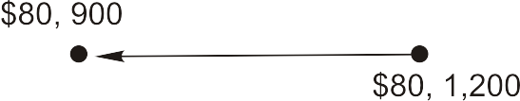
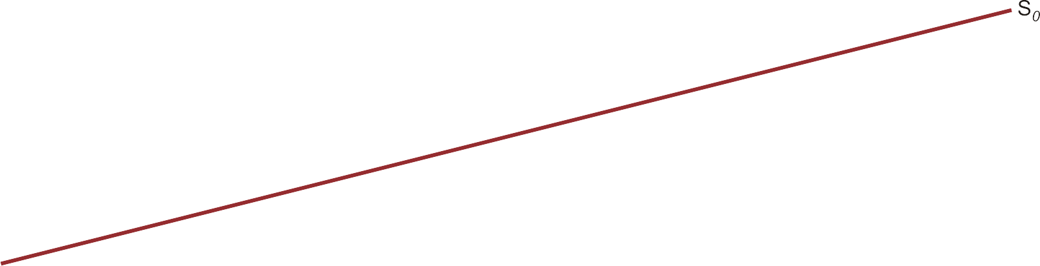
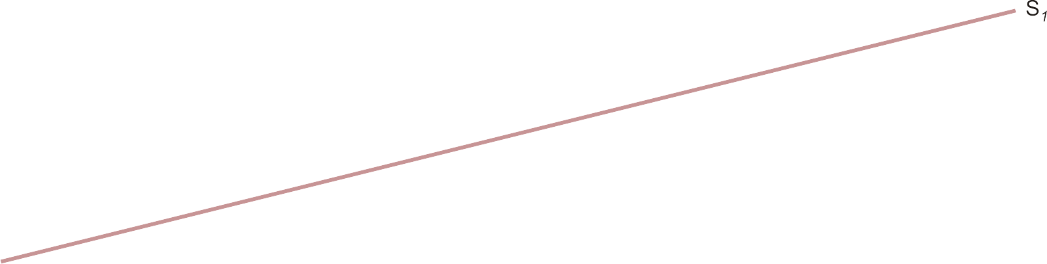

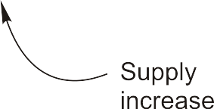
Shifts in Supply (Figure 2.4)

Slide 14
Market Equilibrium
Equilibrium price & quantity are determined by the intersection of demand & supply curves
  At the point of intersection, Q_{d} = Q_{s}
  Consumers can purchase all they want & producers can sell all they want at the “market-clearing” or “equilibrium” price

Slide 15
Market Equilibrium

Slide 16
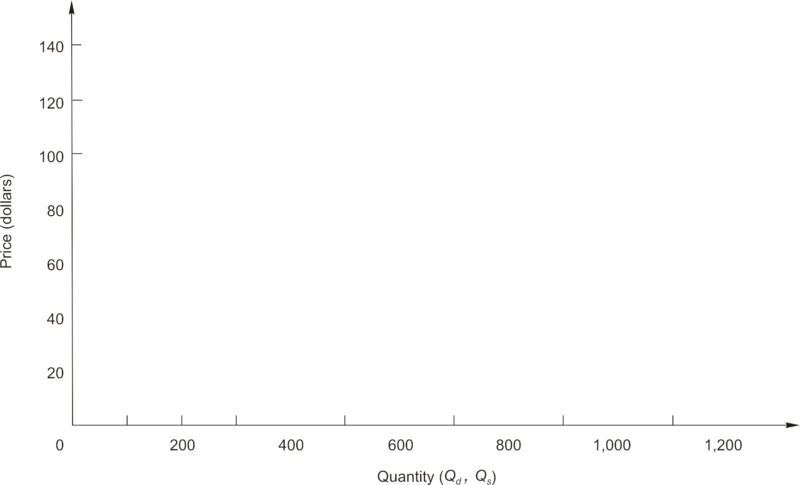
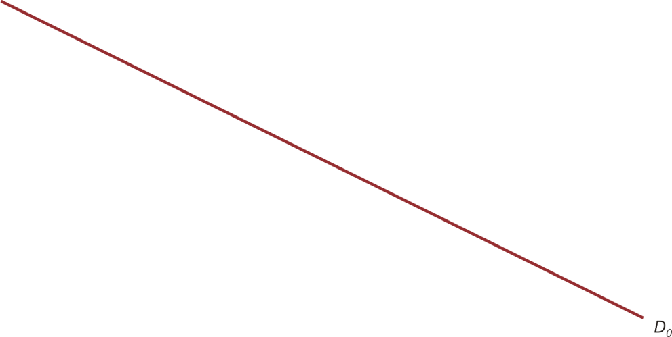
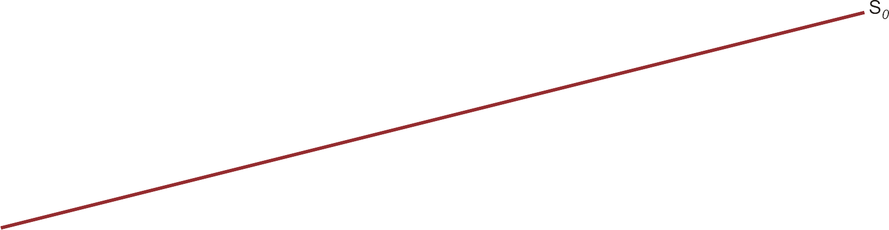
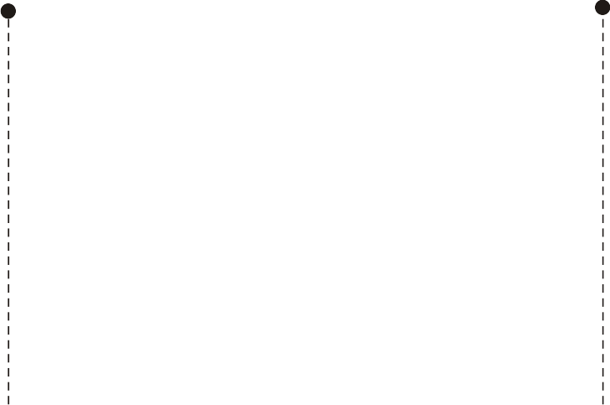
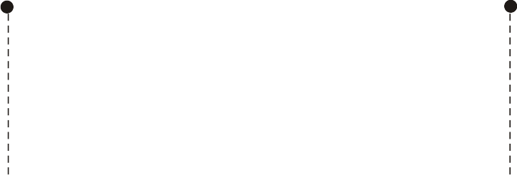
Market Equilibrium (Figure 2.5)

Slide 17
Market Equilibrium
Excess demand (shortage)
  Exists when quantity demanded exceeds quantity supplied
Excess supply (surplus)
  Exists when quantity supplied exceeds quantity demanded

Slide 18
Ceiling & Floor Prices
Ceiling price
  Maximum price government permits sellers to charge for a good
  When ceiling price is below equilibrium, a shortage occurs
Floor price
  Minimum price government permits sellers to charge for a good
  When floor price is above equilibrium, a surplus occurs

Slide 19

Ceiling & Floor Prices (Figure 2.12)
P_{x}
P_{x}
Price (dollars)
S_{x}
S_{x}
3
2
2
1
D_{x}
D_{x}
62
Q_{x}
50
Q_{x}
22
50
32
84
Quantity
Quantity
Panel A – Ceiling price
Panel B – Floor price

Slide 20
Market Equilibrium

Slide 21
$50 Price Ceiling
A price ceiling is only effective when it is set below the equilibrium price

Slide 22
Marginal Valuation

Slide 23
$80 Price Floor

Slide 24
500 Unit Quota

Slide 25
The amount exchanged
Above equilibrium price the amount exchanged is determined by the demand curve
Below equilibrium price the amount exchanged is determined by the supply curve

Slide 26
Value of Market Exchange
Typically, consumers value the goods they purchase by an amount that exceeds the purchase price of the goods
Economic value
  Maximum amount any buyer in the market is willing to pay for the unit, which is measured by the demand price for the unit of the good

Slide 27
Measuring the Value of Market Exchange
Consumer surplus
  Difference between the economic value of a good (its demand price) & the market price the consumer must pay
Producer surplus
  For each unit supplied, difference between market price & the minimum price producers would accept to supply the unit (its supply price)
Social surplus
  Sum of consumer & producer surplus
  Area below demand & above supply over the relevant range of output

Slide 28
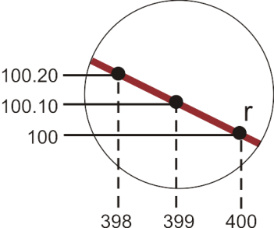
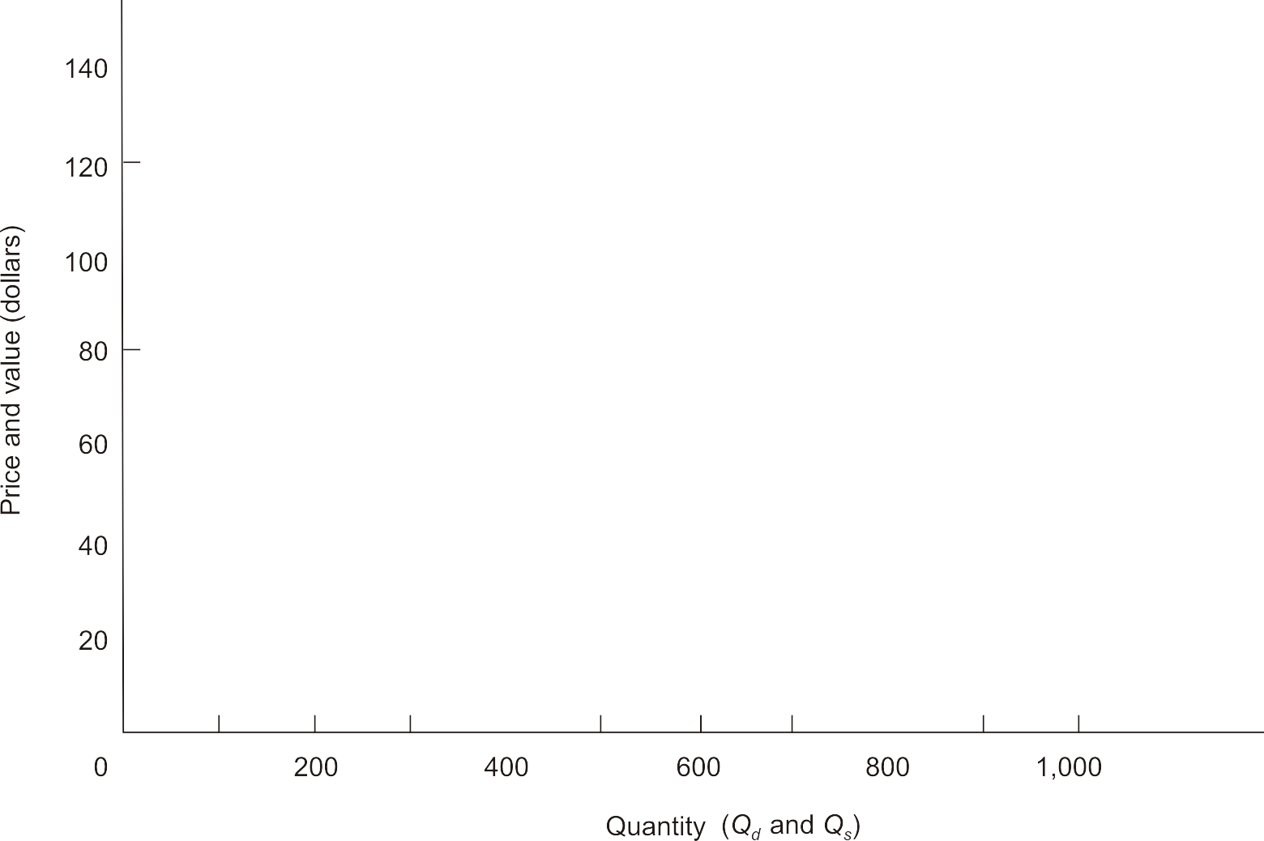

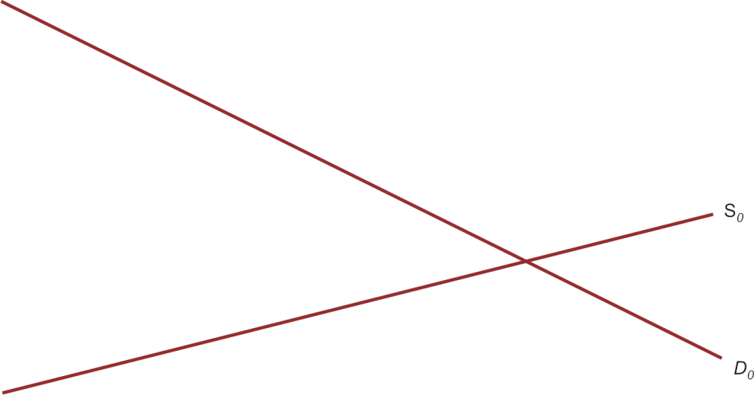
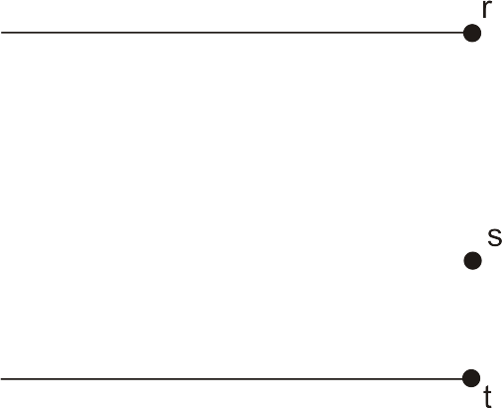
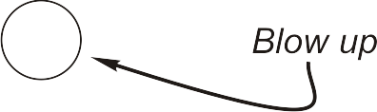


Measuring the Value of Market Exchange (Figure 2.6)

Slide 29
Changes in Market Equilibrium
Qualitative forecast
  Predicts only the direction in which an economic variable will move
Quantitative forecast
  Predicts both the direction and the magnitude of the change in an economic variable

Slide 30
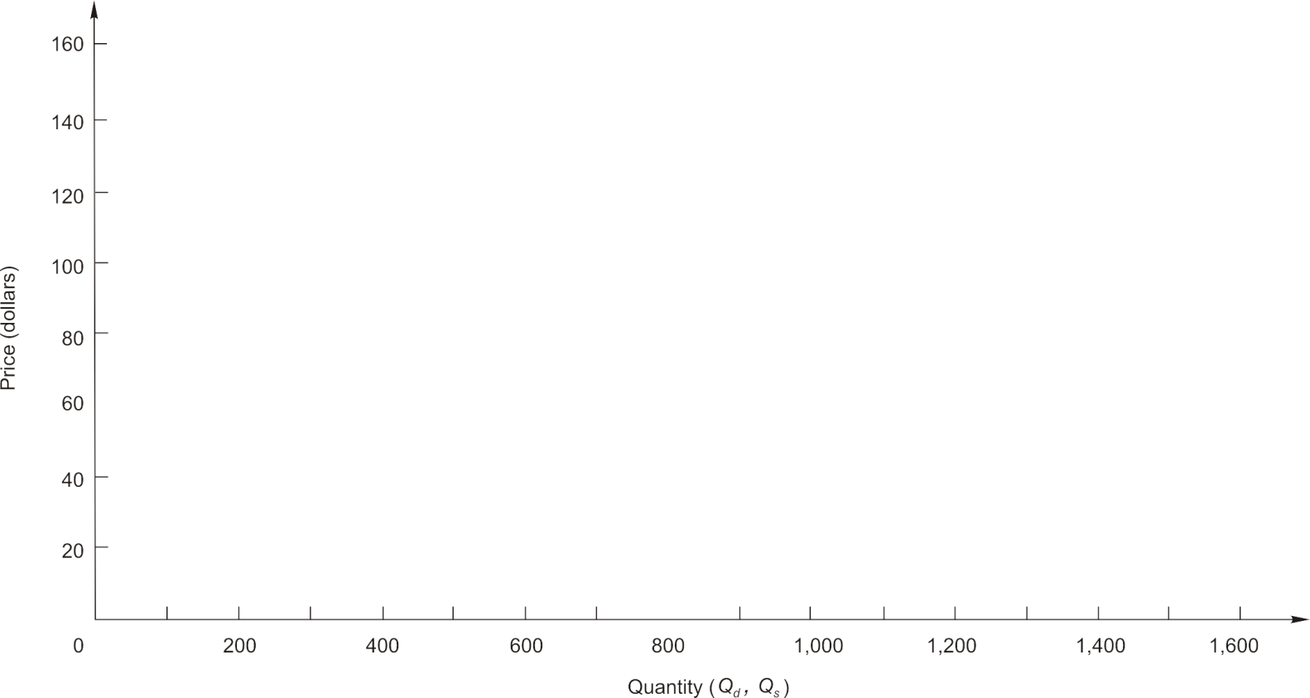
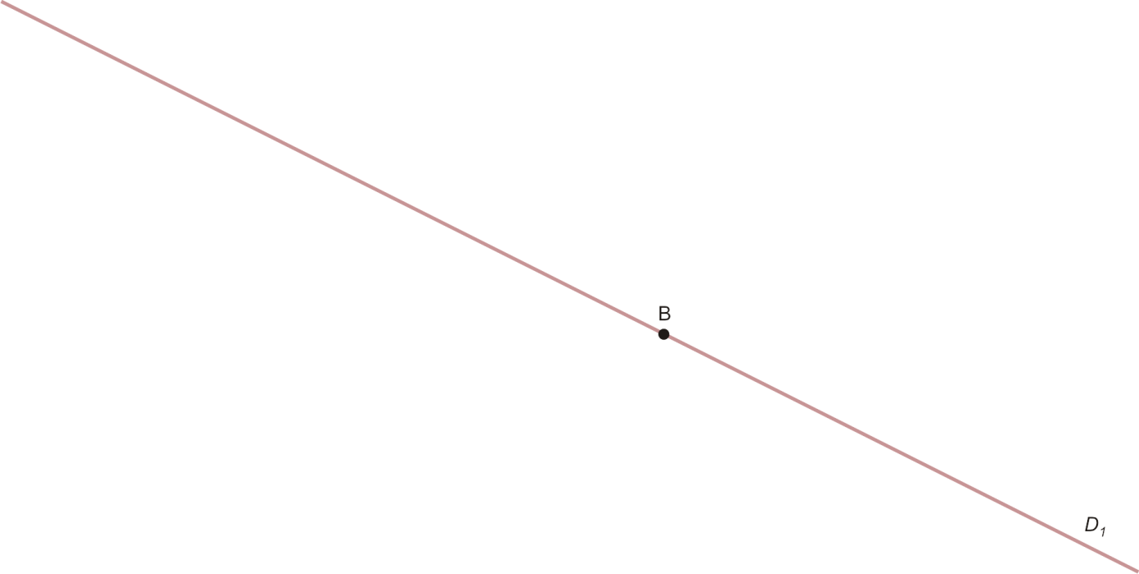
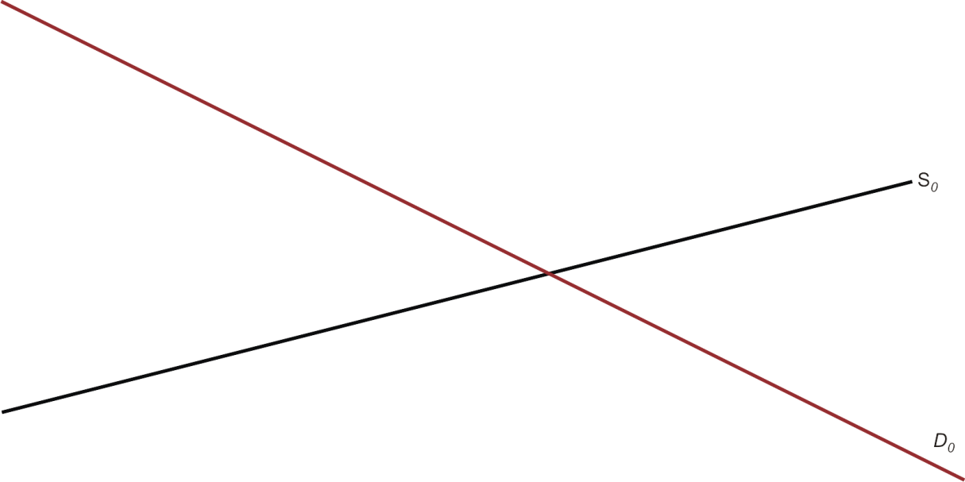
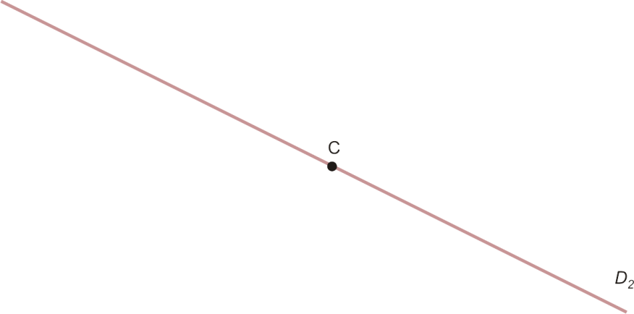


Demand Shifts (Supply Constant) (Figure 2.7)

Slide 31
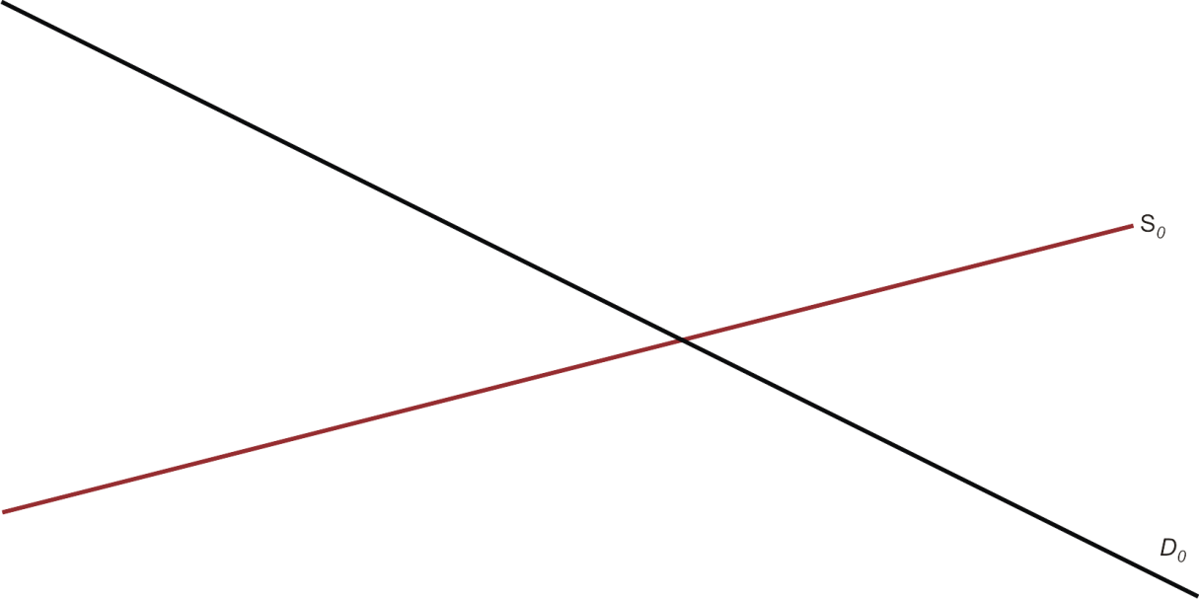
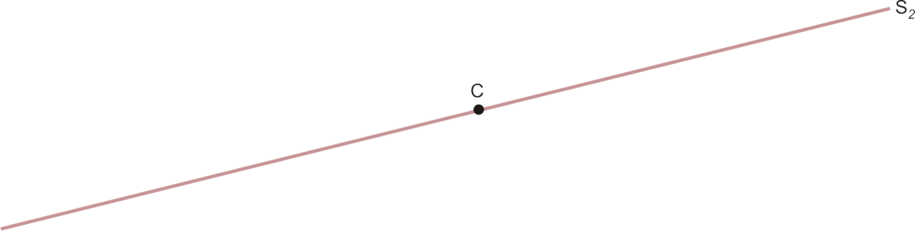
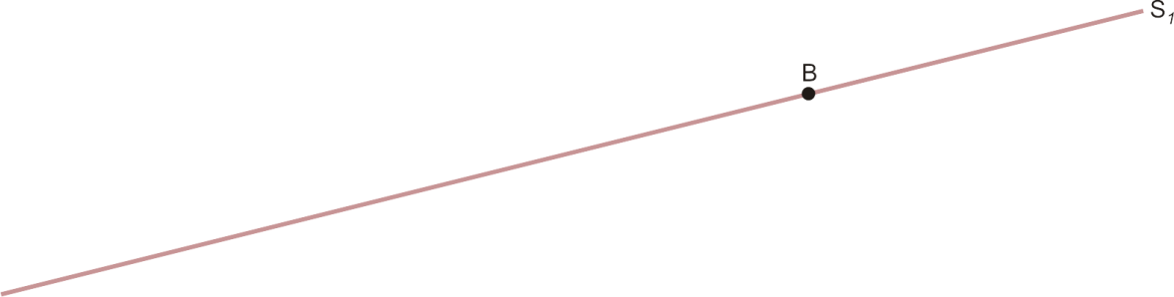

Supply Shifts (Demand Constant) (Figure 2.8)

Slide 32
Simultaneous Shifts
When demand & supply shift simultaneously
  Can predict either the direction in which price changes or the direction in which quantity changes, but not both
  The change in equilibrium price or quantity is said to be indeterminate when the direction of change depends on the relative magnitudes by which demand & supply shift

Slide 33




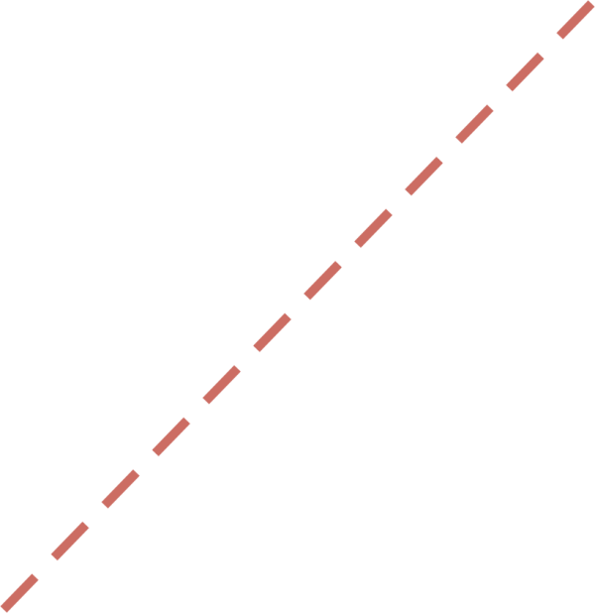
Simultaneous Shifts: (↑D, ↑S)
P
S
S′
S′′
B
P′
•
A
P
•
•
C
P′′
D′
D
Q
Q
Q′
Q′′
Price may rise or fall; Quantity rises

Slide 34
Simultaneous Shifts: (↓D, ↑S)
P
S
S′
S′
A
•
P
B
P′
•
•
C
P′′
D
D′
Q
Q′
Q
Q′′
Price falls; Quantity may rise or fall

Slide 35
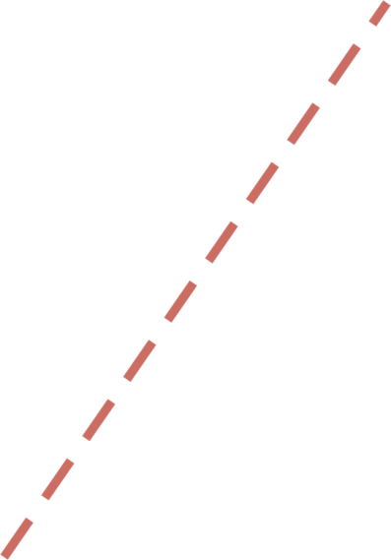
Simultaneous Shifts: (↑D, ↓S)
P
S′′
S′
•
S
P′′
C
B
•
P′
A
•
P
D′
D
Q
Q′′
Q′
Q
Price rises; Quantity may rise or fall

Slide 36
Simultaneous Shifts: (↓D, ↓S)
P
S′′
S′
S
P′′
•
C
A
P
•
•
B
P′
D
D′
Q
Q′′
Q′
Q
Price may rise or fall; Quantity falls

