Slide 1
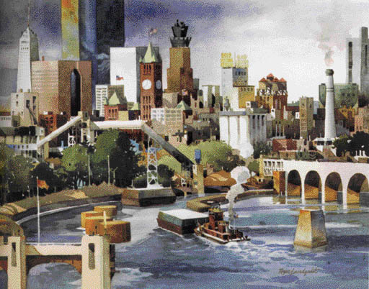
Review of the previous lecture
A monopoly is a firm that is the sole seller in its market.
It faces a downward-sloping demand curve for its product.
A monopoly’s marginal revenue is always below the price of its good.
Like a competitive firm, a monopoly maximizes profit by producing the quantity at which marginal cost and marginal revenue are equal.
Unlike a competitive firm, its price exceeds its marginal revenue, so its price exceeds marginal cost.
A monopolist’s profit-maximizing level of output is below the level that maximizes the sum of consumer and producer surplus.

Slide 2
Review of the previous lecture
A monopoly causes deadweight losses similar to the deadweight losses caused by taxes.
Policymakers can respond to the inefficiencies of monopoly behavior with antitrust laws, regulation of prices, or by turning the monopoly into a government-run enterprise.
If the market failure is deemed small, policymakers may decide to do nothing at all.
Monopolists can raise their profits by charging different prices to different buyers based on their willingness to pay.
Price discrimination can raise economic welfare and lessen deadweight losses.

Slide 3

Lecture 11
Monopolistic Competition
Instructor: Prof.Dr.Qaisar Abbas
Course code: ECO 400

Slide 4
Lecture Outline
Monopolistic competition
Competition with differentiated products
Advertising

Slide 5
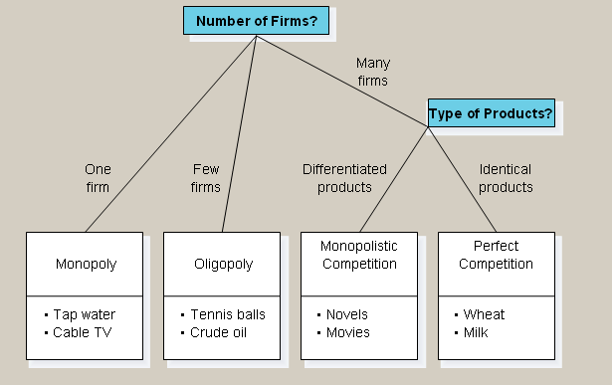
Monopolistic Competition
Imperfect competition refers to those market structures that fall between perfect competition and pure monopoly.
The Four Types of Market Structure

Slide 6
Monopolistic Competition
Types of Imperfectly Competitive Markets
  1. Monopolistic Competition
    Many firms selling products that are similar but not identical.
  2. Oligopoly
    Only a few sellers, each offering a similar or identical product to the others.
Markets that have some features of competition and some features of monopoly.

Slide 7
Monopolistic Competition
Attributes of Monopolistic Competition
  1. Many sellers: There are many firms competing for the same group of customers. Product examples include books, CDs, movies etc.
  2.. Product differentiation: Each firm produces a product that is at least slightly different from those of other firms. Rather than being a price taker, each firm faces a downward-sloping demand curve.
  3. Free entry and exit: Firms can enter or exit the market without restriction.
  The number of firms in the market adjusts until economic profits are zero.

Slide 8
Competition With Differentiated Products
The Monopolistically Competitive Firm in the Short Run
  Short-run economic profits encourage new firms to enter the market. This:
    Increases the number of products offered.
    Reduces demand faced by firms already in the market.
    Incumbent firms’ demand curves shift to the left.
    Demand for the incumbent firms’ products fall, and their profits decline.

Slide 9
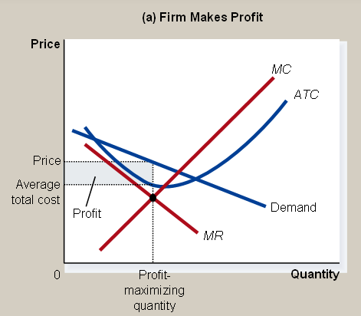
Competition With Differentiated Products
    Monopolistic Competition in the Short Run

Slide 10
Competition With Differentiated Products
The Monopolistically Competitive Firm in the Short Run
  Short-run economic losses encourage firms to exit the market. This:
    Decreases the number of products offered.
    Increases demand faced by the remaining firms.
    Shifts the remaining firms’ demand curves to the right.
    Increases the remaining firms’ profits.

Slide 11
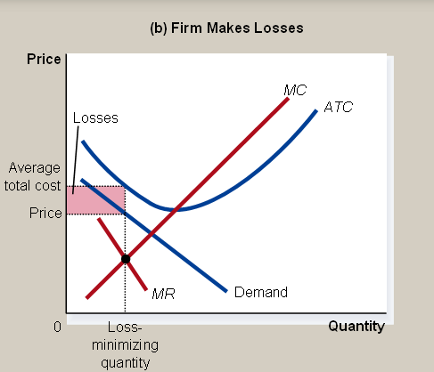
Competition With Differentiated Products
Monopolistic Competitors in the Short Run

Slide 12
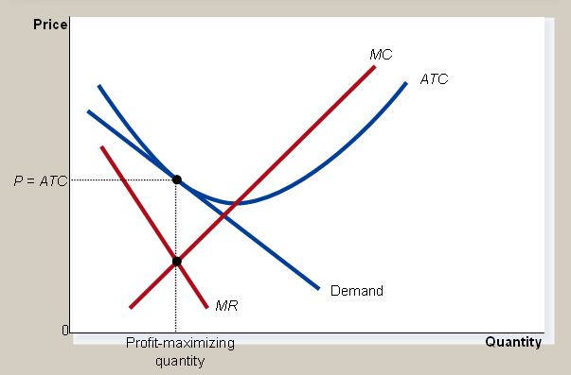
Competition With Differentiated Products
The Long-Run Equilibrium
Firms will enter and exit until the firms are making exactly zero economic profits.
Monopolistic Competitor in the Long Run

Slide 13
Competition With Differentiated Products
Two Characteristics
  As in a monopoly, price exceeds marginal cost.
    Profit maximization requires marginal revenue to equal marginal cost.
    The downward-sloping demand curve makes marginal revenue less than price.
  As in a competitive market, price equals average total cost.
    Free entry and exit drive economic profit to zero.

Slide 14
Competition With Differentiated Products
Monopolistic versus Perfect Competition
There are two noteworthy differences between monopolistic and perfect competition—excess capacity and markup.
Excess Capacity
  There is no excess capacity in perfect competition in the long run.
  Free entry results in competitive firms producing at the point where average total cost is minimized, which is the efficient scale of the firm.
  There is excess capacity in monopolistic competition in the long run.
  In monopolistic competition, output is less than the efficient scale of perfect competition.

Slide 15
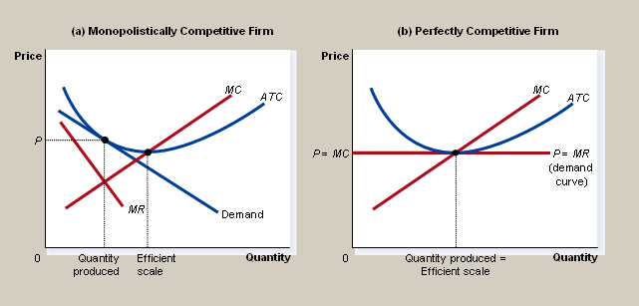
Competition With Differentiated Products
Monopolistic versus Perfect Competition

Slide 16
Competition With Differentiated Products
Markup Over Marginal Cost
  For a competitive firm, price equals marginal cost.
  For a monopolistically competitive firm, price exceeds marginal cost.
  Because price exceeds marginal cost, an extra unit sold at the posted price means more profit for the monopolistically competitive firm.

Slide 17
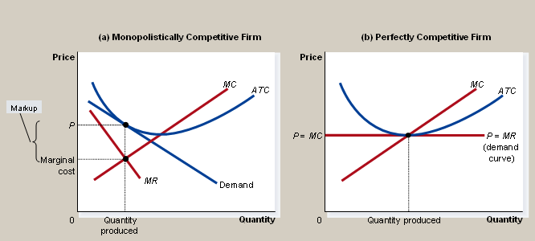
Competition With Differentiated Products
Monopolistic versus Perfect Competition

Slide 18
Competition With Differentiated Products
Monopolistic Competition and the Welfare of Society
Monopolistic competition does not have all the desirable properties of perfect competition.
There is the normal deadweight loss of monopoly pricing in monopolistic competition caused by the markup of price over marginal cost.
However, the administrative burden of regulating the pricing of all firms that produce differentiated products would be overwhelming.
Another way in which monopolistic competition may be socially inefficient is that the number of firms in the market may not be the “ideal” one. There may be too much or too little entry.

Slide 19
Competition With Differentiated Products
Externalities of entry include:
product-variety externalities: Because consumers get some consumer surplus from the introduction of a new product, entry of a new firm conveys a positive externality on consumers.
Business-stealing externalities: Because other firms lose customers and profits from the entry of a new competitor, entry of a new firm imposes a negative externality on existing firms.

Slide 20
Advertising
When firms sell differentiated products and charge prices above marginal cost, each firm has an incentive to advertise in order to attract more buyers to its particular product.
Firms that sell highly differentiated consumer goods typically spend between 10 and 20 percent of revenue on advertising.
Overall, about 2 percent of total revenue, or over $200 billion a year, is spent on advertising.
Critics of advertising argue that firms advertise in order to manipulate people’s tastes.

Slide 21
Advertising
They also argue that it impedes competition by implying that products are more different than they truly are.
Defenders argue that advertising provides information to consumers.
They also argue that advertising increases competition by offering a greater variety of products and prices.
The willingness of a firm to spend advertising dollars can be a signal to consumers about the quality of the product being offered.

Slide 22
Advertising
Critics argue that brand names cause consumers to perceive differences that do not really exist.
Economists have argued that brand names may be a useful way for consumers to ensure that the goods they are buying are of high quality.
providing information about quality.
giving firms incentive to maintain high quality.

Slide 23
Brand Names
Critics argue that brand names cause consumers to perceive differences that do not really exist.
Economists have argued that brand names may be a useful way for consumers to ensure that the goods they are buying are of high quality.
  providing information about quality.
  giving firms incentive to maintain high quality.

Slide 24
Summary
A monopolistically competitive market is characterized by three attributes: many firms, differentiated products, and free entry.
The equilibrium in a monopolistically competitive market differs from perfect competition in that each firm has excess capacity and each firm charges a price above marginal cost.
Monopolistic competition does not have all of the desirable properties of perfect competition.
There is a standard deadweight loss of monopoly caused by the markup of price over marginal cost.

Slide 25
Summary
The number of firms can be too large or too small.
The product differentiation inherent in monopolistic competition leads to the use of advertising and brand names.
  Critics argue that firms use advertising and brand names to take advantage of consumer irrationality and to reduce competition.
  Defenders argue that firms use advertising and brand names to inform consumers and to compete more vigorously on price and product quality.

