Slide 1

Review of the previous lecture
Total output is determined by
  how much capital and labor the economy has
  the level of technology
Competitive firms hire each factor until its marginal product equals its price.
If the production function has constant returns to scale, then labor income plus capital income equals total income (output).

Slide 2
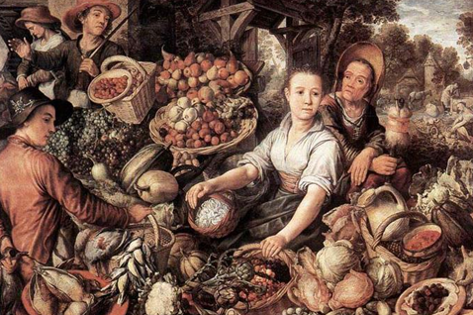
Lecture 5
National Income:
Where it Comes From and Where it Goes - II
Instructor: Prof. Dr.Qaisar Abbas
Notes:
To the instructor:
This is a particularly important chapter for your students to master. Many subsequent chapters in this book develop models that incorporate the material in this chapter and build on it. Your students should know at the outset that the time they invest mastering this chapter will yield returns throughout the semester by making subsequent material much easier to learn.
Also: This PowerPoint presentation introduces some notation that will be used throughout the remaining chapters. In particular, the use of Δ to denote the change in a variable, and the use of arrows as shorthand for increase, decrease, and causality. The slides that introduce this notation have accompanying notes for the instructor (in the same place as the notes you are reading now).
I’ve included several in-class exercises to break up the lecture and to provide immediate reinforcement of the concepts. If you wish, you can “hide” them from your presentation, perhaps assigning them as homework exercises.
Near the end of the chapter, there are two hidden slides showing how the loanable funds model is different when saving depends on the real interest rate.

Slide 3
Lecture Contents
Types of Saving
Lonable funds
Saving and interest rate

Slide 4
Demand for goods & services
Components of aggregate demand:
  C = consumer demand for g & s
  I = demand for investment goods
  G = government demand for g & s
  (closed economy: no NX )
Notes:
“g & s” is short for “goods & services”

Slide 5
Consumption, C
def: disposable income is total income minus total taxes: Y – T
Consumption function: C = C (Y – T )
Shows that ↑(Y – T ) ⇒ ↑C
def: The marginal propensity to consume is the increase in C caused by a one-unit increase in disposable income.
Notes:
Again, we are using the short-hand notation that will appear throughout the remaining PowerPoints:
↑X ⇒ ↓Y means “an increase in X causes a decrease in Y.”
Please feel free to edit slides if you wish to substitute other notation.

Slide 6
The consumption function
C
C (Y –T )
The slope of the consumption function is the MPC.
MPC
1
Y – T

Slide 7
Investment, I
The investment function is I = I (r ),
where r denotes the real interest rate, the nominal interest rate corrected for inflation.
The real interest rate is
● the cost of borrowing
● the opportunity cost of using one’s own funds to finance investment spending.
So, ↑r ⇒ ↓I

Slide 8
The investment function
r
Spending on investment goods is a downward-sloping function of the real interest rate
I (r )
I

Slide 9
Government spending, G
G includes government spending on goods and services.
G excludes transfer payments
Assume government spending and total taxes are exogenous:
Notes:
It might be useful to remind students of the meaning of the terms “exogenous” and “transfer payments.”

Slide 10
The market for goods & services
The real interest rate adjusts to equate demand with supply.
Notes:
Note the only variable in the equilibrium condition that doesn’t have a “bar” over it is the real interest rate.
When the full slide is showing, before you advance to the next one, you might want to note that the interest rate is important in financial markets as well, so we will next develop a simple model of the financial system.

Slide 11
Equilibrium in the financial markets:
The loanable funds market
A simple supply-demand model of the financial system.
One asset: “loanable funds”
  demand for funds: investment
  supply of funds: saving
  “price” of funds: real interest rate

Slide 12
Demand for funds: Investment
The demand for loanable funds:
  comes from investment:
  Firms borrow to finance spending on plant & equipment, new office buildings, etc. Consumers borrow to buy new houses.
  depends negatively on r , the “price” of loanable funds (the cost of borrowing).

Slide 13
Loanable funds demand curve
r
The investment curve is also the demand curve for loanable funds.
I (r )
I

Slide 14
Supply of funds: Saving
The supply of loanable funds comes from saving:
  Households use their saving to make bank deposits, purchase bonds and other assets. These funds become available to firms to borrow to finance investment spending.
  The government may also contribute to saving if it does not spend all of the tax revenue it receives.

Slide 15
Types of saving
private saving = (Y –T ) – C
public saving = T – G
national saving, S
  = private saving + public saving
  = (Y –T ) – C + T – G
  = Y – C – G
Notes:
After showing definition of private saving,
- give the interpretation of the equation: private saving is disposable income minus consumption spending
- explain why private saving is part of the supply of loanable funds:
Suppose a person earns $50,000/year, pays $10,000 in taxes, and spends $35,000 on goods and services. There’s $5000 remaining. What happens to that $5000? The person might use it to buy stocks or bonds, or she might put it in her savings account or money market deposit account. In all of these cases, this $5000 becomes part of the supply of loanable funds in the financial system.
After displaying public saving, explain the equation’s interpretation: public saving is tax revenue minus government spending.
Notice the analogy to private saving – both concepts represent income less spending: for the private household, income is (Y-T) and spending is C. For the government, income is T and spending is G.

Slide 16
Digression
Budget surpluses and deficits
When T > G ,
budget surplus = (T – G ) = public saving
When T < G ,
budget deficit = (G –T )
and public saving is negative.
When T = G ,
budget is balanced and public saving = 0.

Slide 17
The U.S. Federal Government Budget
Notes:
Notes:
1. The huge deficit in the early 1940s was due to WW2: wars are expensive.
2. During the ‘50s, we usually had surpluses.
3. During the ‘60s, the budget was, on average, close to balanced.
4. During the ‘70s, the budget was more volatile, and was always in deficit.
5. We started the 1980s with the budget close to balanced (as % of GDP), but the early 1980s began an era of large and persistent budget deficits, which continued into the early 1990s. This was due to the Reagan tax cuts and defense spending increases, as well as an increase in outlays on entitlements.
6. Beginning in the early 1990s, the budget begins a positive trend, and a surplus emerges in the late 1990s. There are several possible explanations for the improvement. First, President Bush (the first one) broke his campaign promise not to raise taxes. Second, the Clinton administration barely squeaked a deficit reduction deal through Congress (with Al Gore casting the tie-breaking vote in the Senate). And third, and probably most important, there was a swelling of tax revenues due to the surge in economic growth and the stock market boom. (A stock market boom leads to large capital gains, which leads to large revenues from the capital gains tax.)
7. In 2001, the economy slowed and probably was in recession, causing tax revenues to fall. Also, government spending increased due to the war on terrorism and to automatic stabilizers kicking in.
Source of data: U.S. Department of Commerce, Bureau of Economic Analysis.

Slide 18
The U.S. Federal Government Debt
Fun fact: In the early 1990s, nearly 18 cents of every tax dollar went to pay interest on the debt.
(Today it’s about 9 cents.)
Notes:
A later chapter will give more details, but for now, tell students that the government finances its deficits by borrowing from the public. (This borrowing takes the form of selling Treasury bonds). Persistent deficits over time imply persistent borrowing, which causes the debt to increase.
After WW2, occasional budget surpluses allowed the government to retire some of its WW2 debt; also, normal economic growth increased the denominator of the debt-to-GDP ratio. Starting in the early 1980s, corresponding to the beginning of huge and persistent deficits, we see a huge increase in the debt-to-GDP ratio, from 25.5% in 1980 to 48.7% in 1995. Finally, in the last half of the 1990s, budget surpluses and rapid growth started to bring down the debt-to-GDP ratio; it was 32.5% in 2001.
About the “fun fact”: Students are typically shocked when they realize how much extra we are paying in taxes just to service the debt; if it weren’t for the debt, we’d either pay much lower taxes, or have a lot of revenue available to fund financial aid for college students, AIDS and Cancer research, national defense, Social Security reform, or other important uses.
(Calling this a “fun fact” is a bit of dark humor; please feel free to delete “fun”)
Source of data: U.S. Dept of Commerce Bureau of Economic Analysis.

Slide 19
Loanable funds supply curve
r
National saving does not depend on r,
so the supply curve is vertical.
S, I

Slide 20
Loanable funds market equilibrium
r
Equilibrium real interest rate
I (r )
Equilibrium level of investment
S, I

Slide 21
The special role of r
r adjusts to equilibrate the goods market and the loanable funds market simultaneously:
If L.F. market in equilibrium, then
Y – C – G = I
Add (C +G ) to both sides to get
Y = C + I + G (goods market eq’m)
Thus,
Eq’m in L.F. market
Eq’m in goods market
Notes:
This slide establishes that we can use the loanable funds supply/demand diagram to see how the interest rate that clears the goods market is determined.
Explain that the symbol ⇔ means each one implies the other. The thing on the left implies the thing on the right, and vice versa.
More short-hand: “eq’m” is short for “equilibrium.”

Slide 22
Digression: mastering models
To learn a model well, be sure to know:
Which of its variables are endogenous and which are exogenous.
For each curve in the diagram, know
  definition
  intuition for slope
  all the things that can shift the curve
Use the model to analyze the effects of each item in 2c .
Notes:
This is good general advice for students. They will learn many models in this course. Many exams include questions requiring students to show how some event shifts a curve, and then use the model to analyze its effect on the endogenous variables. If students methodically follow the steps on this slide for each model, they will likely do better on the exams and get more out of the course.

Slide 23
Mastering the loanable funds model
Things that shift the saving curve
  public saving
    fiscal policy: changes in G or T
  private saving
    preferences
    tax laws that affect saving
Notes:
Continuing from the previous slide, let’s look at all the things that affect the S curve. Then, we will pick one of those things and use the model to analyze its effects on the endogenous variables. Then, we’ll do the same for the I curve.

Slide 24
CASE STUDY
The Reagan Deficits
Reagan policies during early 1980s:
  increases in defense spending: ΔG > 0
  big tax cuts: ΔT < 0
According to our model, both policies reduce national saving:

Slide 25
The Reagan deficits
1. The increase in the deficit reduces saving…
r
r₂
2. …which causes the real interest rate to rise…
r₁
3. …which reduces the level of investment.
I (r )
I₂
I₁
S, I

Slide 26
Mastering the loanable funds model
Things that shift the investment curve
  certain technological innovations
    to take advantage of the innovation, firms must buy new investment goods
  tax laws that affect investment
    investment tax credit

Slide 27
An increase in investment demand
r
An increase
in desired investment…
…raises the interest rate.
r₂
r₁
But the equilibrium level of investment cannot increase because the
supply of loanable
funds is fixed.
I₂
I₁
S, I

Slide 28
Saving and the interest rate
Why might saving depend on r ?
How would the results of an increase in investment demand be different?
  Would r rise as much?
  Would the equilibrium value of I change?

Slide 29
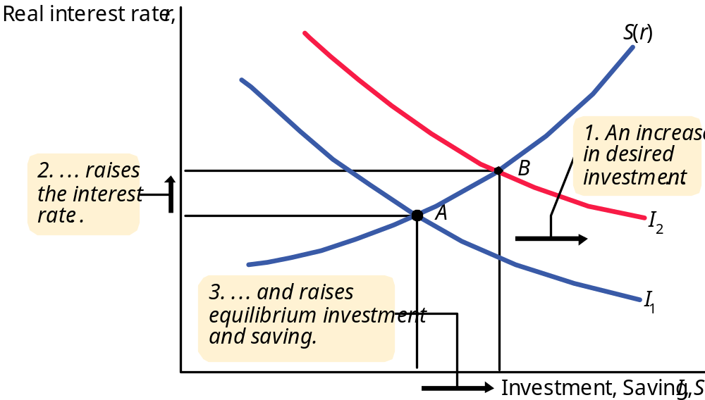
An increase in investment demand when saving depends on the interest rate
Notes:
This is Figure 3-11 from page 65 of the text. See accompanying discussion.

Slide 30
Summary
The real interest rate adjusts to equate the demand for and supply of
  goods and services
  loanable funds
A decrease in national saving causes the interest rate to rise and investment to fall.
An increase in investment demand causes the interest rate to rise, but does not affect the equilibrium level of investment
if the supply of loanable funds is fixed.

