Slide 1

Review of the previous Lecture
Gross Domestic Product (GDP) measures both total income and total expenditure on the economy’s output of goods & services.
Nominal GDP values output at current prices; real GDP values output at constant prices. Changes in output affect both measures, but changes in prices only affect nominal GDP.
GDP is the sum of consumption, investment, government purchases, and net exports.

Slide 2
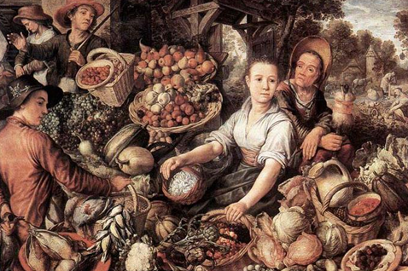
Lecture 3
The data of Macroeconomics- GDP, Unemployment & inflation - II
Instructor: Prof. Dr.Qaisar Abbas

Slide 3
Learning objectives
Shortcomings of GDP
the Consumer Price Index (CPI)
the Unemployment Rate
Notes:
These are three of the most important economic statistics. Policymakers and businesspersons use them to monitor the economy and formulate appropriate policies. Economists use them to develop and test theories about how the economy works. Because we’ll be learning many of these theories, it’s worth spending some time now to really understand what these statistics mean, and how they are measured.

Slide 4
Shortcomings of GDP
Non market transactions
Some productive activities don't take place in the market, and as the GDP only measures the market value of output, these activities don't show up in the GDP.
Thus, GDP understates a nation's total output
Example of such activities are labor of carpenters who repair own homes, black markets
One exception: Portion of farmers' output that the farmers consume themselves is included in the GDP
Leisure
GDP only takes the market value of output, therefore, LEISURE (paid vacation, holidays, leave time), which shows increase of well-being, satisfaction, and 'psychic income' is excluded in the GDP.

Slide 5
Shortcomings of GDP
Improved product quality:
GDP is a quantitative measure, and thus does not capture the value of improvements in product quality
Example. a $200 dollar phone costs the same as a $200 dollar phone 10 years ago technological improvements such as greater memory capacities, viewing screens, and enhanced capabilities is not included in GDP
The Underground Economy ("black market"):
Embedded in the economy is a flourishing and productive underground sector include gamblers, smugglers, drug dealers, etc.
However most participants engage in perfectly legal activities, but choose illegally not to report their full incomes and therefore is not counted in the GDP

Slide 6
Shortcomings of GDP
  Most of these transactions would help to increase a countries GDP as they would increase the money flow; thus, this is a downfall.
  Example: A woman who tutors a student in math is earning money legally, but she doesn't report it to the government and therefore the money involved in the transaction is not counted in GDP. On the other hand, a factory employee, whose economic status is chartered, has an income counted in GDP
  Value of underground transactions in a country is often very large.
GDP and the environment
The growth of GDP is inevitably accompanied by "gross
domestic by-products" (i.e. dirty air, polluted water, toxic waste, congestion, and noise)
The social cost of the negative by-products reduce our economic well-being.
.

Slide 7
Shortcomings of GDP
  Costs of environmental harm are not deducted from GDP
  Therefore GDP overstates national well-being in this aspect
  Ironically, costs of cleaning up the environment are included in the GDP.
  Negative and Positive Externalities are misrepresented or ignored.
Composition and Distribution of output
GDP does not tell us what mix of goods and services benefit or harm society because it assigns equal weight to products of the same price some goods/ services are enriching, or potentially detrimental to society
Ex. As long as they are of the same price.. Assault Rifle = Book

Slide 8
Shortcomings of GDP
      GDP does not reveal anything about how output is distributed (therefore, GDP does not tell us the well-being of a society because distribution makes a big difference).
      Society better off if there is less gap between wealthy and poor, but GDP does not represent this aspect of well-being
Per capita output
      GDP itself does not reflect the well being of people in the nation, it is the GDP per capita that is important.
      E.g. China's GDP in 2004 was $1938 billion and Denmark's $220 billion, but Denmark's GDP per capita was $40,750 while China's was $1500. The living standards in Denmark are superior to those in China, since the average income for each person in Denmark is much higher.
      An increase in GDP could actually be accompanied by a decrease in GDP per capita, and vice versa, depending on population growth.

Slide 9
Shortcomings of GDP
Non economic sources of well-being
      Just as a household's income does not measure its total happiness, a nation's GDP does not measure its total well-being.
      There are many things that could make a society better off without necessarily raising GDP, e.g. crime reduction, peaceful international relations, greater civility among the people, less drug & alcohol abuse, etc.
      GDP merely reflects the trade going on in the country's markets

Slide 10
Consumer Price Index (CPI)
A measure of the overall level of prices
Published by the Bureau of Labor Statistics (BLS)
Used to
  track changes in the typical household’s cost of living
  allow comparisons of dollar figures from different years
Notes:
Regarding the comparison of dollar figures from different years:
If we want to know whether the average college graduate today is better off than the average college graduate of 1975, we can’t simply compare the nominal salaries, because the cost of living is so much higher now than in 1975. We can use the CPI to express the 1975 in “current dollars”, i.e. see what it would be worth at today’s prices.
Also: when the price of oil (and hence gasoline) shot up in 2000, some in the news reported that oil prices were even higher than in the 1970s. This was true, but only in nominal terms. If you use the CPI to adjust for inflation, the highest oil price in 2000 is still substantially less than the highest oil prices of the 1970s.

Slide 11
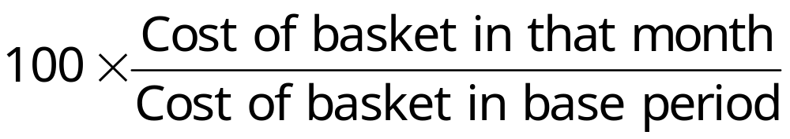
How the BLS constructs the CPI
Survey consumers to determine composition of the typical consumer’s “basket” of goods.
Every month, collect data on prices of all items in the basket; compute cost of basket
CPI in any month equals

Slide 12
Exercise: Compute the CPI
The basket contains 20 pizzas and 10 compact discs.
pizza CDs
2000 $10 $15
2001 $11 $15
2002 $12 $16
2003 $13 $15
For each year, compute
the cost of the basket
the CPI (use 2000 as the base year)
the inflation rate from the preceding year
Notes:
From 2002 to 2003, it’s not obvious that the inflation rate will be positive (that the basket’s cost will increase): the price of pizza rises by $1, the price of CDs falls by $1.
However, since the basket contains twice as many pizzas as CDs, a given change in the price of pizza will have a bigger impact on the basket’s cost (and CPI) than the same sized price change in CDs.

Slide 13
Answers
cost of inflation
basket CPI rate
2000 $350 100.0 n.a.
2001 370 105.7 5.7%
2002 400 114.3 8.1%
2003 410 117.1 2.5%

Slide 14
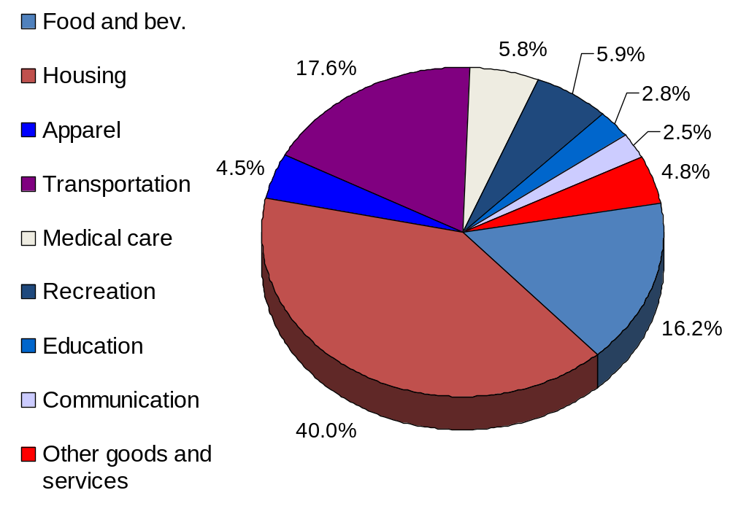
The composition of the CPI’s “basket”
Notes:
Each number is the percent of the “typical” household’s total expenditure.
source: Bureau of Labor Statistics, http://stats.bls.gov/cpihome.htm
Ask students for examples of how the breakdown of their own expenditure differs from that of the typical household shown here. Then, ask students how the typical elderly person’s expenditure might differ from that shown here. (This is relevant because the CPI is used to give Social Security COLAs to the elderly; however, the elderly spend a much larger fraction of their income on medical care, a category in which prices grow much faster than the CPI.)
The website listed above also gives a very fine disaggregation of each category, which enables students to compare their own spending on compact discs, beer, or cell phones to that of the “typical” household.

Slide 15
CPI vs. GDP deflator
Prices of capital goods
included in GDP deflator (if produced domestically)
excluded from CPI
Prices of imported consumer goods
included in CPI
excluded from GDP deflator
The basket of goods
CPI: fixed
GDP deflator: changes every year

Slide 16
Two measures of inflation
Percentage
change
16
14
CPI
12
10
8
6
GDP deflator
4
2
0
-
2
1948
1953
1958
1963
1968
1973
1978
1983
1988
1993
1998
Year
Notes:
Be sure to point out that the data are the percentage changes, not the levels, of the CPI and the GDP deflator.
In 1980, the CPI increased much faster than the GDP deflator. Ask students if they can offer a possible explanation. In 1955, the CPI showed slightly negative inflation, while the GDP deflator showed positive inflation. Ask students for possible explanations.
(For possible answers, just refer to previous slide.)

Slide 17
Categories of the population
employed
working at a paid job
unemployed
not employed but looking for a job
labor force
the amount of labor available for producing goods and services; all employed plus unemployed persons
not in the labor force
not employed, not looking for work.

Slide 18
Two important labor force concepts
unemployment rate
percentage of the labor force that is unemployed
labor force participation rate
the fraction of the adult population that ‘participates’ in the labor force

Slide 19
Exercise: Compute labor force statistics
U.S. adult population by group, April 2002
Number employed = 134.0 million
Number unemployed = 8.6 million
Adult population = 213.5 million
Use the above data to calculate
  the labor force
  the number of people not in the labor force
  the labor force participation rate
  the unemployment rate
Notes:
source: Bureau of Labor Statistics, U.S. Department of Labor. http://stats.bls.gov

Slide 20
Answers
data: E = 134.0, U = 8.6, POP = 213.5
labor force
L = E +U = 134.0 + 8.6 = 142.6
not in labor force
NILF = POP – L = 213.5 – 142.6 = 70.9
unemployment rate
U/L = 8.6/142.6 = 0.06 or 6.0%
labor force participation rate
L/POP = 142.6/213.5 = 0.668 or 68.8%

Slide 21
Okun’s Law
Employed workers help produce GDP, while unemployed workers do not.
So one would expect a negative relationship between unemployment and real GDP.
This relationship is clear in the data…

Slide 22
Okun’s Law
Percentage change
in real GDP
Okun’s Law states that a one-percent decrease in unemployment is associated with two percentage points of additional growth in real GDP
10
8
1951
6
1984
2000
4
1999
2
1993
1975
0
-2
1982
-3
-2
-1
0
1
2
3
4
Change in
unemployment rate

Slide 23
Summary
The overall level of prices can be measured by either
  the Consumer Price Index (CPI), the price of a fixed basket of goods purchased by the typical consumer
  the GDP deflator, the ratio of nominal to real GDP
The unemployment rate is the fraction of the labor force that is not employed.
When unemployment rises, the growth rate of real GDP falls.

