Slide 1

Review of the previous Lecture
Macroeconomics is the study of the economy as a whole, including
  growth in incomes
  changes in the overall level of prices
  the unemployment rate
Macroeconomists attempt to explain the economy and to devise policies to improve its performance.

Slide 2
Review of the previous Lecture
Economists use different models to examine different issues.
Models with flexible prices describe the economy in the long run; models with sticky prices describe economy in the short run.
Macroeconomic events and performance arise from many microeconomic transactions, so macroeconomics uses many of the tools of microeconomics.

Slide 3

Lecture 2
The data of Macroeconomics- GDP, Unemployment & inflation - I
Instructor: Prof. Dr.Qaisar Abbas

Slide 4
Learning objectives
Gross Domestic Product (GDP)
Types of GDP
Notes:
These are three of the most important economic statistics. Policymakers and businesspersons use them to monitor the economy and formulate appropriate policies. Economists use them to develop and test theories about how the economy works. Because we’ll be learning many of these theories, it’s worth spending some time now to really understand what these statistics mean, and how they are measured.

Slide 5
Gross Domestic Product
Two definitions
Total expenditure on domestically-produced final goods and services
Total income earned by domestically-located factors of production
Notes:
Most students, having taken principles of economics, will have seen this definition and be familiar with it. It’s not worth spending a lot of time on.
It might be worthwhile, however, to briefly review the factors of production.

Slide 6
Why expenditure = income
In every transaction,
the buyer’s expenditure becomes the seller’s income.
Thus, the sum of all expenditure equals
the sum of all income.
Notes:
Thus, the sum of all expenditure in all transactions must equal the sum of all income to all sellers (including people who sell the services of the factors of production they own.)

Slide 7
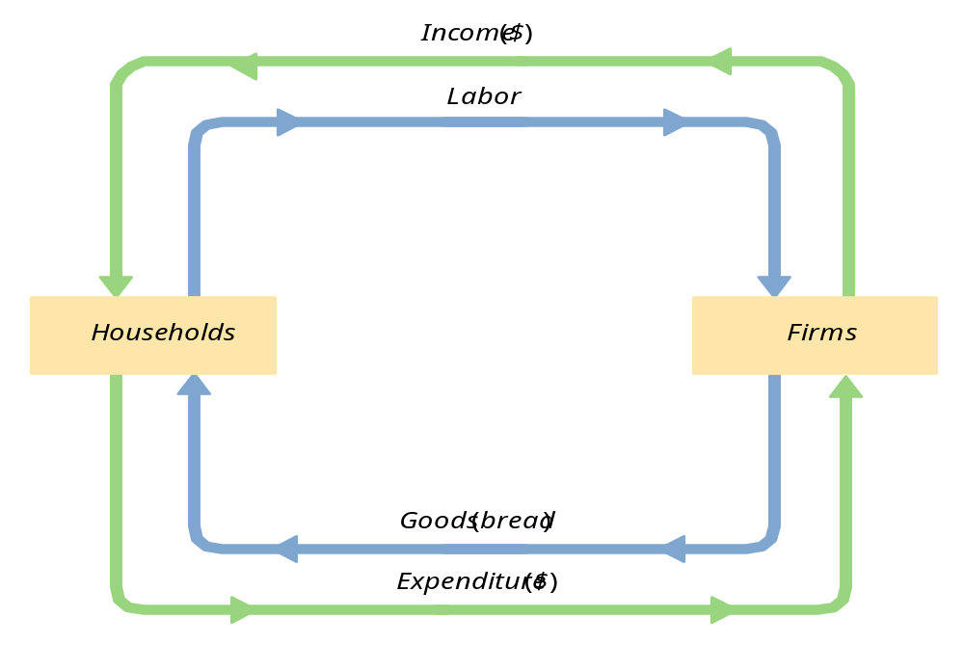
The Circular Flow

Slide 8
Value added
definition
A firm’s value added is the value of its output minus the value of the intermediate goods the firm used to produce that output.
Notes:
It might be useful here to remind students what “intermediate goods” are.

Slide 9
Exercise
A farmer grows a bushel of wheat and sells it to a miller for $1.00.
The miller turns the wheat into flour and sells it to a baker for $3.00.
The baker uses the flour to make a loaf of bread and sells it to an engineer for $6.00.
The engineer eats the bread.
Compute
  value added at each stage of production
  GDP
Notes:
“Compute GDP” assuming, of course, that these are the only transactions in the economy.
Lessons of this problem:
GDP = value of final goods = sum of value at all stages of production
We don’t include the value of intermediate goods in GDP because their value is already embodied in the value of the final goods.
Answer:
Each person’s value-added (VA) equals the value of what he/she produced minus the value of the intermediate inputs he/she started with.
Farmer’s VA = $1
Miller’s VA = $3
Baker’s VA = $3
GDP = $6
Note that GDP = value of final good = sum of value-added at all stages of production.
Even though this problem is highly simplified, its main lesson holds in the real world: the value of all final goods produced equals the sum of value-added in all stages of production of all goods.

Slide 10
Final goods, value added, and GDP
GDP = value of final goods produced
= sum of value added at all stages of production
The value of the final goods already includes the value of the intermediate goods, so including intermediate goods in GDP would be double-counting.

Slide 11
The expenditure components of GDP
Consumption
Investment
government spending
net exports

Slide 12

Consumption (C)
def: the value of all goods and services bought by households. Includes:
  durable goods
  last a long time
  ex: cars, home appliances
  non-durable goods
  last a short time
  ex: food, clothing
  services
  work done for consumers
  ex: dry cleaning,
  air travel.
Notes:
A consumer’s spending on a new house counts under investment, not consumption. More on this in a few moments, when we get to Investment.
A tenant’s spending on rent counts under services -- rent is considered spending on “housing services.”
So what happens if a renter buys the house she had been renting? Conceptually, consumption should remain unchanged: just because she is no longer paying rent, she is still consuming the same housing services as before.
In national income accounting, (the services category of) consumption includes the imputed rental value of owner-occupied housing.
To help students keep all this straight, you might suggest that they think of a house as a piece of capital which is used to produce a consumer service, which we might call “housing services”. Thus, spending on the house counts in “investment”, and the value of the housing services that the house provides counts under “consumption” (regardless of whether the housing services are being consumed by the owner of the house or a tenant).

Slide 13
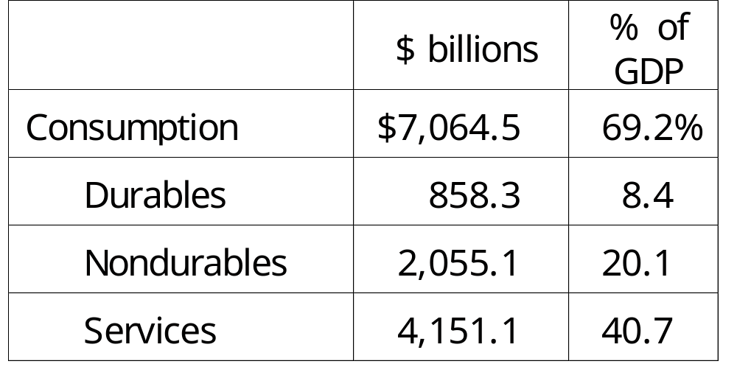
U.S. Consumption, 2001
Notes:
source: Bureau of Economic Analysis, U.S. Department of Commerce
http://www.bea.doc.gov

Slide 14
Investment (I)
def1: spending on [the factor of production] capital.
def2: spending on goods bought for future use.
Includes:
  business fixed investment
  spending on plant and equipment that firms will use to produce other goods & services
  residential fixed investment
  spending on housing units by consumers and landlords
  inventory investment
  the change in the value of all firms’ inventories
Notes:
In definition #1, note that aggregate investment equals total spending on newly produced capital goods. (If I pay $1000 for a used computer for my business, then I’m doing $1000 of investment, but the person who sold it to me is doing $1000 of disinvestment, so there is no net impact on aggregate investment.)
The housing issue
A consumer’s spending on a new house counts under investment, not consumption.
A tenant’s spending on rent counts under services -- rent is considered spending on “housing services.”
So what happens if a renter buys the house she had been renting? Conceptually, consumption should remain unchanged: just because she is no longer paying rent, she is still consuming the same housing services as before.
In national income accounting, (the services category of) consumption includes the imputed rental value of owner-occupied housing.
To help students keep all this straight, you might suggest that they think of a house as a piece of capital which is used to produce a consumer service, which we might call “housing services”. Thus, spending on the house counts in “investment”, and the value of the housing services that the house provides counts under “consumption” (regardless of whether the housing services are being consumed by the owner of the house or a tenant).
Inventories
If total inventories are $10 billion at the beginning of the year, and $12 billion at the end, then inventory investment equals $2 billion for the year.
Note that inventory investment can be negative (which means inventories fell over the year).

Slide 15
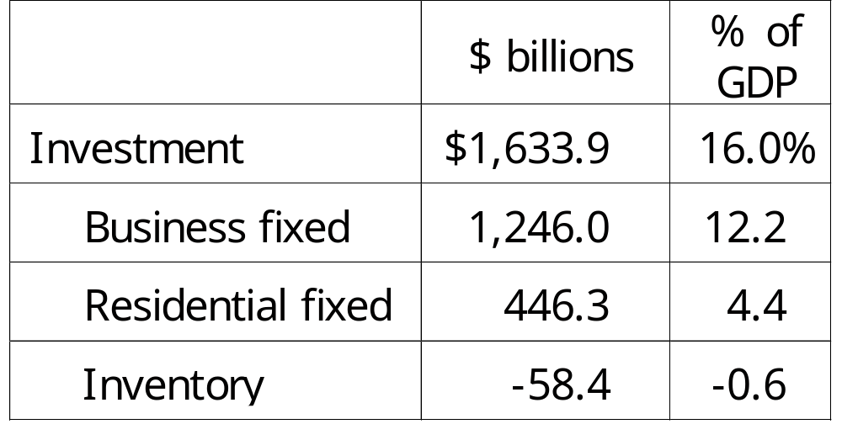
U.S. Investment, 2001
Notes:
source: Bureau of Economic Analysis, U.S. Department of Commerce
http://www.bea.doc.gov

Slide 16
Investment vs. Capital
Capital is one of the factors of production.
At any given moment, the economy has a certain overall stock of capital.
Investment is spending on new capital.

Slide 17
Investment vs. Capital
Example (assumes no depreciation):
  1/1/2002:
  economy has $500b worth of capital
  during 2002:
  investment = $37b
  1/1/2003:
  economy will have $537b worth of capital
Notes:
If you teach the stocks vs. flows concepts, this is a good example of the difference.

Slide 18
Stocks vs. Flows
Flow
Stock
More examples:
stock flow
a person’s wealth a person’s saving
# of people with # of new college
college degrees graduates
the govt. debt the govt. budget deficit

Slide 19
Government spending (G)
G includes all government spending on goods and services.
G excludes transfer payments (e.g. unemployment insurance payments), because they do not represent spending on goods and services.
Notes:
Transfer payments are included in “government outlays,” but not in government spending. People who receive transfer payments use these funds to pay for their consumption. Thus, we avoid double-counting by excluding transfer payments from G.

Slide 20
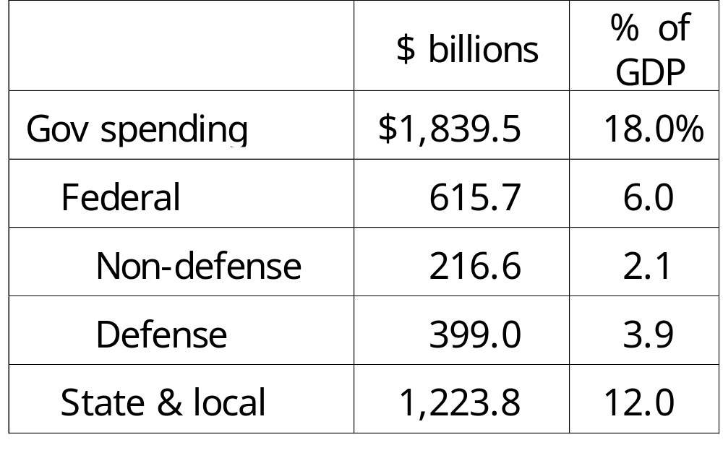
Government spending, 2001
Notes:
source: Bureau of Economic Analysis, U.S. Department of Commerce
http://www.bea.doc.gov

Slide 21
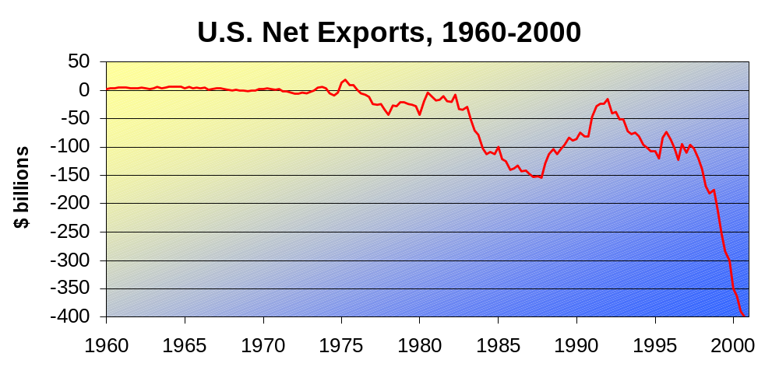
Net exports (NX = EX - IM)
def: the value of total exports (EX) minus the value of total imports (IM)
Notes:
source: FRED Database, The Federal Reserve Bank of St. Louis,
http://www.stls.frb.org/fred/
Before showing the data graph, the following explanation might be helpful:
Remember, GDP is the value of spending on our country’s output of goods & services.
Exports represent foreign spending on our country’s output, so we include exports.
Imports represent the portion of domestic spending (C, I, and G) that goes to foreign goods and services, so we subtract off imports.
NX, therefore, equals net spending by the foreign sector on domestically produced goods & services.

Slide 22
An important identity
Y = C + I + G + NX
where
Y = GDP = the value of total output
C + I + G + NX = aggregate expenditure
Notes:
A few slides ago, we defined GDP as the total expenditure on the economy’s output of goods and services (as well as total income). We can also define GDP as (the value of) aggregate output, not just spending on output.
An identity is an equation that always holds because of the way the variables are defined.

Slide 23
A question for you
Suppose a firm
produces $10 million worth of final goods
but only sells $9 million worth.
Does this violate the expenditure = output identity?
Notes:
If you do not wish to pose this as a question, you can “hide” this slide and “unhide” the next one, which simply gives students the information.
Suggestion (applies generally, not just here):
When you pose this (or any) question to your class, don’t ask for students to volunteer their answers right away. Instead, tell them to think about it for a minute and write their answer down on paper. Then, ask for volunteers (or call on students at random). Giving students this extra minute will increase the quality of participation as well as the number of students who participate.
Correct answer to the question:
Unsold output adds to inventory, and thus counts as inventory investment – whether intentional or unplanned. Thus, it’s as if a firm “purchased” its own inventory accumulation.
Here’s where the “goods purchased for future use” definition of investment is handy: When firms add newly produced goods to their inventory, the “future use” of those goods, of course, is future sales.
Note, also, that inventory investment counts intentional as well as unplanned inventory changes. Thus, when firms sell fewer units than planned, the unsold units go into inventory and are counted as inventory investment. This explains why “output = expenditure” -- the value of unsold output is counted under inventory investment, just as if the firm “purchased” its own output. Remember, the definition of investment is goods bought for future use. With inventory investment, that future use is to give the firm the ability in the future to sell more than its output.

Slide 24
Why output = expenditure
Unsold output goes into inventory, and is counted as “inventory investment”……whether the inventory buildup was intentional or not.
In effect, we are assuming that firms purchase their unsold output.

Slide 25
GDP:
An important and versatile concept
We have now seen that GDP measures
  total income
  total output
  total expenditure
  the sum of value-added at all stages
  in the production of final goods
Notes:
This is why economists often use the terms income, output, expenditure, and GDP interchangeably.

Slide 26
GNP vs. GDP
Gross National Product (GNP)
total income earned by the nation’s factors of production, regardless of where located
Gross Domestic Product (GDP)
total income earned by domestically-located factors of production, regardless of nationality.
Notes:
Emphasize that the difference b/w GDP and GNP boils down to two things:
location of the economic activity, and ownership (domestic vs. foreign) of the factors of production.
From the perspective of the U.S., factor payments from abroad includes things like
wages earned by U.S. citizens working abroad
profits earned by U.S.-owned businesses located abroad
income (interest, dividends, rent, etc) generated from the foreign assets owned by U.S. citizens
Factor payments to abroad includes things like
wages earned by foreign workers in the U.S.
profits earned by foreign-owned businesses located in the U.S.
income (interest, dividends, rent, etc) that foreigners earn on U.S. assets
Chapter 3 introduces factor markets and factor prices. Unless you’ve already covered that material, it might be worth mentioning to your students that factor payments are simply payments to the factors of production, for example, the wages earned by labor.

Slide 27
Discussion Question
In your country,
which would you want
to be bigger, GDP or GNP?
Why?
Notes:
This issue is subjective, and the question is intended to get students to think a little deeper about the difference between GNP and GDP. Of course, there is no single correct answer.
Some students offer this response:
It’s better to have GNP > GDP, because it means our nation’s income is greater than the value of what we are producing domestically. If, instead, GDP > GNP, then a portion of the income generated in our country is going to people in other countries, so there’s less income left over for us to enjoy.

Slide 28
Real vs. Nominal GDP
GDP is the value of all final goods and services produced.
Nominal GDP measures these values using current prices.
Real GDP measure these values using the prices of a base year.

Slide 29
Real GDP controls for inflation
Changes in nominal GDP can be due to:
  changes in prices
  changes in quantities of output produced
Changes in real GDP can only be due to changes in quantities,
because real GDP is constructed using constant base-year prices.
Notes:
Suppose from 2002 to 2003, nominal GDP rises by 10%. Some of this growth could be due to price increases, because an increase in the price of output causes an increase in the value of output, even if the real quantity remains the same.
Hence, to control for inflation, we use real GDP. Remember, real GDP is the value of output using constant base-year prices. If real GDP grows by 6% from 2002 to 2003, we can be sure that all of this growth is due to an increase in the economy’s actual production of goods and services, because the same prices are used to construct real GDP in 2002 and 2003.

Slide 30
Practice problem, part 1
 | 2001 |  | 2002 |  | 2003
 | P | Q | P | Q | P | Q
good A | $30 | 900 | $31 | 1,000 | $36 | 1,050
good B | $100 | 192 | $102 | 200 | $100 | 205
Compute nominal GDP in each year
Compute real GDP in each year using 2001 as the base year.
Notes:
This slide (and a few of the following ones) contain exercises that you can have your students do in class for immediate reinforcement of the material. These problems require calculators (well,
This problem requires calculators. If most of your students do not have calculators, you might “hide” this slide and instead pass out a printout of it for a homework exercise. Tell students that if they don’t have Or: just have them write down the expressions that they would enter into a calculator if they had calculators, i.e. Nominal GDP in 2001 = 30*900 + 100*192.

Slide 31
Answers to practice problem, part 1
Nominal GDP multiply Ps & Qs from same year
2001: $46,200 = $30 × 900 + $100 × 192
2002: $51,400
2003: $58,300
Real GDP multiply each year’s Qs by 2001 Ps
2001: $46,300
2002: $50,000
2003: $52,000 = $30 × 1050 + $100 × 205

Slide 32
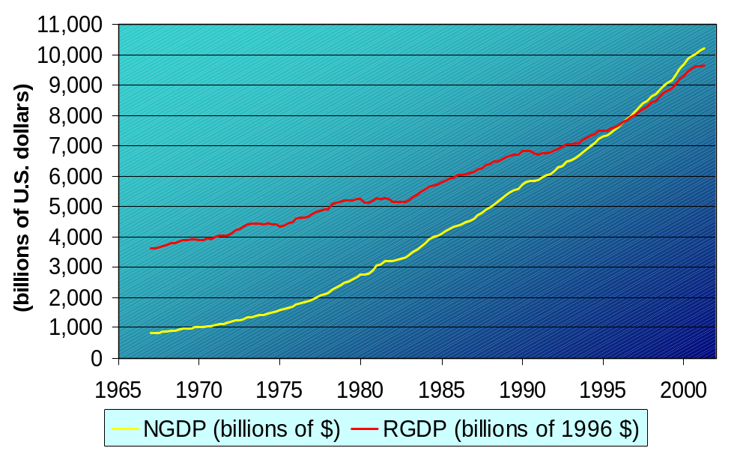
U.S. Real & Nominal GDP, 1967-2001
Notes:
Notice that the yellow line is steeper than the red line. That’s because prices generally rise over time. So, nominal GDP grows at a faster rate than real GDP.
If you’re anal like me, you might ask students what is the significance of the two lines crossing in 1996.
Answer: 1996 is the base year for this real GDP data, so RGDP = NGDP in 1996 only.
Before 1996, RGDP > NGDP, while after 1996, RGDP < NGDP. This is intuitive if you think about it for a minute.
Take 1970. When the economy’s output of 1970 is measured in the (then) current prices, GDP is about $1 trillion. Between 1970 and 1996, most prices have risen. Hence, if you value the country’s 1970 using 1996 prices (to get real GDP), you get a bigger value than if you just measure 1970’s output in 1970 prices (nominal GDP).

Slide 33
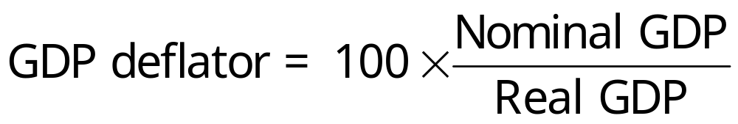
GDP Deflator
The inflation rate is the percentage increase in the overall level of prices.
One measure of the price level is the GDP Deflator, defined as
Notes:
After revealing the first bullet point, mention that there are several different measures of the overall price level. Your students are probably familiar with one of them---the Consumer Price Index, which will be covered shortly. For now, though, we learn about a different one <reveal next bullet point>, the GDP deflator.
The GDP deflator is so named because it is used to “deflate” (remove the effects of inflation from) GDP and other economic variables.

Slide 34
Practice problem, part 2
 | Nom. GDP | Real GDP | GDP deflator | inflation rate
2001 | $46,200 | $46,200 |  | n.a.
2002 | 51,400 | 50,000
2003 | 58,300 | 52,000
Use your previous answers to compute
the GDP deflator in each year.
Use GDP deflator to compute the inflation rate from 2001 to 2002, and from 2002 to 2003.

Slide 35
Answers to practice problem, part 2
 | Nom. GDP | Real GDP | GDP deflator | inflation rate
2001 | $46,200 | $46,200 | 100.0 | n.a.
2002 | 51,400 | 50,000 | 102.8 | 2.8%
2003 | 58,300 | 52,000 | 112.1 | 9.1%

Slide 36
Summary
Gross Domestic Product (GDP) measures both total income and total expenditure on the economy’s output of goods & services.
Nominal GDP values output at current prices; real GDP values output at constant prices. Changes in output affect both measures, but changes in prices only affect nominal GDP.
GDP is the sum of consumption, investment, government purchases, and net exports.

