Slide 1

Review of the previous lecture
Net exports--the difference between
  exports and imports
  a country’s output (Y )
  and its spending (C + I + G)
Net capital outflow equals
  purchases of foreign assets
  minus foreign purchases of the country’s assets
  the difference between saving and investment

Slide 2

Lecture 13
Instructor: Prof.Dr.Qaisar Abbas
Open economy - II

Slide 3
Lecture Outline
Exchange rate
Four experiments
Purchasing power parity

Slide 4
Exchange rate
The nominal exchange rate
e = nominal exchange rate,
the relative price of
domestic currency
in terms of foreign currency
(e.g. Yen per Dollar)
The real exchange rate
= real exchange rate,
the relative price of
domestic goods
in terms of foreign goods
(e.g. Japanese Big Macs per U.S. Big Mac)
ε

Slide 5
Exchange rate
Understanding the units of ε
ε

Slide 6
Exchange rate
ε in the real world & our model
In the real world:
We can think of ε as the relative price of
a basket of domestic goods in terms of a basket of foreign goods
In our macro model:
There’s just one good, “output.”
So ε is the relative price of one country’s output in terms of the other country’s output
How NX depends on ε
↑ε ⇒ U.S. goods become more expensive relative to foreign goods
⇒ ↓EX, ↑IM
⇒ ↓NX

Slide 7
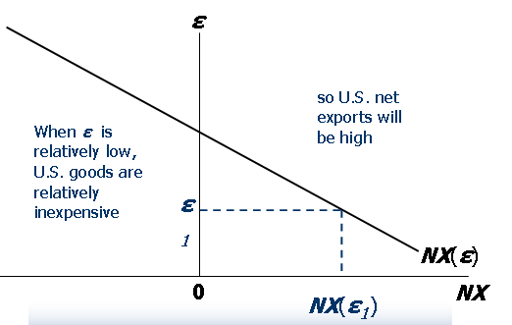
The net exports function
The net exports function reflects this inverse relationship between NX and ε:
NX = NX (ε )
The NX curve for the U.S.

Slide 8
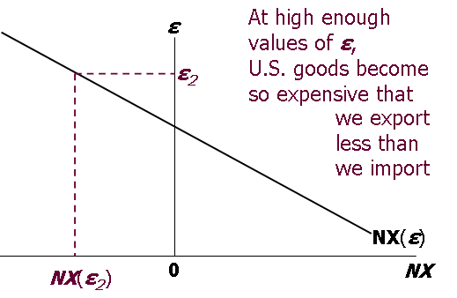
The net exports function
The NX curve for the U.S.

Slide 9
The net exports function
How ε is determined
The accounting identity says NX = S – I
We saw earlier how S - I is determined:
  S depends on domestic factors (output, fiscal policy variables, etc)
  I is determined by the world interest
  rate r *
So, ε must adjust to ensure

Slide 10
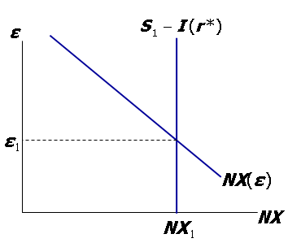
How ε is determined
Neither S nor I depend on ε,
so the net capital outflow curve is vertical.
ε adjusts to equate NX
with net capital outflow, S − I.

Slide 11
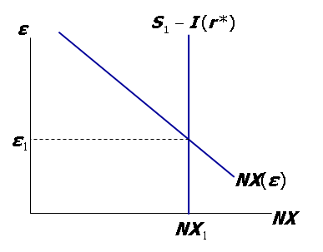
Interpretation: supply and demand in the foreign exchange market
demand:
Foreigners need dollars to buy U.S. net exports.
supply:
The net capital outflow (S − I )
is the supply of dollars to be invested abroad.

Slide 12
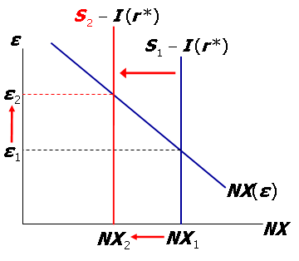
Four experiments
Fiscal policy at home
Fiscal policy abroad
An increase in investment demand
Trade policy to restrict imports
1. Fiscal policy at home
A fiscal expansion reduces national saving, net capital outflows, and the supply of dollars in the foreign exchange market…
…causing the real exchange rate to rise and NX to fall.

Slide 13
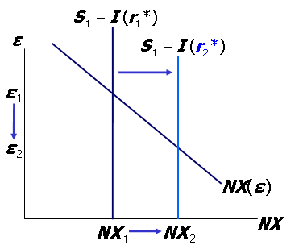
Four experiments
2. Fiscal policy abroad
An increase in r* reduces investment, increasing net capital outflows and the supply of dollars in the foreign exchange market…
…causing the real exchange rate to fall and NX to rise.

Slide 14
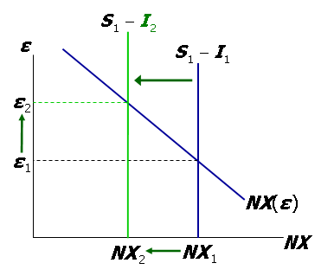
Four experiments
3. An increase in investment demand
An increase in investment reduces net capital outflows and the supply
of dollars in the foreign exchange market…
…causing the real exchange rate to rise and NX to fall.

Slide 15
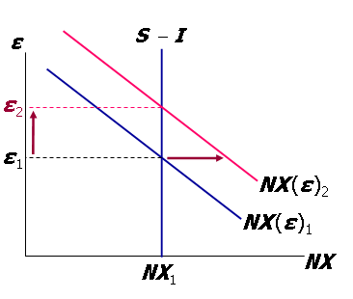
Four experiments
4. Trade policy to restrict imports
At any given value of ε, an import quota
⇒ ↓IM ⇒ ↑NX
⇒ demand for dollars shifts right
Trade policy doesn’t affect S or I , so capital flows and the supply of dollars remains fixed.

Slide 16
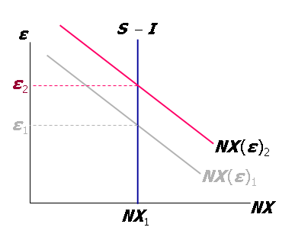
Four experiments
4. Trade policy to restrict imports
Results:
Δε > 0
(demand increase)
ΔNX = 0
(supply fixed)
ΔIM < 0
(policy)
ΔEX < 0
(rise in ε )

Slide 17
The Determinants of the Nominal Exchange Rate
Start with the expression for the real exchange rate:
Solve it for the nominal exchange rate:
So e depends on the real exchange rate and the price levels at home and abroad…
…and we know how each of them is determined:

Slide 18
The Determinants of the Nominal Exchange Rate
We can rewrite this equation in terms of growth rates
For a given value of ε,
the growth rate of e equals the difference between foreign and domestic inflation rates.

Slide 19
Purchasing Power Parity (PPP)
Purchasing Power Parity (PPP)
Two definitions:
  a doctrine that states that goods must sell at the same (currency-adjusted) price in all countries.
  the nominal exchange rate adjusts to equalize the cost of a basket of goods across countries.
Reasoning:
  arbitrage, the law of one price
Solve for e : e = P*/ P
PPP implies that the nominal exchange rate between two countries equals the ratio of the countries’ price levels.
PPP: e ×P = P*
Cost of a basket of foreign goods, in foreign currency.
Cost of a basket of domestic goods, in foreign currency.
Cost of a basket of domestic goods, in domestic currency.

Slide 20
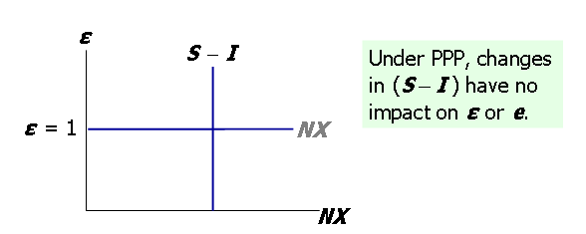
Purchasing Power Parity (PPP)
If e = P*/P,
then
and the NX curve is horizontal:

Slide 21
Purchasing Power Parity (PPP)
Does PPP hold in the real world?
No, for two reasons:
  1.International arbitrage not possible.
    nontraded goods
    transportation costs
  2.Goods of different countries not perfect substitutes.
Nonetheless, PPP is a useful theory:
  It’s simple & intuitive
  In the real world, nominal exchange rates have a tendency toward their PPP values over the long run.

Slide 22
Summary
Exchange rates
  nominal: the price of a country’s currency in terms of another country’s currency
  real: the price of a country’s goods in terms of another country’s goods.
  The real exchange rate equals the nominal rate times the ratio of prices of the two countries.
How the real exchange rate is determined
  NX depends negatively on the real exchange rate, other things equal
  The real exchange rate adjusts to equate
  NX with net capital outflow
How the nominal exchange rate is determined
  e equals the real exchange rate times the country’s price level relative to the foreign price level.
  For a given value of the real exchange rate, the percentage change in the nominal exchange rate equals the difference between the foreign & domestic inflation rates.

