Slide 1
Requirements Elicitation Process
Lecture-9

Slide 2
Recap
Elicitation process
  Elicitation techniques
    Scenarios
    Observation and social analysis
    Prototyping

Slide 3
Scenario exercise: Write a scenario for Registering a course for university
Choose course from course handbook or web site
Collect registration form or download web form
Complete registration form
Submit registration form for checking
Accept registration confirmation

Slide 4
Today’s lecture
Elicitation process
  Elicitation techniques
    Document studies
    Questionnaire
    Brainstorming
    Focus groups
    Collaborative requirement gathering
    QFD
  Analysis
  Negotiation

Slide 5
Document studies
Document studies are used to cross-check the interview information.
It is a fast way to get information about data in the old “database”.
The analyst studies existing documents such as forms, letter files, computer logs and documentation of the existing computer system.
He may also print screen dumps from the existing system.

Slide 6
Questionnaires
It is used to get information from many people.
Can be used in two ways
To get statistical evidence for an assumption,
  People ask closed questions such as, “How easy is it to get customer statistics with the present system: very difficult, quite difficult, easy, very easy…”
To gather opinions and suggestions.
  People ask open questions, e.g. “What are the three biggest problems in your daily work?” and, “What are your suggestions for better IT support of your daily work?”

Slide 7
Brainstorming
In a brainstorming session RE team gather together with a group of people,
Create a stimulating and focused atmosphere, and let people come up with ideas without risk of being ridiculed.
The facilitator notes down all ideas on a whiteboard.
An important rule of the game is not to criticize any idea. Even seemingly stupid ideas may turn out to have a valuable “diamond” seed in them.
The facilitator may finish the session with a joint round where participants prioritize the ideas.

Slide 8
Focus groups
Focus groups resemble brainstorming sessions, but are more structured.
It starts with a phase where participants come up with problems in the current way of doing things.
Next comes a phase where participants try to imagine an ideal way of doing things.
The group also tries to explain why the ideas are good, which helps formulate goals and requirements for the new system.
At the end of the session, each group identifies their high priority issues.
When later prioritizing the requirements, it is important that each stakeholder group gets solutions to some of their high-priority issues.
  If a stakeholder group doesn’t get anything in return, they are rarely willing to contribute to the system.

Slide 9
Study similar companies
One of the best sources of realistic ideas is to see what other companies do to handle problems similar to your own.
A study of their procedures and comparison with your own can give you many ideas.
Most importantly, a visit to their site makes it easier to imagine how the new system could work.
If the companies reluctant to share such knowledge?
Some international auditing and consultancy companies have a huge benchmark database with performance figures for other companies in your field.
At least you can find out how your performance compares to others.

Slide 10
Other techniques
Collaborative requirement gathering
QFD

Slide 11
Requirements analysis
The goal of analysis is to discover problems, incompleteness and inconsistencies in the elicited requirements. These are then fed back to the stakeholders to resolve them through the negotiation process
Analysis is interleaved with elicitation as problems are discovered when the requirements are elicited
A problem checklist may be used to support analysis. Each requirement may be assessed against the checklist

Slide 12
Analysis checklists
Premature design
  Does the requirement include premature design or implementation information?
Combined requirements
  Does the description of a requirement describe a single requirement or could it be broken down into several different requirements?
Unnecessary requirements
  Is the requirement ‘gold plating’? That is, is the requirement a cosmetic addition to the system which is not really necessary.
Use of non-standard hardware
  Does the requirement mean that non-standard hardware or software must be used? To make this decision, you need to know the computer platform requirements.

Slide 13
Analysis checklists
Conformance with business goals
  Is the requirement consistent with the business goals defined in the introduction to the requirements document? Requirements ambiguity
Requirements ambiguity
  Is the requirement ambiguous i.e. could it be read in different ways by different people? What are the possible interpretations of the requirement?
Requirements realism
  Is the requirement realistic given the technology which will be used to implement the system?
Requirements testability
  Is the requirement testable, that is, is it stated in such a way that test engineers can derive a test which can show if the system meets that requirement?

Slide 14
Requirements interactions
A very important objective of requirements analysis is to discover the interactions between requirements and to highlight requirements conflicts and overlaps
A requirements interaction matrix shows how requirements interact with each other. Requirements are listed along the rows and columns of the matrix
  For requirements which conflict, fill in a 1
  For requirements which overlap, fill in a 1000
  For requirements which are independent, fill in a 0

Slide 15
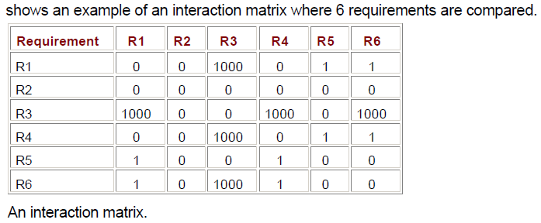
Interaction matrices

Slide 16
Summary
Few more techniques of requirement elicitation
Analysis

