Slide 1
Requirements Elicitation Process
Lecture-6

Slide 2
Recap
Inception
Elicitation
Elaboration
Negotiation
Specification
Validation
Requirements
Management

Slide 3
Today’s Lecture
Inception Process
Elicitation Process

Slide 4
Process

Slide 5
Inception Process

Slide 6
Introduction- Requirements elicitation
Requirements elicitation is the usual name given to activities involved in discovering the requirements of the system.
System developers and engineers work with customers and end-users to find out about
  The problem to be solved, the system services, the required performance of the system, hardware constraints, and so on.
This doesn't just involve asking people what they want;
  It requires a careful analysis of the organization, the application domain and business processes where the system will be used.

Slide 7
Requirements Elicitation Process

Slide 8
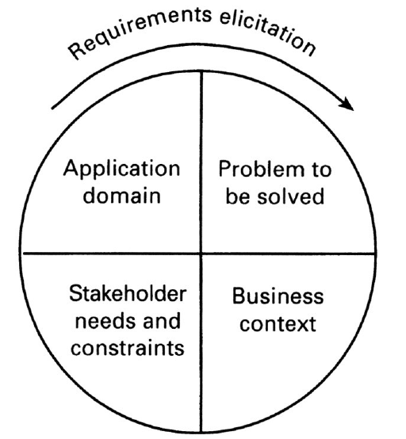
Components of requirements elicitation

Slide 9
Elicitation activities
Application domain understanding
  Application domain knowledge is knowledge of the general area where the system is applied.
    For Example: to understand the requirements for a railway signaling system, you must have background knowledge about the operation of railways and the physical characteristics of trains.
Problem understanding
  The details of the specific customer problem where the system will be applied must be understood.
    For a railway signaling system, you must know the way in which speed limits are applied to particular track segments.
Business understanding
  You must understand how systems interact and contribute to overall business goals. (Means, the contribution of the system in business goal)
Understanding the needs and constraints of system stakeholders
  You must understand, in detail, the specific needs of people who require system support in their work.

Slide 10
Elicitation process problems
1. Application domain knowledge is not collected neatly in one place.
  It exists in a variety of different sources such as in textbooks, operating manuals and in the heads of the people working in that area.
  It usually involves specialist terminology which is not immediately understandable by the requirements engineer.
2. People who understand the problem to be solved are often too busy solving the problem without any new system.
  They can't spend a lot of time helping requirements engineers understand the requirements for a new system.
  They will not necessarily be convinced of the need for a new system so may not want to be involved in the requirements engineering process.

Slide 11
Elicitation process problems
3. Organizational issues and political factors may influence the system requirements.
  Higher management may influence the system requirements in ways that satisfy their personal agendas.
  4. Stakeholders often don't really know what they want from the computer system except in the most general terms.

Slide 12
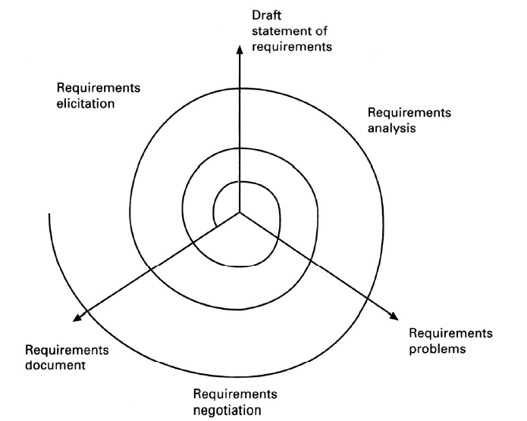
Elicitation, analysis and negotiation

Slide 13
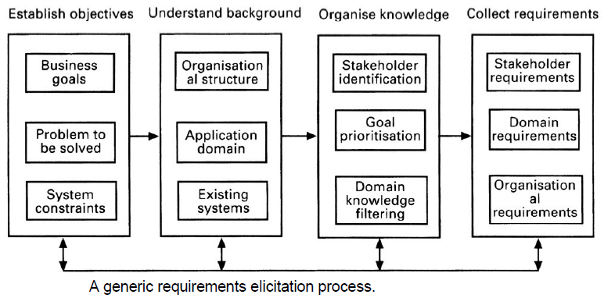
The requirements elicitation process

Slide 14
Elicitation stages
Objective setting
  The organizational objectives should be established including general goals of the business, an outline description of the problem to be solved, why the system is necessary and the constraints on the system.
Background knowledge acquisition
  Background information about the system includes information about the organization where the system is to be installed, the application domain of the system and information about existing systems
Knowledge organization
  The large amount of knowledge which has been collected in the previous stage must be organized and collected.
Stakeholder requirements collection
  System stakeholders are consulted to discover their requirements.

Slide 15
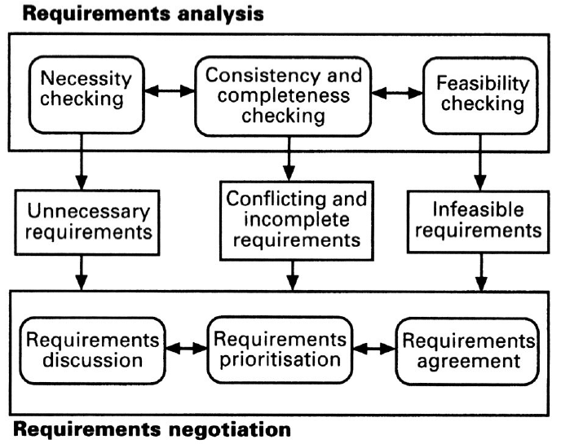
Requirements analysis and negotiation

Slide 16
Analysis checks
Necessity checking
  The need for the requirement is analyzed. In some cases, requirements may be proposed which don’t contribute to the business goals of the organization or to the specific problem to be addressed by the system.
Consistency and completeness checking
  The requirements are cross-checked for consistency and completeness.
  Consistency means that no requirements should be contradictory; completeness means that no services or constraints which are needed have been missed out.
Feasibility checking
  The requirements are checked to ensure that they are feasible in the context of the budget and schedule available for the system development.

Slide 17
Requirements negotiation
Requirements discussion
  Requirements which have been highlighted as problematical are discussed and the stakeholders involved present their views about the requirements.
Requirements prioritization
  Disputed requirements are prioritized to identify critical requirements and to help the decision making process.
Requirements agreement
  Solutions to the requirements problems are identified and a compromise set of requirements are agreed. Generally, this will involve making changes to some of the requirements.

Slide 18
Summary
Inception Process
Elicitation Process
  Elicitation activities
  Elicitation stages

