Slide 1
Requirements Engineering Process Tasks
Lecture-4

Slide 2
Recap
Problems with requirements engineering practices
Seven distinct tasks
  Inception
  Elicitation
  Elaboration
  Negotiation
  Specification
  Validation
  Requirements Management

Slide 3
RE Tasks (Cont…)
Inception
Elicitation
Elaboration
Negotiation
Specification
Validation
Requirements
Management

Slide 4
Quality Function Deployment
This is a technique that translates the needs of the customer into technical requirements for software
It emphasizes an understanding of what is valuable to the customer and then deploys these values throughout the engineering process through functions, information, and tasks
It identifies three types of requirements
  Normal requirements: These requirements are the objectives and goals stated for a product or system during meetings with the customer
  Expected requirements: These requirements are implicit to the product or system and may be so fundamental that the customer does not explicitly state them
  Exciting requirements: These requirements are for features that go beyond the customer's expectations and prove to be very satisfying when present

Slide 5
Elicitation Work Products
The work products will vary depending on the system, but should include one or more of the following items
A statement of need and feasibility
A bounded statement of scope for the system or product
A list of customers, users, and other stakeholders who participated in requirements elicitation
A description of the system's technical environment
A list of requirements (organized by function) and the domain constraints that apply to each
A set of preliminary usage scenarios (in the form of use cases) that provide insight into the use of the system or product under different operating conditions
Any prototypes developed to better define requirements

Slide 6
Inception
Elicitation
Elaboration
Negotiation
Specification
Validation
Requirements
Management

Slide 7
Elaboration Task
During elaboration, the software engineer takes the information obtained during inception and elicitation and begins to expand and refine it
Elaboration focuses on developing a refined technical model of software functions, features, and constraints
It is an analysis modeling task
  Use cases are developed
  Domain classes are identified along with their attributes and relationships
  State machine diagrams are used to capture the life on an object
The end result is an analysis model that defines the functional, informational, and behavioral domains of the problem

Slide 8
Developing Use Cases
Step One – Define the set of actors that will be involved in the story
  Actors are people, devices, or other systems that use the system or product within the context of the function and behavior that is to be described
  Actors are anything that communicate with the system or product and that are external to the system itself
Step Two – Develop use cases, where each one answers a set of questions

Slide 9
Questions Commonly Answered by a Use Case
Who is the primary actor(s), the secondary actor(s)?
What are the actor’s goals?
What preconditions should exist before the scenario begins?
What main tasks or functions are performed by the actor?
What exceptions might be considered as the scenario is described?
What variations in the actor’s interaction are possible?
What system information will the actor acquire, produce, or change?
What information does the actor desire from the system?
Does the actor wish to be informed about unexpected changes?

Slide 10
Elements of the Analysis Model
Scenario-based elements
  Describe the system from the user's point of view using scenarios that are depicted in use cases and activity diagrams
Class-based elements
  Identify the domain classes for the objects manipulated by the actors, the attributes of these classes, and how they interact with one another; they utilize class diagrams to do this

Slide 11
Elements of Analysis Model
Behavioral elements
  Use state diagrams to represent the state of the system, the events that cause the system to change state, and the actions that are taken as a result of a particular event; can also be applied to each class in the system
Flow-oriented elements
  Use data flow diagrams to show the input data that comes into a system, what functions are applied to that data to do transformations, and what resulting output data are produced

Slide 12
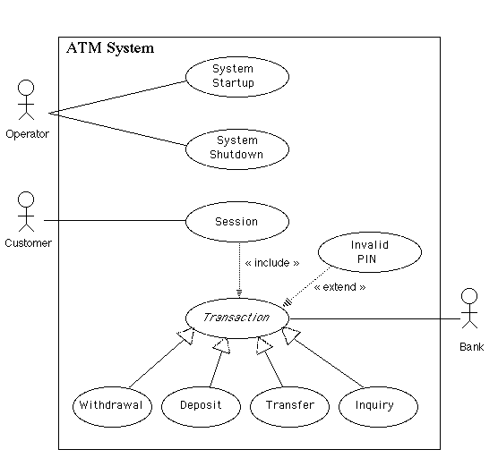
Use Case Example

Slide 13
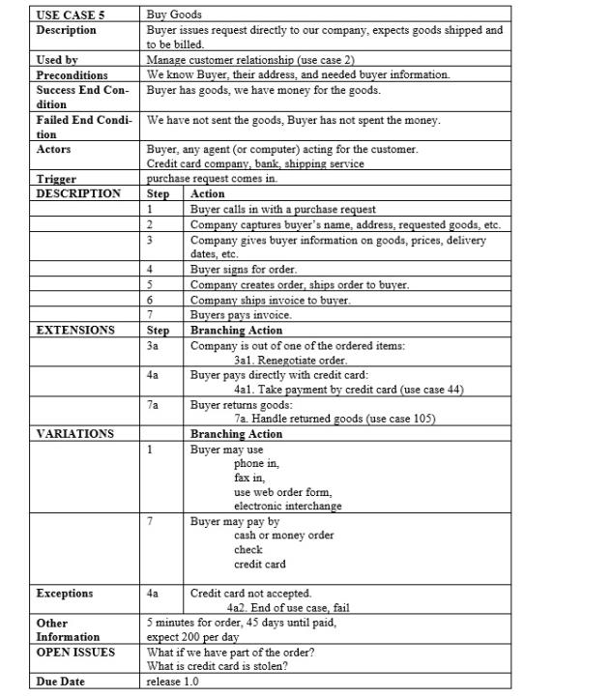
Use Case Example

Slide 14
Inception
Elicitation
Elaboration
Negotiation
Specification
Validation
Requirements
Management

Slide 15
Negotiation Task
During negotiation, the software engineer reconciles the conflicts between what the customer wants and what can be achieved given limited business resources
Requirements are ranked (i.e., prioritized) by the customers, users, and other stakeholders
Risks associated with each requirement are identified and analyzed
Rough guesses of development effort are made and used to assess the impact of each requirement on project cost and delivery time
Using an iterative approach, requirements are eliminated, combined and/or modified so that each party achieves some measure of satisfaction

Slide 16
Inception
Elicitation
Elaboration
Negotiation
Specification
Validation
Requirements
Management

Slide 17
Summary
Elaboration
Negotiation

