Slide 1
Methods for Requirements Engineering
Lecture-30

Slide 2
Recap
Requirement Engineering in AMs
  XP
    Customer involvement
    Requirement scenarios
    Changes/Refactoring
    Testing
Requirement methods
  System models

Slide 3
Today’s lecture
Methods for requirement engineering

Slide 4
Class definition
An implementation of an object type
  The object type Bank Customer refers to a class of bank customers
Objects that share common attributes and operations
  An object is an instance of a class
  For example, if “John Smith” is a bank customer, then bank customer is the class and “John Smith” is an instance of the bank customer

Slide 5
Operations and methods
Used to read and manipulate the data of an object
Reference only the data structures of that object type
To access the data structures of another object, objects must send messages to that object
Methods specify the way in which operations are encoded in software

Slide 6
Encapsulation
Packaging together of data and operations that manipulate the data
Details of how the operation is performed hidden from user
Prevents the unauthorised access of an object’s data

Slide 7
Inheritance
Objects at a lower level in class hierarchy inherit the operations and attributes of their parent(s)
Objects are able to incorporate data and/or operations specific to themselves
Inherits data from more than one parent is called multiple inheritance.

Slide 8
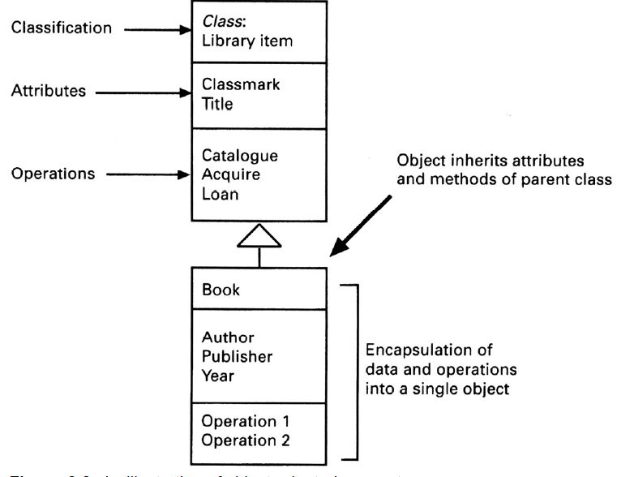
Illustration of object concepts

Slide 9
Messages
Objects communicate by sending messages
Message comprises:
  Name of receiver object
  Operation to be invoked
  Optional set of parameters
When an object receives a message it causes an operation to be invoked
The operation performs the appropriate method

Slide 10
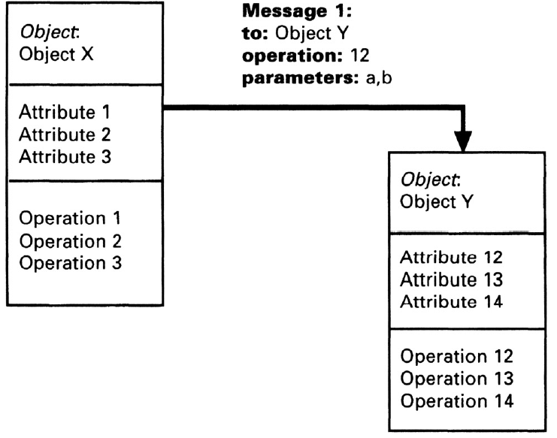
Message passing

Slide 11
Object modelling - Library example
A library system is intended to provide its users with the ability to automate the process of:
  Acquiring library items
  Cataloguing library items
  Browsing library items
  Loaning library items
Library items comprise published and recorded material
The system will be administered by a member of the library staff
Users must register with the system administrator before they can borrow library items

Slide 12
Library example (contd.)
Library users are drawn from three primary groups:
  Students, Members of staff and External users
All library users have as part of their registration:
  Name, Library number, Address, Account
In addition the following information also required for registration:
  Students - Degree programme and admission number.
  Staff - Staff number
  External users - Employer details

Slide 13
Steps in object-oriented method
Most methods based on the object-oriented model share certain common analysis steps:
  Identify core objects
  Construct the object structures defining the associations between object classes
  Define the attributes associated with each object
  Determine the relevant operations for each object
  Define the messages that may be passed between objects

Slide 14
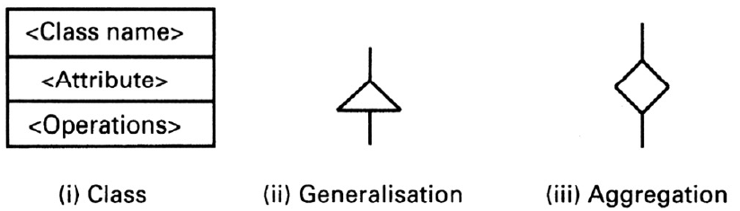
Object-oriented notation used

Slide 15
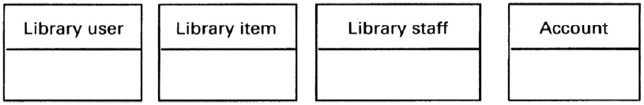
Step 1 - Initial classes identified

Slide 16
Step 2 - Relationships between classes
We can identify the following relationships from the partial requirements:
  (i) A library user borrows a library item
  (ii) A library item is recorded or published
  (iii) The system administrator registers the library user
  (iv) Library users are students, staff and external users
  (v) The system administrator catalogues the library items
  (vi) The library assistant issues the library items

Slide 17
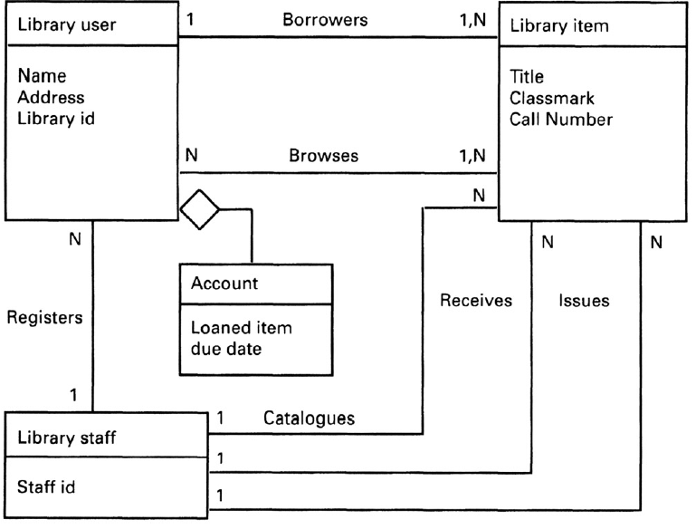
Step 2 - Basic object model showing attributes and relationships

Slide 18
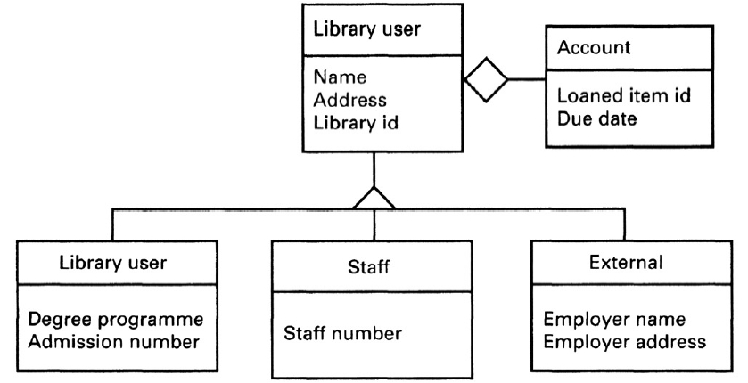
Step 2 - Inheritance for Library user

Slide 19
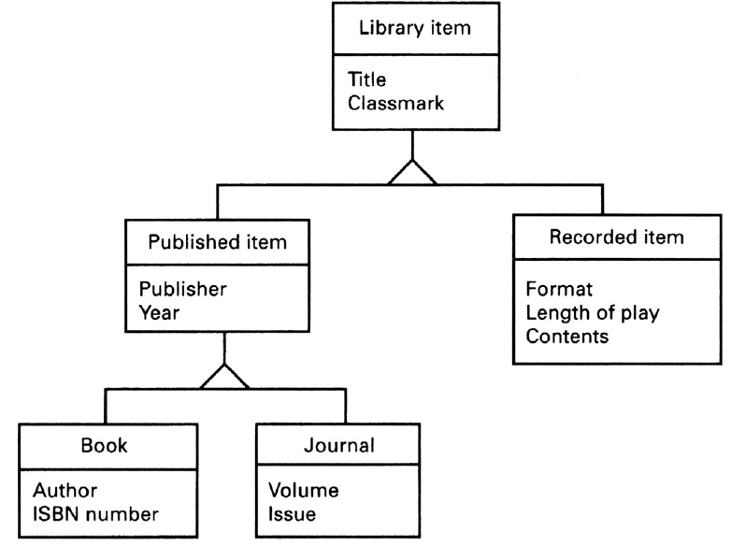
Step 2 - Inheritance for library item

Slide 20
Step 3 - Identifying the attributes
Attributes can be revealed by the analysis of the system requirements
For example, it is a requirement that all library users must be registered before they can use the library
  This means that we need to keep registration data about library users
  Library users may also be provided with an account to keep track of the items loaned to them
Library item has the attributes; title, description and classmark
The library user class has the attributes; name, address and library id

Slide 21
Step 4 - Object operations
This step is intended to describe operations to be performed on the objects
Certain operations are implicit from the object structure
  These include operations for accessing and modifying the attribute values. These operations are assumed and we need not show them explicitly in the model
One way of identifying operations is by modelling the messages that may be passed between the objects

Slide 22
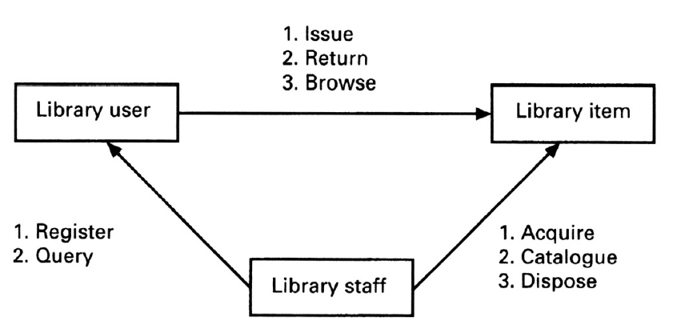
Step 4 - Messages between objects

Slide 23
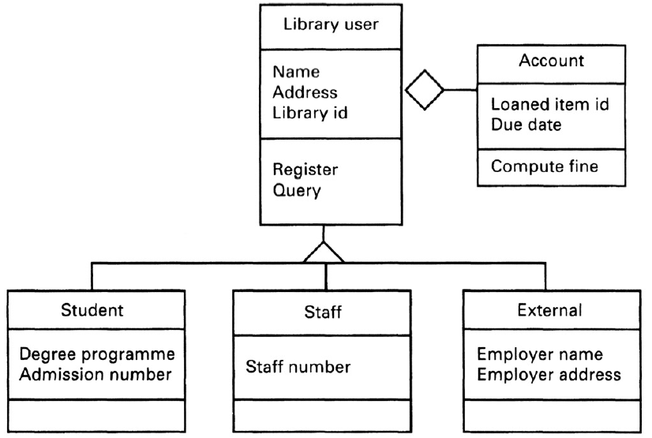
Step 4 - Operations for library user and library staff

Slide 24
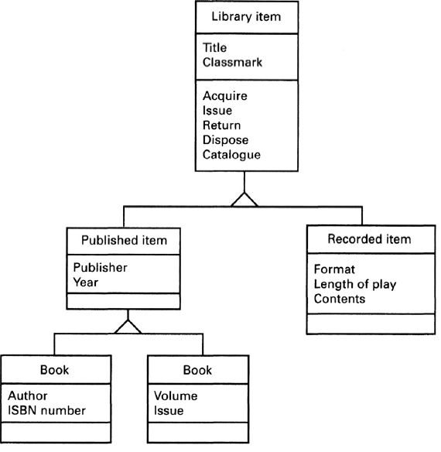
Step 4 - Operations for library item

Slide 25
Use case and event scenarios
Object operations may also be identified by modelling event scenarios for the different functions provided by the system
  Events are then traced to objects that react to them
Typically scenarios model the interactions between the users and the system

Slide 26
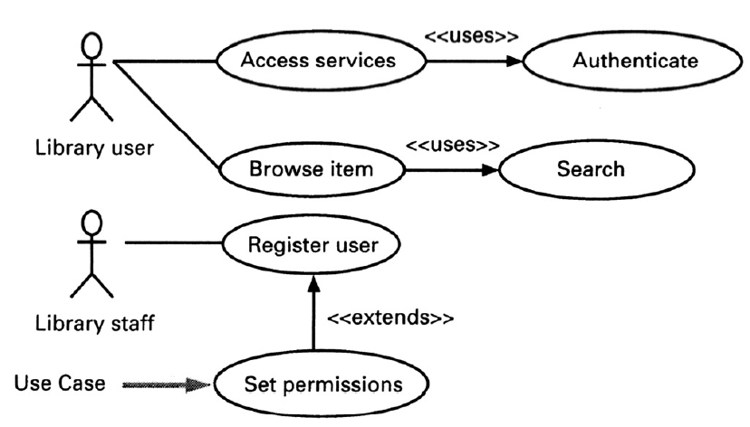
Typical use-case scenario for library system

Slide 27
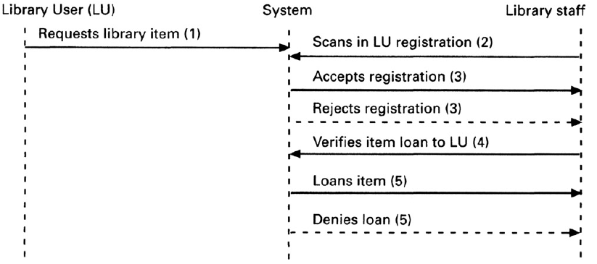
Event scenario for borrowing item

Slide 28
Formal methods
Requirements specification techniques can be categorised on a “formality” spectrum
Semi-formal and informal methods
  Use natural language, diagrams, tables and simple notation
  Include structured analysis and object-oriented analysis
Formal methods include:
  Based on mathematically formal syntax and semantics
  Include Z, B, VDM, LOTOS

Slide 29
Formal methods (contd.)
Provide a means for achieving a high degree of confidence that a system will conform to its specification
Do not absolute guarantee of correctness
Have little directly to offer to the problems of managing software projects
  However, benefits can be gained from gaining a clear understanding of the task at an early stage

Slide 30
Components of formal specification language
Syntax that defines the specific notation with which the specification is represented
Semantics that help to define a “universe of objects” that will be used to describe the system
Relations which define the rules that indicate which objects properly satisfy the specification

Slide 31
Formal methods not widespread
Formal methods are not widely used amongst software developers
Factors contributing to slow acceptance of formal methods:
  Difficulty in understanding the notations
  Difficulty in formalising certain aspects of requirements
  Payoff is not obvious.

Slide 32
Formal specification languages
The number of formal specification languages in use today can be broadly divided into two categories.
Model-based notations
  Z and Vienna Development Method (VDM)
Process algebras -based notations
  Communicating Sequential Processes (CSP), CCS and LOTOS

Slide 33
Advantages of formal methods
Removes ambiguity
Encourages greater rigor in the early stages of software engineering
Possible to verify the correctness, incompleteness and inconsistency checking of the specification

Slide 34
Disadvantages of formal methods
Difficult to represent behavioural aspects of problem
Some requirements can only be determined through empirical evaluation and prototyping
Do not address the problem of how the requirements are constructed
Lack of adequate tool support

Slide 35
Z - A model based formal method
A Z specification is presented as a collection of schemas
A Schema comprises three main parts:
  Name, Declarations and Predicates
Schema declarations set out the names and types of entities introduced in the schema
Schema predicate sets out the relationships between the entities in the declaration

Slide 36
Using Z
Variable declarations are of the form identifier:type
Predicates give properties of, and relationships between the variables
A schema may be used to describe either a state or an operation
  To describe a state, the declared variables form the components of the state and the predicates give the invariant properties of the state
  For an operation, the declarations consist of the initial state components, the final components, the inputs and the outputs of the operation
  For an operation, the predicate part describes the relation between the inputs, outputs, and initial and final states

Slide 37
Z Schema

Slide 38
Library example
The state space of the lending library can be defined using the following schema:

Slide 39
Schema for borrow operation

Slide 40
Schema for ‘New’ and ‘Return’ operations

Slide 41
Key points
No ideal requirements method
System models can be considerably enriched by combining different techniques
Data-flow model is based on the notion that systems can be modelled as a set of interacting functions
The object-oriented approach is based on the notion that systems can be modelled as a set of interacting objects
Formal methods are based on mathematical principles and are intended to achieve a high degree of confidence that a system will conform to its specifications

