Slide 1
Requirements Engineering in Agile Methods
Lecture-29

Slide 2
Recap
Requirement engineering in AMs

Slide 3
Today’s lecture
Requirement engineering in AMs
Requirement methods

Slide 4
XP and agile principles
Incremental development is supported through small, frequent system releases.
Customer involvement means full-time customer engagement with the team.
People not process through pair programming, collective ownership and a process that avoids long working hours.
Change supported through regular system releases.
Maintaining simplicity through constant refactoring of code.

Slide 5
Customer involvement
Customer involvement is a key part of XP where the customer is part of the development team.
The role of the customer is:
  To help develop stories that define the requirements
  To help prioritize the features to be implemented in each release
  To help develop acceptance tests which assess whether or not the system meets its requirements.

Slide 6
Requirements scenarios
In XP, user requirements are expressed as scenarios or user stories.
These are written on cards and the development team break them down into implementation tasks. These tasks are the basis of schedule and cost estimates.
The customer chooses the stories for inclusion in the next release based on their priorities and the schedule estimates.

Slide 7
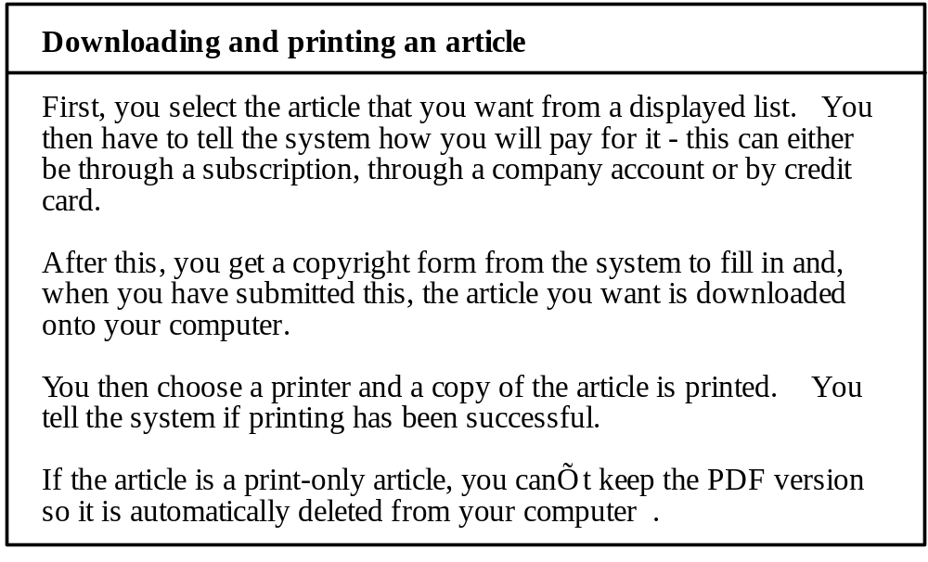
Story card for document downloading

Slide 8
XP and change
Conventional wisdom in software engineering is to design for change. It is worth spending time and effort anticipating changes as this reduces costs later in the life cycle.
XP, however, maintains that this is not worthwhile as changes cannot be reliably anticipated.
Rather, it proposes constant code improvement (refactoring) to make changes easier when they have to be implemented.

Slide 9
Refactoring
Refactoring is the process of code improvement where code is reorganised and rewritten to make it more efficient, easier to understand, etc.
Refactoring is required because frequent releases mean that code is developed incrementally and therefore tends to become messy.
Refactoring should not change the functionality of the system.
Automated testing simplifies refactoring as you can see if the changed code still runs the tests successfully.

Slide 10
Testing in XP
Test-first development.
Incremental test development from scenarios.
User involvement in test development and validation.
Automated test harnesses are used to run all component tests each time that a new release is built.

Slide 11
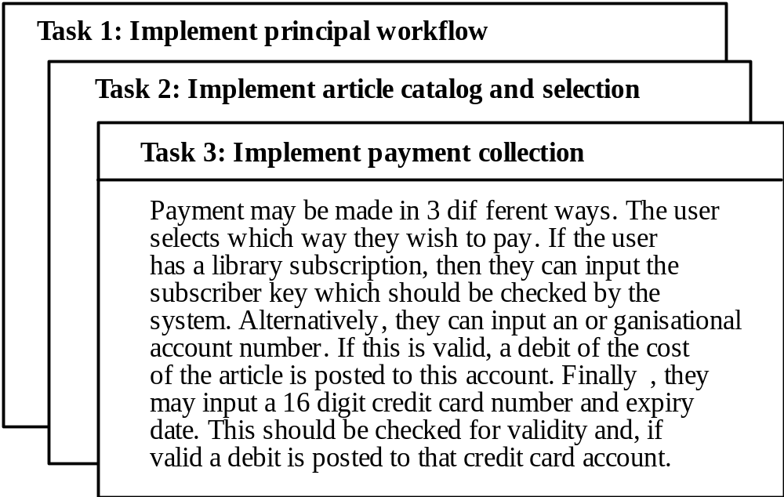
Task cards for document downloading

Slide 12
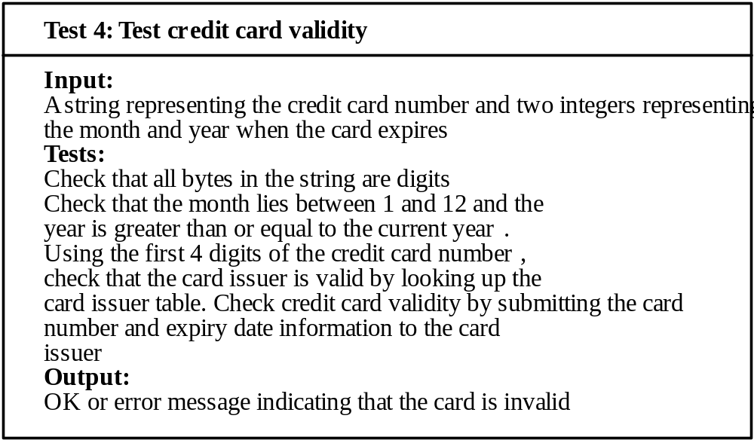
Test case description

Slide 13
Test-first development
Writing tests before code clarifies the requirements to be implemented.
Tests are written as programs rather than data so that they can be executed automatically. The test includes a check that it has executed correctly.
All previous and new tests are automatically run when new functionality is added. Thus checking that the new functionality has not introduced errors.

Slide 14
Tools for Requirements Management in AMs
UML Modeling Tools
Requirements Negotiation Tools
Instant Messaging Tools
Project Management Tools

Slide 15
Methods for Requirement Engineering

Slide 16
Role of methods in RE
Process of requirements engineering (RE) is usually guided by a requirements method
Requirement methods are systematic ways of producing system models
System models bridges gap between the analysis and the design process

Slide 17
Necessary properties for a RE method
Suitability for agreement with the end-user
The precision of definition of its notation
Assistance with formulating requirements
Definition of the world outside
Scope for malleability
Scope for integrating other approaches
Scope for communication
Tool support

Slide 18
No ideal RE method
There is no ideal requirement method
A number of methods use a variety of modelling techniques to formulate system requirements
System models can be enriched by modelling different aspects of using modelling techniques

Slide 19
Modeling techniques
Data-flow models
Compositional models
Classification models
Stimulus-response models
Process models

Slide 20
Data flow modelling
Based on the notion that systems can be modelled as a set of interacting functions
Uses data-flow diagrams (DFDs) to graphically represent the external entities, processes, data-flow, and data stores

Slide 21
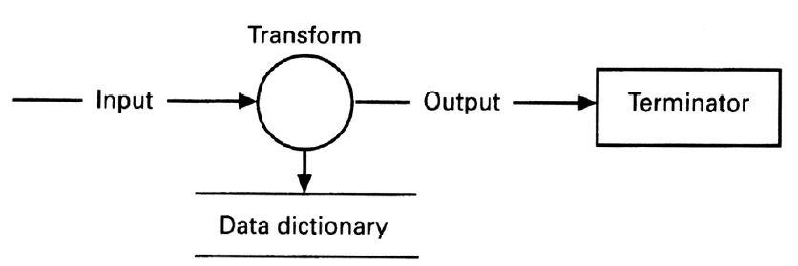
Data flow notation

Slide 22
Notation variability
There is little uniformity in industry concerning the DFD notation
The notation shown was advanced by DeMarco
Gane and Sarson use rounded rectangles for bubbles shadowed rectangles for sources and destinations, and squared off C’s for data stores
Orr uses rectangles for bubbles, ellipses for sources and destinations, and ellipses for data stores

Slide 23
DFD example
Consider a simple library system intended to automate the issuing of library items
The first data-flow diagram derived by the analyst represents the ‘target’ system at its context level
The next level (level 1) of the data-flow diagram is constructed by decomposing the library system bubble into sub-functions

Slide 24
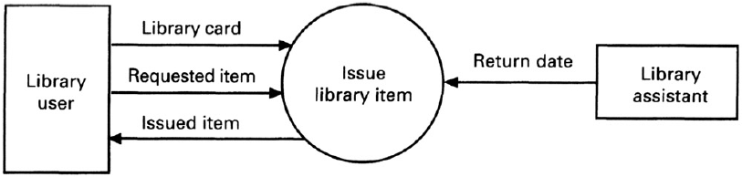
Library example-
Context level data flow diagram

Slide 25
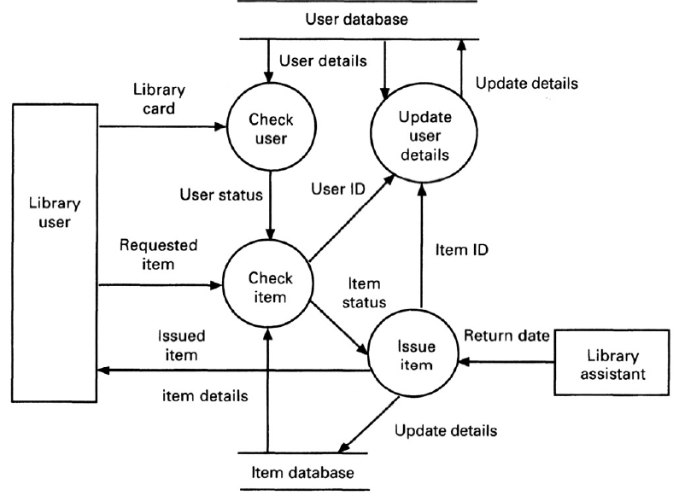
Library example -
Level 1 data flow diagram

Slide 26
Structured analysis
The data-flow approach is typified by the Structured Analysis method (SA)
Two major strategies dominate structured analysis
  ‘Old’ method popularised by DeMarco
  ‘Modern’ approach by Yourdon

Slide 27
DeMarco
A top-down approach
  The analyst maps the current physical system onto the current logical data-flow model
The approach can be summarised in four steps:
  Analysis of current physical system
  Derivation of logical model
  Derivation of proposed logical model
  Implementation of new physical system

Slide 28
Modern structured analysis
Distinguishes between user’s real needs and those requirements that represent the external behaviour satisfying those needs
Includes real-time extensions
Other structured analysis approaches include:
  Structured Analysis and Design Technique (SADT)
  Structured Systems Analysis and Design Methodology (SSADM)

Slide 29
Relational model
Data may be modelled using the relational model
  Specifies data as a set of tables, with some columns being used as common keys
Disadvantages of relational model
  Implicit data typing
  Inadequate modelling of relations
Data model should include information about the semantics of the data

Slide 30
Semantic model
Approaches to semantic data modelling include:
  Entity-relationship model (Chen, 1976)
  RM/ T (Codd, 1979)
  SDM (Hammer and McLeod, 1981)
Models identify the entities in a database, their attributes and their relationships
Uses graphical notations

Slide 31
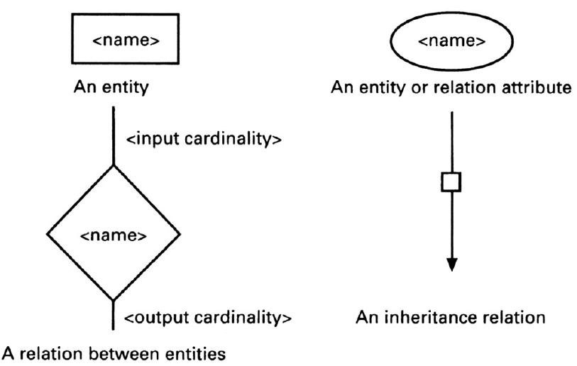
Notation for semantic data modelling

Slide 32
Extensions to entity relationship model
The basic ERM has been extended to include sub and super-types to the basic entity and relation primitives
Types may have sub-types
Types may inherit the attributes of their super-types
In addition, sub-types may have private attributes

Slide 33
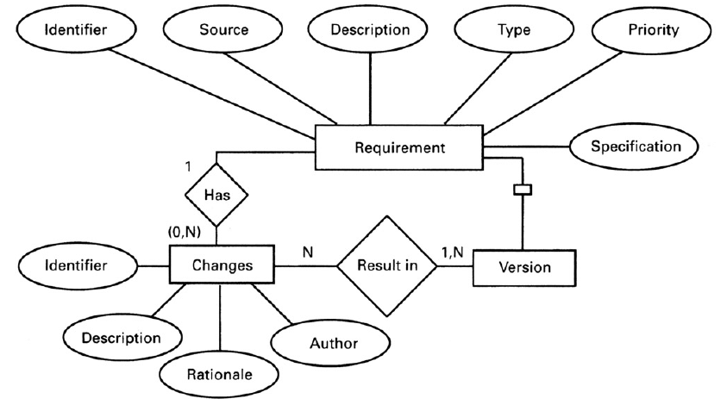
ERM example - Software requirement

Slide 34
Object-oriented approaches
Closest precursor is entity relationship model
Requirements methods based on object orientation:
  Shlaer and Mellor (1988)
  Colbert (1989)
  Coad and Yourdon (1989)
  Wirf-Brock (1990)
  Rumbaugh (1991)
  Jacobson (1992)
  Martin-Odell (1992)
Notations for the various methods are semantically similar

Slide 35
Object
Are major actors, agents, and servers in the problem space of the system
Identified by analysing the domain
Objects include:
  Devices that the system interacts with
  Systems that interface with the system under study
  Organisational units
  Things that must be remembered over time
  Physical locations or sites
  Specific roles played by humans

Slide 36
Basic concepts
Encapsulation
Class
Inheritance
Operations or Services

Slide 37
Object definition
Something real or abstract about which we store data and those operations that manipulate the data
Examples include:
  An account, a sensor, a software design, a car , an organisation
May be composite - composed of other objects

Slide 38
Summary
Requirement Engineering in AMs
  XP
    Customer involvement
    Requirement scenarios
    Changes/Refactoring
    Testing
Requirement methods
  System models

