Slide 1
Requirements Specification
Lecture-22

Slide 2
Recap
Specifying NFRs
  Deriving NFRs
    Concern decomposition
    Goal decomposition
  Specifying NFRs for safety critical systems

Slide 3
Today’s lecture
Specifying NFRs
  Specifying NFRs for safety critical systems
Requirements validation

Slide 4
NFRs for critical systems
A failure of a critical system may result from a failure to meet a functional requirement but, more often, it results from a failure of the system to satisfy some non-functional constraint on its operation.
The principal non-functional constraints which are relevant to critical systems:
  Reliability
  Performance
  Security
  Usability
  Safety

Slide 5
Reliability
Constraints on the run-time behaviour of the system
Can be considered under two separate headings:
  Availability - is the system available for service when requested by end-users.
  Failure rate - how often does the system fail to deliver the service expected by end-users.
Reliability requirements can often be expressed quantitatively.
  Availability may be specified in terms of the time when the system is unavailable for service (e.g. 3 minutes in 24 hours)
  The acceptable failure rate may be specified in terms of the rate of occurrence of failures in a given time period (ROCOF) or the mean time between system failures (MTTF).

Slide 6
Performance
Constrain the speed of operation of a system
Types of performance requirements:
Response requirements which specify the acceptable response of the system to end-user input: for example, it might be specified that the system should respond to a user request for service within 2 seconds.
Throughput requirements which specify the amount of data which must be processed in a given time: for example, it might be specified that the system must process at least 10 transactions per second.
Timing requirements which specify how quickly the system must collect input from sensors before it is overwritten by the next input value, or which specify how quickly outputs must be produced for processing by other systems: for example, it might be specified that the system must poll sensors at least 6 times per second.

Slide 7
Security
Security requirements are included in a system to ensure:
  Unauthorised access to the system and its data is not allowed
  Ensure the integrity of the system from accidental or malicious damage
Examples of security requirements are:
  The access permissions for system data may only be changed by the system’s data administrator
  All system data must be backed up every 24 hours and the backup copies stored in a secure location which is not in the same building as the system
  All external communications between the system’s data server and clients must be encrypted

Slide 8
Usability
Concerned with specifying the user interface and end-user interactions with the system
Well structured user manuals, informative error messages, help facilities and consistent interfaces enhance usability

Slide 9
Usability metrics
Measurable attributes of usability requirements include:
  Entry requirements Measured in terms of years of experience with class of applications or simply age
  Learning requirements Denotes the time needed to learn the facilities of the system. This could be measured in terms of speed of learning, say hours of training required before independent use is possible
  Handling requirements Denotes the error rate of the end-users of the system. This could be measured in terms of the errors made when working at normal speed
  Likeability Denotes ‘niceness’ to use. The most direct to measure user satisfaction is to survey actual users and record the proportion who ‘like to work with the product’

Slide 10
Safety
No consensus in the system’s engineering community about what is meant by the term ‘safety requirement’
  Sometimes considered to be all requirements (functional and non-functional) on safety-related systems
  Sometimes the sub-set of these requirements which are directly related to ensuring safe operation and sometimes requirements on protection systems which are designed to protect against accident
Usage of the term often depends on the culture and practice of the organisation

Slide 11
Safety requirement definition
Informal definition:
Safety requirements are the ‘shall not’ requirements which exclude unsafe situations from the possible solution space of the system

Slide 12
Examples of safety requirements
The system shall not permit operation unless the operator guard is in place
The system shall not allow the sedative dose delivered to the patient to be greater than the maximum value which is determined by the patient’s physician
The system shall not operate if the external temperature is below 4 degrees Celsius

Slide 13
Non-functional Requirements Checklist
Availability: A system's availability, or "uptime," is the amount of time that it is operational and available for use. This is specified because some systems are designed with expected downtime for activities like database upgrades and backups.
Efficiency: Specifies how well the software utilizes limited resources: CPU cycles, disk space, memory, bandwidth, etc.
Flexibility: If the organization intends to increase or extend the functionality of the software after it is deployed, that should be planned from the beginning; it influences choices made during the design, development, testing, and deployment of the system.
Portability: Portability specifies the ease with which the software can be installed on all necessary platforms, and the platforms on which it is expected to run.

Slide 14
Non-functional Requirements
Performance: The performance constraints specify the timing characteristics of the software. Certain tasks or features are more time-sensitive than others; the nonfunctional requirements should identify those software functions that have constraints on their performance.
Reliability: Reliability specifies the capability of the software to maintain its performance over time. Unreliable software fails frequently, and certain tasks are more sensitive to failure (for example, because they cannot be restarted, or because they must be run at a certain time).
Reusability: Many systems are developed with the ability to leverage common components across multiple products. Reusability indicates the extent to which software components should be designed in such a way that they can be used in applications other than the ones for which they were initially developed.
Robustness: A robust system is able to handle error conditions gracefully, without failure. This includes a tolerance of invalid data, software defects, and unexpected operating conditions.

Slide 15
Non-Functional Requirements
Scalability: Software that is scalable has the ability to handle a wide variety of system configuration sizes. The nonfunctional requirements should specify the ways in which the system may be expected to scale up (by increasing hardware capacity, adding machines, etc.).
Usability: Ease-of-use requirements address the factors that constitute the capacity of the software to be understood, learned, and used by its intended users.
Integrity: Integrity requirements define the security attributes of the system, restricting access to features or data to certain users and protecting the privacy of data entered into the software.

Slide 16
Key points
Non-functional requirements define the overall qualities or attributes of the resulting system
Non-functional requirements may be classified into three main types; product, process and external requirements
Product requirements specify the desired characteristics that the system or subsystem must posses
Non-functional requirements tend to conflict and interact with other system requirements
The principal non-functional constraints which are relevant to critical systems are reliability, performance, security, usability and safety

Slide 17
Requirements validation

Slide 18
Inception
Elicitation
Elaboration
Negotiation
Specification
Validation
Requirements
Management

Slide 19
Validation objectives
Certifies that the requirements document is an acceptable description of the system to be implemented
Checks a requirements document for
  Completeness and consistency
  Conformance to standards
  Requirements conflicts
  Technical errors
  Ambiguous requirements

Slide 20
Analysis and validation
Analysis works with raw requirements as elicited from the system stakeholders
  “Have we got the right requirements” is the key question to be answered at this stage
Validation works with a final draft of the requirements document i.e. with negotiated and agreed requirements
  “Have we got the requirements right” is the key question to be answered at this stage

Slide 21
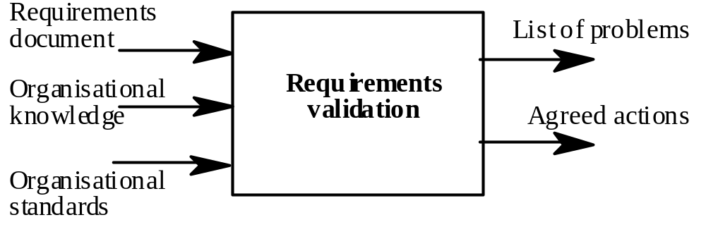
Validation inputs and outputs

Slide 22
Validation inputs
Requirements document
  Should be a complete version of the document, not an unfinished draft. Formatted and organised according to organisational standards
Organisational knowledge
  Knowledge, often implicit, of the organisation which may be used to judge the realism of the requirements
Organisational standards
  Local standards e.g. for the organisation of the requirements document

Slide 23
Validation outputs
Problem list
  List of discovered problems in the requirements document
Agreed actions
  List of agreed actions in response to requirements problems. Some problems may have several corrective actions; some problems may have no associated actions

Slide 24
Requirements reviews
A group of people read and analyse the requirements, look for problems, meet and discuss the problems and agree on actions to address these problems

Slide 25
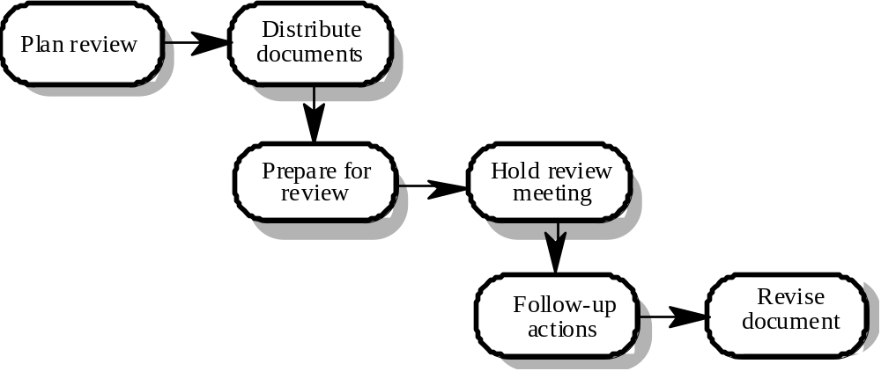
Requirements review process

Slide 26
Review activities
Plan review
  The review team is selected and a time and place for the review meeting is chosen.
Distribute documents
  The requirements document is distributed to the review team members
Prepare for review
  Individual reviewers read the requirements to find conflicts, omissions, inconsistencies, deviations from standards and other problems.

Slide 27
Review activities
Hold review meeting
  Individual comments and problems are discussed and a set of actions to address the problems is agreed.
Follow-up actions
  The chair of the review checks that the agreed actions have been carried out.
Revise document
  The requirements document is revised to reflect the agreed actions. At this stage, it may be accepted or it may be re-reviewed

Slide 28
Problem actions
Requirements clarification
  The requirement may be badly expressed or may have accidentally omitted information which has been collected during requirements elicitation.
Missing information
  Some information is missing from the requirements document. It is the responsibility of the requirements engineers who are revising the document to discover this information from system stakeholders.
Requirements conflict
  There is a significant conflict between requirements. The stakeholders involved must negotiate to resolve the conflict.
Unrealistic requirement
  The requirement does not appear to be implementable with the technology available or given other constraints on the system. Stakeholders must be consulted to decide how to make the requirement more realistic.

Slide 29
Pre-review checking
Reviews are expensive because they involve a number of people spending time reading and checking the requirements document
This expense can be reduced by using pre-review checking where one person checks the document and looks for straightforward problems such as missing requirements, lack of conformance to standards, typographical errors, etc.
Document may be returned for correction or the list of problems distributed to other reviewers

Slide 30
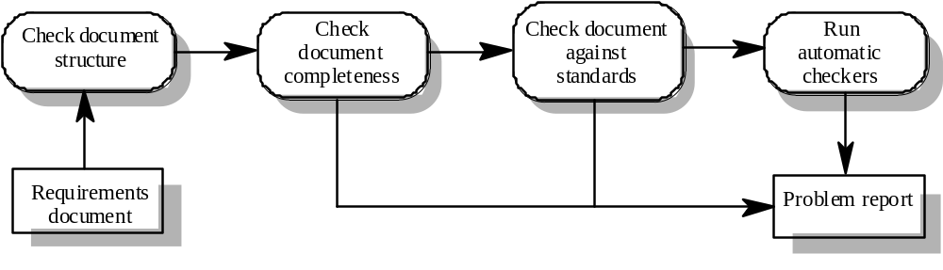
Pre-review checking

Slide 31
Summary
Specification
  Specifying NFRs for critical systems
  NFRs checklist
Requirements validation
  Inputs/outputs to validation process
  Requirement review process

Slide 32
Review team membership
Reviews should involve a number of stakeholders drawn from different backgrounds
  People from different backgrounds bring different skills and knowledge to the review
  Stakeholders feel involved in the RE process and develop an understanding of the needs of other stakeholders
Review team should always involve at least a domain expert and an end-user

Slide 33
Review checklists
Understandability
  Can readers of the document understand what the requirements mean?
Redundancy
  Is information unnecessarily repeated in the requirements document?
Completeness
  Does the checker know of any missing requirements or is there any information missing from individual requirement descriptions?
Ambiguity
  Are the requirements expressed using terms which are clearly defined? Could readers from different backgrounds make different interpretations of the requirements?

Slide 34
Review checklists
Consistency
  Do the descriptions of different requirements include contradictions? Are there contradictions between individual requirements and overall system requirements?
Organisation
  Is the document structured in a sensible way? Are the descriptions of requirements organised so that related requirements are grouped?
Conformance to standards
  Does the requirements document and individual requirements conform to defined standards? Are departures from the standards, justified?
Traceability
  Are requirements unambiguously identified, include links to related requirements and to the reasons why these requirements have been included?

Slide 35
Checklist questions
Is each requirement uniquely identified?
Are specialised terms defined in the glossary
Does a requirement stand on its own or do you have to examine other requirements to understand what it means?
Do individual requirements use the terms consistently
Is the same service requested in different requirements? Are there any contradictions in these requests?
If a requirement makes reference to some other facilities, are these described elsewhere in the document?
Are related requirements grouped together? If not, do they refer to each other?

Slide 36
Requirements problem example
“4. EDDIS will be configurable so that it will comply with the requirements of all UK and (where relevant) international copyright legislation. Minimally, this means that EDDIS must provide a form for the user to sign the Copyright Declaration statement. It also means that EDDIS must keep track of Copyright Declaration statements which have been signed/not-signed. Under no circumstances must an order be sent to the supplier if the copyright statement has not been signed.”

Slide 37
Problems
Incompleteness
  What international copyright legislation is relevant?
  What happens if the copyright declaration is not signed?
  If a signature is a digital signature, how is it assigned?
Ambiguity
  What does signing an electronic form mean? Is this a physical signature or a digital signature?
Standards
  More than 1 requirement. Maintenance of copyright is one requirement; issue of documents is another

Slide 38
Prototyping
Prototypes for requirements validation demonstrate the requirements and help stakeholders discover problems
Validation prototypes should be complete, reasonably efficient and robust. It should be possible to use them in the same way as the required system
User documentation and training should be provided

Slide 39
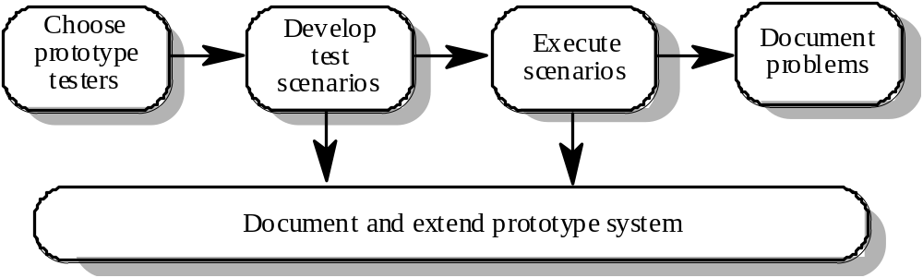
Prototyping for validation

Slide 40
Prototyping activities
Choose prototype testers
  The best testers are users who are fairly experienced and who are open-minded about the use of new systems. End-users who do different jobs should be involved so that different areas of system functionality will be covered.
Develop test scenarios
  Careful planning is required to draw up a set of test scenarios which provide broad coverage of the requirements. End-users shouldn’t just play around with the system as this may never exercise critical system features.
Execute scenarios
  The users of the system work, usually on their own, to try the system by executing the planned scenarios.
Document problems
  Its usually best to define some kind of electronic or paper problem report form which users fill in when they encounter a problem.

Slide 41
User manual development
Writing a user manual from the requirements forces a detailed requirements analysis and thus can reveal problems with the document
Information in the user manual
  Description of the functionality and how it is implemented
  Which parts of the system have not been implemented
  How to get out of trouble
  How to install and get started with the system

Slide 42
Model validation
Validation of system models is an essential part of the validation process
Objectives of model validation
  To demonstrate that each model is self-consistent
  If there are several models of the system, to demonstrate that these are internally and externally consistent
  To demonstrate that the models accurately reflect the real requirements of system stakeholders
Some checking is possible with automated tools
Paraphrasing the model is an effective checking technique

Slide 43
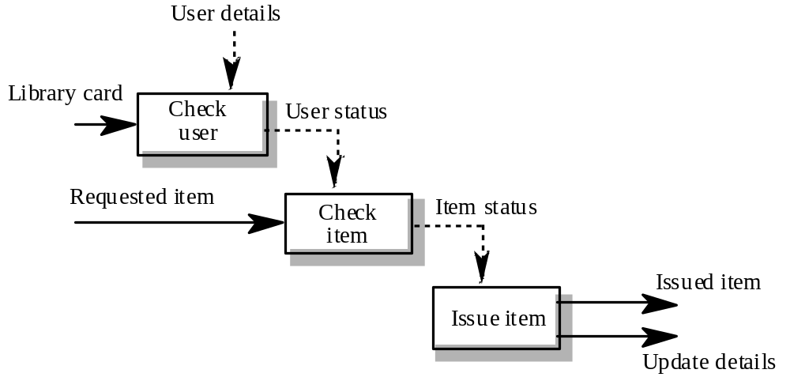
Data-flow diagram for Issue

Slide 44
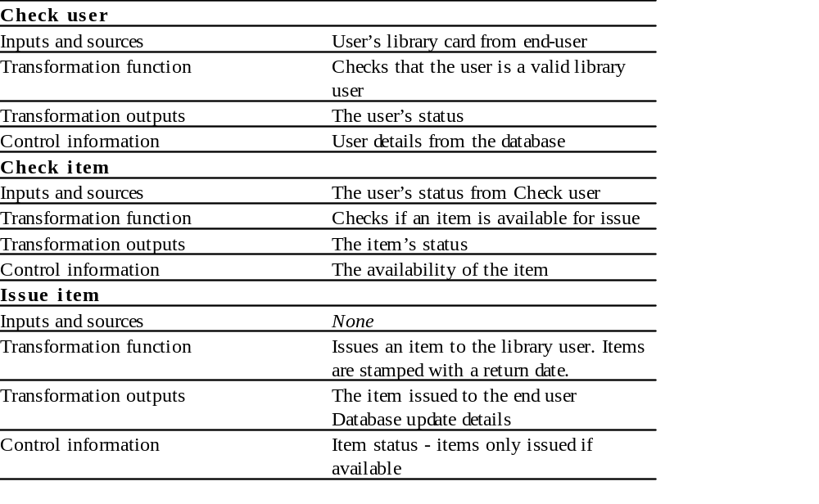
Paraphrased description

Slide 45
Requirements testing
Each requirement should be testable i.e. it should be possible to define tests to check whether or not that requirement has been met.
Inventing requirements tests is an effective validation technique as missing or ambiguous information in the requirements description may make it difficult to formulate tests
Each functional requirement should have an associated test

Slide 46
Test case definition
What usage scenario might be used to check the requirement?
Does the requirement, on its own, include enough information to allow a test to be defined?
Is it possible to test the requirement using a single test or are multiple test cases required?
Could the requirement be re-stated to make the test cases more obvious?

Slide 47
Test record form
The requirement’s identifier
  There should be at least one for each requirement.
Related requirements
  These should be referenced as the test may also be relevant to these requirements.
Test description
  A brief description of the test and why this is an objective requirements test. This should include system inputs and corresponding outputs.
Requirements problems
  A description of problems which made test definition difficult or impossible.
Comments and recommendations
  These are advice on how to solve requirements problems which have been discovered.

Slide 48
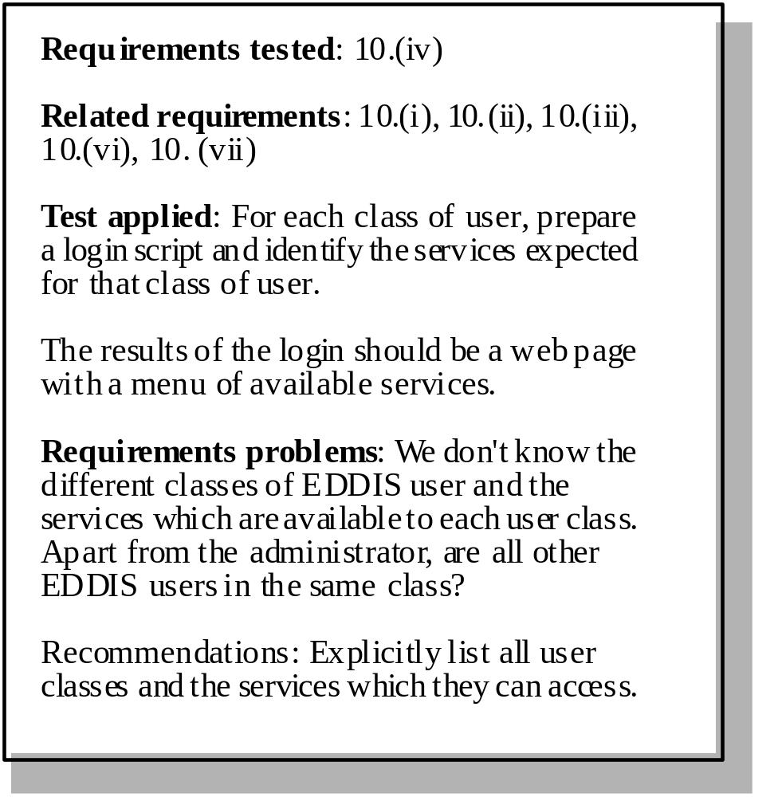
Requirements test form

Slide 49
Hard-to-test requirements
System requirements
  Requirements which apply to the system as a whole. In general, these are the most difficult requirements to validate irrespective of the method used as they may be influenced by any of the functional requirements. Tests, which are not executed, cannot test for non-functional system-wide characteristics such as usability.
Exclusive requirements
  These are requirements which exclude specific behaviour. For example, a requirement may state that system failures must never corrupt the system database. It is not possible to test such a requirement exhaustively.
Some non-functional requirements
  Some non-functional requirements, such as reliability requirements, can only be tested with a large test set. Designing this test set does not help with requirements validation.

Slide 50
Key points
Requirements validation should focus on checking the final draft of the requirements document for conflicts, omissions and deviations from standards.
Inputs to the validation process are the requirements document, organisational standards and implicit organisational knowledge. The outputs are a list of requirements problems and agreed actions to address these problems.
Reviews involve a group of people making a detailed analysis of the requirements.
Review costs can be reduced by checking the requirements before the review for deviations from organisational standards. These may result from more serious requirements problems.

Slide 51
Key points
Checklists of what to look for may be used to drive a requirements review process.
Prototyping is effective for requirements validation if a prototype has been developed during the requirements elicitation stage.
Systems models may be validated by paraphrasing them. This means that they are systematically translated into a natural language description.
Designing tests for requirements can reveal problems with the requirements. If the requirement is unclear, it may be impossible to define a test for it.

