Slide 1
Specification Process
Lecture-21

Slide 2
Recap
Specifying functional requirements
  Good/bad requirements
Specifying non-functional requirements
  Types of NFRs
  Classification of NFRs

Slide 3
Today’s lecture
Specifying non-functional requirements

Slide 4
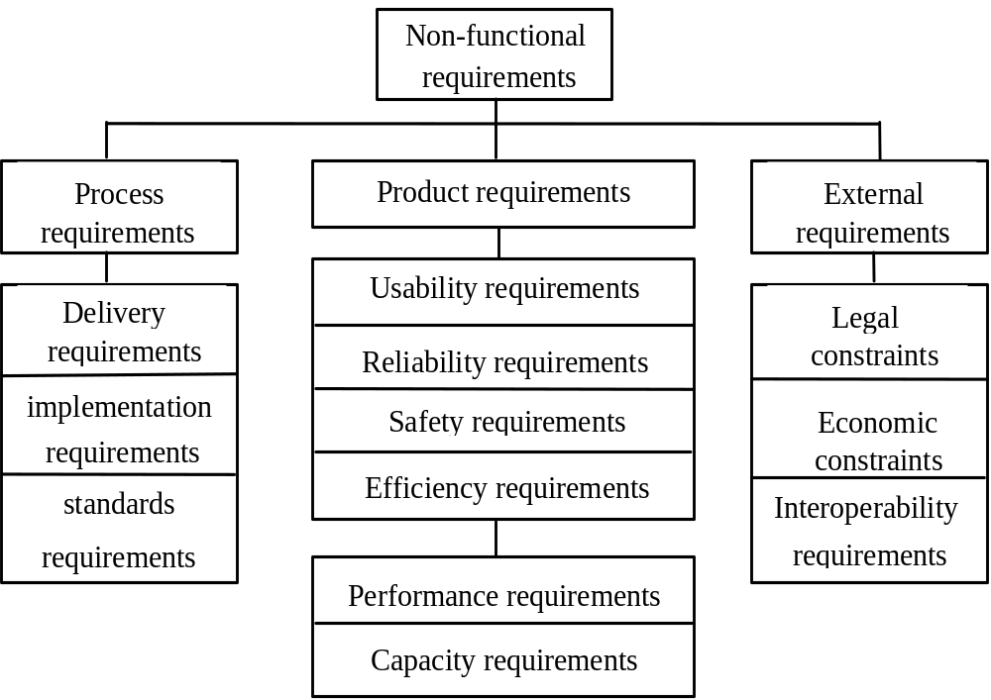
Classification of NFRs (contd.)

Slide 5
Examples of product requirements
The System service X shall have an availability of 999/1000 or 99%. This is a reliability requirement which means that out of every 1000 requests for this service, 999 must be satisfied.
System Y shall process a minimum of 8 transactions per second. This is a performance requirement.
The executable code of System Z shall be limited to 512Kbytes. This is a space requirement which specifies the maximum memory size of the system.
The request for the user's PIN shall be issued within 5 seconds of the card being entered in the card reader. This is a
performance requirement.
We can do some brainstorming when specifying the section special requirements in Use case development.

Slide 6
Examples of process requirements
The development process to be used must be explicitly defined and must be conformant with ISO 9000 standards
The system must be developed using the XYZ suite of CASE tools
Management reports setting out the effort expended on each identified system component must be produced every two weeks
A disaster recovery plan for the system development must be specified

Slide 7
Examples of external requirements
Medical data system The organisation’s data protection officer must certify that all data is maintained according to data protection legislation before the system is put into operation.
Train protection system The time required to bring the train to a complete halt is computed using the following function:
The deceleration of the train shall be taken as:
  γ_{train} = γ_{control} + γ_{gradient}

Slide 8
Deriving NFRs
NFRs are difficult to express
A number of important issues contribute to the problem of expressing non-functional requirements:
  Certain constraints are related to the design solution that is unknown at the requirements stage
  Certain constraints, are highly subjective and can only be determined through complex empirical evaluations
  Non-functional requirements tend to be related to one or more functional requirements
  Non-functional requirements tend to conflict and contradict
  There are no ‘universal’ rules and guidelines for determining when non-functional requirements are optimally met.

Slide 9
Stakeholder concerns
Stakeholders normally have a number of ‘concerns’
Concerns are typically non-functional
Examples include:
  Critical business objectives
  Essential system characteristics (e.g. security)
  Safety, performance, functionality and maintainability
Vaguely defined user concerns may be related to NFRs

Slide 10
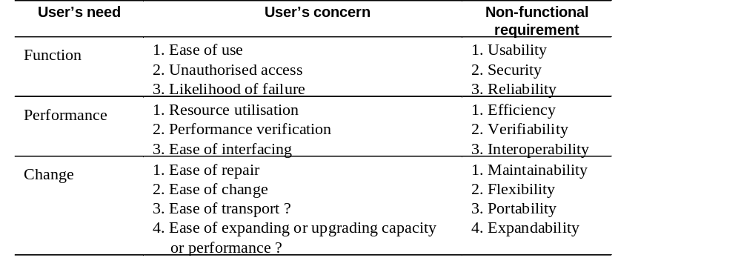
Relationships between user needs, concerns and NFRs

Slide 11
Concerns
A way of expressing critical ‘holistic’ requirements
Concerns may be broken down into sub-concerns and finally into specific questions
Questions act as a check list to ensure that specific requirements do not conflict with global priorities

Slide 12
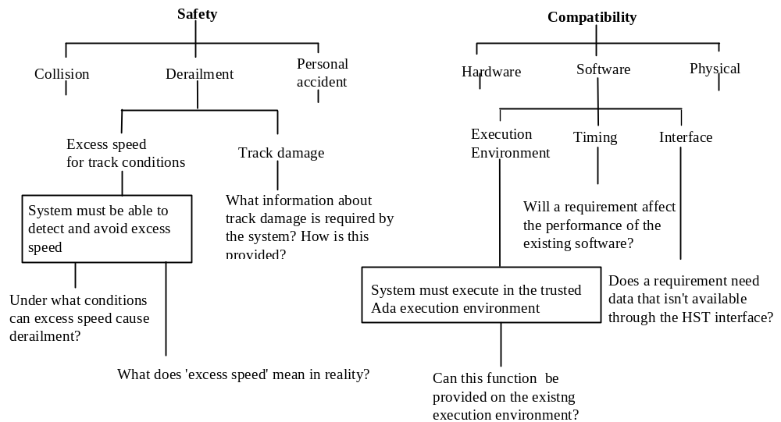
Concern decomposition

Slide 13
Goal-based derivation
Relates non-functional requirements to the goals of the enterprise
Goal-based NFR derivation is a 3 step approach:
  Identify the enterprise goal
  Decompose of the goal into sub-goals
  Identify non-functional requirements.

Slide 14
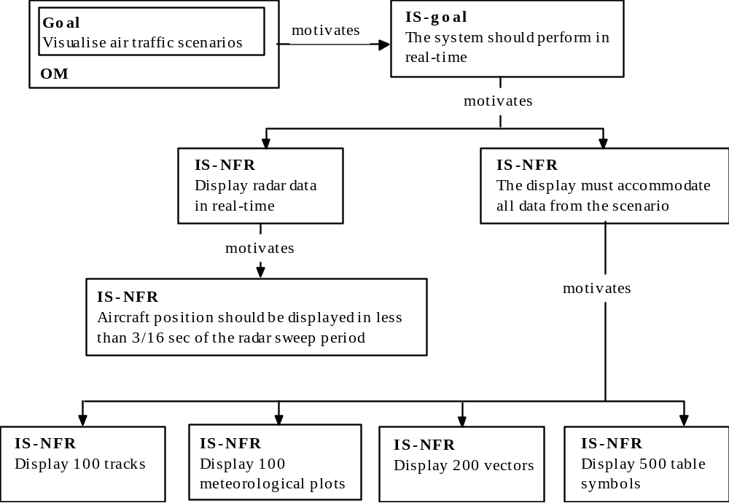
Example of goal-based derivation

Slide 15
Testable NFRs
Stakeholders may have vague goals which cannot be expressed precisely
Vague and imprecise ‘requirements’ are problematic
NFRs should satisfy two attributes
  Must be objective
  Must be testable (Use measurable metrics)
It is not always possible to express NFRs objectively

Slide 16
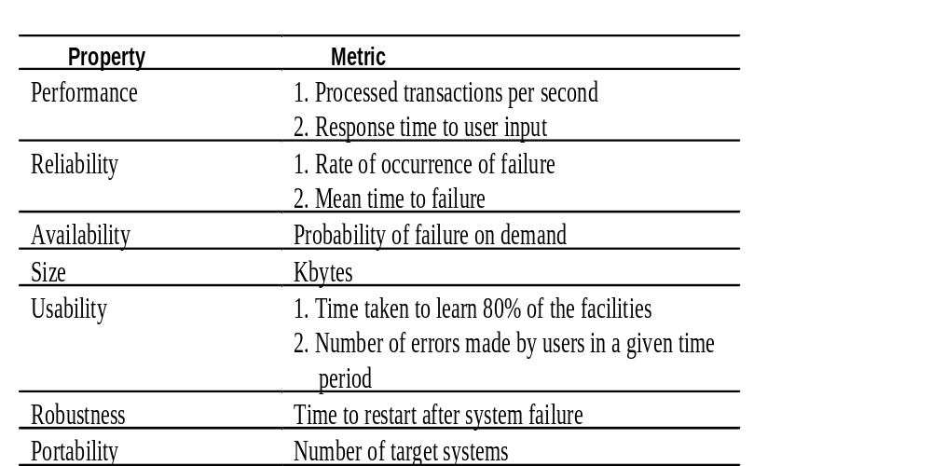
Examples of measurable metrics for NFRs

Slide 17
Requirements for critical systems
Systems whose ‘failure’ causes significant economic, physical or human damage to organisations or people.
There are three principal types of critical system:
  Business critical systems
    where a failure of the system causes significant economic damage to a business. An example of such a system is an airline reservation system.
  Mission critical systems
    where the failure of the system means that some mission cannot be accomplished. An example of such a system is a control system on a spacecraft.
  Safety critical systems
    where a failure of a system endangers human life or causes significant environmental damage. An example of such a system is a control system for a radiation therapy machine.

Slide 18
NFRs for critical systems
A failure of a critical system may result from a failure to meet a functional requirement but, more often, it results from a failure of the system to satisfy some non-functional constraint on its operation.
The principal non-functional constraints which are relevant to critical systems:
  Reliability
  Performance
  Security
  Usability
  Safety

Slide 19
Reliability
Constraints on the run-time behaviour of the system
Can be considered under two separate headings:
  Availability - is the system available for service when requested by end-users.
  Failure rate - how often does the system fail to deliver the service expected by end-users.
Reliability requirements can often be expressed quantitatively.
  Availability may be specified in terms of the time when the system is unavailable for service (e.g. 3 minutes in 24 hours)
  The acceptable failure rate may be specified in terms of the rate of occurrence of failures in a given time period (ROCOF) or the mean time between system failures (MTTF).

Slide 20
Performance
Constrain the speed of operation of a system
Types of performance requirements:
Response requirements which specify the acceptable response of the system to end-user input: for example, it might be specified that the system should respond to a user request for service within 2 seconds.
Throughput requirements which specify the amount of data which must be processed in a given time: for example, it might be specified that the system must process at least 10 transactions per second.
Timing requirements which specify how quickly the system must collect input from sensors before it is overwritten by the next input value, or which specify how quickly outputs must be produced for processing by other systems: for example, it might be specified that the system must poll sensors at least 6 times per second.

Slide 21
Summary
Specifying NFRs
  Deriving NFRs
    Concern decomposition
    Goal decomposition
  Specifying NFRs for safety critical systems

Slide 22
Security
Security requirements are included in a system to ensure:
  Unauthorised access to the system and its data is not allowed
  Ensure the integrity of the system from accidental or malicious damage
Examples of security requirements are:
  The access permissions for system data may only be changed by the system’s data administrator
  All system data must be backed up every 24 hours and the backup copies stored in a secure location which is not in the same building as the system
  All external communications between the system’s data server and clients must be encrypted

Slide 23
Usability
Concerned with specifying the user interface and end-user interactions with the system
Well structured user manuals, informative error messages, help facilities and consistent interfaces enhance usability

Slide 24
Usability metrics
Measurable attributes of usability requirements include:
  Entry requirements Measured in terms of years of experience with class of applications or simply age
  Learning requirements Denotes the time needed to learn the facilities of the system. This could be measured in terms of speed of learning, say hours of training required before independent use is possible
  Handling requirements Denotes the error rate of the end-users of the system. This could be measured in terms of the errors made when working at normal speed
  Likeability Denotes ‘niceness’ to use. The most direct to measure user satisfaction is to survey actual users and record the proportion who ‘like to work with the product’

Slide 25
Safety
No consensus in the system’s engineering community about what is meant by the term ‘safety requirement’
  Sometimes considered to be all requirements (functional and non-functional) on safety-related systems
  Sometimes the sub-set of these requirements which are directly related to ensuring safe operation and sometimes requirements on protection systems which are designed to protect against accident
Usage of the term often depends on the culture and practice of the organisation

Slide 26
Safety requirement definition
Informal definition:
Safety requirements are the ‘shall not’ requirements which exclude unsafe situations from the possible solution space of the system

Slide 27
Examples of safety requirements
The system shall not permit operation unless the operator guard is in place
The system shall not allow the sedative dose delivered to the patient to be greater than the maximum value which is determined by the patient’s physician
The system shall not operate if the external temperature is below 4 degrees Celsius

Slide 28
Non-functional Requirements Checklist
Availability: A system's availability, or "uptime," is the amount of time that it is operational and available for use. This is specified because some systems are designed with expected downtime for activities like database upgrades and backups.
Efficiency: Specifies how well the software utilizes limited resources: CPU cycles, disk space, memory, bandwidth, etc.
Flexibility: If the organization intends to increase or extend the functionality of the software after it is deployed, that should be planned from the beginning; it influences choices made during the design, development, testing, and deployment of the system.
Portability: Portability specifies the ease with which the software can be installed on all necessary platforms, and the platforms on which it is expected to run.

Slide 29
Non-functional Requirements
Performance: The performance constraints specify the timing characteristics of the software. Certain tasks or features are more time-sensitive than others; the nonfunctional requirements should identify those software functions that have constraints on their performance.
Reliability: Reliability specifies the capability of the software to maintain its performance over time. Unreliable software fails frequently, and certain tasks are more sensitive to failure (for example, because they cannot be restarted, or because they must be run at a certain time).
Reusability: Many systems are developed with the ability to leverage common components across multiple products. Reusability indicates the extent to which software components should be designed in such a way that they can be used in applications other than the ones for which they were initially developed.
Robustness: A robust system is able to handle error conditions gracefully, without failure. This includes a tolerance of invalid data, software defects, and unexpected operating conditions.

Slide 30
Non-Functional Requirements
Scalability: Software that is scalable has the ability to handle a wide variety of system configuration sizes. The nonfunctional requirements should specify the ways in which the system may be expected to scale up (by increasing hardware capacity, adding machines, etc.).
Usability: Ease-of-use requirements address the factors that constitute the capacity of the software to be understood, learned, and used by its intended users.
Integrity: Integrity requirements define the security attributes of the system, restricting access to features or data to certain users and protecting the privacy of data entered into the software.

Slide 31
Key points
Non-functional requirements define the overall qualities or attributes of the resulting system
Non-functional requirements may be classified into three main types; product, process and external requirements
Product requirements specify the desired characteristics that the system or subsystem must posses
Non-functional requirements tend to conflict and interact with other system requirements
The principal non-functional constraints which are relevant to critical systems are reliability, performance, security, usability and safety

