Slide 1
Lecture-2

Slide 2
Recap
Introduction to course
What is a requirement?
Types of requirement
What is requirement engineering process?
System engineering and software requirements

Slide 3
Today’s Lecture
System engineering
  Software requirement engineering
Software requirements document
  Sample requirements document

Slide 4
Why system engineering?
There is a close relationship between software and more general system requirements
General system requirements
  Software requirements

Slide 5
Systems engineering
Computer-based systems fall into two broad categories:
  User-configured systems where a purchaser puts together a system from existing software products
  Custom systems where a customer produces a set of requirements for hardware/software system and a contractor develops and delivers that system

Slide 6
Classes of custom systems
Information systems
  Primarily concerned with processing information which is held in some database.
Embedded systems
  Systems where software is used as a controller in some broader hardware system
Command and control systems
  Essentially, a combination of information systems and embedded systems where special purpose computers provide information which is collected and stored and used to make decisions

Slide 7
Emergent properties
Emergent properties are properties of the system as a whole and only emerge once all of its individual sub-systems have been integrated
Examples of emergent properties
  Reliability
  Maintainability
  Performance
  Usability
  Security
  Safety

Slide 8
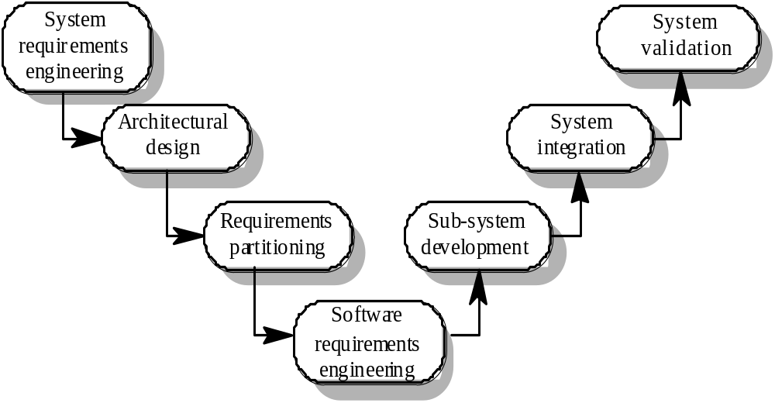
The systems engineering process

Slide 9
System engineering activities
System requirements engineering
  The requirements for the system as a whole are established and written to be understandable to all stakeholders
Architectural design
  The system is decomposed into sub-systems
Requirements partitioning
  Requirements are allocated to these sub-systems
Software requirements engineering
  More detailed system requirements are derived for the system software

Slide 10
System engineering activities
Sub-system development
  The hardware and software sub-systems are designed and implemented in parallel.
System integration
  The hardware and software sub-systems are put together to make up the system.
System validation
  The system is validated against its requirements.

Slide 11
Requirements document
The requirements document is a formal document used to communicate the requirements to customers, engineers and managers.
The requirements document describes:
  The services and functions which the system should provide
  The constraints under which the system must operate
  Overall properties of the system i.e.. constraints on the system’s emergent properties
  Definitions of other systems which the system must integrate with.

Slide 12
Requirements document
The requirements document describes:
  Information about the application domain of the system e.g. how to carry out particular types of computation
  Constraints on the processes used to develop the system
  Description of the hardware on which the system is to run
In addition, the requirements document should always include an introductory chapter which provides an overview of the system, business needs supported by the system and a glossary which explains the terminology used.

Slide 13
Users of requirements documents
System customers
  specify the requirements and read them to check they meet their needs
Project managers
  Use the requirements document to plan a bid for system and to plan the system development process
System engineers
  Use the requirements to understand the system being developed
System test engineers
  Use the requirements to develop validation tests for the system
System maintenance engineers
  Use the requirements to help understand the system

Slide 14
Requirements document structure
IEEE/ANSI 830-1993 standard proposes a structure for software requirements documents
1. Introduction
  1.1 Purpose of requirements document
  1.2 Scope of the product
  1.3 Definitions, acronyms and abbreviations
  1.4 References
  1.5 Overview of the remainder of the document

Slide 15
Requirements document structure
2. General description
  2.1 Product perspective
  2.2 Product functions
  2.3 User characteristics
  2.4 General constraints
  2.5 Assumptions and dependencies
3. Specific requirements
  Covering functional, non-functional and interface requirements.
4. Appendices
Index

Slide 16
Adapting the standard
The IEEE standard is a generic standard which is intended apply to a wide range of requirements documents.
In general, not all parts of the standard are required for all requirements documents
Each organisation should adapt the standard depending on the type of systems it develops
Consider a company (XYZ) that develops scientific instruments

Slide 17
Organisation XYZ standard
Preface
  This should define the expected readership of the document and describe its version history including a rationale for the creation of a new version and a summary of the changes made in each version.
Introduction
  This should define the product in which the software is embedded, its expected usage and present and overview of the functionality of the control software.
Glossary
  This should define all technical terms and abbreviations used in the document.

Slide 18
Organisation XYZ standard
General user requirements
  This should define the system requirements from the perspective of the user of the system. These should be presented using a mixture of natural language and diagrams.
System architecture
  This chapter should present a high-level overview of the anticipated system architecture showing the distribution of functions across system modules. Architectural components which are to be reused should be highlighted.
Hardware specification
  This is an optional chapter specifying the hardware that the software is expected to control. It may be omitted if the standard instrument platform is used.

Slide 19
Organisation XYZ standard
Detailed software specification
  This is a detailed description of the functionality expected of the software of the system. It may include details of specific algorithms which should be used for computation. If a prototyping approach is to be used for development on the standard instrument platform, this chapter may be omitted.
Reliability and performance requirements
  This chapter should describe the reliability and performance requirements which are expected of the system. These should be related to the statement of user requirements in Chapter 4.

Slide 20
Organisation XYZ standard
The following appendices may be included where appropriate:
  Hardware interface specification
  Software components which must be reused in the system implementation
  Data structure specification
  Data-flow models of the software system
  Detailed object models of the software system
Index

Slide 21
Writing requirements
Requirements are usually written as paragraphs of natural language text supplemented by diagrams and equations
Problems with requirements
  use of complex conditional clauses which are confusing
  sloppy and inconsistent terminology
  writers assume readers have domain knowledge

Slide 22
Writing essentials
Requirements are read more often than they are written. You should invest time to write readable and understandable requirements
Do not assume that all readers of the requirements have the same background and use the same terminology as you
Allow time for review, revision and re-drafting of the requirements document

Slide 23
Writing guidelines
Define standard templates for describing requirements
Use language simply consistently and concisely
Use diagrams appropriately
Supplement natural language with other description of requirements
Specify requirements quantitatively

Slide 24
Example – Bus Locator Project
Problem Statement: Students using busses as means to get to the campus face problems when busses are late, especially when they have to wait for busses under scorching sun or heavy rain. This application intends to facilitate students by providing means to track busses in real time which will not only allow students to view locations of their busses and get to stop on time. It will also facilitate the transport office to keep track of all the active busses.
SRS

Slide 25
Users of Bus Locator SRS
End User / Customer
  Bus Drivers
  Students
  Transport Office
Project Manager
Development Team
Test

Slide 26
Summary
System engineering and software requirements
The requirements document is the definitive specification of requirements for customers, engineers and managers.
The requirements document should include a system overview, glossary, statement of the functional requirements and the operational constraints

