Slide 1
Elaboration Process
Lecture-16

Slide 2
Today’s lecture
Structure analysis
  Flow oriented modeling

Slide 3
Flow-Oriented Modeling

Slide 4
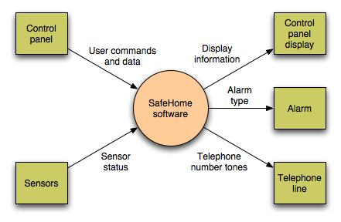
Data Flow Diagram
Context-level DFD for SafeHome security function

Slide 5
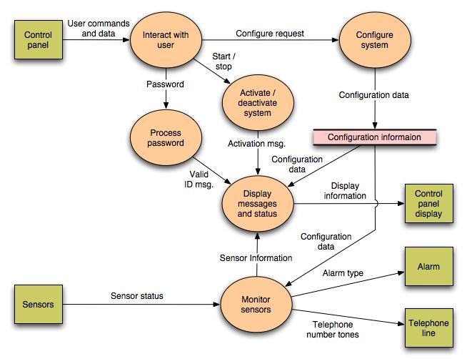

Slide 6
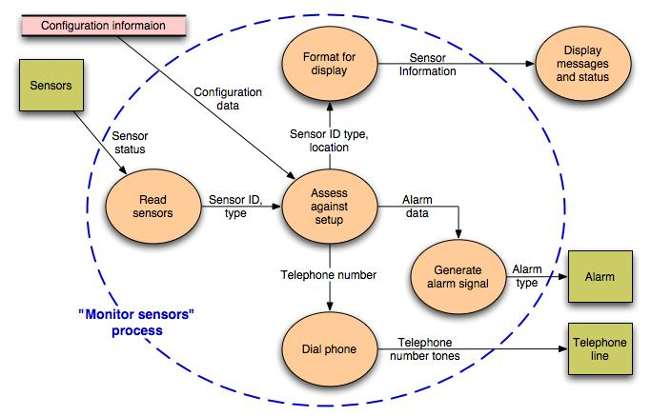
Level 2 DFD that refines the monitor sensors process

Slide 7
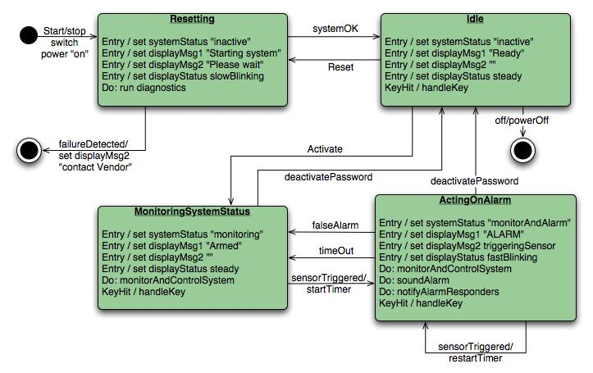
Control Flow Diagram
State diagram for SafeHome security function

Slide 8
Processing narrative
The SafeHome security function enables the homeowner to configure the security system when it is installed, monitors all sensors connected to the security system, and interacts with the homeowner through the Internet, a PC, or a control panel.
During installation, the SafeHome PC is used to program and configure the system. Each sensor is assigned a number and type, a master password is programmed for arming and disarming the system, and telephone number(s) are input for dialing when a sensor event occurs.
When a sensor event is recognized, the software invokes an audible alarm attached to the system. After a delay time that is specified by the homeowner during system configuration activities, the software dials a telephone number of a monitoring service, provides information about the location, reporting the nature of the event that has been detected. The telephone number will be redialed every 20 seconds until a telephone connection is obtained.
The homeowner receives security information via a control panel, the PC, or a browser, collectively called an interface. The interface displays prompting messages and system status information on the control panel, the PC, or the browser window. Homeowner interaction takes the following form…

Slide 9
Processing narrative
The SafeHome security function enables the homeowner to configure the security system when it is installed, monitors all sensors connected to the security system, and interacts with the homeowner through the Internet, a PC, or a control panel.
During installation, the SafeHome PC is used to program and configure the system. Each sensor is assigned a number and type, a master password is programmed for arming and disarming the system, and telephone number(s) are input for dialing when a sensor event occurs.
When a sensor event is recognized, the software invokes an audible alarm attached to the system. After a delay time that is specified by the homeowner during system configuration activities, the software dials a telephone number of a monitoring service, provides information about the location, reporting the nature of the event that has been detected. The telephone number will be redialed every 20 seconds until a telephone connection is obtained.
The homeowner receives security information via a control panel, the PC, or a browser, collectively called an interface. The interface displays prompting messages and system status information on the control panel, the PC, or the browser window. Homeowner interaction takes the following form…

Slide 10
Summary
Flow Based Modeling
  DFDs
  CFDs
  Processing narratives

