Slide 1
Elaboration Process
Lecture-14

Slide 2
Recap
Object Oriented Analysis
  Class Modeling

Slide 3
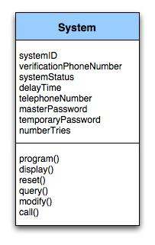
Class Diagram
Class diagram for the system class

Slide 4
Today’s lecture
Object Oriented analysis
  Object oriented modeling
  Behavioral modeling
Structure analysis
  Flow oriented modeling

Slide 5
CRC Modeling

Slide 6
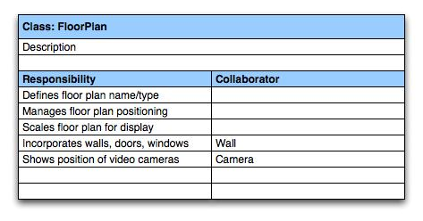
CRC Modeling
A CRC model index card for FloorPlan class

Slide 7
Behavioral Modeling

Slide 8
Creating a Behavioral Model
Identify events found within the use cases and implied by the attributes in the class diagrams
Build a state diagram for each class, and if useful, for the whole software system

Slide 9
Identifying Events in Use Cases
An event occurs whenever an actor and the system exchange information
An event is NOT the information that is exchanged, but rather the fact that information has been exchanged
Some events have an explicit impact on the flow of control, while others do not
  An example is the reading of a data item from the user versus comparing the data item to some possible value

Slide 10
Building a State Diagram
A state is represented by a rounded rectangle
A transition (i.e., event) is represented by a labeled arrow leading from one state to another
  Syntax: trigger-signature [guard]/activity
The active state of an object indicates the current overall status of the object as is goes through transformation or processing
  A state name represents one of the possible active states of an object
The passive state of an object is the current value of all of an object's attributes
  A guard in a transition may contain the checking of the passive state of an object

Slide 11
Identifying Events
A use-case is examined for points of information exchange.
The homeowner uses the keypad to key in a four-digit password. The password is compared with the valid password stored in the system. If the password in incorrect, the control panel will beep once and reset itself for additional input. If the password is correct, the control panel awaits further action.

Slide 12
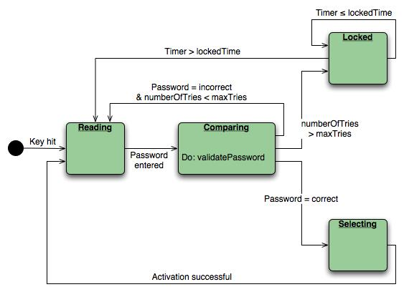
State Diagram
State diagram for the ControlPanel class

Slide 13
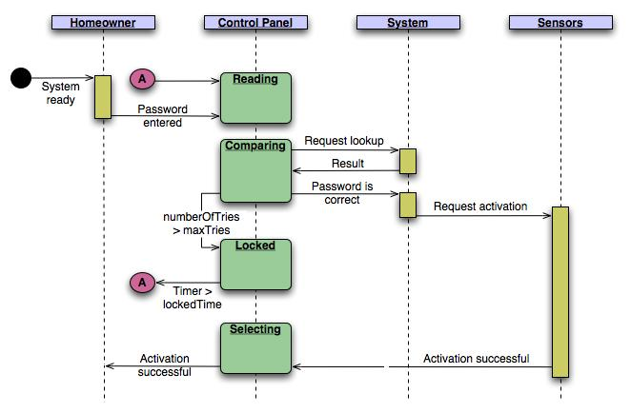
Sequence Diagram
Sequence diagram (partial) for the SafeHome security function

Slide 14
Summary
Class Modeling
  CRC
Behavioral modeling
  State diagrams
  Sequence diagrams

