Slide 1
Elicitation and Analysis
Lecture-11

Slide 2
Stakeholder analysis
Elicitation techniques
  Interviews
  Scenarios
  Requirements reuse
  Observation and social analysis
  Prototyping
  Questionnaire
  Brainstorming
  Focus groups
  Collaborative requirement gathering
  QFD
Analysis
Negotiation

Slide 3
Key points
Requirements elicitation involves understanding the application domain, the specific problem to be solved, the organizational needs and constraints and the specific facilities needed by system stakeholders.
The processes of requirements elicitation, analysis and negotiation are iterative, interleaved processes which must usually be repeated several times.
There are various techniques of requirements elicitation which may be used including interviewing, scenarios, soft systems methods, prototyping and participant observation.

Slide 4
Key points
Prototypes are effective for requirements elicitation because stakeholders have something which they can experiment with to find their real requirements.
Checklists are particularly useful as a way of organizing the requirements validation process. They remind analysts what to look for when reading through the proposed requirements.
Requirements negotiation is always necessary to resolve requirements conflicts and remove requirements overlaps. Negotiation involves information interchange, discussion and resolution of disagreements.

Slide 5
Inception
Elicitation
Elaboration
Negotiation
Specification
Validation
Requirements
Management

Slide 6
Goals of Analysis Modeling
Provides the first technical representation of a system
Is easy to understand and maintain
Deals with the problem of size by partitioning the system
Uses graphics whenever possible
Differentiates between essential information versus implementation information
Helps in the tracking and evaluation of interfaces
Provides tools other than narrative text to describe software logic and policy

Slide 7
Analysis Rules of Thumb
The analysis model should focus on requirements that are visible within the problem or business domain
  The level of abstraction should be relatively high
Each element of the analysis model should add to an overall understanding of software requirements and provide insight into the following
  Information domain, function, and behavior of the system
The model should delay the consideration of infrastructure and other non-functional models until the design phase
  First complete the analysis of the problem domain
The model should minimize coupling throughout the system
  Reduce the level of interconnectedness among functions and classes
The model should provide value to all stakeholders
The model should be kept as simple as can be

Slide 8
Analysis Modeling Approaches
Structured analysis
  Considers data and the processes that transform the data as separate entities
  Data is modeled in terms of only attributes and relationships (but no operations)
  Processes are modeled to show the 1) input data, 2) the transformation that occurs on that data, and 3) the resulting output data
Object-oriented analysis
  Focuses on the definition of classes and the manner in which they collaborate with one another to fulfill customer requirements

Slide 9
Elements of the Analysis Model
Object-oriented Analysis
Structured Analysis
Scenario-based
modeling
Flow-oriented
modeling
Use case text
Use case diagrams
Activity diagrams
Swim lane diagrams
Data structure diagrams
Data flow diagrams
Control-flow diagrams
Processing narratives
Class-based
modeling
Behavioral
modeling
Class diagrams
Analysis packages
CRC models
Collaboration diagrams
State diagrams
Sequence diagrams

Slide 10
Elements of the Analysis Model
Scenario-based elements
  Describe the system from the user's point of view using scenarios that are depicted in use cases and activity diagrams
Class-based elements
  Identify the domain classes for the objects manipulated by the actors, the attributes of these classes, and how they interact with one another; they utilize class diagrams to do this
Behavioral elements
  Use state diagrams to represent the state of the system, the events that cause the system to change state, and the actions that are taken as a result of a particular event; can also be applied to each class in the system
Flow-oriented elements
  Use data flow diagrams to show the input data that comes into a system, what functions are applied to that data to do transformations, and what resulting output data are produced

Slide 11
Developing Use Cases
Step One – Define the set of actors that will be involved in the story
  Actors are people, devices, or other systems that use the system or product within the context of the function and behavior that is to be described
  Actors are anything that communicate with the system or product and that are external to the system itself
Step Two – Develop use cases, where each one answers a set of questions

Slide 12
Questions Commonly Answered by a Use Case
Who is the primary actor(s), the secondary actor(s)?
What are the actor’s goals?
What preconditions should exist before the scenario begins?
What main tasks or functions are performed by the actor?
What exceptions might be considered as the scenario is described?
What variations in the actor’s interaction are possible?
What system information will the actor acquire, produce, or change?
Will the actor have to inform the system about changes in the external environment?
What information does the actor desire from the system?
Does the actor wish to be informed about unexpected changes?

Slide 13
When to Use Use Cases
No body can imagine a situation in which use cases are not used.
They are an essential tool in requirements capture and in planning and controlling an iterative project.
Capturing use cases is one of the primary tasks of the elaboration phase.
Every use case is a potential requirement, and until you have captured a requirement, you cannot plan to deal with it.
Some people list and discuss the use cases first, then do some modeling..
It is important to remember that use cases represent an external view of the system. As such, don't expect any correlations between use cases and the classes inside the system.
Use cases are not as helpful in identifying the nonfunctional aspects of the system requirements, such as the requirements for usability, reliability, performance, and the like. We'll rely on other techniques to address these issues.

Slide 14
What is a scenario?
A scenario is a sequence of steps describing an interaction between a user and a system.
So if we have a Web-based online store, we might have a Buy a Product scenario that would say this:
  The customer browses the catalog and adds desired items to the shopping basket. When the customer wishes to pay, the customer describes the shipping and credit card information and confirms the sale.
  The system checks the authorization on the credit card and confirms the sale both immediately and with a follow-up email.
This scenario is one thing that can happen. However, the credit card authorization might fail. This would be a separate scenario.

Slide 15
What is use case
A use case, then, is a set of scenarios tied together by a common user goal.
Other, alternative paths for the use case would be further scenarios.
A simple format for capturing a use case involves describing its primary scenario as a sequence of numbered steps and the alternatives as variations on that sequence

Slide 16
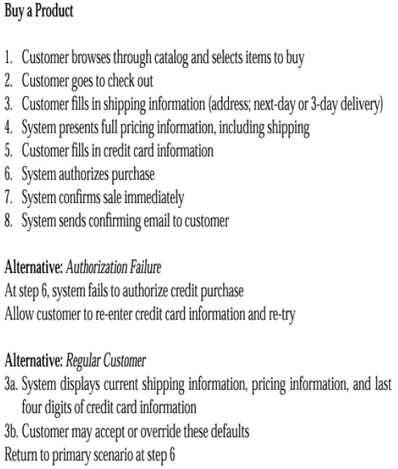
Example Use Case Text

Slide 17
Additional section
There are also additional sections you can add. For example, you can add a line for preconditions, which are things that should be true when the use case can start.
Take a look at the various books that address use cases, and add the elements that make sense for you.
Don't include everything, just those things that really seem to help

Slide 18
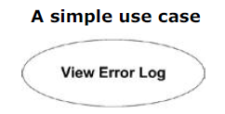
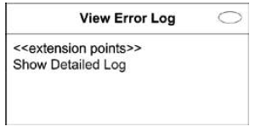
Use Case Diagrams
UML provides two ways to draw a use case.
  The first is an oval with the name of the use case in the center.
  However, the oval representation of use cases doesn't hold up well with detailed compartments.
  UML recommends you use the classifier notation if you want to provide details about a use case.
  Show the use case as a rectangle, with the use case oval in the top-right corner.

Slide 19
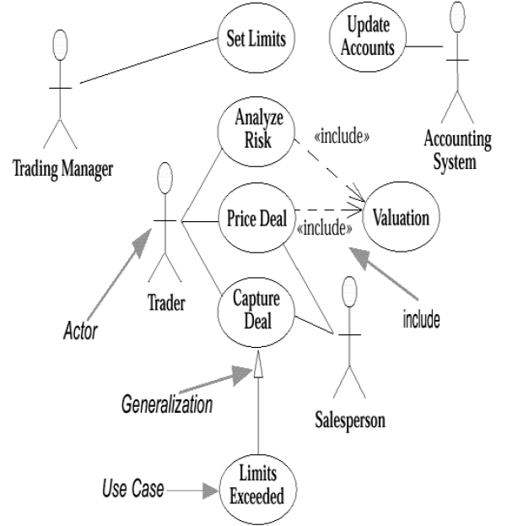
Use Case Diagrams-example

Slide 20
Actors
An actor is a role that a user plays with respect to the system. There are four actors in the Figure
  Trading Manager,
  Trader,
  Salesperson,
  and Accounting System.
There will probably be many traders in the given organization, but as far as the system is concerned, they all play the same role.
A user may also play more than one role.
  For instance, one senior trader may play the Trading Manager role and also be a regular trader;
  A Trader may also be a Salesperson.
When dealing with actors, it is important to think about
roles rather than people or job titles.

Slide 21
Cont….
Actors carry out use cases.
A single actor may perform many use cases; conversely, a use case may have several actors performing it.
In practice, actors are most useful when trying to come up with the use cases.
Faced with a big system, it can often be difficult to come up with a list of use cases.
It is easier in those situations to arrive at the list of actors first, and then try to work out the use cases for each actor.
Actors don't need to be human, even though actors are represented as stick figures within a use case diagram.
An actor can also be an external system that needs some information from the current system.

Slide 22
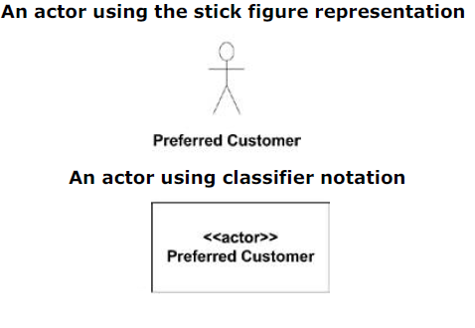
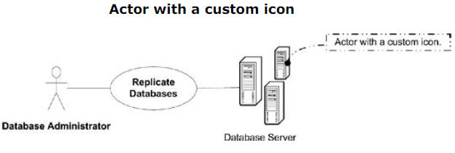
Different representation of an actor

Slide 23
Cont…
There are several variations on what people show as actors.
Some people show every external system or human actor on the use case diagram;
  Others prefer to show the initiator of the use case.
But recommended is to show the actor that gets value from the use case, which some people refer to as the primary actor.

Slide 24
Cont….
There are some situations in which it can be worth tracking the actors later.
  The system may need configuring for various kinds of users. In this case, each kind of user is an actor, and the use cases show you what each actor needs to do.
  Tracking who wants use cases can help you negotiate priorities among various actors.

Slide 25
Cont….
Some use cases don't have clear links to specific actors.
Consider a utility company. Clearly, one of its use cases is Send Out Bill.
A good source for identifying use cases is external events.
Think about all the events from the outside world to which you (system) want to react.
A given event may cause a system reaction that does not involve users, or it may cause a reaction mainly from the users.
Identifying the events that you need to react to will help you identify the use cases.

Slide 26
Summary
Finished elicitation process
Elaboration process
  Object oriented approach
    Scenario based modelling
  Structured approach

Slide 27
System Boundaries
By definition, use cases capture the functionality of a particular subject.
Anything not realized by the subject is considered outside the system boundaries and should be modeled as an actor.
This technique is very useful in determining the scope and assignment of responsibilities when designing a system, subsystem, or component.
For example,
If while you are modeling an ATM system, your design discussions deviate into discussions of the details of the back-end banking system,
A use case model with clearly defined system boundaries would identify the banking system as an actor and therefore outside the scope of the problem.
You represent system boundaries in a generic sense using a simple rectangle, with the name of the system at the top.

Slide 28
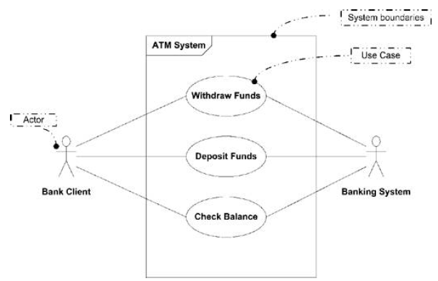
A use case diagram showing the system boundaries of an ATM System

Slide 29
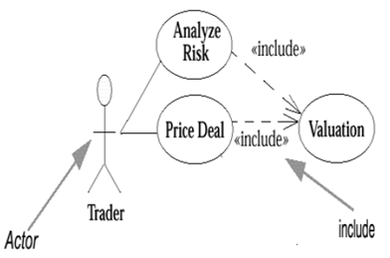
Use Case Relationships <include>
The include relationship occurs when you have a chunk of behavior that is similar across more than one use case and you don't want to keep copying the description of that behavior.
For instance, both Analyze Risk and Price Deal require you to rate the deal.

Slide 30
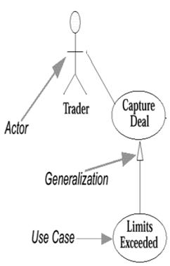
Use Case Relationships (generalization)
You use use case generalization when you have one use case that is similar to another use case but does a bit more.
In effect, this gives us another
way of capturing alternative
scenarios.

Slide 31
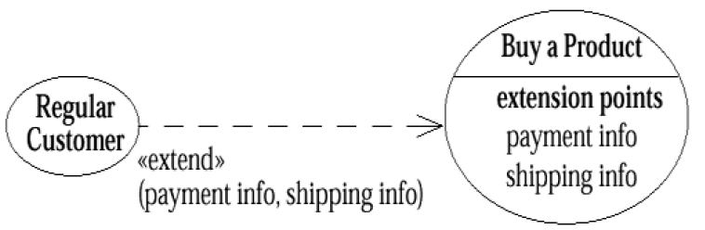
Use Case Relationships <extend>
This is similar to generalization but with more rules to it.
With this construct, the extending use case may add behavior to the base use case, but this time the base use case must declare certain "extension points," and the extending use case may add additional behavior only at those extension points.

Slide 32
Cont……
A use case may have many extension points, and an extending use case may extend one or more of these extension points.
You indicate which ones on the line between the use cases on the diagram.
Both generalization and extend allow you to split up a use case, when it getting too complicated.

Slide 33
Apply the following rules
Use include when you are repeating yourself in two or more separate use cases and you want to avoid repetition.
Use generalization when you are describing a variation on normal behavior and you wish to describe it casually.
Use extend when you are describing a variation on normal behavior and you wish to use the more controlled form, declaring your extension points in your base use case.

Slide 34
Format and guideline to write use case(s)
Use Case ID: | Enter a unique numeric identifier for the Use Case. e.g. UC-1.2.1
Use Case Name: | Enter a short name for the Use Case using an active verb phrase. e.g. Withdraw Cash
Actors: | [An actor is a person or other entity external to the software system being specified who interacts with the system and performs use cases to accomplish tasks. Different actors often correspond to different user classes, or roles, identified from the customer community that will use the product. Name the actor that will be initiating this use case (primary) and any other actors who will participate in completing the use case (secondary).]
Description: | [Provide a brief description of the reason for and outcome of this use case.]
Trigger: | [Identify the event that initiates the use case. This could be an external business event or system event that causes the use case to begin, or it could be the first step in the normal flow.]

Slide 35
Preconditions: | [List any activities that must take place, or any conditions that must be true, before the use case can be started. Number each pre-condition. e.g. Customer has active deposit account with ATM privileges Customer has an activated ATM card.]
Postconditions: | [Describe the state of the system at the conclusion of the use case execution. Should include both minimal guarantees (what must happen even if the actor’s goal is not achieved) and the success guarantees (what happens when the actor’s goal is achieved. Number each post-condition. e.g. Customer receives cash Customer account balance is reduced by the amount of the withdrawal and transaction fees]

Slide 36
Normal Flow: | [Provide a detailed description of the user actions and system responses that will take place during execution of the use case under normal, expected conditions. This dialog sequence will ultimately lead to accomplishing the goal stated in the use case name and description. Customer inserts ATM card Customer enters PIN System prompts customer to enter language performance English or Spanish System validates if customer is in the bank network System prompts user to select transaction type Customer selects Withdrawal From Checking System prompts user to enter withdrawal amount … System ejects ATM card]

Slide 37
Alternative Flows: [Alternative Flow 1 – Not in Network] | [Document legitimate branches from the main flow to handle special conditions (also known as extensions). For each alternative flow reference the branching step number of the normal flow and the condition which must be true in order for this extension to be executed. e.g. Alternative flows in the Withdraw Cash transaction: 4a. In step 4 of the normal flow, if the customer is not in the bank network System will prompt customer to accept network fee Customer accepts Use Case resumes on step 5 4b. In step 4 of the normal flow, if the customer is not in the bank network System will prompt customer to accept network fee Customer declines Transaction is terminated Use Case resumes on step 9 of normal flow Note: Insert a new row for each distinctive alternative flow. ]

Slide 38
Exceptions: | [Describe any anticipated error conditions that could occur during execution of the use case, and define how the system is to respond to those conditions. e.g. Exceptions to the Withdraw Case transaction 2a. In step 2 of the normal flow, if the customer enters and invalid PIN Transaction is disapproved Message to customer to re-enter PIN Customer enters correct PIN Use Case resumes on step 3 of normal flow]
Includes: | [List any other use cases that are included (“called”) by this use case. Common functionality that appears in multiple use cases can be split out into a separate use case that is included by the ones that need that common functionality. e.g. steps 1-4 in the normal flow would be required for all types of ATM transactions- a Use Case could be written for these steps and “included” in all ATM Use Cases.]

Slide 39
Special Requirements: | [Identify any additional requirements, such as nonfunctional requirements, for the use case that may need to be addressed during design or implementation. These may include performance requirements or other quality attributes.]
Assumptions: | [List any assumptions that were made in the analysis that led to accepting this use case into the product description and writing the use case description. e.g. For the Withdraw Cash Use Case, an assumption could be: The Bank Customer understands either English or Spanish language.]
Notes and Issues: | [List any additional comments about this use case or any remaining open issues or TBDs (To Be Determined) that must be resolved. e.g. What is the maximum size of the that a use can have?]

