Slide 1
Requirements Elicitation Process
Lecture-10

Slide 2
Recap
Elicitation process
  Elicitation techniques
    Document studies
    Questionnaire
    Brainstorming
    Focus groups
    Collaborative requirement gathering
    QFD
  Analysis
  Negotiation

Slide 3
Requirements negotiation
Disagreements about requirements are inevitable when a system has many stakeholders. Conflicts are not ‘failures’ but reflect different stakeholder needs and priorities
Requirements negotiation is the process of discussing requirements conflicts and reaching a compromise that all stakeholders can agree to
In planning a requirements engineering process, it is important to leave enough time for negotiation. Finding an acceptable compromise can be time-consuming

Slide 4
Negotiation meetings
An information stage where the nature of the problems associated with a requirement is explained.
A discussion stage where the stakeholders involved discuss how these problems might be resolved.
  All stakeholders with an interest in the requirement should be given the opportunity to comment. Priorities may be assigned to requirements at this stage.
A resolution stage where actions concerning the requirement are agreed.
  These actions might be to delete the requirement, to suggest specific modifications to the requirement or to elicit further information about the requirement.

Slide 5
State of the art in requirement elicitation
  Wiki-Based Stakeholder Participation in Requirements Engineering
  Decker et al. have proposed using Wikis as a platform for asynchronous collaboration of multiple stakeholders to elicit software requirements .
  They claim it to be a way to enhance stakeholders’ involvement in requirement engineering process.
  This wiki-based approach relies on a moderator, who provides information about the requirement topics, specifies content template and allocates requirements to stakeholders.
Decker, B., Ras, E., Rech, J., Jaubert, P., & Rieth, M. (2007). Wiki-based stakeholder participation in requirements engineering. Software, IEEE, 24(2), 28-35.

Slide 6
  iRequire
  Seyff et al. have presented a framework for increasing end users’ involvement in the process of requirements elicitation.
  It is powered by a mobile tool , enabling end users to blog their needs and the approach recommends on-site blogging.
  In the first step, the end user is required to register information about his/her environment.
  In the second step, the end user is required to blog their needs/requirements precisely.
  The third step finally requires the end user to justify why a need is important by describing the reasons why the need should be deemed important.
  iRequire supports various media types such as voice recordings, videos, images and text and provides an interface in the tool for using all of them.
Seyff, N., Graf, F., & Maiden, N. (2010, September). Using mobile re tools to give end users their own voice. In Requirements Engineering Conference (RE), 2010 18th IEEE International (pp. 37-46). IEEE.

Slide 7
Athena
  Laporti et al. have presented a collaborative approach for eliciting informal stories from end users.
  Athena comprises of a model, a method of group storytelling and finally, a web based tool.
  Stakeholders will narrate stories on how they use the current system;
  These stories are fined into scenarios by a facilitator
  The scenarios are converted into use cases by the system analyst.
  The Athena Tool is a web based application that implements their proposed method and provides an interface that enables the stakeholders to work collaboratively.
Laporti, V., Borges, M. R., & Braganholo, V. (2009). Athena: A collaborative approach to requirements elicitation. Computers in Industry, 60(6), 367-380.

Slide 8
Contexter
  Wehrmaker et al. have presented a method to gather end users’ needs through a geographically deployed feedback system.
  Their method is supported by a smartphone based mobile application that lets users submit their context-specific feedback of a software system or subsystem.
  This feedback is used to identify problems and weaknesses so that software intensive systems can be improved and evolved.
  It needs to have predefined entities (e.g. a ticket machine, a train station, etc.) against which feedback can be submitted.
  The entities become available in the mobile application according to the user’s context information such as his/her GPS coordinates, MAC address, visited websites, etc.
  The service provider can control which entities to present for feedback.
  The feedback, which is sent anonymously, is essentially textual with the option to attach multimedia elements such as a photo, video or sound captured through the mobile phone.
Wehrmaker, T., Gärtner, S., & Schneider, K. (2012, June). ConTexter feedback system. In Proceedings of the 2012 International Conference on Software Engineering (pp. 1459-1460). IEEE Press.

Slide 9
Visual requirements specification through Annotate Pro
  Rashid et al. have claimed that end users cannot always articulate their needs and requirements using textual methods.
  They have proposed ways for the end users to specify their requirements visually through mechanisms built into their day-to-day working processes.
  It will enable end-users to visually chalk out their thoughts and deliver them to a web based collaboration system.
  The working principle that they have laid down is that end users and requirement analysts will work collaboratively.
  End users will sketch out the requirements and analysts will analyze the significance of each submitted requirement.
Rashid, A., Meder, D., Wiesenberger, J., & Behm, A. (2006, September). Visual requirement specification in end user participation. In Multimedia Requirements Engineering, 2006. MERE'06. First International Workshop on (pp. 6-6). IEEE.

Slide 10
  StakeRare (Stakeholder- and Recommender-assisted method for requirements elicitation)
  Lim et al. have proposed StakeRare, a method aimed at prioritizing and identifying requirements in large scale software projects..
  It uses social networks and collaborative filtering.
  It claims to address three problems faced by large software (inadequate stakeholder input, information overload and biased prioritization of requirements.)
  Social network analysis techniques is used to identify stakeholders and asks them to recommend other stakeholders.
  It then builds a social network with nodes representing stakeholders and links representing their recommendations and prioritizes stakeholders based on their social relationships.
  Each stakeholder is required to rate an initial list of requirements.
  Using this list, a set of similar stakeholders is identified for each stakeholder
  From the requirements provided by these similar stakeholders, it predicts relevant requirements to the stakeholder who can approve the predicted requirements to add to his/her ratings.
  To rid the requirements engineer of information overload, StakeRare prioritizes stakeholders and their requirements.
  To address the problem of biased requirements prioritization, StakeRare considers each stakeholder’s ratings and their influence in the project and produces a prioritized list of requirements.
Lim, S. L., & Finkelstein, A. (2012). StakeRare: Using social networks and collaborative filtering for large-scale requirements elicitation. Software Engineering, IEEE Transactions on, 38(3), 707-735.

Slide 11
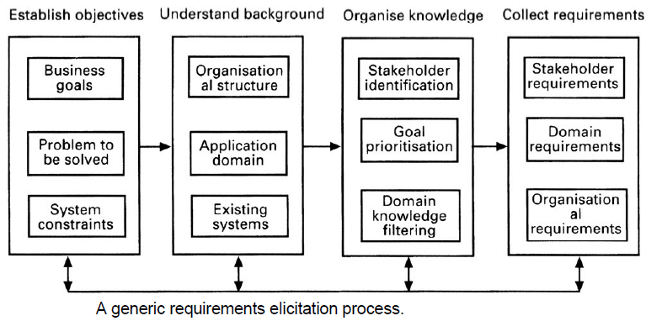
The requirements elicitation process

Slide 12
Stakeholder analysis
Elicitation techniques
  Interviews
  Scenarios
  Requirements reuse
  Observation and social analysis
  Prototyping
  Questionnaire
  Brainstorming
  Focus groups
  Collaborative requirement gathering
  QFD
Analysis
Negotiation

Slide 13
Key points
Requirements elicitation involves understanding the application domain, the specific problem to be solved, the organizational needs and constraints and the specific facilities needed by system stakeholders.
The processes of requirements elicitation, analysis and negotiation are iterative, interleaved processes which must usually be repeated several times.
There are various techniques of requirements elicitation which may be used including interviewing, scenarios, soft systems methods, prototyping and participant observation.

Slide 14
Key points
Prototypes are effective for requirements elicitation because stakeholders have something which they can experiment with to find their real requirements.
Checklists are particularly useful as a way of organizing the requirements validation process. They remind analysts what to look for when reading through the proposed requirements.
Requirements negotiation is always necessary to resolve requirements conflicts and remove requirements overlaps. Negotiation involves information interchange, discussion and resolution of disagreements.

Slide 15
Exercises
The system shall provide an easy-to-use graphical user interface based on MS Windows 95
Accredited users should have privileged access to the cataloguing facilities of the system.

Slide 16
  What does easy-to-use mean?
  Who should find it easy to use?
  This is untestable as it doesn’t set out the usability requirement in an unambiguous way
  Specifying the use of Windows 95 is (perhaps) premature design. Is it entirely necessary?
  Does it mean that Windows NT or 98 cannot be used?

Slide 17
This requirement if OK is the specification includes elsewhere a definition of ‘accredited user’ and ‘privileged access’.

Slide 18
How to write quality requirements in quantitative way.
The library system shall be easy-to-use.
It should be possible to train end-users of the system to use all retrieval facilities in a single 15 minute training session.
The library system shall provide reliable service to all classes of user.
The rate of occurrence of failures in the retrieval facilities of the system shall be less than 1 in 1000 queries.
The rate of occurrence of failure for the cataloging facilities of the system shall be less than 1 in 500 cataloging operations.
The library system shall provide a rapid response to all user requests for book information.
The average system response time for user requests shall be less than 4 seconds.

