Slide 1
Formal Methods in Software Engineering
Lecture # 28
1
Notes:
1
1

Slide 2
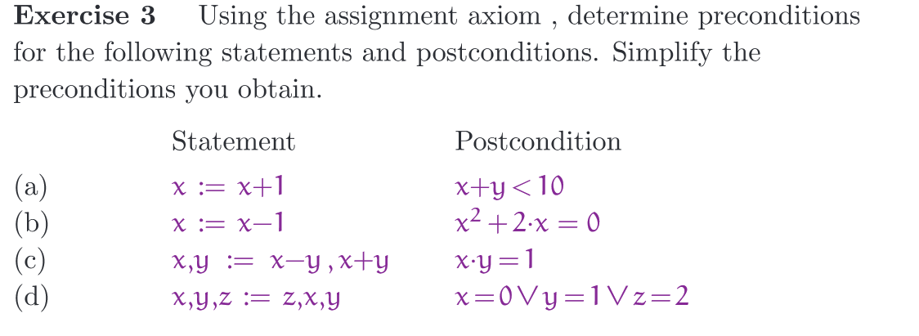
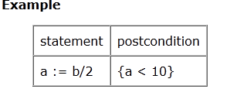
2
Notes:
2
2
2

Slide 3
Functions
  Find the index of the minimum value in a function
  First write pre and post condition and then proof
  You need to pass the size of the array to function
  Any Conditions on the input?
  There is no specific condition to apply on input
  Pre-condition: True i.e. Any array of integer with any size
  Post condition: ?
3
Notes:
3
3
3

Slide 4
Functions
  Function min ( X: in INTEGER_ARRAY)
  Return INTEGER
  Pre: True
  Post: j in X’First ........ X’Last :
  min (X) = X (j) and
  i in X’First ........ X’Last: min (x) <= X (i)
  and X = X’’
4
Notes:
4
4
4
Ada programming syntax
J is an index between the first and last index
When this function is executed then is there any change in the array
Min(x)- value return by the function i.e. It return value which is present in array at some index

Slide 5
Functions
  You need to specify that what would happen to the input array ( i.e. Any change after function execution)
  The returning value will be the small among all but also ....
  The return value exists in the given set
  Question: If any of the specification component missing then ?
5
Notes:
5
5
5

Slide 6
Another example
  We have an array and we want to find a key and want to determine that key is present or not. If present then return index – If key is not present then message not found
  Pre-condition ( any condition on input)?
  No Condition
  Post condition?
  Need to answerer some questions (about input and output array:
  Do we make any changes in array so X = X’’
  What about the key ( what is returning): Key found or not found.
6
Notes:
6
6
6

Slide 7
Key search example
  Pre: True
  Post: (( found and X (index) = key ) or
  ( N NOT found and
  ( j in X’First ........ X’Last :
  x (j) not equal key )) and ( X = X’’)
7
Notes:
7
7
7
Found and theat is present at the index

Slide 8
  Suppose we have a sorting function then array would modified?
  You have noted that until now, no condition is imposed on input so the pre-condition is true
  Restriction on input: any case?
  If I want to apply binary search algorithm then what will be the condition?
  Pre-condition? Array is sorted ( how you will specify)
  Specification -> data present at index “i” is <= data present at index “i+1”
  Post condition?
  Post condition is same as the previous searching strategy
Another example
8
Notes:
8
8
8

Slide 9
Binary search Functions
  Procedure binary_search ( X : in INTEGER_ARRAY;
  key : in INTEGER;
  Found: in out Boolean;
  L : in out INTEGER
  begin;
  bot: ( INTEGER := X’First;
  top: ( INTEGER := X’Last;
  Mid : INTEGER;
  L:= ( bot + top) / 2;
9
Notes:
9
9
9
Found and theat is present at the index

Slide 10
Binary search Functions
  Found := X (L) = key;
  While ( bot <= top AND NOT found) loop
  begin;
  mid := ( bot + top) / 2;
  If x (mid ) = key then
  found := TRUE;
  L := mid;
  Elseif X (mid) < key then
  bot := mid + 1
  Else top: = mid -1
  End if; end loop
10
Notes:
10
10
10
Found and theat is present at the index

Slide 11
  Look at the program - > Find the invariant condition
  The invariant condition is some how look like post condition
  Remember that loop invariant must be true in every iteration
  In case of loop you must provide loop termination proof
  Question: When your are designing loop then what is in your mind that why it will complete your work?
  You are starting with large space and with each iteration you are reducing the search space by half
  What you can say about that search space which you leave i.e. If you moved the index from top to middle – 1 ( you come to middle point because the key was actually smaller than the mid value so it can not be in the list from top to middle)
  Now your search space is from bottom to middle – 1
  What you can say about the post condition?
  If key is not present then you your bottom and top will cross each other.
11
Notes:
11
11
11

Slide 12
  So one part of post condition is that found is not true and key is not present in the entire range.
  Loop invariant: If key is not present then in every iteration (i.e. When loop is start and when loop terminate) the key is not found and this condition is true.
  2nd condition: The key is found (key is present at index)
12
Notes:
12
12
12

Slide 13
  Some time proof is not easy and incorrect
  If you have formal specification, could you generate the program from that specification?
  If this is possible then no need to give proof of its correctness
  In this case, assignment axiom is simple but what about IF and loop statments
13
Notes:
13
13
13

Slide 14
Program construction
  Diskjestra Guarded command: It is like a conditional statement
  i.e. Condition is a guard -> If guard is true we execute the statement
  There are multiple clauses and each clause have guard
  If more than one guard is true at the same time then one the statement will be selected arbitrary
  At least one of the guard has to be true
  If none of the guard is true in that case it is an error
14
Notes:
14
14
14

Slide 15
Dijkstra’s Guarded Command
  If C1 -→ S1
  [] C2 → S2
  [] C3 → S3
15
Notes:
15
15
15

Slide 16
Dijkstra’s Guarded Command
  {P}
  If b1 → S1
  [] b2 → S2
  fi
  {Q}
  P => b1 v b2
  {P ^ b1 } S1 {Q}
  {P ^ b2} S2 { Q}
16
Notes:
16
16
16

Slide 17
Constructing Conditional Statements
  {P} S {Q}
  P and Q are given, we want to calculate S.
  Three step Process:
  1) Split the pre-condition into two ( or possibly more cases) b1 and b1. That is, identify b1 and b2 such that
  P => b1 v b2
17
Notes:
17
17
17

Slide 18
Constructing Conditional Statements
  2) Construct a program statement S1 that gurantees termination in a state satisfying Q given the pre-condition
  P ^ b1
  3) Construct a program statement S1 that guarantees termination in a state satisfying Q given the pre-condition
  P ^ b2
  Termination case is not valid for assignment and conditional statements i.e. Only for iteration
18
Notes:
18
18
18

Slide 19
Output variables
  { true} S { i= j}
  For S: i := j; or j:= i;
  Which one is input and which one is output variable?
  If “i” is the output variable then i:=j
19
Notes:
19
19
19

Slide 20
Ghost variables
  Suppose we want to specify that the sum of two variables i and j should remain constant
  We specify this by introducing the Ghost variable C.
  This variable should not be used any where in the program.
  Then S is specified by
  { i + j = C} S { i + j = C}
  We tie input to the output using Ghost variables.
20
Notes:
20
20
20

Slide 21
Simultaneous assignment statements
  x , y, z := 2 * y, x + y, 3 * z
  X, y := y, x
  Has the effect of swapping
  IF not using simultaneous assignments then?
21
Notes:
21
21
21

Slide 22
Z-Specification, Structure and Schema
  New technique – model based specification
  Previously specification method and algebraic specific method
  Roots originate from Hore’s logic
  We use the concept of state and space concept
  State: State of any problem is the type or number of variables this problem have
  E.g. three variable a, b and c ( state)
  Space: All possible values these variables have
22
Notes:
22
22
22

Slide 23
Z-Specification, Structure and Schema
  In algebraic specification we did not talk about the state of the system
  We only talk about the external behaviour i.e. These are the publically interfaces to the system and when we send a message to these interfaces then how the system will behave in terms of expected outcome so algebraic specification did not talk about the internal state of the system
  State-based specification take different approach and they do talk about the internal state of the system so when certain operation is performed, they tell you what are the internal changes to the system i.e. How the state of the system is defined and in response to a message or an operation perform on that entity for which we are defining the state, how does this operation change the state of the entity
23
Notes:
23
23
23

Slide 24
Z-Specification Language
  VDM (Vienna Development Method)– Many derivative of VDM has been already presented
  Specification methodology which is greatly influenced by VDM
  Called Z- Specification
  Developed in England – Cambridge university
  English origin -> Do not call it ZEE ( American) , Its ZAD
  Z has number of features which make it easy
  Building systems using Z is easier as compared to other specification languages
  It is a state-based modelling language
24
Notes:
24
24
24

Slide 25
Z-Specification Language
  Basic unit of Z-Specification is called Z-Schema
  Schema calculus is used to join different schema and rich the specification and built more complex system using smaller and simple system
25
Notes:
25
25
25

Slide 26
Structure of Z- Schema
  Container
  Contents: N
  Capacity: N
  Contents <= Capacity
  No operations in this schema
  Contents and capacity defined the state of the system
  Predicate act like invariant
Schema signature
Schema Predicate
26
Notes:
26
26
26

Slide 27
Structure of Z- Schema
  BirthdayBook
  Known: P Name
  Birthday: Name <=> date
  Known = dom Birthday
  Known is a set of names
  Birthday is a function which when applied to a name gives the birthday associate with it. (Domain to range mapping)
  Known is a set of values of Names for which the birthday is defined.
  Each person can you only one birthday
  Invariant: Name must associate with birthday.
27
Notes:
27
27
27

Slide 28
One possible state of the system
  Known = { Ahmed , Iram, Farrukh}
  Birthday = { Ahmed <-> 25-march,
  Iram <-> 20- dec,
  Farrukh <-> 25-march
  }
  Function types: One-to-One and On-to
  If every entity from domain map on the range ( On-to)
  So in birthday function we do not have such entry which do not have the ans:
28
Notes:
28
28
28

Slide 29
Structure of Z- Schema
  BirthdayBook
  Known: P Name
  Birthday: Name <=> date
  Known = dom Birthday
  Known is a set of names
  Birthday is a function which when applied to a name gives the birthday associate with it. (Domain to range mapping)
  Known is a set of values of Names for which the birthday is defined.
  Each person can you only one birthday
  Invariant: Name must associate with birthday.
29
Notes:
29
29
29

